Slide 1
Collaborator or Assistant? How AI Coding Agents Partition Work Across PR Lifecycles
Young Jo(seph) Chung, Safwat Hassan
2026
University of Toronto - Faculty of Information
AIWare 2026 - Montreal
Notes:
Good afternoon. I am Joseph Chung from the University of Toronto. This is joint work with Professor Safwat Hassan.
The paper asks a simple question with governance consequences: when AI coding agents enter pull-request workflows, who starts the work, and who still authorizes merge?
I will answer that question in the next twenty minutes around a single number, a six-cell taxonomy, and one bounded conceptual distinction. The deck closes on a Q&A slide with the replication-package link and my contact details.

Slide 2
COLD OPEN | 02 / 18
Tool identity predicts PR collaboration scenario: who starts work, who authorizes merge, and where governance remains human.
V = 0.50
What does Cramer's V measure?
29,585
5
6
lifecycle traces
tools
paths
PRs
compared
scenario table
Collaborator or Assistant? Chung & Hassan | University of Toronto
Notes:
Rather than open with a research question, I want to start with a number.
Cramer's V is an association measure for categorical data. For a five-tool by six-scenario table like ours, Cohen's conventional 'large' threshold is V = 0.25. We observed 0.50, well beyond that threshold.
That number is what this talk is about. It says tool identity strongly predicts the collaboration scenario a pull request actually follows. And in the next twenty minutes I want to make three things concrete: who starts the work, who authorizes the merge, and where governance remains human.
So the question to carry into the next slide is simply this. What is V = 0.50 measuring?

Slide 3
FRAME
FRAME | 03 / 18
A spectrum with partial decoupling
INITIATION
AUTHORIZATION
INTERPRETATION
Tools separate sharply
Merge stays human
Related, not locked
Collaborator tools initiate most PRs.
Assistant tools mostly enter human-started PRs.
Agent-classified approvers are rare in this snapshot.
Governance is observable but not reducible to operation.
Operational work and merge governance can diverge.
That divergence is the measurement target.
Notes:
Here is the thesis in plain language.
The finding is not that some tools are agents and others are assistants. The pattern is more specific. Tools separate sharply on initiation and on review routing. But merge authority remains mostly human in this snapshot.
That asymmetry is what makes the result interesting. Operational work and governance authority are related, but they are not locked together. The partial separation between them is what makes lifecycle traces useful for governance research at all. If everything moved together, the trace would have nothing to add over outcome metrics.

Slide 4
FRAME
FRAME | 04 / 18
Today's agenda
1
GAP
Prior work vs lifecycle reconstruction
RQ1-RQ3
2
METHOD
Pipeline, trace vocabulary, observability bounds
research questions
partitioning, workflows, automation boundaries
3
SPECTRUM
Taxonomy, V = 0.50, decoupling
4
WORKFLOWS
State machines: Copilot vs OpenAI
5
IMPLICATIONS
Contributions and future layers
Notes:
That is the question. Here is how I will answer it.
Five short moves. The empirical heart sits in the middle: a single number, 0.50, that captures how tightly tool identity predicts the pull-request lifecycle. Everything else is what gets us to that number, and what we should and should not conclude from it.
First, what prior work measures and what it leaves under-counted. Second, how we reconstruct lifecycle traces, and where the trace stops being trustworthy. Third, the Collaborator-Assistant spectrum. Fourth, the workflow-state-machine contrast that the spectrum makes visible. And finally, what the result implies for teams, researchers, and tool builders.
One argument runs through all of it. Tool identity predicts lifecycle, and lifecycle traces make governance research reproducible - within explicit bounds.

Slide 5
GAP
GAP | 05 / 18
What prior work measures, and what we add
Outcome metrics
merge rates and acceptance
not who did what, when
OUR ADD
29,585 PR lifecycles
initiator to approver
state machines
replication package
Single-phase studies
suggestions and comments
not full lifecycle
Governance frameworks
oversight design
rarely at scale in traces
Notes:
Here is the landscape we are entering.
The point is not that prior work is wrong. The point is that it usually observes a narrower slice of what a pull request actually is.
Outcome studies tell us whether AI-authored contributions are accepted. Single-phase studies tell us about suggestions or review comments. Governance frameworks tell us what oversight should consider. What is harder to see in any of those is the whole pull-request lifecycle - who initiates, who routes through review, who approves, and how the process terminates.
What we add is the lifecycle itself: 29,585 pull-request traces across five AI tools, the initiator-to-approver pairing on each one, five workflow state machines, and a public replication package.

Slide 6
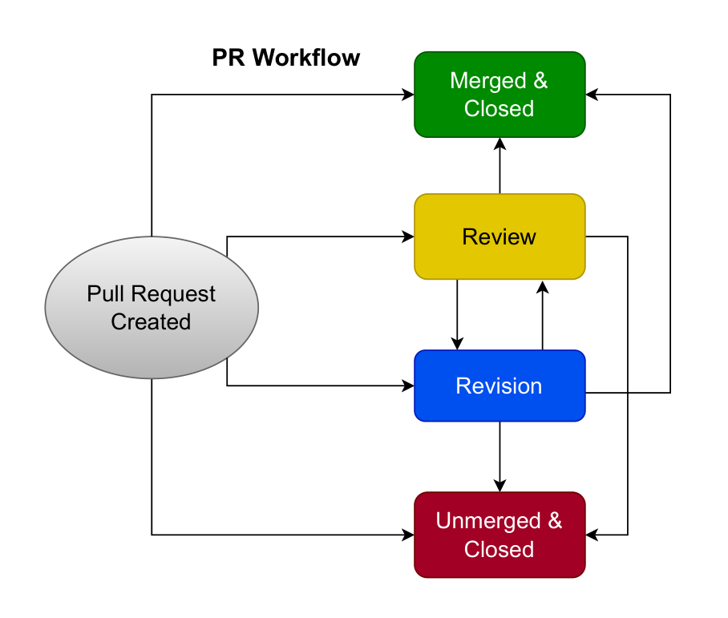
METHOD
METHOD | 06 / 18
Lifecycle model + pipeline
29,585 PRs
sample
5
tools
state machines
output
29,585 PRs | 5 tools | AIDev (Li et al., 2025)
Notes:
Let me walk through the pipeline. Read it left to right.
Each pull request is observable as a lifecycle. We parse the public GitHub event stream, classify actors as agent or human, assign each event to a phase, identify the initiator and the approver, and then aggregate those traces into scenarios and into workflow state machines.
What the pipeline gives you is a behavioral reconstruction of how a pull request moves - who did what, and when. The pipeline is portable. Any human-AI workflow that produces event logs admits the same reconstruction. PRs are one operationalization of the method, not the method itself.
What the pipeline does not give you is private intention, off-platform decisions, or whether an automation bot is executing a decision made somewhere we cannot see. Those limits are the next slide's job - and I want to put them on the table early, because they shape every empirical claim I am about to make.

Slide 7
METHOD
METHOD | 07 / 18
What the trace lets us reconstruct
AGENTS
ROLES
DEPENDENCIES
PROTOCOLS
who acts
what work
how flow moves
what rules
initiator and approver on each PR
operational work vs merge governance
review routing and revision loops
branch protection, merge rules, automation bots
Notes:
A quick orientation. These four labels are the vocabulary the rest of the talk uses. The empirical patterns I am about to show live inside them.
Agents - who initiates the pull request, and who approves it. Roles - operational work versus merge governance. Dependencies - review routing and revision loops. Protocols - branch protection, merge rules, and the automation bots that enforce them.
These are reading conventions, not a theoretical claim. They let the audience hear the empirical results that follow as governance-laden, not merely process-laden.

Slide 8
METHOD
METHOD | 08 / 18
What GitHub traces can observe
CAN OBSERVE
CANNOT INFER FROM TRACES ALONE
committed, review_requested, reviewed, merged/closed events
actor classification: Bot flag + pattern heuristic
phase transitions, terminal outcomes, median hours
developer intent
off-platform decisions
decision vs executor on auto-merge
0.36% FP
0 FN
actor heuristic validation
false negatives
Notes:
Before the results, let me name what the trace can and cannot do. This is part of the method, not a footnote.
GitHub traces are powerful because they preserve events: commits, review requests, reviews, merges, closes, the phase transitions between them, and the terminal outcome of each pull request. We also validate the actor classification - a Bot flag plus a pattern heuristic, with a false-positive rate I will mention later.
What the trace cannot directly recover is developer intent, anything decided off-platform, and the distinction between an automation bot that is merely executing a decision and an agent that is making one. That last gap is what RQ3 returns to at the end of the talk.

Slide 9
EXAMPLE
EXAMPLE | 09 / 18
Illustrative composite: Collaborator PR (S1)
STEP 1
STEP 2
STEP 3
STEP 4
Agent commits
PR opened
Human review
Human merge
agent-authored changes appear in the PR history
the lifecycle trace begins as an observable review object
review routing makes governance work visible
authorization remains with a human approver
Illustrative composite - aggregate Copilot-style S1 pattern synthesized from scenario definitions; not a single quoted repository PR.
Notes:
Before the taxonomy, an example. And I want to be explicit about its status. This is a composite, not a quoted repository case. It shows the shape of an S1 pull request - an agent commits, a pull request is opened, a human reviews, a human merges.
The footer on the slide says the same thing, and I am pointing at it on purpose: what you are seeing is the aggregate Copilot-style pattern synthesized from the scenario definitions, not a single observed PR. The example exists to make the taxonomy easier to read on the next slide. Nothing more.

Slide 10
TAXONOMY
TAXONOMY | 10 / 18
Initiator x Approver: six scenarios
AGENT-INITIATED
HUMAN-INITIATED
TOOL SPLIT
S1 / S2 / S3
S4 / S5 / S6
>=90%
human-approved
agent-approved
not merged
human-approved
agent-approved
not merged
Collaborators cluster in S1-S3
Assistants cluster in S4-S6
Notes:
Now the classification logic. The six scenarios are the cells of a two-by-three cross-tab.
On one axis, the initiator: agent or human. On the other axis, the terminal authorization point: human-approved, agent-approved, or not merged. S1 through S3 sit in the agent-initiated row. S4 through S6 sit in the human-initiated row.
Point first at the axis labels. Hold there for three or four seconds while the audience reads the carving. Then trace the cluster pattern with one gesture: Collaborator tools in the agent-initiated row at ninety percent or more; Assistant tools in the human-initiated row at ninety percent or more. Do not read individual cells. The taxonomy is the contribution; the cell values are the evidence the taxonomy carves the population sharply.

Slide 11
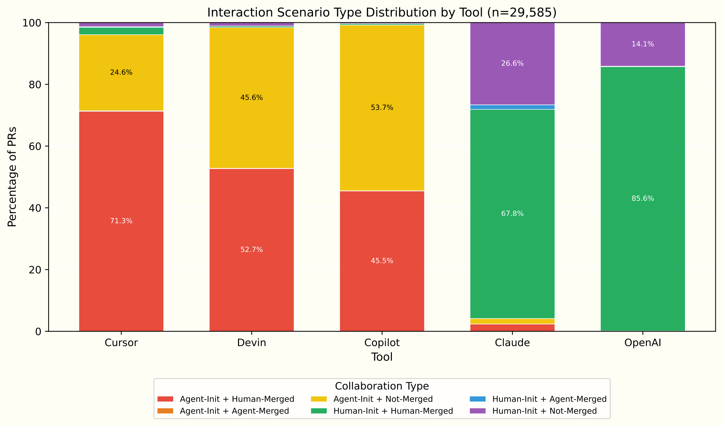
SPECTRUM
SPECTRUM | 11 / 18
The Collaborator-Assistant spectrum
0.50
V
>=0.25 large
threshold
review vs direct
contrast
Cramer's V = 0.50; chi-square rejects independence at p < 0.001.
Notes:
Here is where the opening number comes from.
The association is V = 0.50, well beyond the conventional large threshold of 0.25 for a table of this size. The chi-square test rejects independence at p below 0.001, and V carries the magnitude of the relationship. I want to keep those two claims apart: chi-square tells us there is a relationship; V tells us how strong it is.
The number is the statistic. The contribution is the axis. What we are reporting is that initiator and approver can be observed independently in event-log data at this scale, and that the joint distribution carries signal that outcome-centric metrics - merge rates, comment counts - cannot recover.
The pattern on the screen: Cursor, Devin, and Copilot sit toward the Collaborator side. Claude and OpenAI sit toward the Assistant side. And inside that, the workflow contrast is striking. Copilot is review-heavy - 90.3 percent of its pull requests go through review. OpenAI is much more direct-resolution-heavy - 76.5 percent resolve without iteration.
That contrast is what the next slide makes visible at the state-machine level.

Slide 12
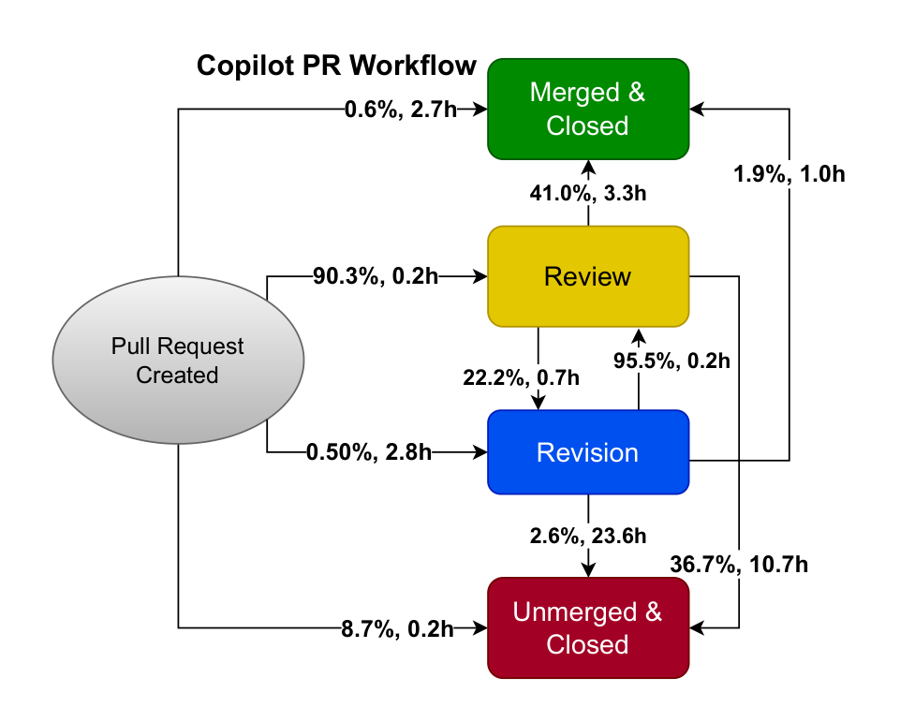
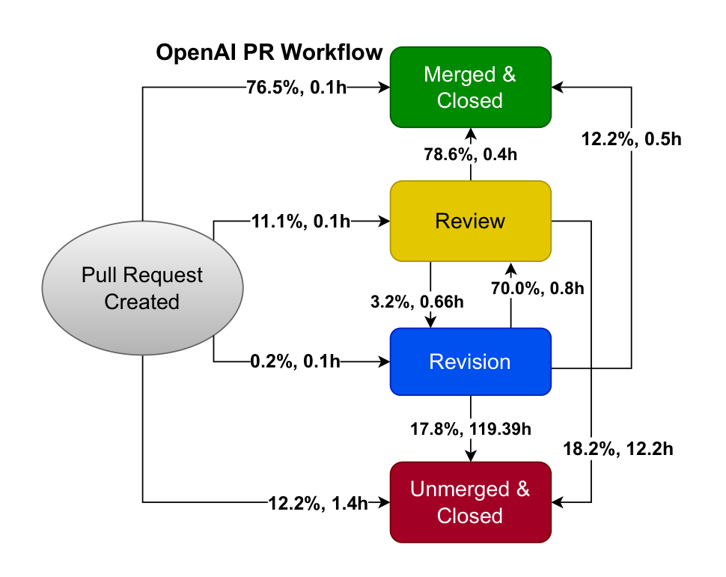
WORKFLOWS
WORKFLOWS | 12 / 18
Copilot vs OpenAI: workflow state machines
Review-heavy Collaborator
Direct-resolution Assistant
Notes:
Two state machines, side by side. The spectrum is not just a label.
Copilot moves heavily through review and revision - 90.3 percent routing through review. OpenAI moves more directly to resolution - 76.5 percent resolving without that loop. I will not read every transition percentage. The point is the shape difference. Different tools do not merely produce different acceptance rates. They produce different workflow shapes.
If I am running short on time, I will show Copilot here and summarize OpenAI verbally. The contrast survives without both diagrams on screen.

Slide 13
FINDING
FINDING | 13 / 18
Agency and governance decouple
>=96%
<0.05%
14 PRs
Collaborator tools
agent-approved (S2)
S2 cases
agent-initiated PRs
of all 29,585 PRs
rare in this snapshot
Junior-teammate pattern: agents operate; humans authorize merge.
Endorsement is measurable here; accountability is the layer the paper does not measure.
Notes:
This is the governance claim, and the most easily misread slide in the talk. So I want to land it carefully.
Collaborator tools initiate most pull requests. But scenario S2 - agent-initiated and agent-approved - accounts for fourteen PRs out of 29,585, less than 0.05 percent of the sample. The pattern is close to a junior-teammate one: agents do operational work, humans retain authorization.
What this paper adds is more specific than the word 'decoupling' usually carries. Operational agency and governance authority are conceptually separable in the human-AI collaboration literature. We show they are also empirically separable at population scale. The junior-teammate pattern names that separability; we do not claim priority over the conceptual literature, only that the lifecycle trace makes the separation observable.
One refinement worth keeping on the record. Endorsement is clear acceptance of a PR outcome - a review event, an approval, a merge authorization. Accountability is who remains answerable for the merged code after it ships. The trace measures endorsement signals more directly than accountability, and that boundary is part of the contribution. A team can stay accountable when no person gave a clear approval, because branch protection or auto-merge handled the last step.
The pattern is descriptive, not prescriptive. Branch protection, organizational trust, and tool design can all move the boundary.

Slide 14
BOUNDS
BOUNDS | 14 / 18
Policy and snapshot bounds
BRANCH PROTECTION
WITHIN-REPO CONTROL
SNAPSHOT
shapes routing
96.8 pp
94%
direct resolution is partly repository governance
initiation gap persists; review routing partly reverses
of PRs from 2025 Q2-Q3; not a trend claim
Notes:
A note on what shaped these patterns. I will keep this short, and the longer version lives in the Q&A if anyone wants it.
The patterns I just showed were observed under real repository policy. Branch protection shapes review routing and the direct-resolution rate. Even within the same repository, the initiation gap persists - but the review-routing contrast can partly reverse, because the policy is doing some of the work.
And on time. Ninety-four percent of the pull requests in this sample come from 2025 Q2 and Q3. AIDev is a tool-driven sample of AI-adopting repositories. So this is a snapshot of an emerging practice, not a longitudinal trend, and not a random sample of GitHub.

Slide 15
RQ3
RQ3 | 15 / 18
What traces cannot settle
54 PRs
automation bot
decision-maker
agent-classified approvers
merge actor
taxonomy boundary
0.24% of merged PRs
often executor, not coding agent
not always visible in logs
Logs record executor, not always decision-maker.
Different denominators: 14 of all, 54 of merged.
Notes:
RQ3 returns to the trace limits I named earlier.
Of merged PRs only, fifty-four had an agent-classified approver - about 0.24 percent of merged. And even within those fifty-four, the merge actor we observed may be an automation bot rather than the coding agent. The log records who executed the merge event, not always who made the decision behind it.
So the taxonomy is deliberately conservative at the boundary of automation-authorized merges. We do not claim agents are deciding when the data only shows them executing. That gap is a measurement boundary, not a claim about how teams actually work.
If anyone asks: the two figures are on different denominators on purpose. Slide thirteen reported S2 as fourteen PRs out of all 29,585. This slide reports fifty-four PRs with an agent-classified approver out of the merged subset. Both are correct against their own denominator.

Slide 16
BUNDLE
BUNDLE | 16 / 18
Contributions, scope, and limitations
CONTRIBUTIONS
SCOPE
LIMITS
what we ship
what we cover
what we honestly admit
Initiator x Approver taxonomy
five workflow state machines
public replication package
AIDev cross-sectional snapshot
tool-adopting repositories
Q2-Q3 2025
observability ceiling
policy confound
Claude small-n; 0.36% FP rate
Notes:
Let me bundle the contributions, the scope, and the limitations.
The contribution is three things: a lifecycle taxonomy that crosses initiator and approver, five workflow state machines for the five tools, and a public replication package.
The scope is an AIDev cross-sectional snapshot - tool-adopting repositories observed over Q2 and Q3 of 2025. Cross-sectional, not longitudinal.
The limits, named honestly. An observability ceiling at the points the trace does not reach. A policy confound at the points branch protection is doing the work. A small Claude sample, only 338 PRs, which is why I reported Claude's state machine tentatively. And the actor-classification false-positive rate at 0.36 percent with zero false negatives. False positives inflate within-pole separation; they do not flip pole assignment, so the spectrum claim is robust to the 0.36 percent false-positive rate.
The method makes each of these explicit and inspectable. That is the point of the bundle.

Slide 17
IMPLICATIONS
IMPLICATIONS | 17 / 18
Implications and future research
TEAMS
RESEARCHERS
TOOL BUILDERS
lifecycle-based review
workflow-situated
decision provenance
route agent-opened PRs differently from human-opened PRs
complements task-realistic benchmarks
asks how code moves through governance
expose who decided, who executed, under which rule
Method portable to any human-AI workflow with logged events. PRs are one operationalization.
Notes:
What this implies.
The method is portable to any human-AI workflow with logged events. PRs are one operationalization. With that in view, three audiences hear different implications.
For teams, lifecycle-based review allocation. A PR opened by an agent and a PR opened by a person warrant different routing, and the workflow trace tells you which is which.
For researchers, workflow-situated evaluation as a complement to task-realistic benchmarks. The benchmark literature asks whether the code is good. We ask how the code moves through governance. Different layers, not substitutes.
For tool builders, decision provenance as a first-class affordance. Expose who decided, who executed, and under which rule.
All three rest on the same primitive: making decision provenance observable, not just outcome. Without it, governance research and review allocation are both blind to the most consequential moment in a pull request, which is the merge.
Let me close on three callbacks. V = 0.50 makes the Collaborator-Assistant spectrum measurable. That is the cold open returning. Merge authority remains mostly human, and only partially coupled to initiation. That is the decoupling slide returning. The method and the replication package together make governance research reproducible, with the trace bounds named explicitly. That is the observability move from slide eight returning.

Slide 18

Q & A
Lifecycle traces for governance in AI-assisted pull requests.
REPLICATION PACKAGE
CONTACT
doi.org/10.6084/m9.figshare.31343038
jo.chung@utoronto.ca
Thank you.
Notes:
Brief pause for the slide change. The deck is over; the conversation begins.
The replication package is on the slide, along with my email. If a question comes up about the supplementary state machines for Cursor, Devin, or Claude that I did not detail in the main talk, I have one backup slide I can return to.
Thank you. I would be happy to take questions.

Slide 19



BACKUP
BACKUP | B1
Backup B1: Cursor, Devin, Claude state machines
Cursor
Devin
Claude
Notes:
Backup B1, on demand only. If someone asks whether the result generalizes beyond Copilot and OpenAI, this is the slide I would turn to.
The supplementary state machines for Cursor, Devin, and Claude show the same lifecycle reconstruction working on three more tools. The workflow reconstruction extends beyond the two tools I detailed in the main talk - and Claude in particular sits at the small-n boundary, with only 338 PRs, which is why I reported it tentatively.
If the question does not come up, I will not spend talk time on it.

