Slide 1

Collaborator or Assistant?
How AI Coding Agents Partition Work Across Pull Request Lifecycles
AI coding agents now open pull requests at scale. When their code merges into the trunk — did anyone actually review it?
Young Jo Chung · Safwat Hassan University of Toronto
AIware 2026 · 3rd ACM Intl. Conference on AI-powered Software · Montreal
Supported by NSERC (RGPIN-2021-03969).
Notes:
HOOK. Open with the question, not the method. "AI coding agents now open pull requests at scale - Copilot, Devin, Cursor, Claude Code, OpenAI Codex. When an agent's PR merges into the trunk, did a human actually review it? It sounds like a yes/no question, but you cannot answer it from raw metadata. Our paper gives you the tool to answer it - and the answer is surprising." Paper: Collaborator or Assistant? How AI Coding Agents Partition Work Across Pull Request Lifecycles. Chung & Hassan, University of Toronto. AIware 2026, Montreal, 6-7 July.

Slide 2
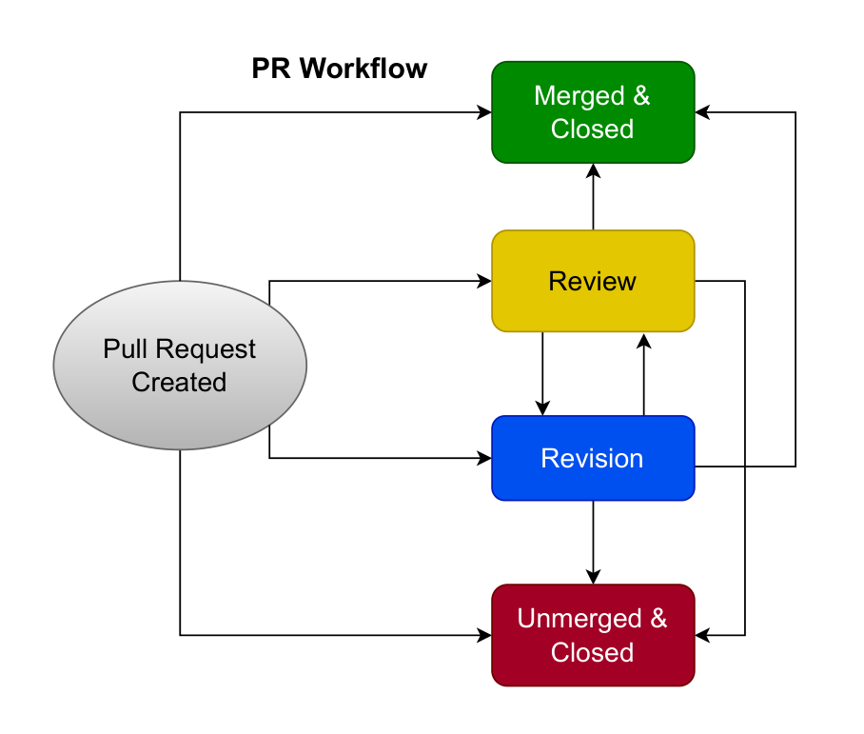
Our contribution: a map of where to look
Raw PR metadata says what happened — not who authorized it, or who answers for it. We turn it into a map.
1
Each PR is a lifecycle
A process to characterize — not a row in a table.
2
Timeline maps the pathways
State-machine transitions recover the routes a PR can take.
3
Three separable observables
Attribution · review routing · merge — who initiates vs who executes the merge.
The paper's PR-lifecycle state machine (the map).
2
Notes:
KICK - the contribution is an instrument. "Raw pull-request metadata is a pile of events: timestamps, authors, review actions. It tells you WHAT happened, not WHERE governance happens. Our contribution turns those events into a map." 1) Each PR is a lifecycle - characterized as a process, not a single row. 2) Timeline data maps the pathways - state-machine transitions over the event timeline recover the routes a PR can travel: PR created -> Review <-> Revision -> Merged & closed / Unmerged & closed, plus the direct-to-merge shortcut. 3) Three separable observables - visible first-commit attribution, review routing, and merge governance, each measured independently (this independence is the camera-ready's core contribution; tool-scenario association ~ Cramer's V 0.50). Land it: this is an INSTRUMENT - point it at ANY PR metadata and it tells you which path a change took and whether a human gate was crossed. The figure is the actual state machine from the paper (Contribution 3).

Slide 3
Same data, a different lens
No new dataset and no new sample — the same PRs and the same metadata. Read the review-and-merge layer (not just initiation) and the same structures tell a governance story.
1
Construct correction
Every PR is agent-associated by construction — 'Human-Init' is an attribution appearance (login-or-name), not human authorship.
2
The pathways generalize
Same map, fuller data: the Collaborator / Assistant routing profile re-reads through recorded review-and-merge traces.
3
Reframe, not retract
The review axis alone reproduces the split; the small-sample case is caveated.
3
Notes:
BUILD - the map generalizes; this is why the reframe is credible. "When the fuller Hugging Face AIDev metadata arrived, we re-ran the same machinery - and every PR fell cleanly into the same pathways. Nothing had to be bent to fit." 1) Construct correction - nearly every PR in AIDev's curated subset is agent-associated BY CONSTRUCTION, so the old Initiator axis measures the VISIBILITY of agent attribution at the first-commit surface, not human authorship. Documented in Li, Zhang & Hassan 2025 (Finding 9): OpenAI Codex provides no commit attribution; Claude Code's Co-Authored-By tag is disableable; Copilot, Devin and Cursor commit as visible bots. The corpus is AGENTS-ONLY - AIDev keeps human PRs in a separate file (6,618 rows) excluded from our sample, so Human/Agent are within-PR roles, not a population split; in the analytic sample, the 72% 'Human-Init' share is 97.8% OpenAI Codex (no machine-visible attribution), while the merge axis is confound-free (99.8% human-resolved across all five tools). 2) The pathways generalize - same state machine, richer data; the Collaborator/Assistant routing profile re-reads through recorded review-and-merge traces (review-mediated vs direct-to-merge) - a descriptive profile, not a proven collaboration mode. 3) Reframe, not retract - the review axis ALONE reproduces the split, so it is not circular. Claude Code is the fragile case: n=338, and 57% of its initiation labels flip under attribution-aware detection - so it is explicitly caveated. Net: a reframe, not a retraction. LOGIC: one dataset, one metadata schema - the difference between the paper's reading and the governance reading is the LENS (which layer you read + how strictly you read the labels), not a different population. The full >100-star-free population (932,791) is a separate axis of SCALE, reserved for future work, not the source of the correction.

Slide 4
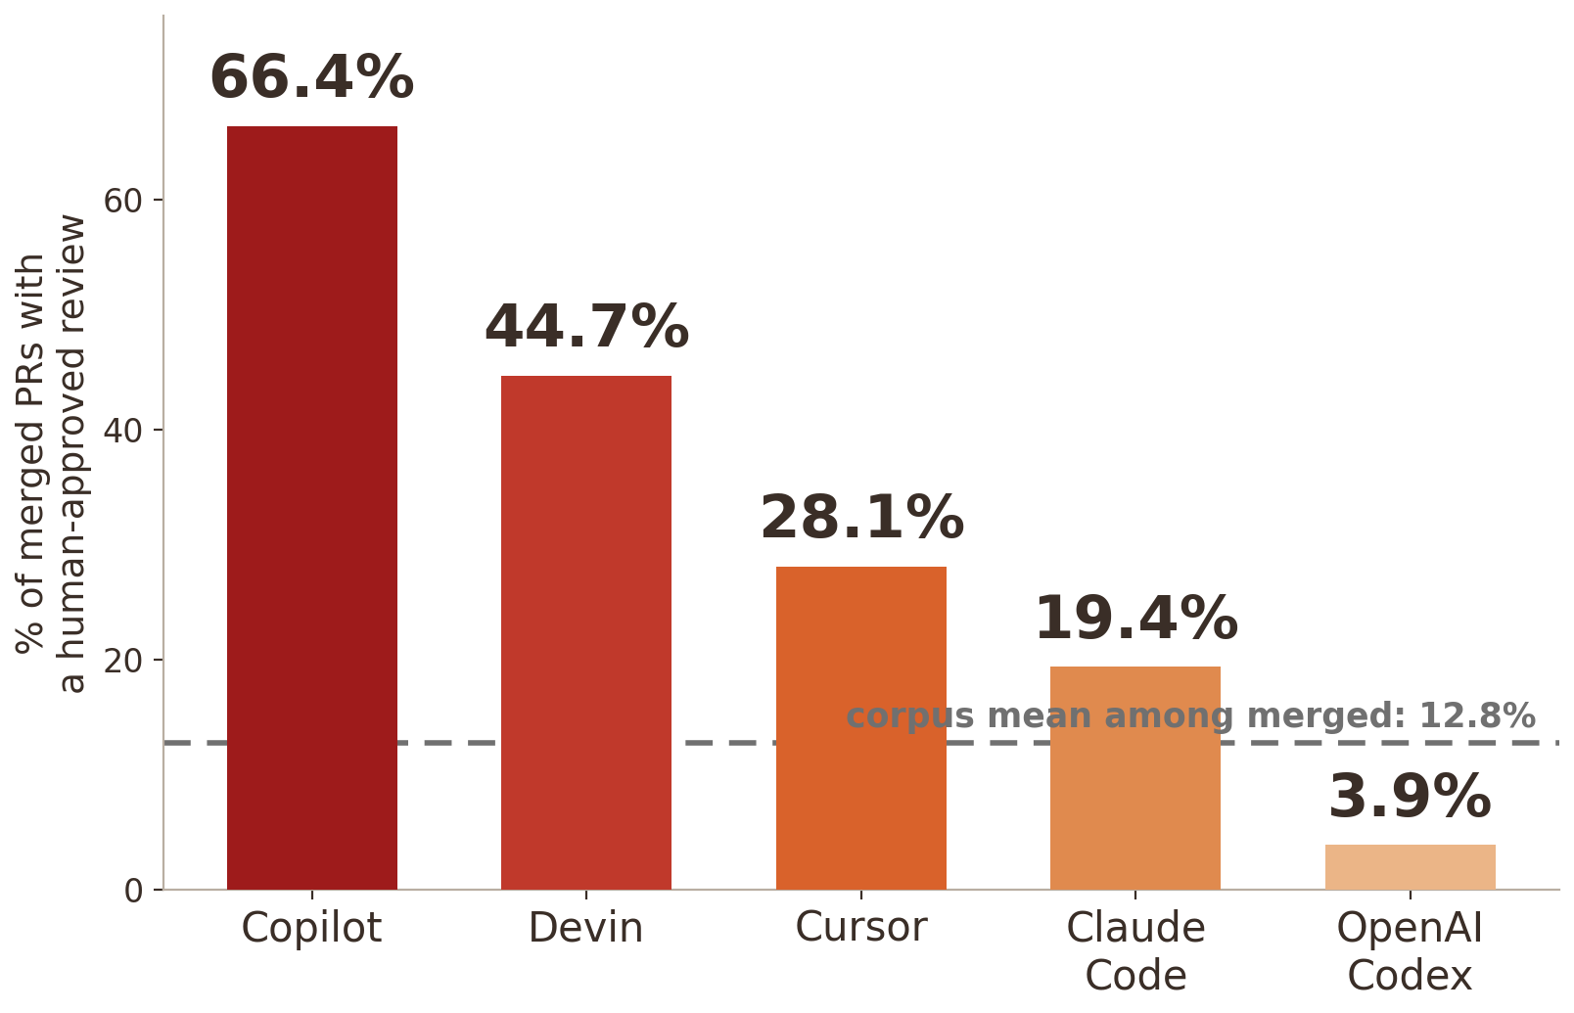
The twist: recorded human review is the exception
89.6%
of 29,585 PRs reach a terminal state with no recorded human-approved review
17×
across the Collaborator→Assistant spectrum (Copilot 66.4% → Codex 3.9%)
Most agent PRs merge with no recorded human-approved review.
4
Notes:
TWIST - point the instrument at the merge gate. "The merge is the governing apex of a pull request, so we point the map at it. Across 29,585 agent-associated PRs, 89.6% reach a terminal state with NO human-approved review. Among the 22,672 that merged, only 12.78% carry a recorded human-approved review - even though a human-classified executor RESOLVES 99.8% of merges. The paper's controlling boundary: it captures who executes the merge but not who decides; a missing recorded review is not proof that no verification happened." Bar chart: human-approved-review rate among MERGED PRs by tool - Copilot 66.4%, Devin 44.7%, Cursor 28.1%, Claude Code 19.4%, OpenAI Codex 3.9%. A 17-fold spread in recorded review routing, which differs by tool and by repository adoption (association, not cause). Boundary condition (do not overclaim): thin review is NOT fragile code. Same AIDev lineage - Haider & Zimmermann 2026: inline review on ~9.5% of curated PRs; Rahman & Shihab 2026: agent code modified LESS often (HR 0.842) - but longevity is not robustness, so code quality stays open. A productivity story is really a governance one. Collaborator tools (Cursor, Devin, Copilot) draw more review; Assistant tools (OpenAI Codex, Claude Code) resolve without it. But agency and authority DECOUPLE: >=96% agent-initiated, yet agent-executed merges <0.1% - agents do the work without executing the merge, a 'junior teammate' pattern (a current-state description, not destiny).

Slide 5
Collaborator or Assistant? A junior teammate — see the poster
Agents do the operational work (≥96% of Collaborator-tool PRs are agent-initiated) yet humans execute almost every merge (<0.1% agent-executed): operational agency and governance authority decouple.
The per-tool governance profile — behind the 17-fold.
The construct correction — attribution as appearance, not identity.
Trace vs governance legibility — what a recorded merge can and cannot evidence.
A future-work prototype — quality / outcome analysis on live AIDev data.
Come to the poster — the instrument, and what it reveals.
Notes:
LANDING - sell reusability, then hand off. "The finding matters, but the lasting contribution is the MAP. Point it at any PR metadata - ours, or live data tomorrow - and it pinpoints where governance happens, or does not." The poster carries, in depth: the full per-tool governance profile behind the 17-fold; the construct correction; the form-vs-substance reading of the merge gate; and a worked future-work prototype for quality/outcome analysis on refreshed/live AIDev metadata. Close: "Come to the poster - the instrument, and what it reveals." Corroboration if asked: Li, Zhang & Hassan 2025 (AIDev / attribution); Haider & Zimmermann 2026, MSR'26 (review themes); Rahman & Shihab 2026, EASE'26 (survival).

