Slide 1

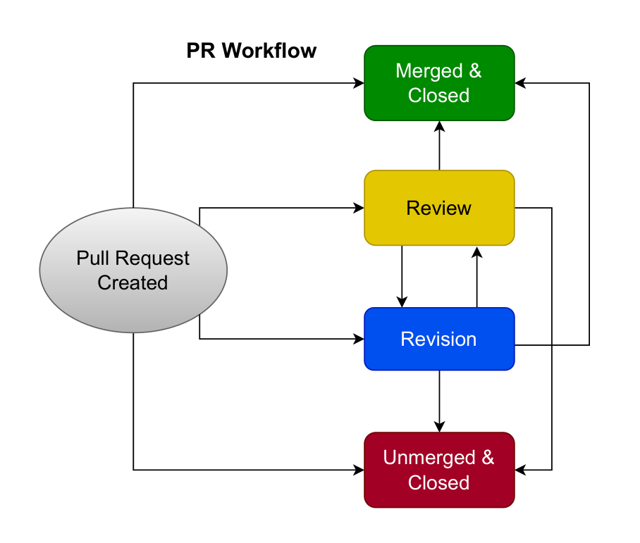
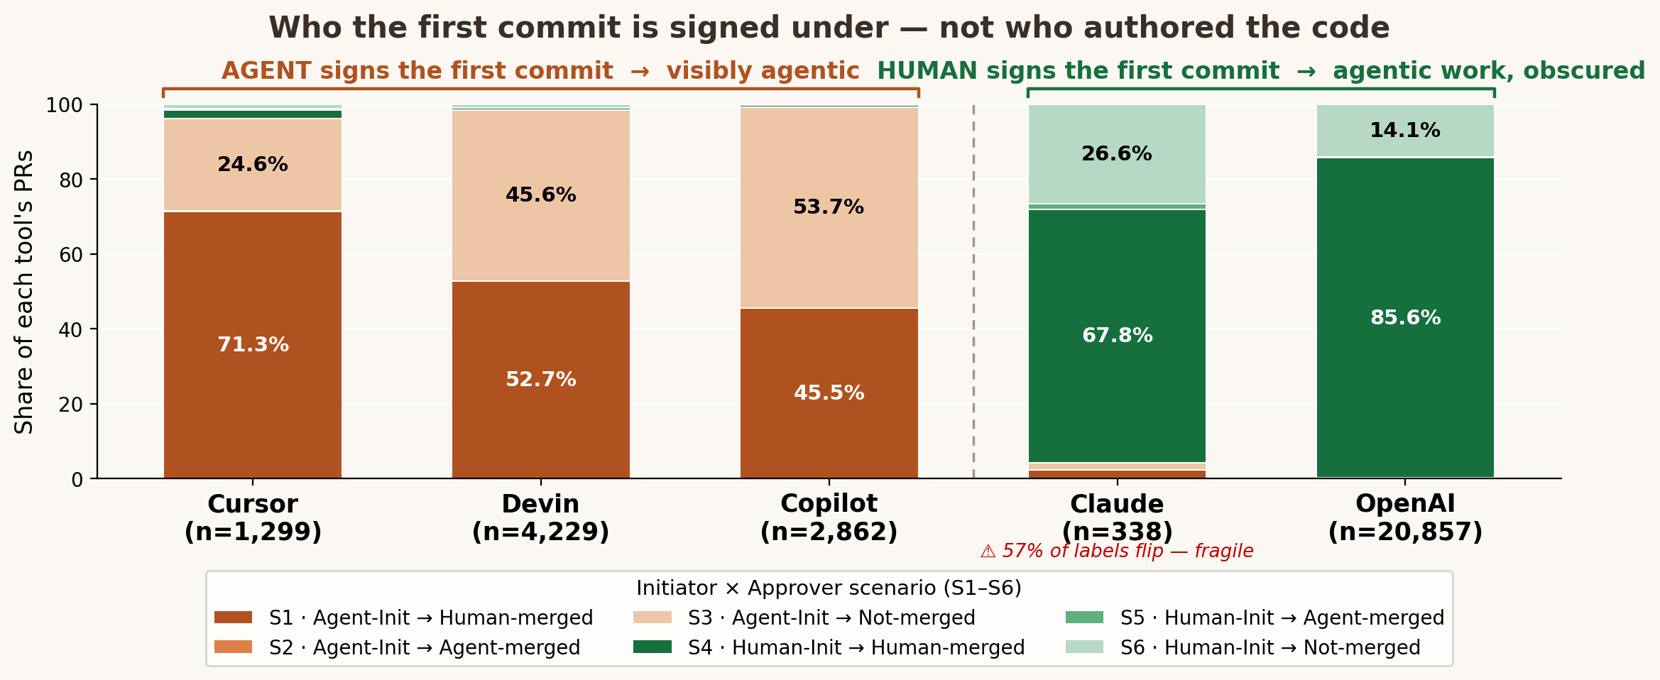
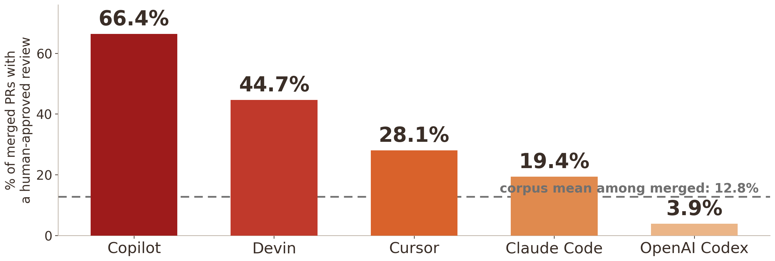

Collaborator or Assistant?
How AI Coding Agents Partition Work Across Pull Request Lifecycles
An agent's work can surface under a human identity; the trace measures visibility, not authorship.
Young Jo Chung · Safwat Hassan · University of Toronto
AIware 2026 · Montreal · 6–7 July
STEP
The instrument: PRs as traces
1
The talk gave the map; the poster uses it to read visibility and review.
1.
Each PR is a lifecycle
Why a state machine?
A sequence of events, not just a row in a table.
Because the question is not only whether a PR merged. It is what path it took: who appears first, whether review appears, and who executes the merge.
2.
The map separates roles
First commit, review, and merge are distinct trace surfaces.
3
Initiator = first committer
3.
It records who the commit is logged under — an attribution surface.
That surface is visible identity, not verified authorship. This is the gap the poster follows.
The paper's PR-lifecycle state machine (the map).
STEP
Figure 3 changes meaning: visibility, not workforce
2
Same six scenarios, corrected lens: the bars show how agentic work surfaces in the trace.
How to read it
Warm bars: the agent/bot is visible at first commit. Green bars: the first commit surfaces under a human account. In this agentic corpus, green does not mean human-authored; it means agent work is less visible.
Codex carries the pattern (n=20,857, ~99.9% human-signed); Claude is consistent but fragile — n=338 and 57% of its labels flip under attribution-aware re-detection.
STEP
Visibility meets review
3
One association to remember: the least visible agentic work has the least recorded human-approved review.
89.6%
of 29,585 terminal PRs have no recorded human-approved review. Among merged PRs, only 12.8% show one.
17×
spread in human-approved review: Copilot 66.4% to OpenAI Codex 3.9%.
The poster's claim
The lifecycle map still works, but Figure 3 should be read as attribution visibility. Once read that way, the same traces expose a governance gap: human review is sparse overall and lowest where agentic work is least visible as agentic. Association, not cause.
Collaborator or Assistant? A junior teammate — often under your name.
The puzzle: AI work can enter a repository under a human name.
The trace: most merges still look human-governed.
The gap: recorded human-approved review is often absent.
The question: what should repositories log if they want to govern agent-generated change?
Scan for code & data
Data: AIDev (Li, Zhang & A. E. Hassan, 2025), hao-li/AIDev on Hugging Face, CC-BY-4.0. Repro: governance_stats.json (n=29,585; merged n=22,672).
Method: lifecycle state-machine taxonomy over PR timelines + AIDev review metadata. Corroboration: Li et al. 2025; Agarwal et al. 2026; Haider & Zimmermann 2026; Rahman & Shihab 2026. Supported by NSERC RGPIN-2021-03969.
AIware 2026 · Montreal

