Slide 1
BCBS Testing Strategy

Slide 2
PDM
SA -
SVC_TEST_CACTUS_MINN
DB -CACTUS_MIN1
Has Uma updated the Matillion IIT repository with the service account.
For new account , create the ID in vault and provide the secret name. Uma can find it.
Same repository with different env variable.
Mahi coordinate with Uma.

Slide 3
Testing Strategy
Prep
Plan
Execute
Report
Identify app to be tested
Validate data Stage runbook availability
Identify source & target table/file
Verify Matillion job access to jobs
Prepare test plan
Prepare test cases
Review test cases
A/B Test framework
Data sync data stage
Data sync matillion
Execute A/B Test
Raise bugs
Validate test result
Close defects in ADO
Test Summary result
Review & Approval

Slide 4
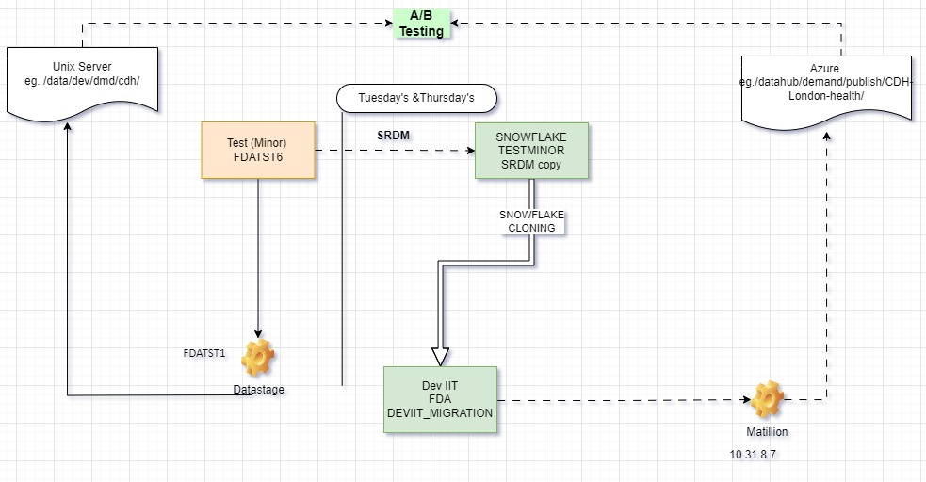
Execution Strategy – A/B Testing
Demand A/B Testing – File based
A → Represent data from Data Stage & Netezza loaded into Unix server.
B → Represent data from Matillion & Snowflake loaded into Azure blob
A/B Testing framework covers below.
Record count match
Data set matches
Data level validation
Manual Testing
File Type match
File name match
File size match
File Header match
Job run in DS & Matillion

Slide 5
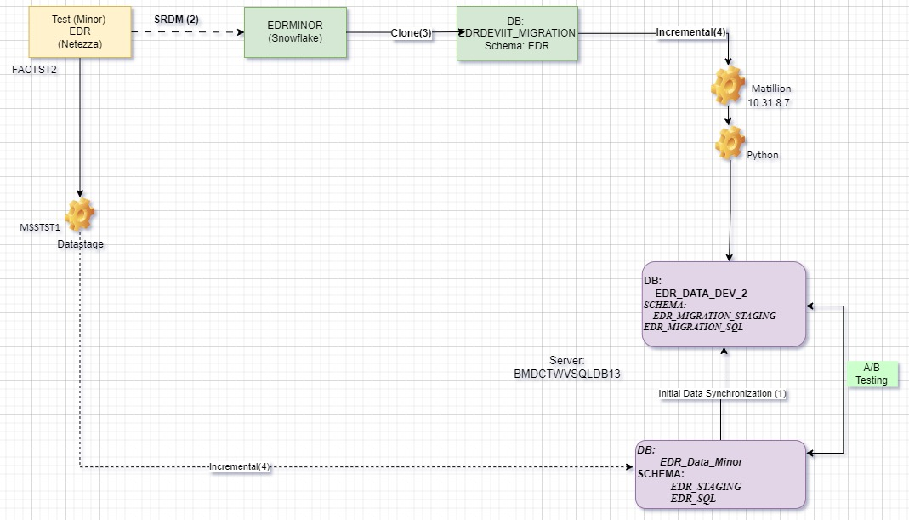
Execution Strategy – A/B Testing
MSS Supply A/B Testing – Table based
A → Represent data from Data Stage & Netezza loaded into SQL database.
B → Represent data from Matillion & Snowflake loaded into SQL database.
A/B Testing framework covers this.
Record count match
Data set matches
Data level validation
Column validation
MSS Supply A/B Testing

Slide 6
Test Execution Timeline
 |  | total app | Completed | Work Remaining | Effort Hrs per app | no resources | Total effort hrs | Days Required | Planned Start | Planned End | Actual No of days | Resource Hrs
IIT
 | Demand Test
 | P1G2/P1G3/P1G4 | 27 | 8 | 19 | 32 | 3 | 608 | 25 | 25-Mar | 3-May | 30
 | MSS Supply | 1 | 0 | 1 | 160 | 1.2 | 160 | 17 | 1-Apr | 26-Apr | 20
 | MSS Demand | 1 | 0 | 1 | 60 | 1 | 60 | 8 | 29-Apr | 10-May | 10
 | Bug Fixes |  |  |  |  | 6 | 1920 | - | 25-Mar | 10-May | 35
 |  |  |  |  |  | . | 2748 |  |  |  | IIT Total
SIT
 | SIT Prep |  |  |  |  | 0.2 |  |  | 25-Mar | 10-May | 35
 | P1G21/P1G3/P1G4 | 27 | 0 | 27 | 22 | 4 | 594 | 19 | 6-May | 7-Jun | 25
 | MSS Supply | 1 | 0 | 1 | 80 | 1 | 80 | 10 | 3-Jun | 21-Jun | 15
 | MSS Demand | 1 | 0 | 1 | 40 | 1 | 40 | 5 | 10-Jun | 21-Jun | 10
 | Bug Fixes |  |  |  |  | 6 | 1920 | - | 6-May | 21-Jun | 35

Slide 7
Test Result Summary
A/B framework setup
A/B framework Test result
 | Database / Server | File / Table
A
Test Minor Netezza Source | FDAMINOR.FDA, EDRMINOR.EDR
Test Minor DataStage | Unix Server | /data/uat/dmd1/HCBB/Lab_Data/output/ LAB_M01_LANDMARK_O_MTHLY_LABMEM_DATA_20240304_041420_01.TXT
Data Stage Job Execution Date | 03/04/2024
Snowflake Source Database | FDADEVIIT_MIGRATION, EDRDEVIIT_MIGRATION
Snowflake Clone Date | 02/29/2024 10:43 AM ET
B
Matillion Source | FDADEVIIT_MIGRATION.FDA
Matillion Target | ADLS | datahub / demand / publish / HCBB / LAB_DATA/ LAB_D01_LANDMARK_O_MTHLY_LABMEM_DATA_20240304_041420_01.txt
Matillion Job Execution Date | 03/04/2024
AB Test Summary
Created By: Srinivasulu Naidu
Date | Count Check |  |  |  | Data Check
2024-03-18T03:43:34.34-04:00 | Count A | Count B | Expected Result | Result | A Minus B | B Minus A | Expected Result | Result
Tester: Srinivasulu Naidu | 356327 | 356327 | 100% match | Pass | 0 | 0 | Zero Record count for A-B and B-A | Pass

