Slide 1
BM&G MORTGAGE EXAMINATION INTAKE · MVP OVERVIEW
From Upload to Invoice
How BM&G's new intake automation carries a lender's documents
all the way to a ready invoice — step by step.
Prepared for Moder · September 2026

Slide 2
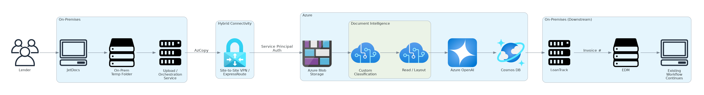
The Whole Journey, at a Glance
A lender's documents travel from JetDocs, through a private hand-off into Azure, and land back home as a ready-to-work invoice — with no one manually in the middle.
1 · On-Premises
Lender submits
2 · Hybrid Connectivity
Secure hand-off
3 · Azure
Read & organize
4 · Back On-Premises
Invoice & file
BM&G Intake Automation MVP

Slide 3
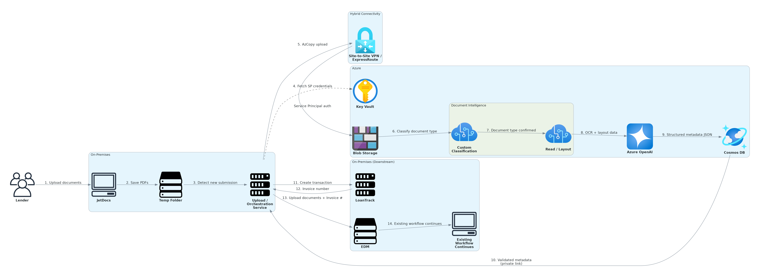

Slide 4
Four Stages, One Seamless Hand-off
1
Lender submits, as usual
A lender uploads documents in JetDocs, exactly like today. The files land in a temporary folder, and our orchestration service notices the new submission right away — nobody has to go looking for it.
2
A secure hand-off into Azure
The documents travel over a private, dedicated connection into Azure — never the open internet — and the service proves who it is before anything is allowed to move.
3
Azure reads and makes sense of it
Each document is sorted by type (Note, Deed of Trust, Title Commitment, Survey, Closing Instructions), read for its text and layout, and the handful of details needed to raise an invoice are pulled out.
4
Invoice created, files delivered home
With that information in hand, the system creates the transaction in LoanTrack, gets the invoice number, and uploads the original documents into EDM under that number. From here, the existing process carries on unchanged.
BM&G Intake Automation MVP

Slide 5
Why It's Worth Doing
Three small shifts that add up to a much smoother start for every submission.
1
2
3
No more manual re-keying
Faster, more consistent hand-offs
Nothing downstream has to change
Coordinators no longer open every document just to create an invoice number — the metadata is captured automatically.
Classification and extraction happen in seconds and the same way every time, instead of depending on who's at the desk.
ClosingExpress, SecureDocs, and the MS Access queue keep working exactly as they do today — this simply feeds them faster.
BM&G Intake Automation MVP

Slide 6
QUESTIONS & DISCUSSION
Same Trusted Process Downstream —
Just a Faster Front Door
The MVP stops right after the EDM upload. Everything the team does today —
queueing, examination, and release — continues exactly as it always has.

