Slide 1
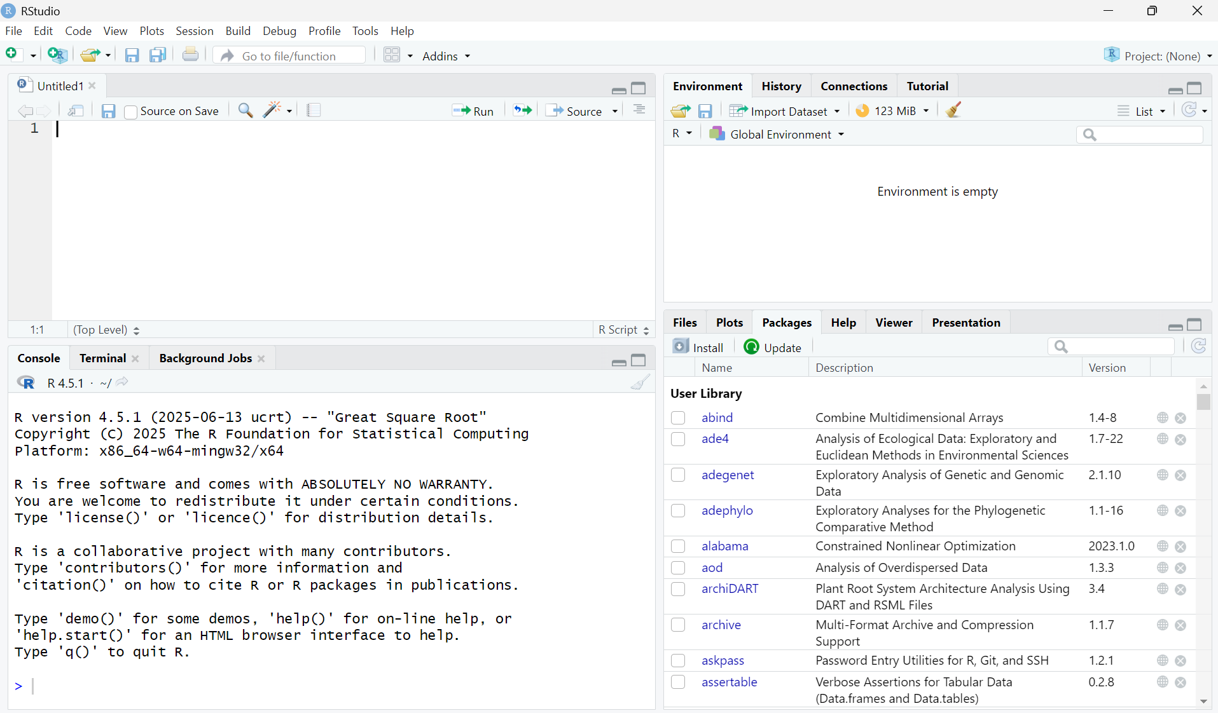
1
R script
3
Environment and History
File explorer, Plot viewer, R package management, Help
4
2
R console

Slide 2
Create a file
Open an existing file
Save current document
Save all open documents

Slide 3
Find and Replace
Save R script
Run the current line or selection

Slide 5
Environment
View R objects that have been created
History
View the code that has already been executed
Load workspace
Clear objects from the workspace
Save workspace
Import a dataset

Slide 6
Files
Manage and explore files
Plots
View plots
Packages
Install, update, load, and unload R packages
Help
Access package documentation and vignettes
Load and unload an R package by (un)checking a box

