Slide 1

Silicosis Diagnostic Prediction Rule overview
Javier Mancilla Galindo
Occupational Epidemiology
One Health Chemical Agents – IRAS, UU

Slide 2
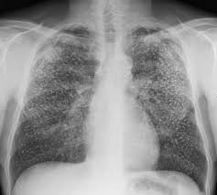
Original Study
Dutch male construction workers >30 y (N = 1335)
Cross-sectional study: 1998
50% smokers, 30% ex-smokers
95% exposed to mineral dust
https://www.Radiopaedia.org/articles/silicosis
Chest X-Ray
Read independently in the USA by 3 NIOSH certified radiologists.
Blinded to participant characteristics, except source of data
Tjoe Nij E, et al. Radiographic abnormalities among construction workers exposed to quartz containing dust. Occup Environ Med. 2003;60(6):410-417. doi:10.1136/oem.60.6.410

Slide 3
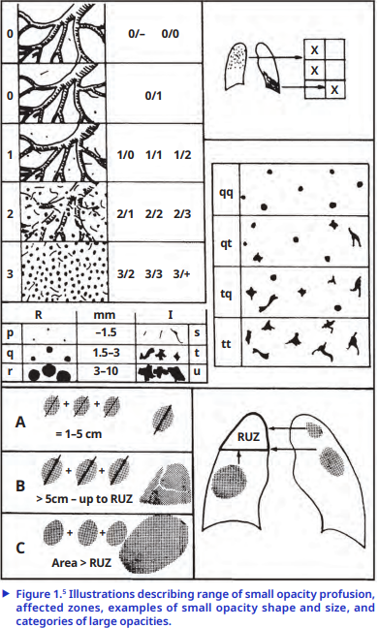
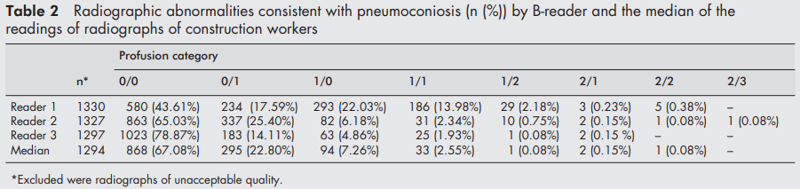
ILO chest X-ray classification
WHO recommendation
Prediction rule
https://www.ilo.org/resource/ilo-international-classification-radiographs-pneumoconioses-1
Tjoe Nij E, et al. Radiographic abnormalities among construction workers exposed to quartz containing dust. Occup Environ Med. 2003;60(6):410-417. doi:10.1136/oem.60.6.410

Slide 4
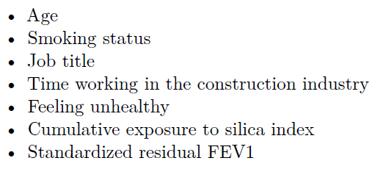
Diagnostic Prediction RULE
1291 participants
Outcome: pneumoconiosis (ILO 1/1) n = 37 (2.9%)
Predictors
Categorized (binary) based on RCS function at inflection point in change of outcome risk.
Backward stepwise selection, starting with pool of predictors significant in univariable analysis.
Candidate predictors
Suarthana E, Moons KG, Heederik D, Meijer E. A simple diagnostic model for ruling out pneumoconiosis among construction workers. Occup Environ Med. 2007;64(9):595-601. doi:10.1136/oem.2006.027904

Slide 5
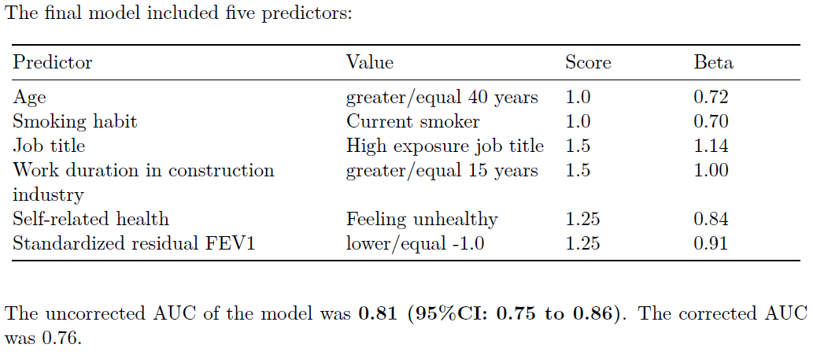
Diagnostic Prediction RULE
No difference in AUC continuous vs binary predictors
But predictors in final model different???
Suarthana E, Moons KG, Heederik D, Meijer E. A simple diagnostic model for ruling out pneumoconiosis among construction workers. Occup Environ Med. 2007;64(9):595-601. doi:10.1136/oem.2006.027904

Slide 6
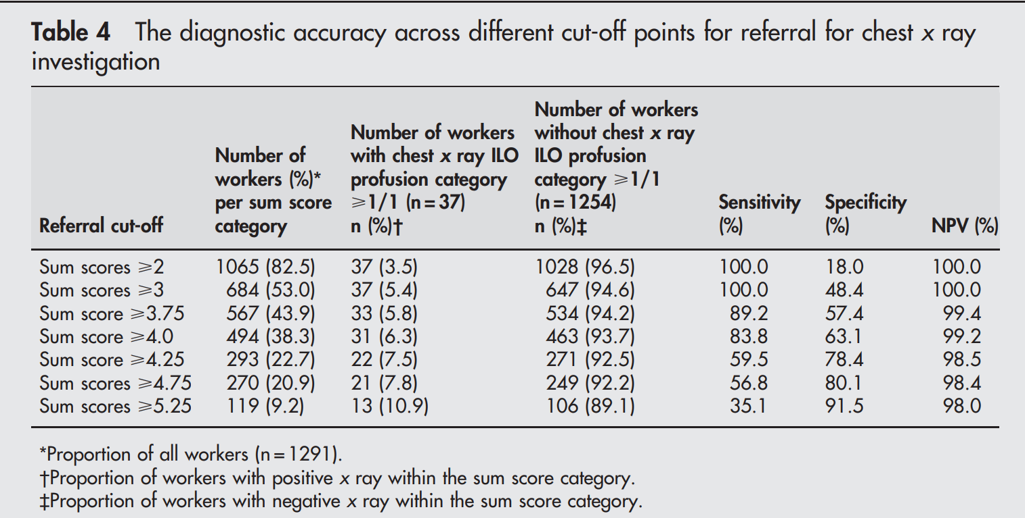
Diagnostic Prediction RULE
Optimal
Used in practice
Suarthana E, Moons KG, Heederik D, Meijer E. A simple diagnostic model for ruling out pneumoconiosis among construction workers. Occup Environ Med. 2007;64(9):595-601. doi:10.1136/oem.2006.027904

Slide 7
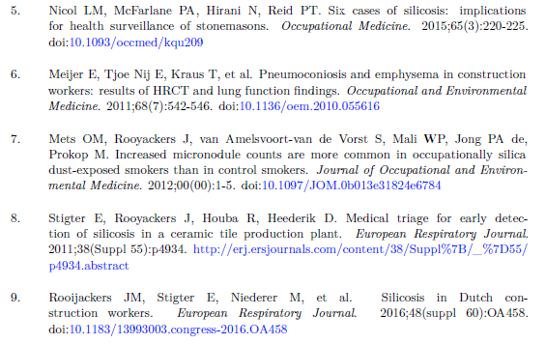
Validation Studies
Citations retreived from Google scholar on 10/09/2024.
Out of 59 records citing the paper, 5 studies applying diagnostic rule. Overview in my working paper (link).

Slide 8
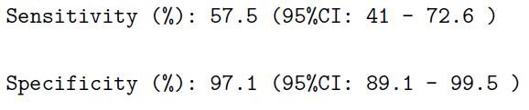
Chest X-RAY VS HRCT
Study | CXR - ILO 1/1 | CXR - ILO 1/0 | HRCT
Tjoe Nij (Netherlands) | 2.55% | 7.26% | ???
Hoy RF (Australia) | 22.7% | 24.5% | 36.4%
Study in Australia, artificial stone benchtop industry workers (n = 110)
ILO 1/1:
Hoy RF, Jones C, Newbigin K, et al. Chest x-ray has low sensitivity to detect silicosis in artificial stone benchtop industry workers. Respirology. 2024;29(9):785-794. doi:10.1111/resp.14755

Slide 9
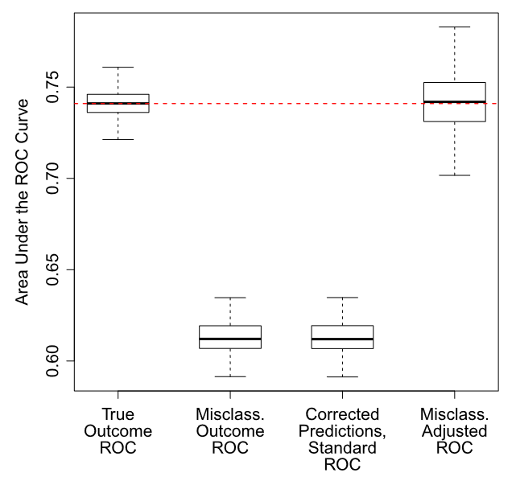
Misclassification ERROR in prediction models
Corrected ROC analysis for misclassified binary outcomes
Case when misclassification is non-differential:
Zawistowski M, Sussman JB, Hofer TP, Bentley D, Hayward RA, Wiitala WL. Corrected ROC analysis for misclassified binary outcomes. Stat Med. 2017;36(13):2148-2160. doi:10.1002/sim.7260

Slide 10
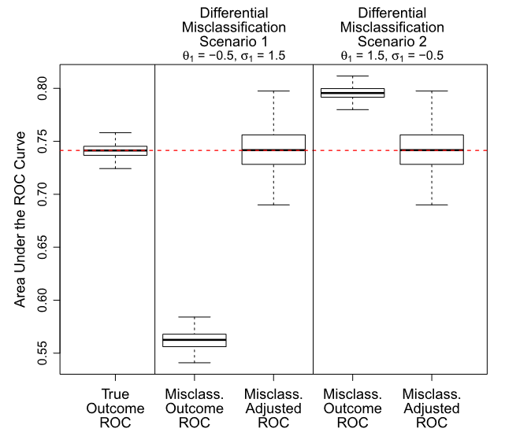
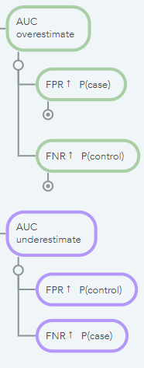
Differential Misclassification
Zawistowski M, Sussman JB, Hofer TP, Bentley D, Hayward RA, Wiitala WL. Corrected ROC analysis for misclassified binary outcomes. Stat Med. 2017;36(13):2148-2160. doi:10.1002/sim.7260

Slide 11
Simulated data to replicate ORIGINAL MODEL DEVELOPMENT DATA
Non-differential misclassification
Sensitivity: 0.41; 0.726
Specificity: 0.891; 0.995
Correlation = -0.8
Summary of 5000 simulated datasets, each N = 1291
Risk Categories
Number of cases
Risk | Median | Q1 | Q3 | Min | Max
Low (<5 points) | 1067 | 1058 | 1076 | 1019 | 1115
High (>=5 points) | 224 | 215 | 233 | 176 | 272
Characteristic | Median | P.25. | P.75. | Min | Max
Silicosis (CXR) | 36 | 32 | 40 | 18 | 61
Silicosis (HRCT) | 56 | 32 | 81 | 6 | 213
Silicosis (CXR) | high-risk | 17 | 15 | 20 | 4 | 36
Silicosis (CXR) | low-risk | 19 | 16 | 22 | 5 | 35
Silicosis (HRCT) | high-risk | 16 | 11 | 21 | 2 | 47
Silicosis (HRCT) | low-risk | 40 | 20 | 61 | 1 | 168

Slide 12
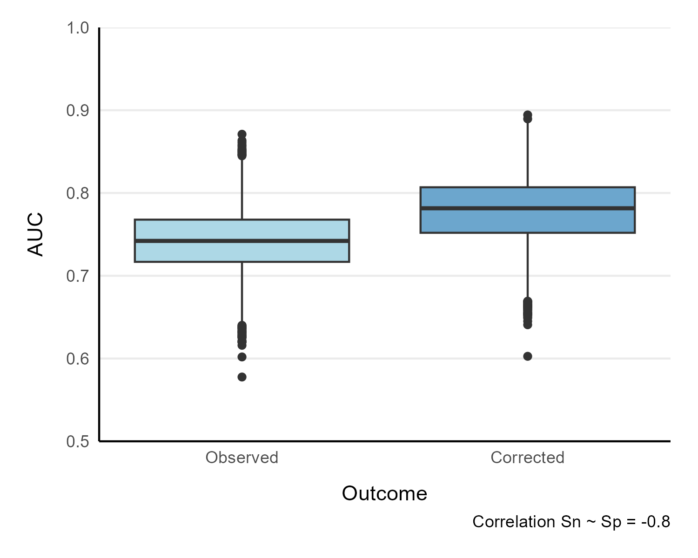
Simulated data to replicate ORIGINAL MODEL DEVELOPMENT DATA
Non-differential misclassification
Sensitivity: 0.41; 0.726
Specificity: 0.891; 0.995
Correlation = -0.8
Area under the curve (AUC)

Slide 13
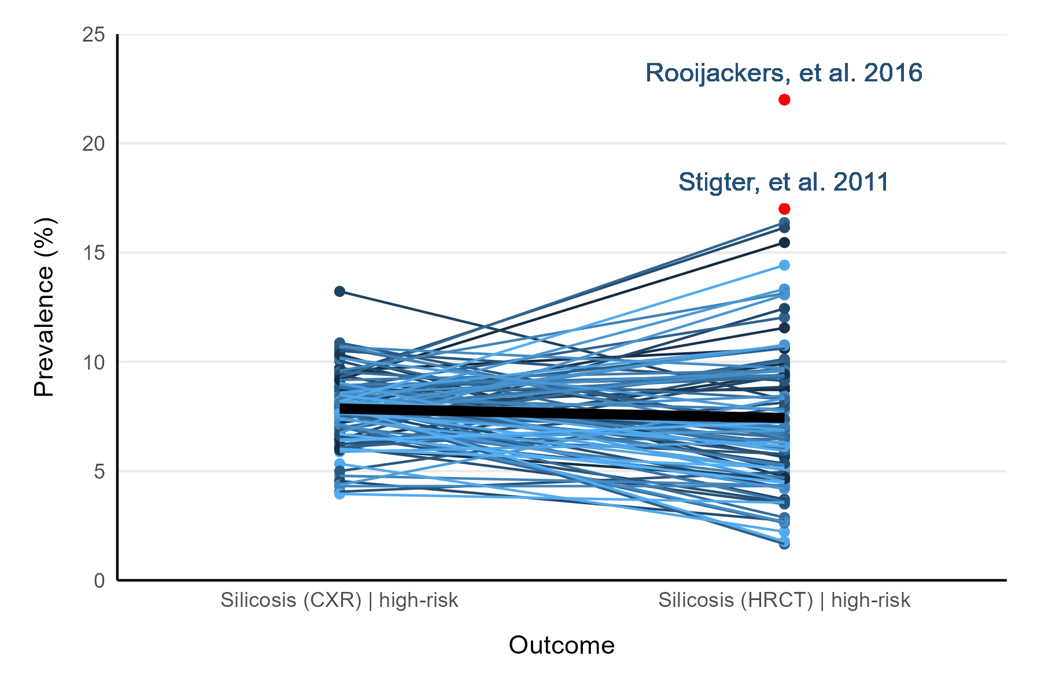
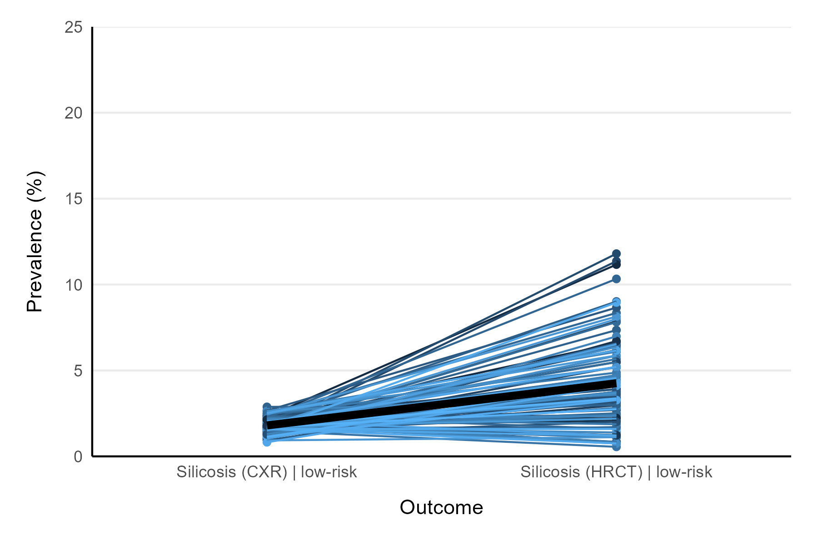
Simulated data to replicate ORIGINAL MODEL DEVELOPMENT DATA
Non-differential misclassification
Sensitivity: 0.41; 0.726
Specificity: 0.891; 0.995
Correlation = -0.8
Random sample n = 100 simulations for visualization

Slide 14
Future work
Assess differential outcome misclassification scenarios
Simulate scenarios for:
Cumulative exposure index: Not sure how reliable, but may be possible
SYN-JEM: Not possible? Are there studies reporting silicosis prevalence with SYN-JEM?
In any case, I could perhaps provide insight into how good it would need to be to outperform diagnostic rule

