Slide 1
Solution slides Introduction to R & Data for Humanities
Afternoon session Text-mining with Tidyverse

Slide 2
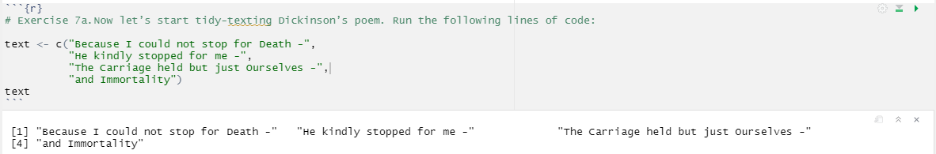
Exercise 7
7a.

Slide 3
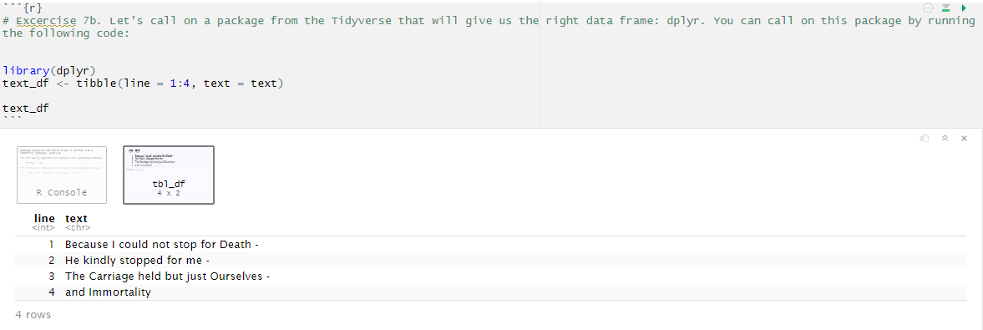
7b.

Slide 4
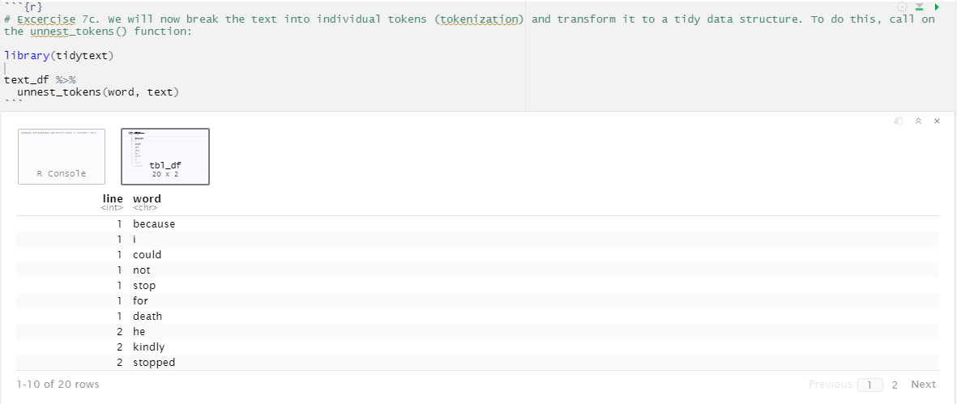
7c.

Slide 5
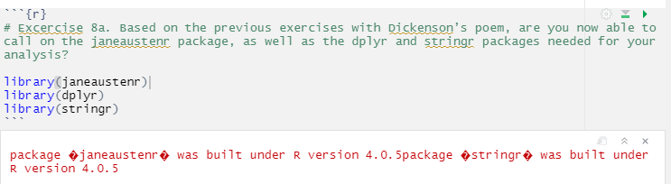
8a.
← Don’t worry about the warnings, the packages should work just fine!

Slide 6
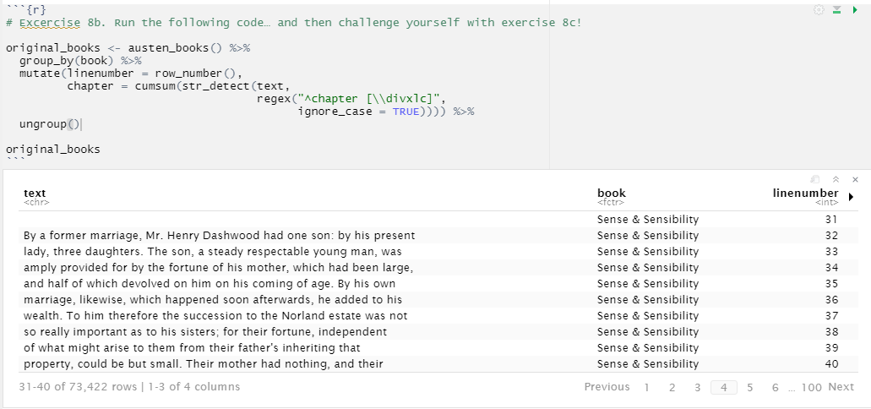
8b.
When you see the output at first, you see a lot of blank lines in the ‘text’ column. This is because the title page is also taken into account. When you browse through the table, you will soon encounter actual lines of text.
If you press the arrow next to the ‘linenumber’ column, you see the number of the chapter the line is in.

Slide 7
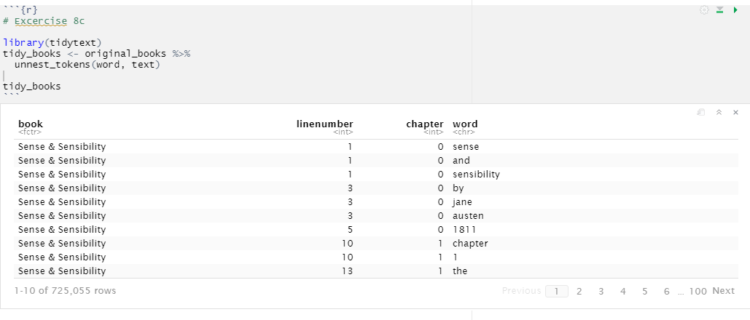
8c.

Slide 8
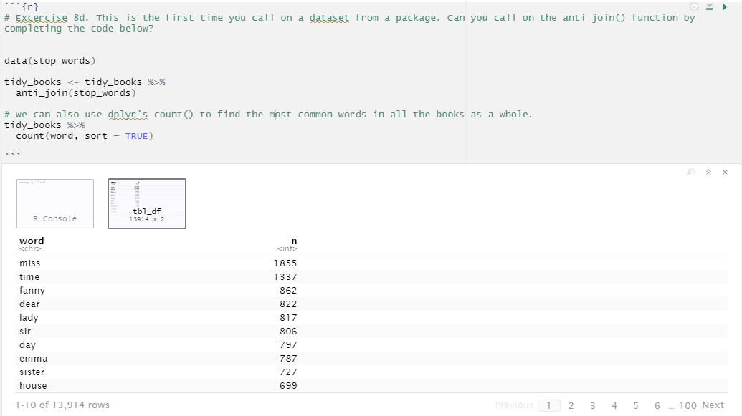
8d.

Slide 9
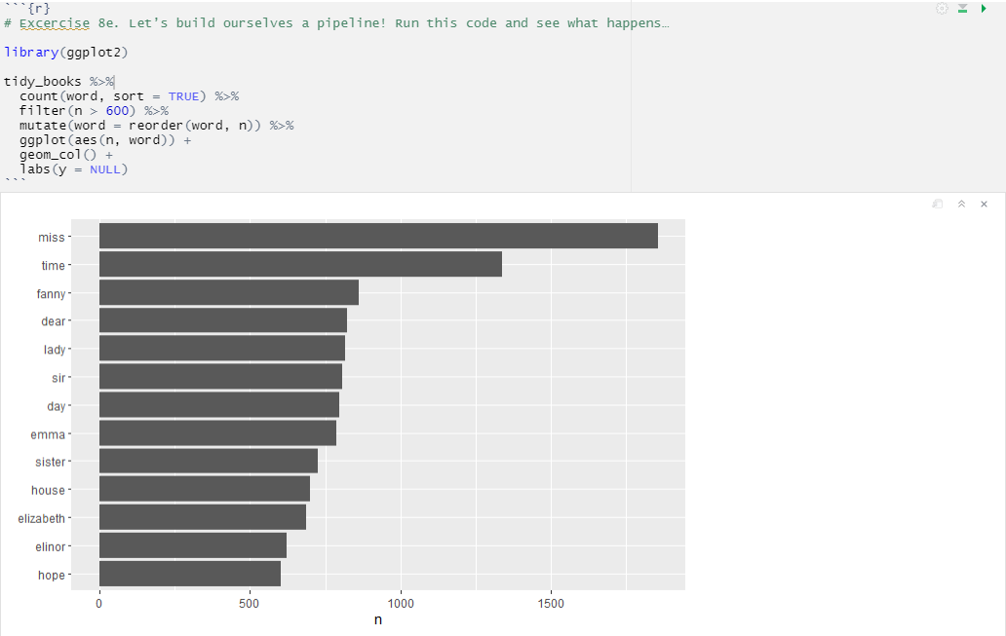
8e.

Slide 10
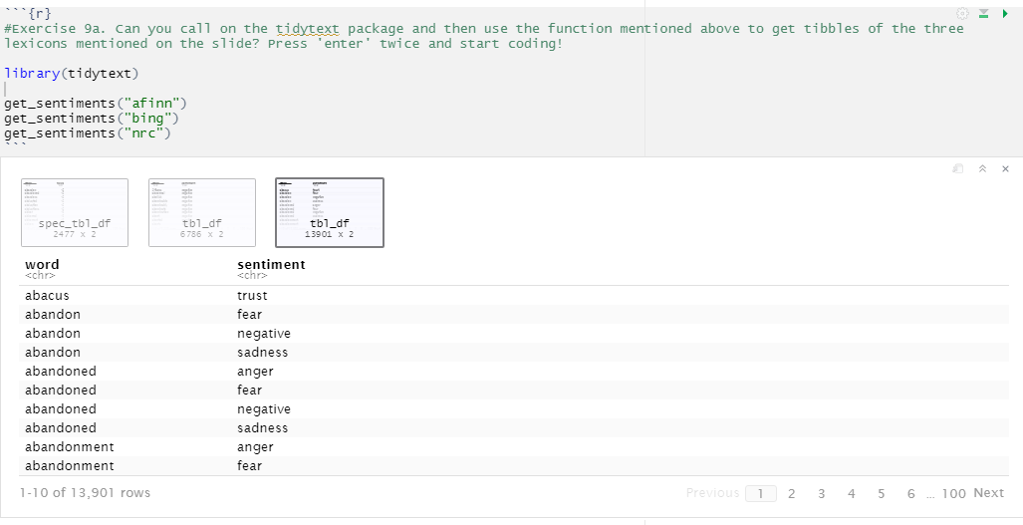
Exercise 9
9a.
See next slide for a characteri-zation of how these lexicons score sentiment

Slide 11
9a. (resumed)
All three of these lexicons are based on unigrams, i.e., single words. These lexicons contain many English words and the words are assigned scores for positive/negative sentiment, and also possibly emotions like joy, anger, sadness, and so forth. The nrc lexicon categorizes words in a binary fashion (“yes”/“no”) into categories of positive, negative, anger, anticipation, disgust, fear, joy, sadness, surprise, and trust. The bing lexicon categorizes words in a binary fashion into positive and negative categories. The AFINN lexicon assigns words with a score that runs between -5 and 5, with negative scores indicating negative sentiment and positive scores indicating positive sentiment.

Slide 12
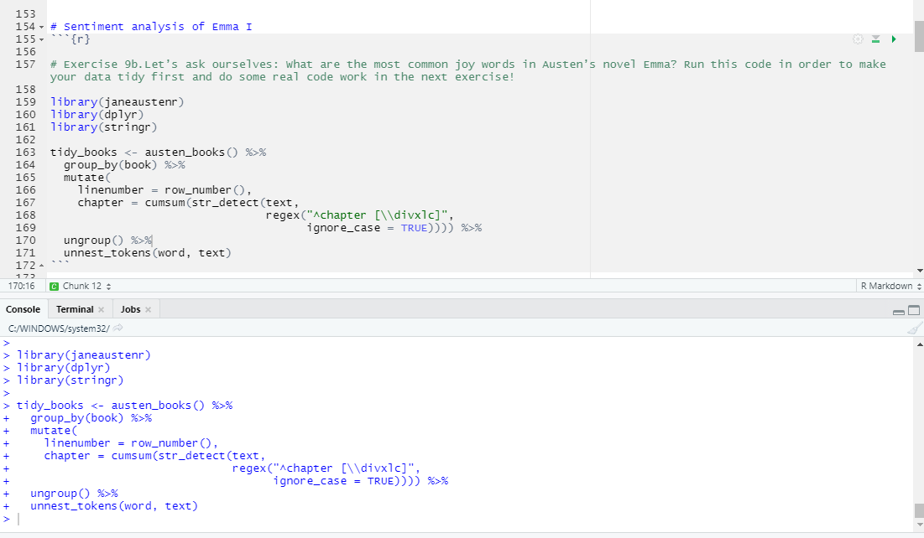
9b.
We only run this code to make sure that our data is tidy; there is no visible output you need to take into account.

Slide 13
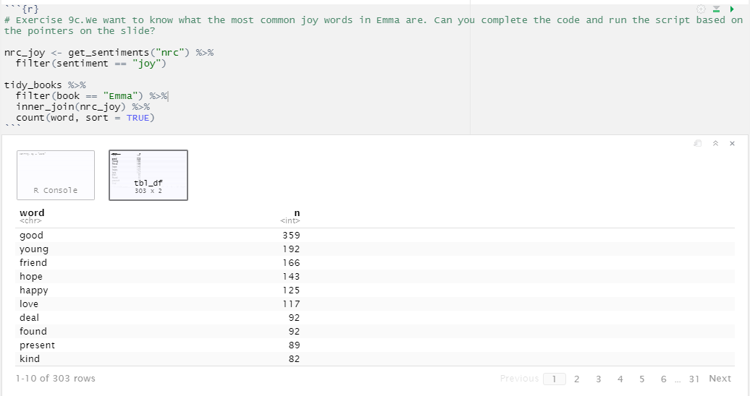
9c.

Slide 14
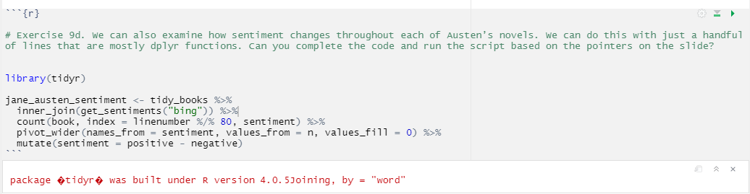
9d.
We run this code as a precursor to visualizing how sentiment changes throughout each of Austen’s novels, so there is no visible output you need to take into account right now.
If you see the warning in red, you can safely ignore it.

Slide 15
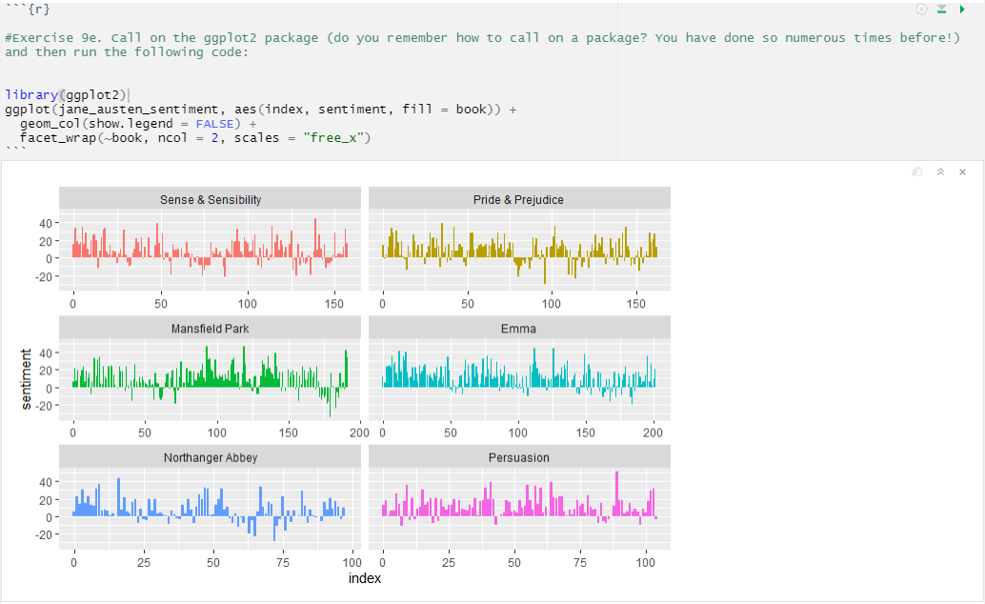
9e.

Slide 16
9e. (resumed)
Based on these graphs, we can begin to explore trends or differences in the novels’ sentiment structures. For example, how the plot of each novel changes toward more positive or negative sentiment over the trajectory of the story. Based on your observations of the visualization you might want to start close reading certain passages of the novels, in order to analyze the specific language used in specific sections. You could also use these graphs as a starting point to look into how Austen’s writing changes over time when it comes to the sentiment character of her novels.

Slide 17
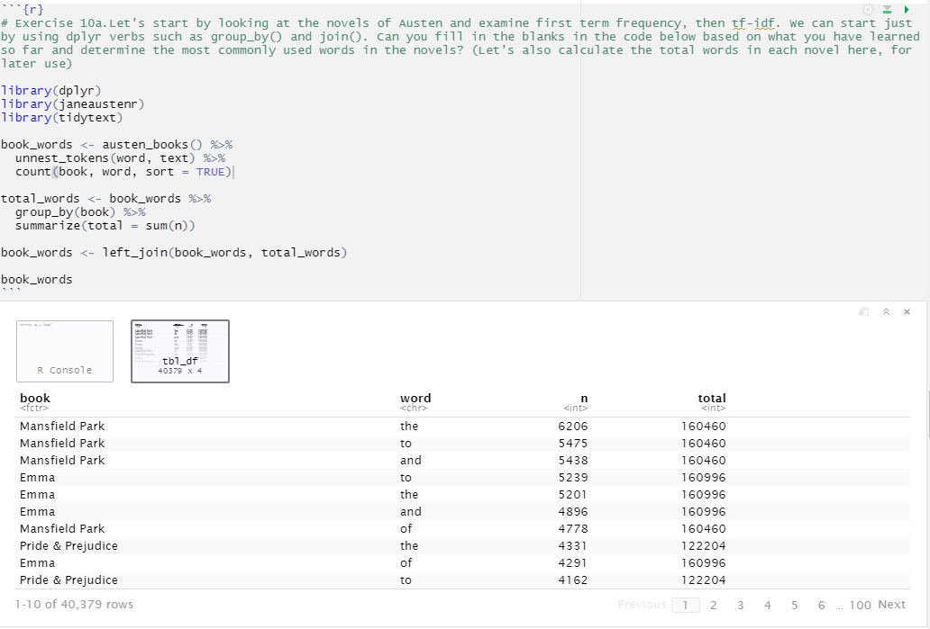
Exercise 10
10a.
Note that the usual suspects are here with the highest n, “the”, “and”, “to”, and so forth.

Slide 18
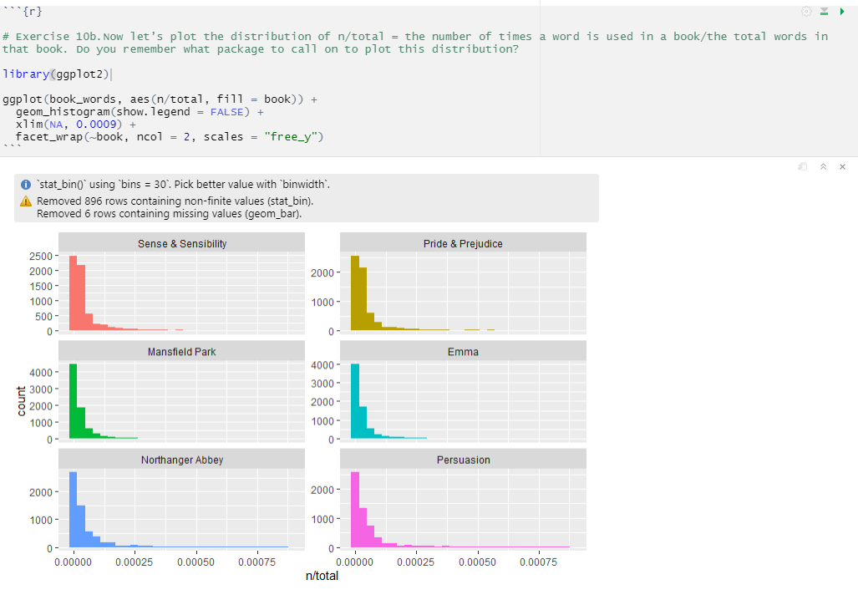
10b.
← These plots exhibit similar distributions for all the novels, with many words that occur rarely and fewer words that occur frequently.

Slide 19
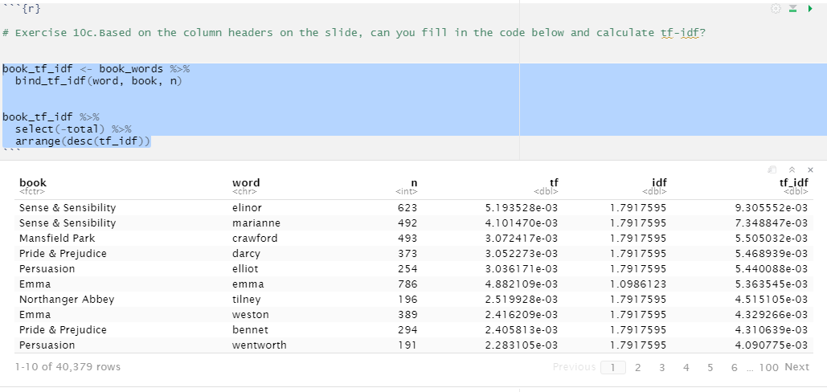
10c.
Here we see all proper nouns, names that are in fact important in these novels. None of them occur in all of the novels, and they are important, characteristic words for each text within the corpus of Jane Austen’s novels.

Slide 20
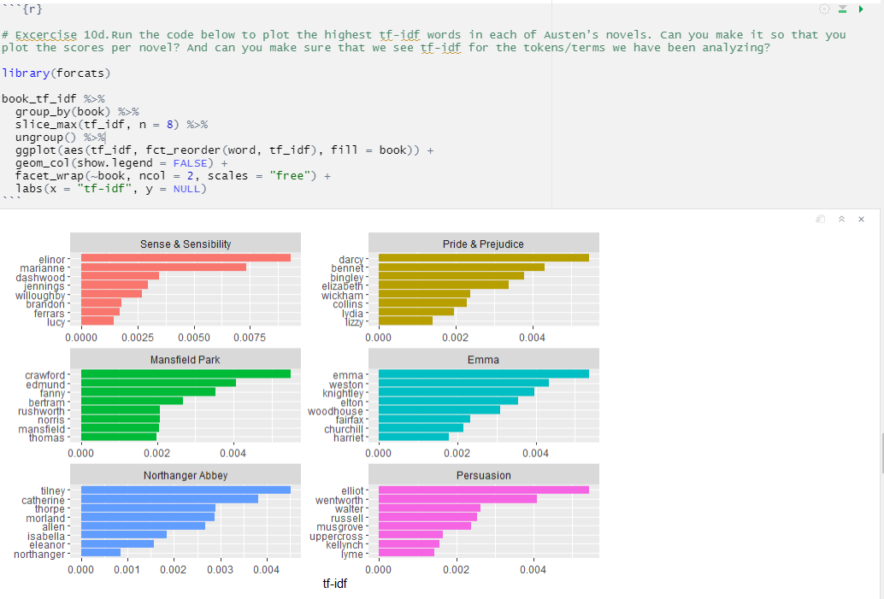
10d.

Slide 21
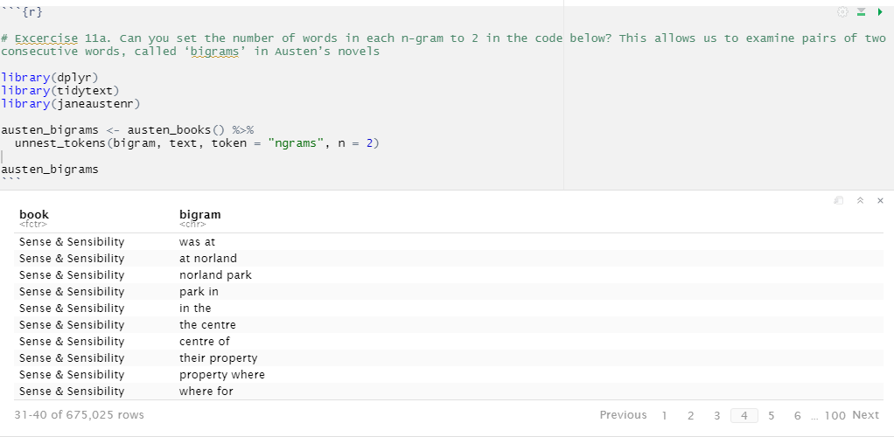
Exercise 11
11a.
Notice that these bigrams overlap: “norland park” is one token, while “park in” is another.

Slide 22
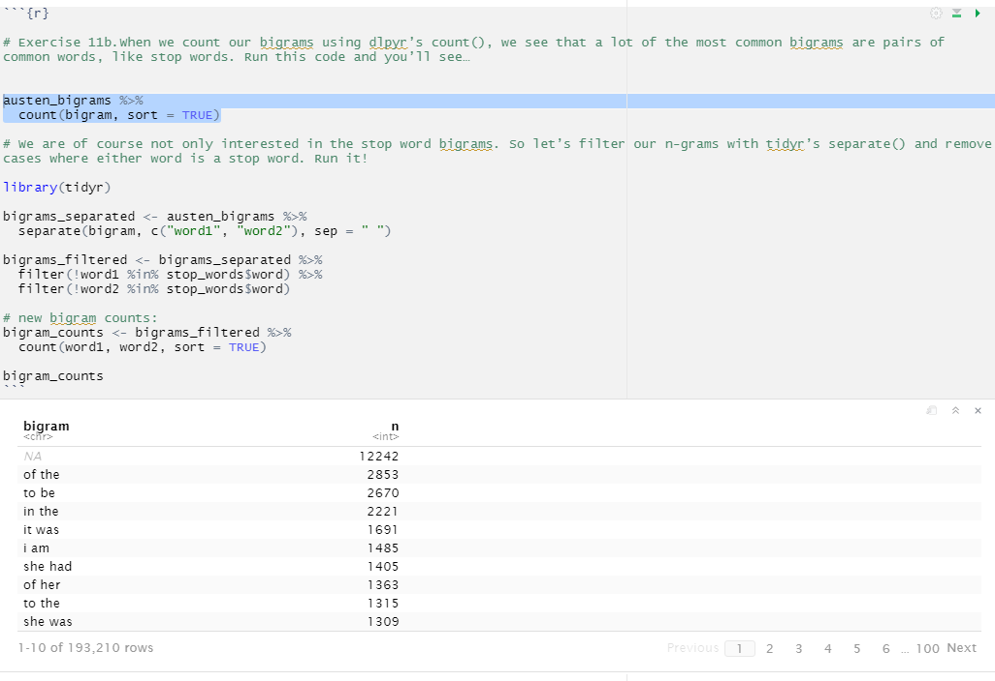
11b.
The output here is based on running the piece of code in blue.

Slide 23
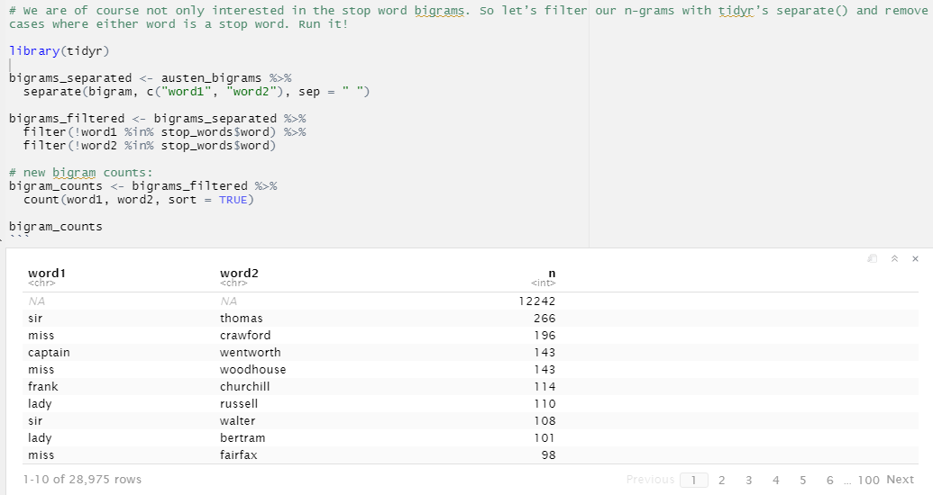
11b. (resumed)
Looks familiar? Again with the proper nouns, that is: names!

Slide 24
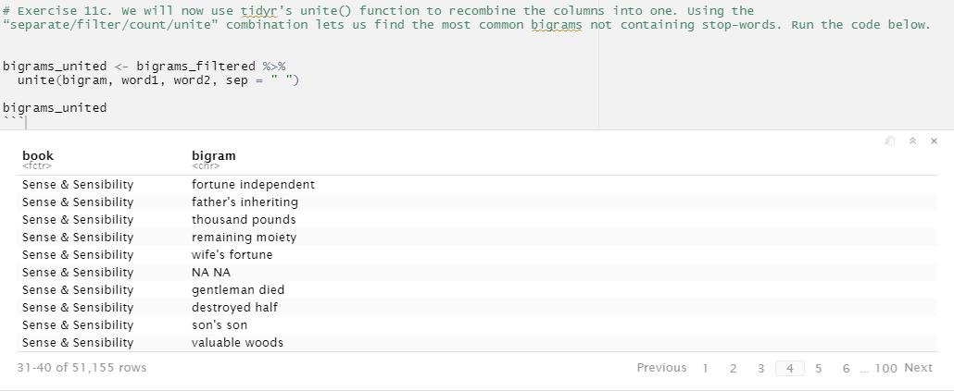
11c.

Slide 25
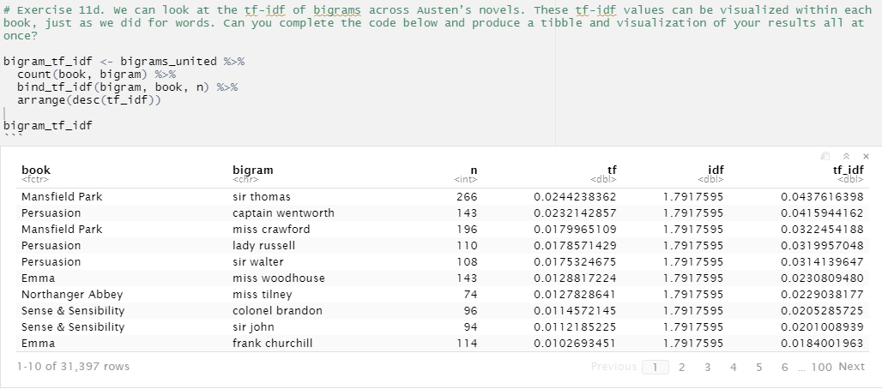
11d.

Slide 26
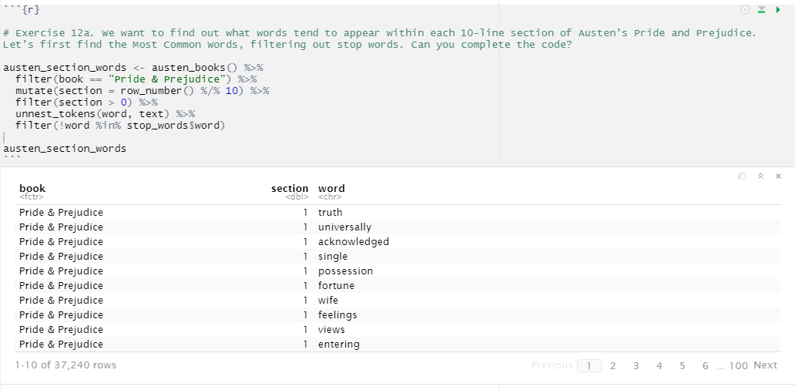
Exercise 12
12a.

Slide 27
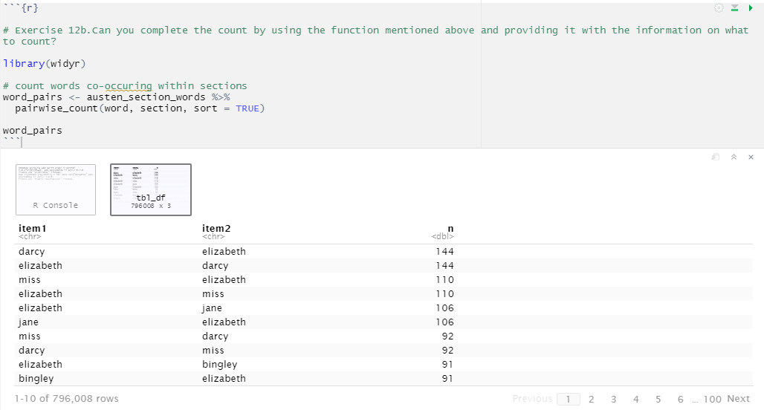
12b.

Slide 28
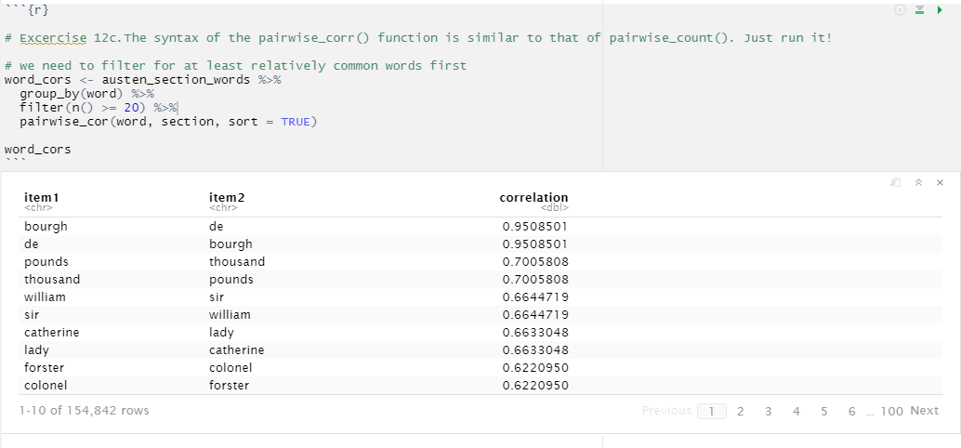
12c.

Slide 29
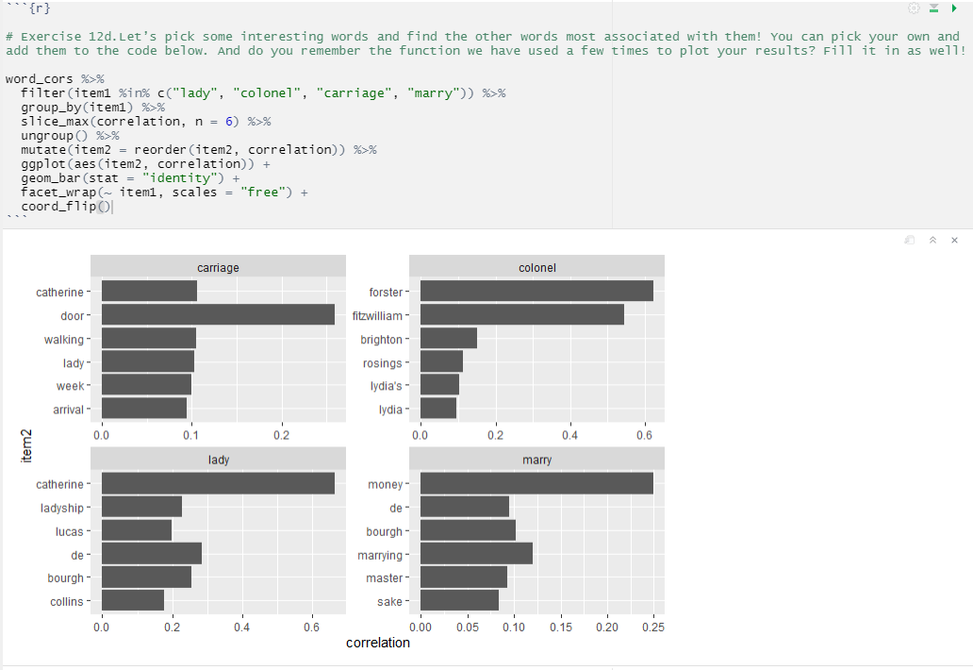
12d.
One of the word correlations that stand out (both in the tibble in exercise 12c and in this visualization, is the one between “marry” and “money”. This could be a semantic relationship to explore in further analyses.

