Slide 1
Solution slides Part 4 Introduction to R & Data for Humanities
Afternoon session Text-mining with Tidyverse

Slide 2
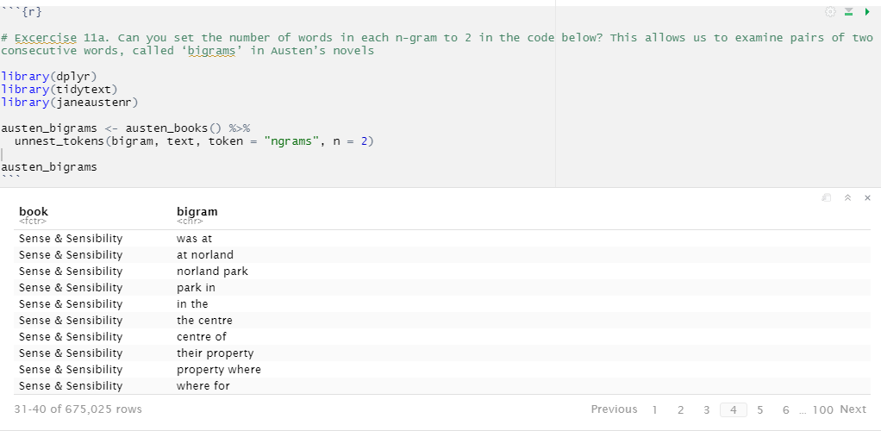
Exercise 11
11a.
Notice that these bigrams overlap: “norland park” is one token, while “park in” is another.

Slide 3
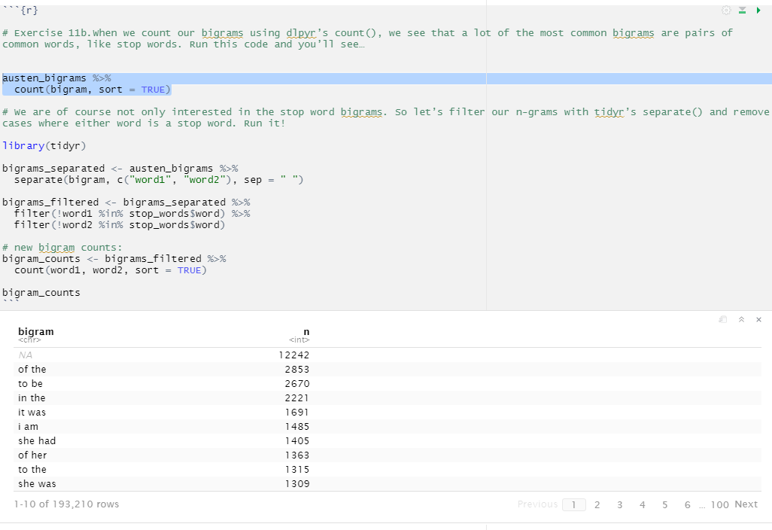
11b.
The output here is based on running the piece of code in blue.

Slide 4
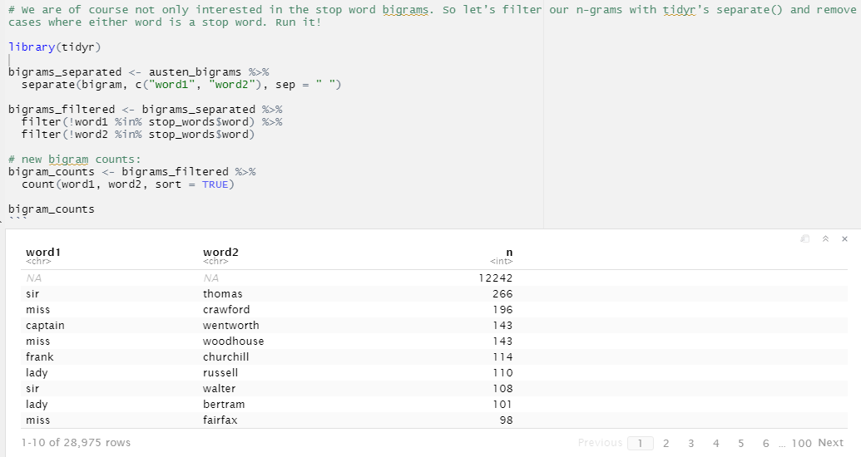
11b. (resumed)
Looks familiar? Again with the proper nouns, that is: names!

Slide 5
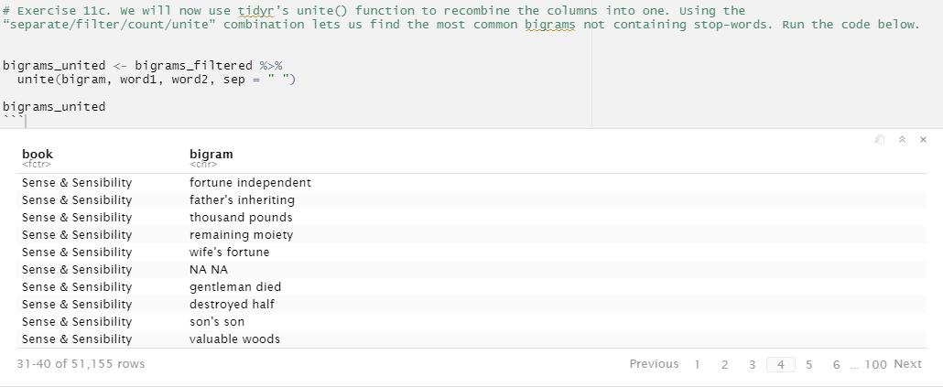
11c.

Slide 6
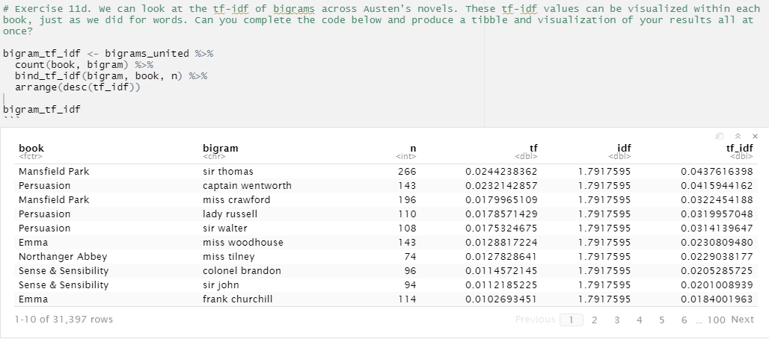
11d.

Slide 7
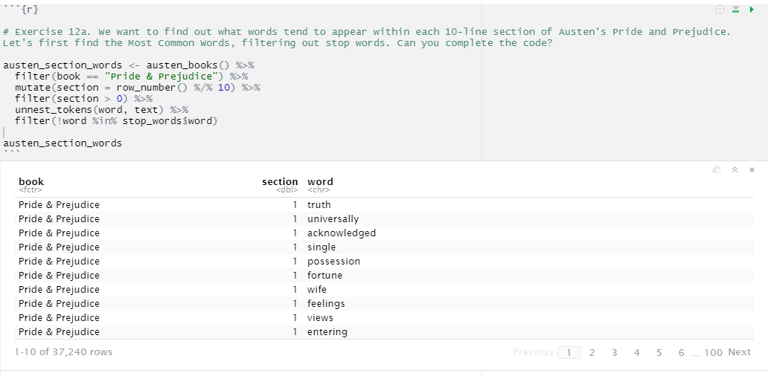
Exercise 12
12a.

Slide 8
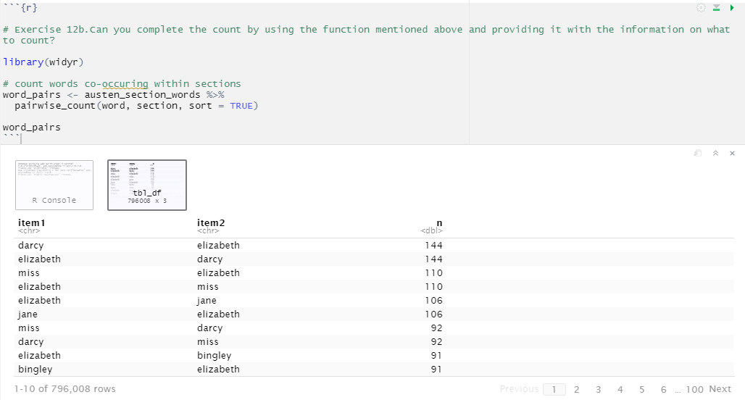
12b.

Slide 9
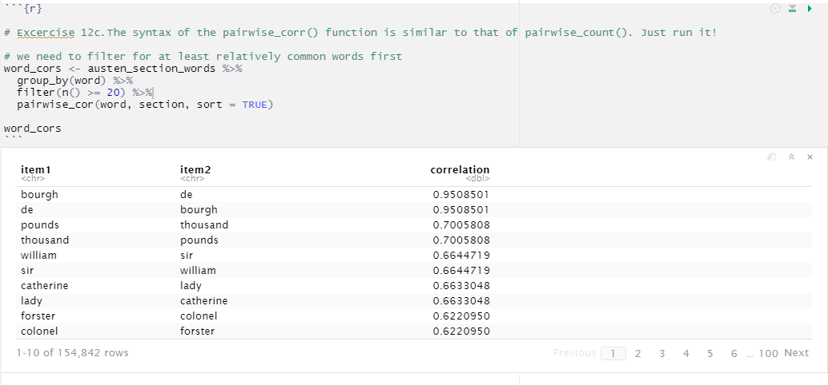
12c.

Slide 10
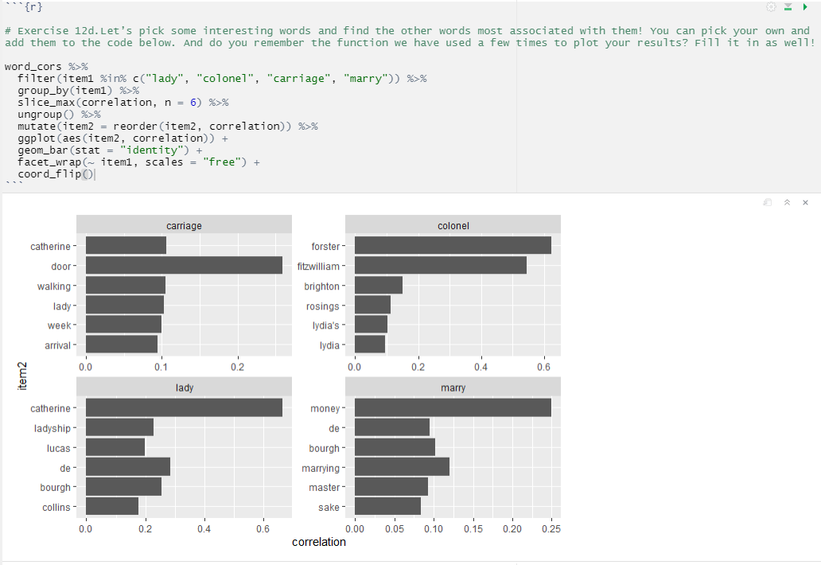
12d.
One of the word correlations that stand out (both in the tibble in exercise 12c and in this visualization, is the one between “marry” and “money”. This could be a semantic relationship to explore in further analyses.

