Slide 1
Solution slides Part 1 Introduction to R & Data for Humanities
Afternoon session Text-mining with Tidyverse

Slide 2
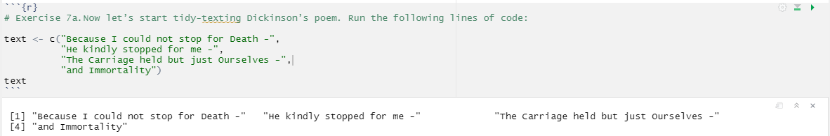
Exercise 7
7a.

Slide 3
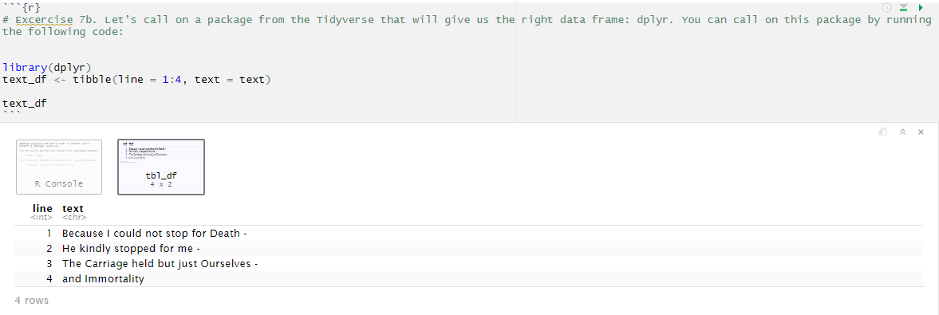
7b.

Slide 4
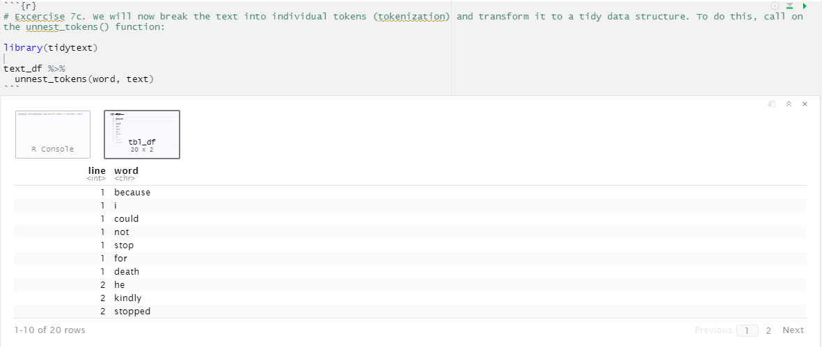
7c.

Slide 5
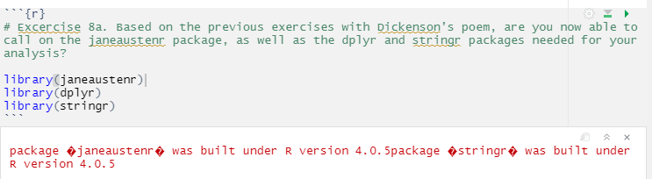
8a.
← Don’t worry about the warnings, the packages should work just fine!

Slide 6
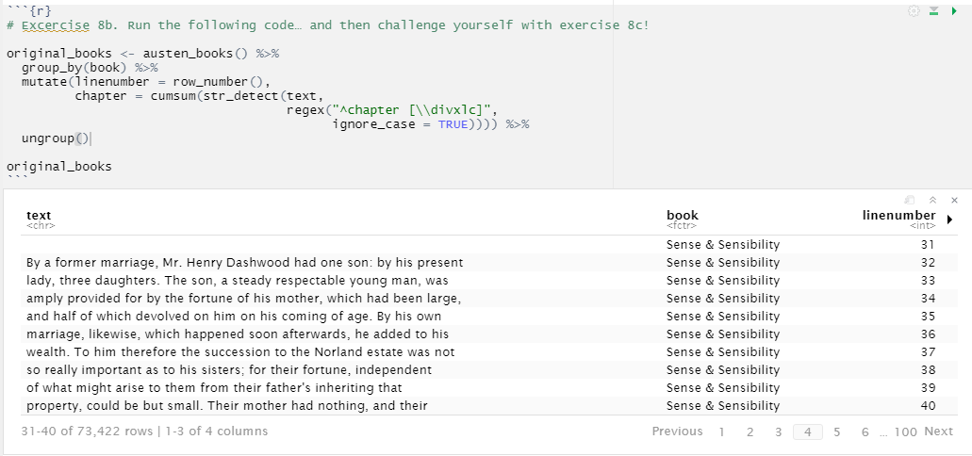
8b.
When you see the output at first, you see a lot of blank lines in the ‘text’ column. This is because the title page is also taken into account. When you browse through the table, you will soon encounter actual lines of text.
If you press the arrow next to the ‘linenumber’ column, you see the number of the chapter the line is in.

Slide 7
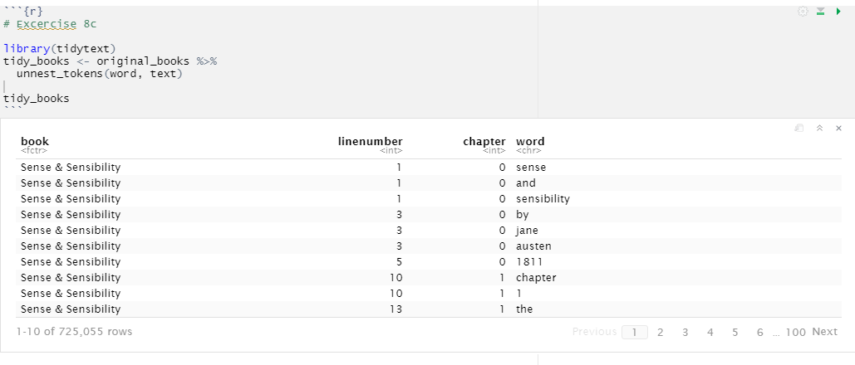
8c.

Slide 8
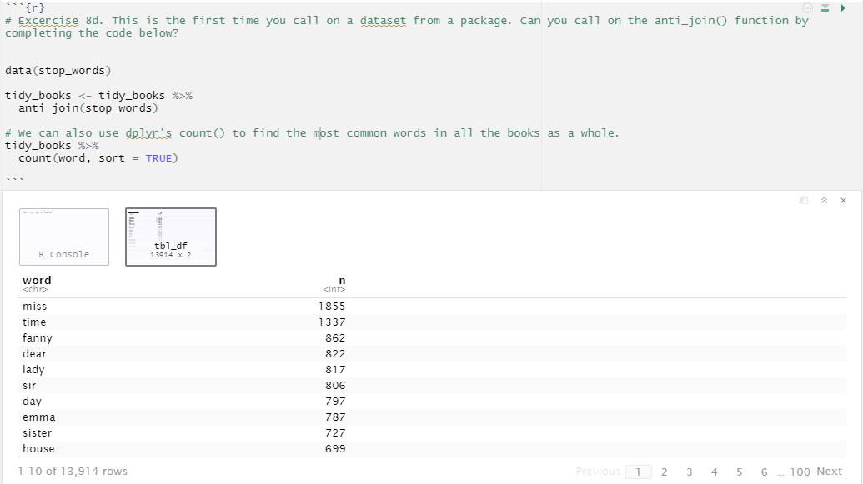
8d.

Slide 9
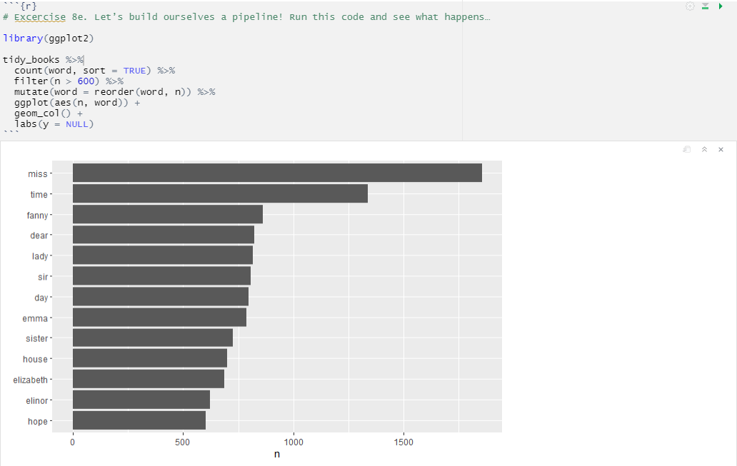
8e.

