Slide 1
Solution slides Part 2 Introduction to R & Data for Humanities
Afternoon session Text-mining with Tidyverse

Slide 2
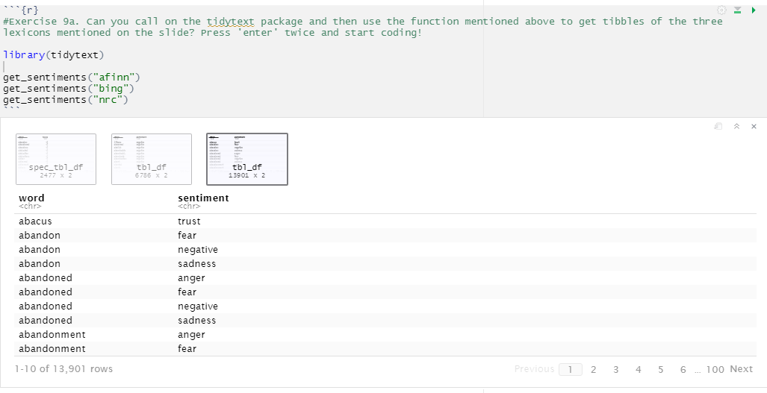
Exercise 9
9a.
See next slide for a characteri-zation of how these lexicons score sentiment

Slide 3
9a. (resumed)
All three of these lexicons are based on unigrams, i.e., single words. These lexicons contain many English words and the words are assigned scores for positive/negative sentiment, and also possibly emotions like joy, anger, sadness, and so forth. The nrc lexicon categorizes words in a binary fashion (“yes”/“no”) into categories of positive, negative, anger, anticipation, disgust, fear, joy, sadness, surprise, and trust. The bing lexicon categorizes words in a binary fashion into positive and negative categories. The AFINN lexicon assigns words with a score that runs between -5 and 5, with negative scores indicating negative sentiment and positive scores indicating positive sentiment.

Slide 4
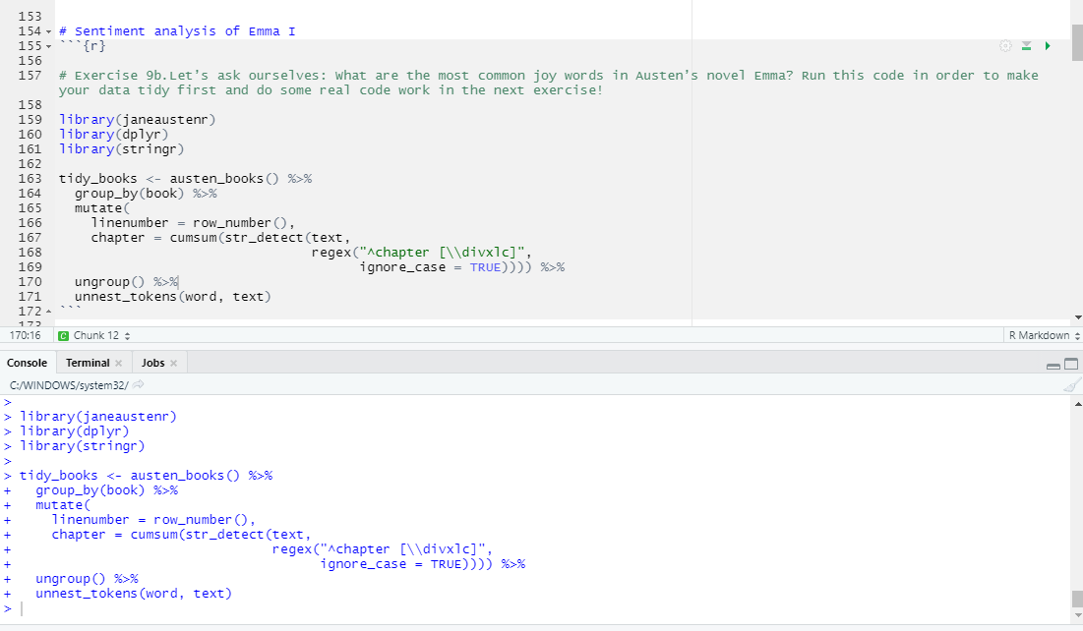
9b.
We only run this code to make sure that our data is tidy; there is no visible output you need to take into account.

Slide 5
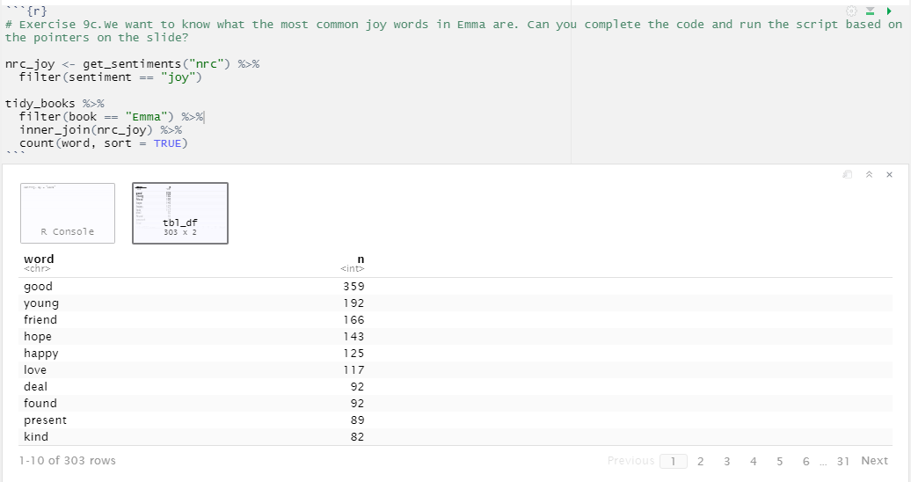
9c.

Slide 6
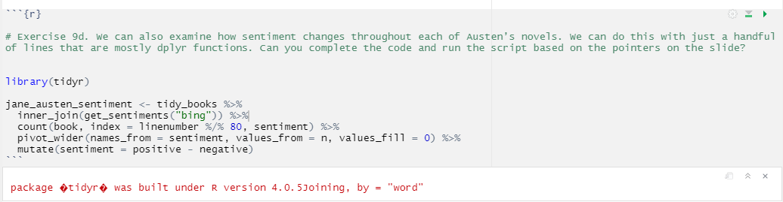
9d.
We run this code as a precursor to visualizing how sentiment changes throughout each of Austen’s novels, so there is no visible output you need to take into account right now.
If you see the warning in red, you can safely ignore it.

Slide 7
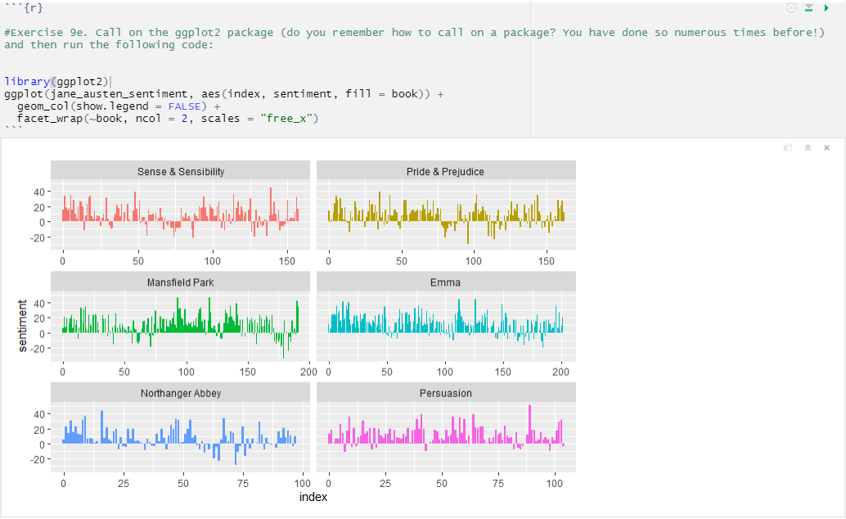
9e.

Slide 8
9e. (resumed)
Based on these graphs, we can begin to explore trends or differences in the novels’ sentiment structures. For example, how the plot of each novel changes toward more positive or negative sentiment over the trajectory of the story. Based on your observations of the visualization you might want to start close reading certain passages of the novels, in order to analyze the specific language used in specific sections. You could also use these graphs as a starting point to look into how Austen’s writing changes over time when it comes to the sentiment character of her novels.

