Slide 1
Solution slides Part 3 Introduction to R & Data for Humanities
Afternoon session Text-mining with Tidyverse

Slide 2
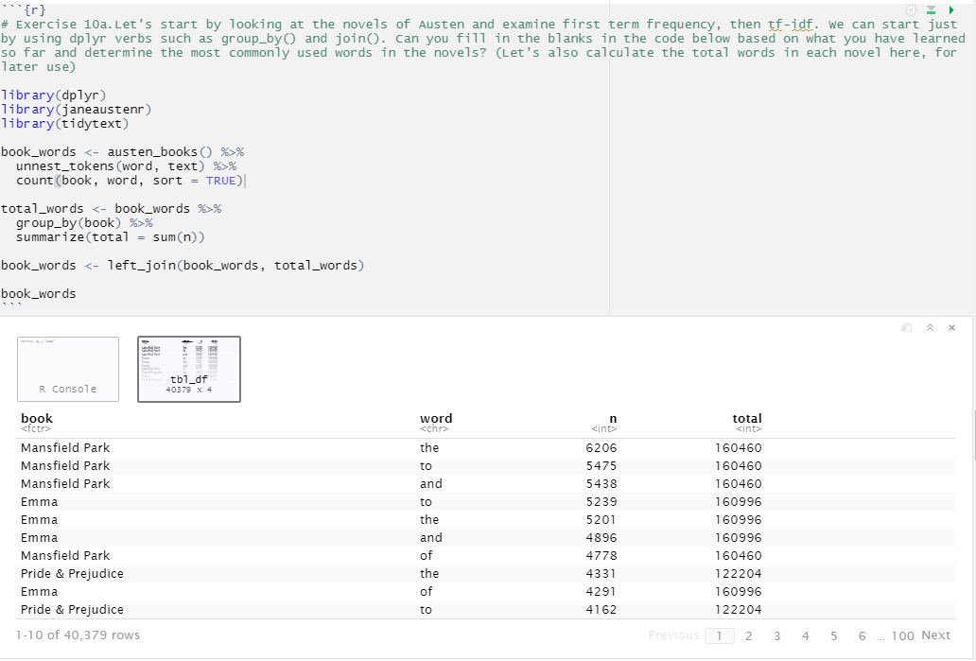
Exercise 10
10a.
Note that the usual suspects are here with the highest n, “the”, “and”, “to”, and so forth.

Slide 3
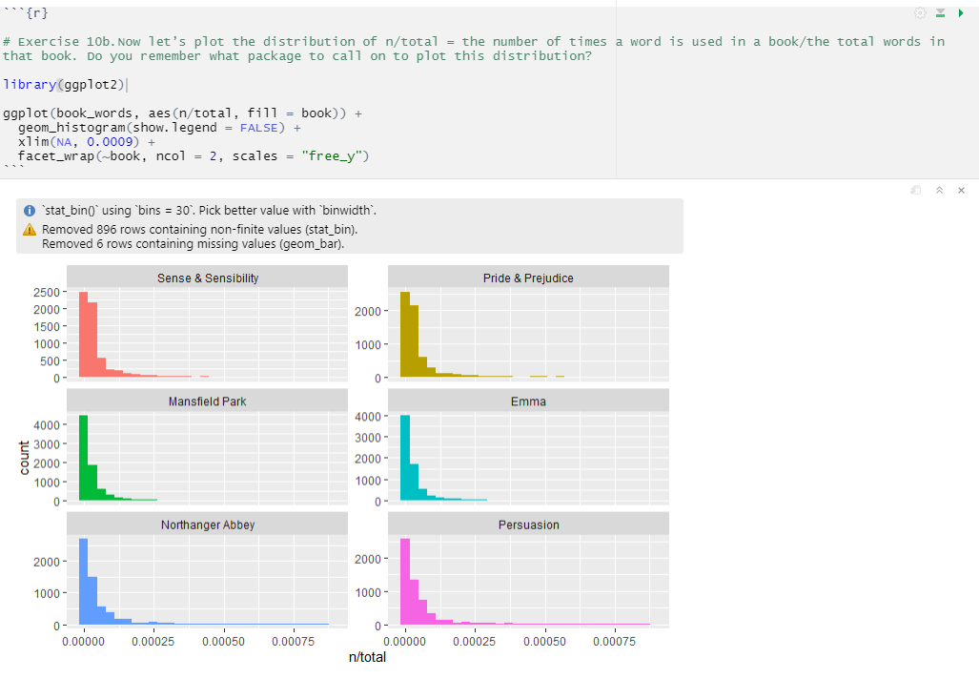
10b.
← These plots exhibit similar distributions for all the novels, with many words that occur rarely and fewer words that occur frequently.

Slide 4
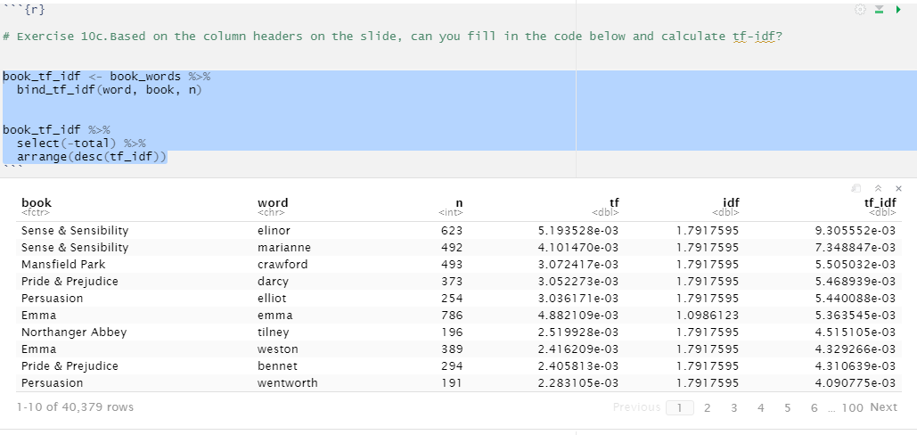
10c.
Here we see all proper nouns, names that are in fact important in these novels. None of them occur in all of the novels, and they are important, characteristic words for each text within the corpus of Jane Austen’s novels.

Slide 5
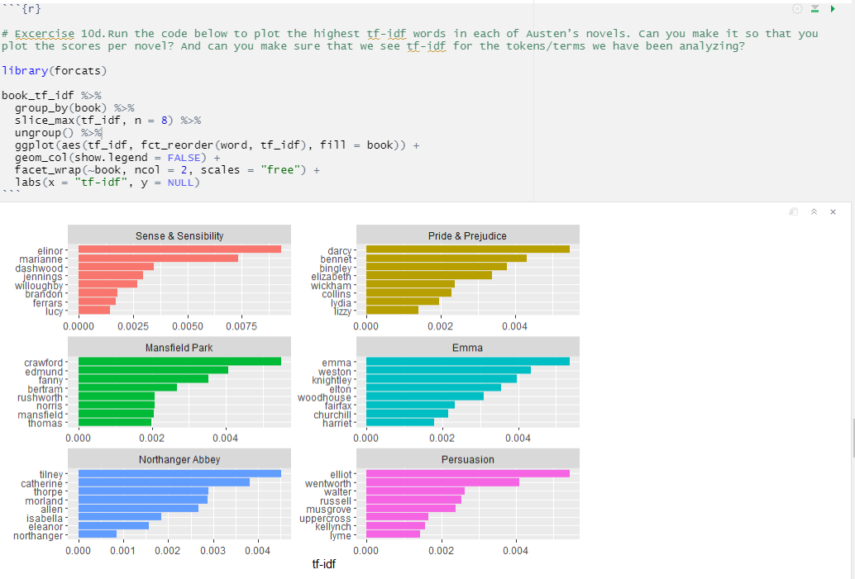
10d.

