Slide 1
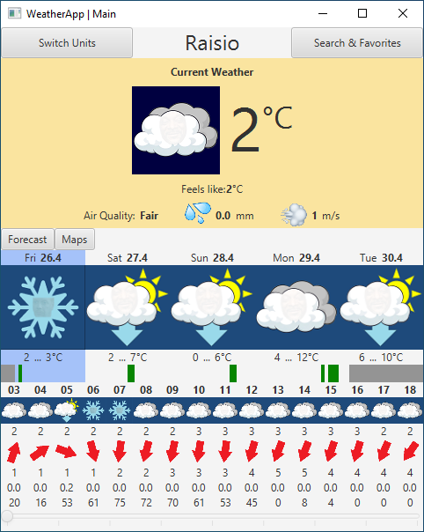
Active location
Current weather (cloudy, night-time)
Current temperature
Current rain intensity
Current air quality
Current wind speed
Weekday and date
Average weather
Daily forecast (5 days)
Minimum and maximum temperature
Rain intensity graph
Hour
Weather
Hourly forecast (16 hours window)
Temperature
Wind speed,
direction
Hourly forecast slider
Rain intensity,
probability of precipitation

Slide 2
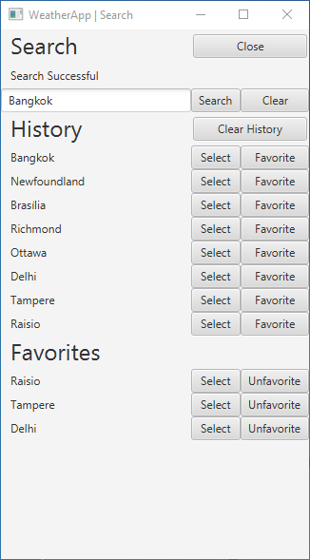
Close window
Search status
Start Search
Search section
Clear input box
Input box
Clear search history
History section
Location identifier
Add to Favorites
Set as Active Location
Remove from Favorites
Favorites section

Slide 3
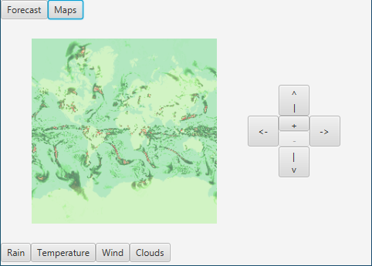
Panel selection
Movement, zoom controls
Move left
Move up
Zoom in
Move right
Zoom out
Move down
Map
Mode controls

