Slide 1




Slide 3
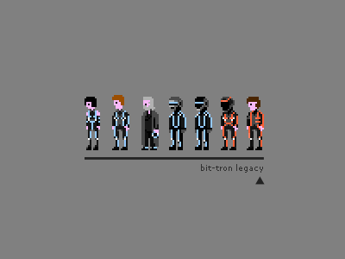

Slide 6
A Maze Game
a simple maze solving game
press any key to begin

Slide 7
GAME OVER!
You are out of lives
press any key to return to the menu

