Slide 1
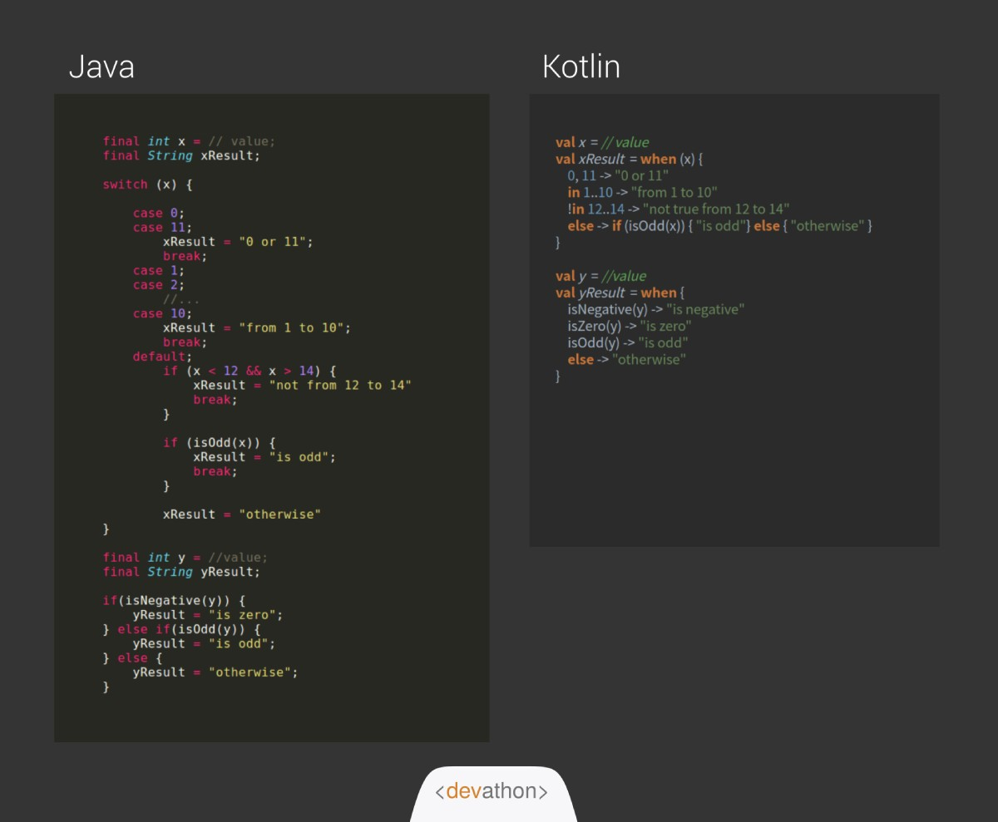
Kotlin:
Developed by Jetbrains.
Concise.
Run in JVM.
Official Language for
Android Development.

Slide 2
Create new Project
Create Hello World Program.

Slide 3
Variable:
Variable is a Container to store value.
Example: to store salt we use container. And if someone ask for salt then I will give container and use salt inside the container not container.
Syntax:
var/val variable_name = value
Example:
val num = 10
num
10

Slide 4
Why we use variable?
In order to use that variable in the other place of code until its life cycle (code reusability too). Life cycle of any variable is until between {}.
Also we can store the change made in the variable.
var class = 10;
printf(class) // output = 10
// completes 1 year
class = 10 + 1; // update class by 1
printf(class) // output = 11

Slide 5
var vs val:
var is a variable which we can update.
val is a variable which we can’t update.

Slide 6
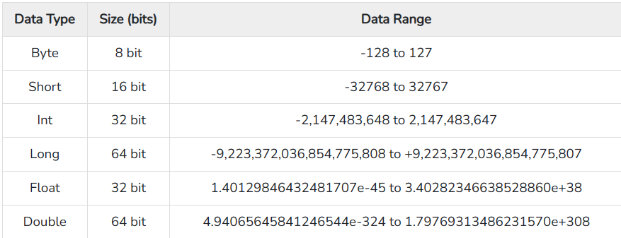
Data Type:
Data Type
Numeric
String
Boolean

Slide 7
Comment:
Single line comment: //
Multi line comment: /*… */

Slide 8
Function in Kotlin
Function is a block of code which is used to perform a particular task. Eg. addNumber, jumpCharacter, etc.
Syntax:
fun
function_name
(parameters)
: return_type {
// body…
}
Named Parameters in kotlin:

Slide 9
Lambdas Expression in kotlin
Lambda is a special type of function which doesn’t have function name.
It allow us to pass function, return function to and from the another function.

Slide 10
Class and Objects:
Class is a blueprint where as objects is an entity.
Class consists of properties and method.
Syntax to define class:
class class_name {
// Properties and methods
}
Syntax to create object:
var obj_name = class_name(constructor)

Slide 11
Constructor:
Special type of method which is used to define properties of the class while creating an object
Syntax:
constructor(parameters) {
//assigning properties through parameters
}

Slide 12
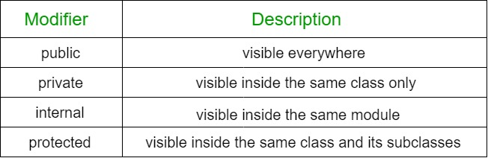
Access Modifier:
Where the variable/method/class are accessed
Inheritance:
Accessing parent properties and method from the another class(especially child of that parent class). open keyword is used.

Slide 13
Creating Android App Project

Slide 14
Constructor:
Special type of method which is used to define properties of the class while creating an object
Syntax:
constructor(parameters) {
//assigning properties through parameters
}

Slide 15
Constructor:
Special type of method which is used to define properties of the class while creating an object
Syntax:
constructor(parameters) {
//assigning properties through parameters
}

Slide 16
Constructor:
Special type of method which is used to define properties of the class while creating an object
Syntax:
constructor(parameters) {
//assigning properties through parameters
}

Slide 17
Constructor:
Special type of method which is used to define properties of the class while creating an object
Syntax:
constructor(parameters) {
//assigning properties through parameters
}

Slide 18
Add a Slide Title - 3

Slide 24
Add a Slide Title - 4

Slide 25
Add a Slide Title - 5

