Slide 1
Hello there !
Presentation 1: Introduction to modern web technologies.
Author/speaker: Utsab kafle
Github: utsabkafle
Mail: utshubkaphle@gmail.com

Slide 2
Every website we interact with was written/coded by some programmer.

Slide 3
In case of websites, they are written using specific scripting languages like HTML.

Slide 4
Initially, that was all about websites. The sites used to be static (i.e. the page used to be the same throughout the time you were in the site.)

Slide 5
But now, we are able to create more dynamic pages, thanks to these awsome backend programming languages and web servers.

Slide 6
Now, the pages are often changing, take your facebook feed for instance. Let’s stick with the idea of the facebook feed and explore few more things.

Slide 7
Now, when you go to your browser and type `www.facebook.com` and hit enter, the browser sends an request to the web-server of facebook.

Slide 8
The web-server acknowledges the request and sends back the assets as requested by the browser.

Slide 9
The asset, in this sense; is the HTML code predefined by the facebook developers.
Confused? Don’t worry, you will get this !

Slide 10
And when the browser receives the asset sent by the browser, the browser then *kind-of compiles it and present it to you!

Slide 11
Observe this whole process in the next figure.

Slide 12
Facebook
server
Browser
Request: www.facebook.com

Slide 13
Hmm, this sucker needs that asset
Browser
Facebook
server
Request: www.facebook.com

Slide 14
Damn it!
Take this !!
Browser
Facebook
server
Request: www.facebook.com

Slide 15
Facebook
server
Response: <html><head>……</html>
Browser

Slide 16
Response: <html><head>……</html>
Full response:
<html>
<head>
<title>facebook</title>
</head>
<body>
<navbar……/>
<content-bar……/>
</body>
</html>
Plus, the response includes other things as well (those things are out of context in our case.)

Slide 17
Okay, I received this shit. Let’s compile it and show it to the user.
<html>
<head>
<title>facebook</title>
</head>
<body>
<navbar……/>
<content-bar……/>
</body>
</html>
Browser

Slide 18
Now the browser compiles and displays the data/content.

Slide 19
But, if both You and I requested for `www.facebook.com`, both of us get different results.

Slide 20
Hmm…

Slide 21
Here, the backend of the website comes into play.

Slide 22
The whole logic, including the response of that specific code for `www.facebook.com` is defined in backend using that programming language.

Slide 23
We can write specific conditions and define specific response for each variation of request.

Slide 24
For example, google owns both maps and youtube. If both maps and youtube were to be run using a single server, then the condition would look like
If request == “maps”:
return “<html for maps>”
If request == “Youtube”:
return “<html for youtube>”

Slide 25
So, in case of request for facebook.com;
The browser specified your id as different from my id…. A similar condition was raised:
If id==“utshub.kaphle”:
return “<html for Utsab>”
If id==“mr.beast”:
return “<html for mr.beast>”

Slide 26
Enough… server and client(browser)

Slide 27
At last of this section, web-server receives the request sent by the browser, acknowledges them, runs the backend code and returns the produced result.

Slide 28
Plus, there is more things within these topics… which are impossible to discuss all at once

Slide 29
Now, let’s see some basic structure of HTML.

Slide 30
HTML, standing for Hyper Text Markup Language; is an scripting language(*not programming) used to write/script the frontend of the webpages.

Slide 31
HTML is composed of tags, which are special type of text; inclosed within less-than and greater-than sign (“<” & “>”)

Slide 32
HTML defines the webpage in different sections, and each section has different tags.

Slide 33
Let’s explore some sections and few tags within them.

Slide 34
Some pre-defined sections:
Head
Body

Slide 35
Head
This section contains tags, related to SEO, title, crawlers, linking external files, styles.

Slide 36
Head
This part of the website is described in the head section.

Slide 37
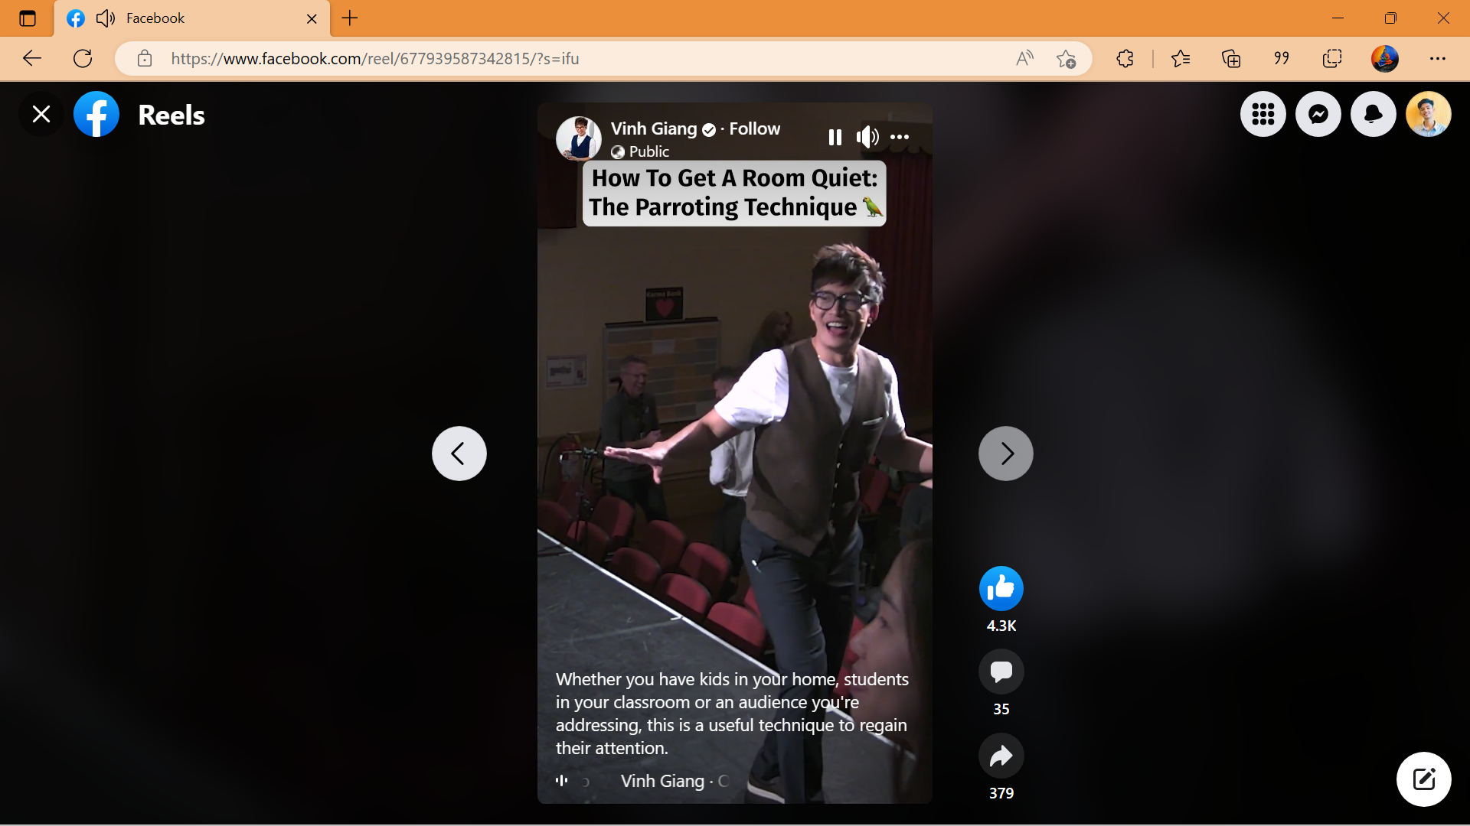

Head

Slide 38
Some pre-defined sections:
Head
Body

Slide 39
Body
This part of the website is described in the body section.

Slide 40
Now, let’s see the basic structure of a HTML script.

Slide 41
1. First, we start off by starting and closing a *universal tag.
<html>
</html>
The upper one is called opening tag, while the second one is called closing tag. Think of it like braces, <html> is “(” and </html> is “)”. Now, we can put other tags inside them.

Slide 42
Now, we can define those sections we discussed before;
<html>
<head>
</head>
<body>
</body>
</html>
Head section
Body section

Slide 43
As we saw earlier, we can define the title and other stuffs inside the head section.
<html>
<head>
<title> sample title </title>
</head>
<body>
</body>
</html>

Slide 44
Let’s observe this specific line of code.
<title> sample title </title>
Opening tag
Closing tag
Content to be displayed as title.

Slide 45
Still alive

