Slide 1


MINeD Hackathon 2023
Company Name : JK Lakshmi Cement Ltd. & Udaipur Cement Works Ltd.
TRACK NAME: MANUFACTURING
TEAM NAME:- The Matrix
UNIVERSITY NAME- Nirma University
Group Members:-
UTSAV HARIDWARI (Team Leader)(20BCE302)
RIKIN SOLANKI (20BCE284)
MAYUR VADHADIYA(20BCE303)

Slide 2
Problem statEment
Human Face Recognition by using Computer Vison (Deep Learning)
Overview :-
In this project, team task is to identify the human face real time from a CCTV (For this project
we will provide you Video Clip) camera with the help of computer Vision. If CCTV camera
frame (image from the Video) contains multiple faces, then developed model must have
capability to recognize all the faces in frame.
After recognition of faces developed, Software will return the face identity (For Example
Employee Code) and Date and time of recognition in a csv file (You can also insert the record
into MySQL database).

Slide 3
Introduction
Face recognition has been one of the most popular and rapidly growing technologies in the field of computer vision.
Face recognition has gained immense popularity in recent years due to its numerous applications in various industries such as security, entertainment, marketing, and healthcare.
Facial recognition technology involves capturing, analyzing, and comparing patterns and features of a person's face. It uses biometric measurements to identify individuals, either for authentication or for surveillance purposes.

Slide 4
Proposed approach
We used deep learning approach, where we perform face detection using MTCNN, feature extraction using FaceNet and classification using cosine similarity.
MTCNN or Multi-Task Cascaded Convolutional Neural Networks is a neural network which detects faces and facial landmarks on images. It was published in 2016 by Zhang et al.
FaceNet is a deep neural network used for extracting features from an image of a person’s face. It was published in 2015 by Google researchers Schroff et al.
We use cosine similarity to identify person name(id) of detected face by using embedded vector from video and pre-calculated embedded vector of person

Slide 5
Why should you choose the solution?
MTCNN is one of the most popular and most accurate face detection tools today. It consists of 3 neural networks connected in a cascade.
Using FaceNet, We can get embedded vector of given images of employees. Which then can used directly of consine similarity check in video frame.
We don’t have train separate models for this by using pre-trained models such as MTCNN and FaceNet.

Slide 6
Limitations
In video, face detection is being performed for all the frame.
Then for every face detected in frame we calculate embedding vector and then find its cosine similarity with every person(employee).
It becomes very lengthy process so speed is very low.
We can it fast by skipping some frame, but that may affect the accuracy.

Slide 7
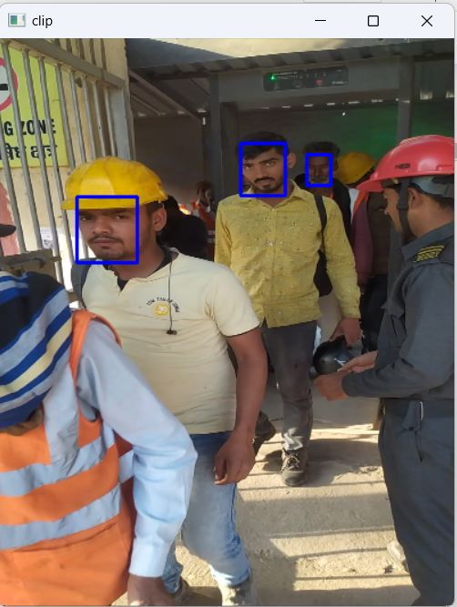
Screenshot of faces detected

Slide 8
References
https://github.com/arsfutura/face-recognition
https://www.kaggle.com/code/yhuan95/face-recognition-with-facenet/input?select=facenet_keras.h5
https://www.sitepoint.com/keras-face-detection-recognition/#:~:text=In%20the%20first%20step%20of,belong%20to%20the%20same%20person

Slide 9
Thank you

