Slide 1
BLUESTOCK FINTECH · DATA ANALYST CAPSTONE
Mutual Fund Analytics Platform
End-to-End Data Engineering, ETL Pipeline, Risk Analytics
and Interactive Business Intelligence Dashboard
Utsav Ratpiya
B.Tech CSE (AI & ML), Adani University
Data Analyst Intern | Offer ID: BFDA60407
Internship: 20 Jun – 20 Aug 2026 (Remote) | Report Date: 10 Jul 2026
github.com/Utsav-Ratpiya/Mutual-Fund-Analytics-Bluestock-

Slide 2
EXECUTIVE SUMMARY
A Full-Stack Analytics Platform, Built End to End
40
10
87K+
4.5 Yrs
Mutual Fund
Schemes
Structured
Datasets
Transaction &
NAV Rows
NAV History
(2022–2026)
Platform scope: Public AMFI / mfapi.in / NSE-BSE data ingested through a reproducible Python ETL pipeline, warehoused in a 7-table SQLite star schema, analysed through CAGR / Sharpe / Sortino / Alpha / Beta / VaR-CVaR risk metrics, and delivered via a 4-page Power BI dashboard.
All 7 core deliverables (D1–D7) completed and self-assessed against the rubric
2 bonus modules completed in full: Monte Carlo Simulation & Markowitz Portfolio Optimization
Anchored to real AMFI figures — ₹81L Cr industry AUM, ₹31,002 Cr monthly SIP, 26.12 Cr folios (Dec 2025)
BLUESTOCK FINTECH | MUTUAL FUND ANALYTICS PLATFORM
2

Slide 3
PROBLEM & OBJECTIVES
Five Business Problems, Eight Delivered Objectives
P1
Data Fragmentation
NAV/AUM/SIP data scattered across formats → unified into one SQLite warehouse
P2
No Risk-Adjusted Comparison
Investors can't compare funds on Sharpe/Alpha/Beta → all computed & ranked
P3
No Benchmark Tracking
Investors don't know if a fund beats its index → tracking error computed per scheme
P4
Investor Behaviour Blind Spot
AMCs lack visibility into demographics/geography → cohort & SIP-continuity analysis
P5
Slow, Static Reporting
Monthly PDF reports take days → self-service, refreshable Power BI dashboard
BLUESTOCK FINTECH | MUTUAL FUND ANALYTICS PLATFORM
3

Slide 4
SYSTEM DESIGN
Five-Layer Architecture: Extract → Transform → Load → Analyse → Visualise
Sources
Process
Store
Analyse
Visualise
→
→
→
→
AMFI, mfapi.in
API, NSE/BSE
Pandas cleaning,
ffill, validation
SQLite star
schema (7 tables)
7 Jupyter
notebooks
4-page
Power BI
Technology Stack
Star-Schema Fact & Dimension Tables
Python 3.10+ · Pandas · NumPy · SciPy
dim_fund 40 rows — scheme master
Matplotlib · Seaborn · Plotly for visualisation
dim_date ~1,500 rows — calendar dim
SQLite3 + SQLAlchemy for the data warehouse
fact_nav 46,000 rows — daily NAV
Power BI Desktop for the interactive dashboard
fact_transactions 32,778 rows — investor txns
Jupyter Lab · Git/GitHub for notebooks & versioning
fact_performance / fact_aum 40 / 90 rows
BLUESTOCK FINTECH | MUTUAL FUND ANALYTICS PLATFORM
4

Slide 5
DATA ENGINEERING
ETL Pipeline: Reproducible, Error-Handled, Logged
1
data_ingestion.py
Loads raw CSVs from AMFI-style sources; profiles shape/nulls/dupes
2
data_cleaning.py
Reindexes NAV to full business-day calendar, ffill() across weekends/holidays
3
validate_amfi_code.py
Validates AMFI codes & data integrity before load
4
database_loader.py
Loads processed data into SQLite; logs every step to logs/etl_pipeline.log
5
etl_pipeline.py
Orchestrates the full workflow end-to-end — zero manual steps
Engineering standard: no hard-coded paths (pathlib throughout) · CAGR annualised on 252 trading days · every stage wrapped in try/except with full logging
BLUESTOCK FINTECH | MUTUAL FUND ANALYTICS PLATFORM
5

Slide 6
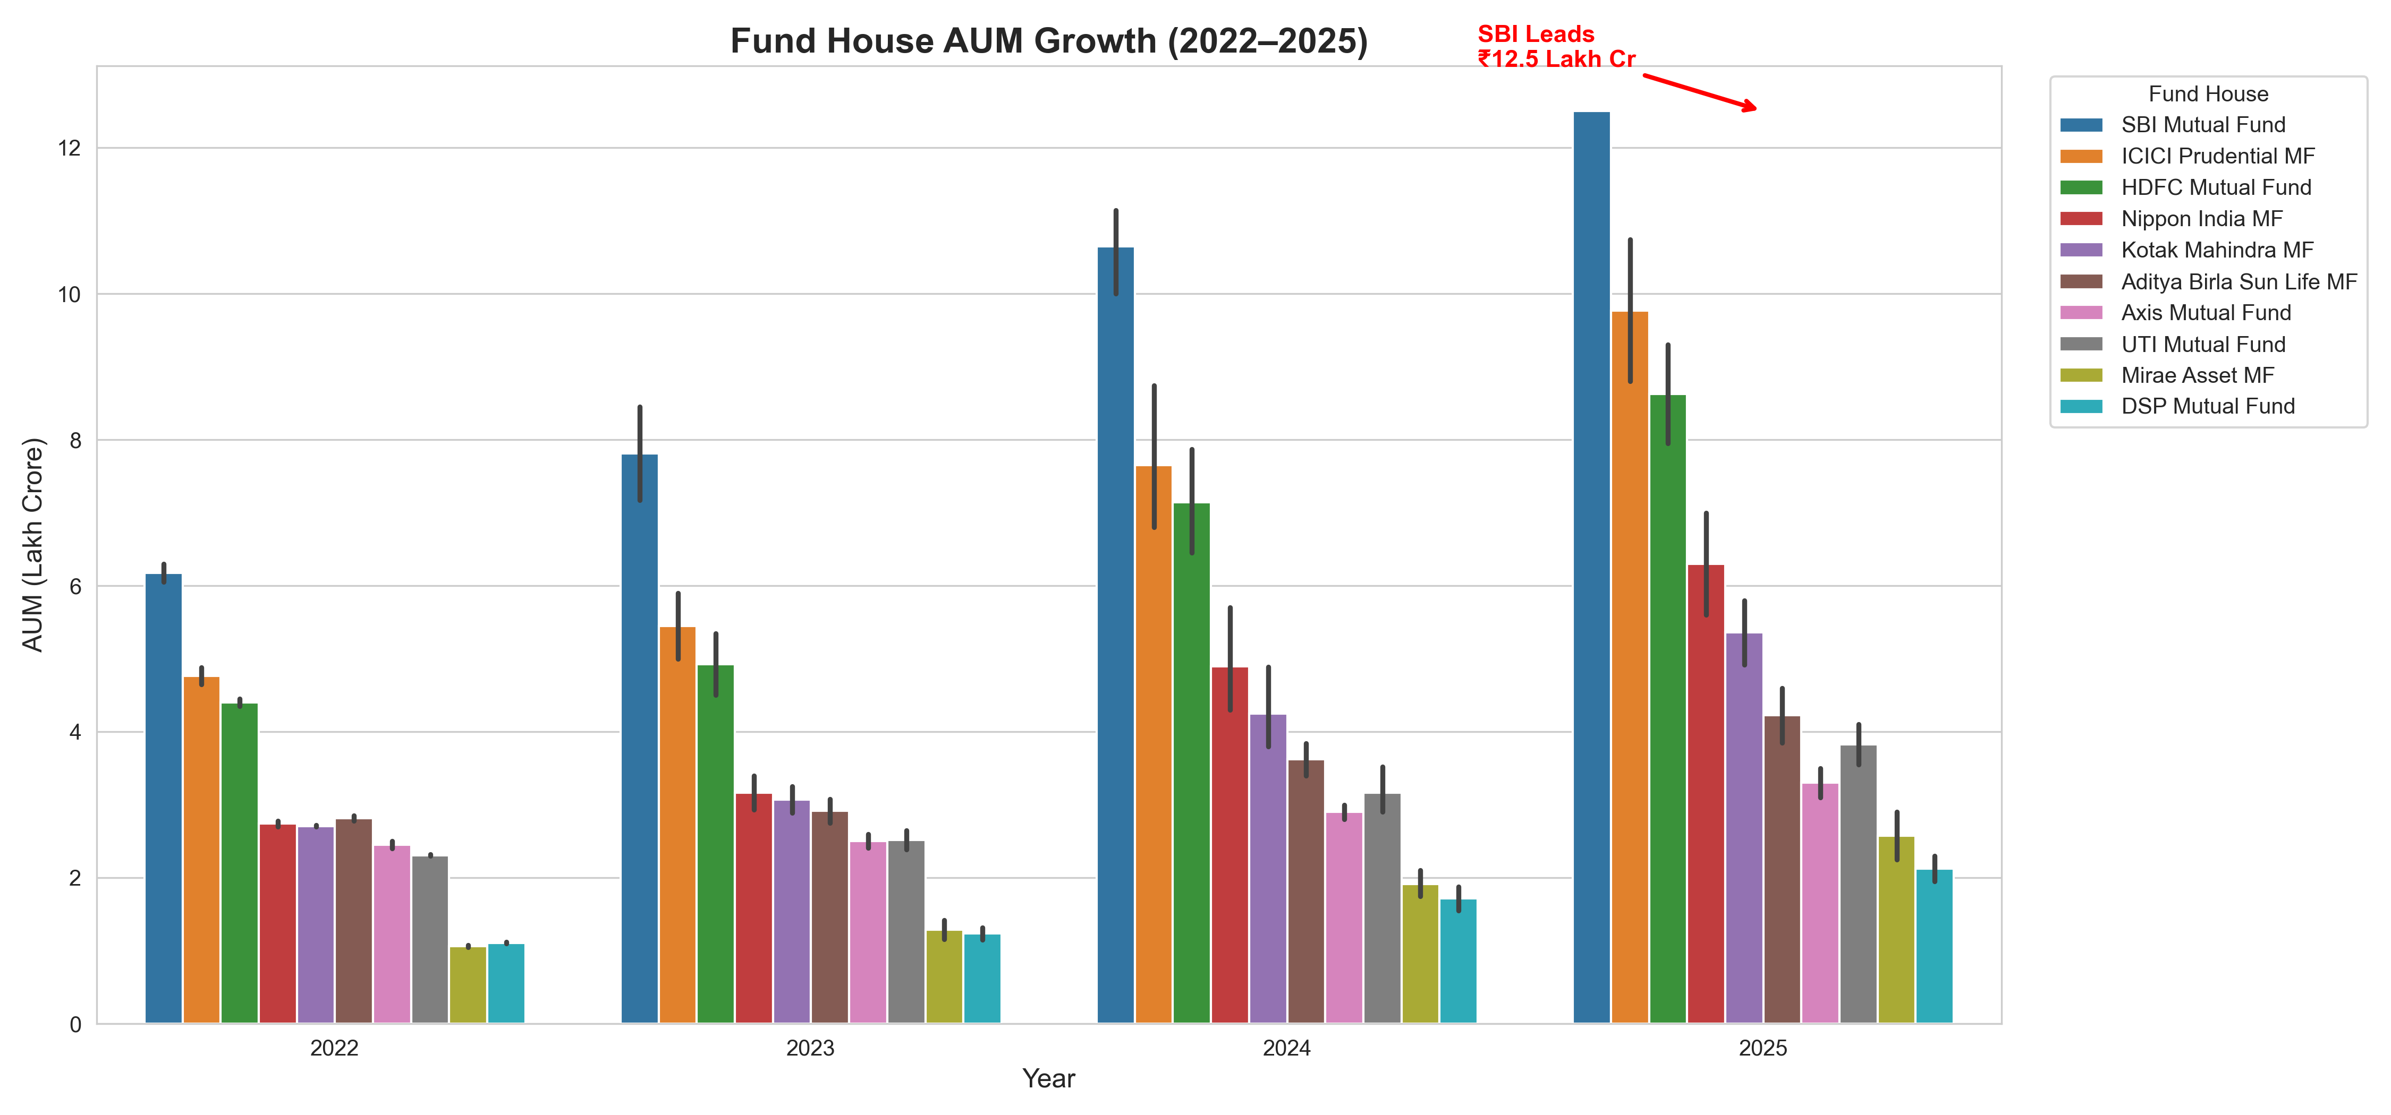
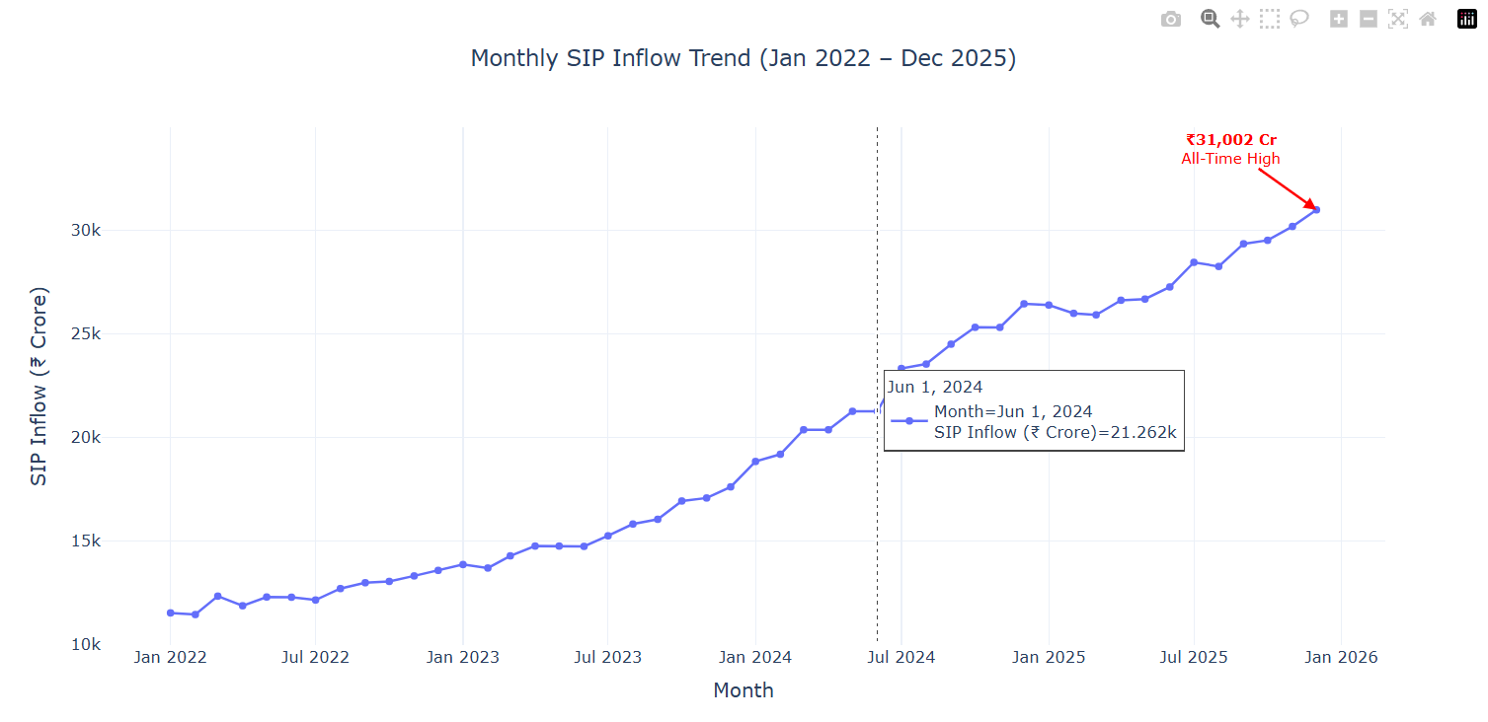
EXPLORATORY DATA ANALYSIS
Industry Growth: AUM & SIP Inflows, 2022–2025
SBI Mutual Fund leads AUM at ₹12.5L Cr — ₹1.76L Cr ahead of ICICI Prudential
Monthly SIP inflow hit an all-time high of ₹31,002 Cr in December 2025
BLUESTOCK FINTECH | MUTUAL FUND ANALYTICS PLATFORM
6

Slide 7
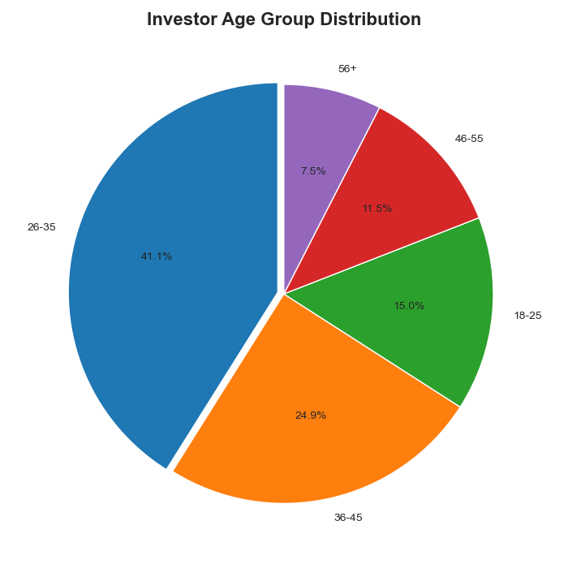
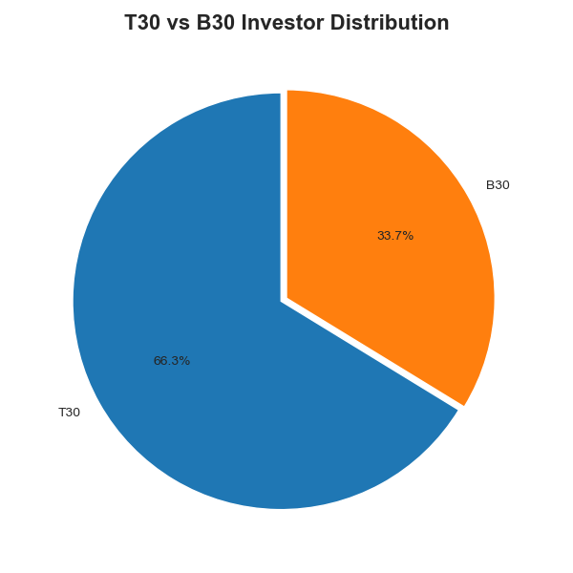
EXPLORATORY DATA ANALYSIS
Who Is Investing? Demographics & Geography
26–45 age band is the largest investor cohort (41.1%) by count and SIP contribution
T30 cities contribute 66.3% of SIP value; B30 is a meaningful, growing 33.7%
BLUESTOCK FINTECH | MUTUAL FUND ANALYTICS PLATFORM
7

Slide 8
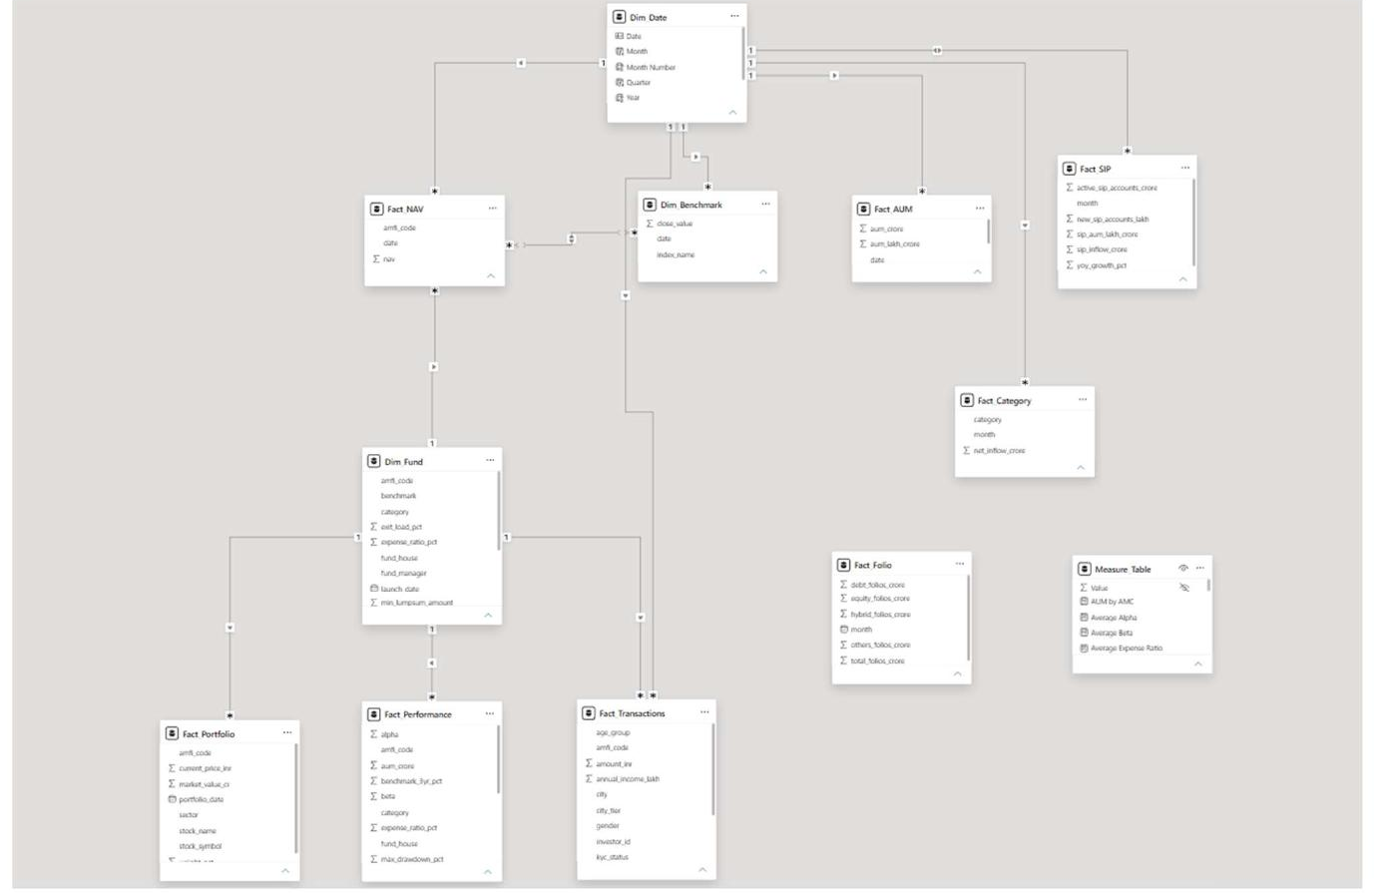
DATA ENGINEERING
Database Design: Table Star Schema
Design Rationale
dim_fund & dim_date sit at the centre; fact_nav, fact_transactions, fact_performance, fact_aum radiate out — chosen over OLTP normalisation because analytical queries aggregate far faster against wide fact tables.
Validation
verify_database.py cross-checks every table's row count in bluestock_mf.db against its source CSV to confirm a lossless load.
10 Analytical Queries
AUM ranking, SIP YoY growth, low-cost funds, top 5-year performers, category-wise expense ratios and more — version-controlled in sql/queries.sql.
BLUESTOCK FINTECH | MUTUAL FUND ANALYTICS PLATFORM
8

Slide 9
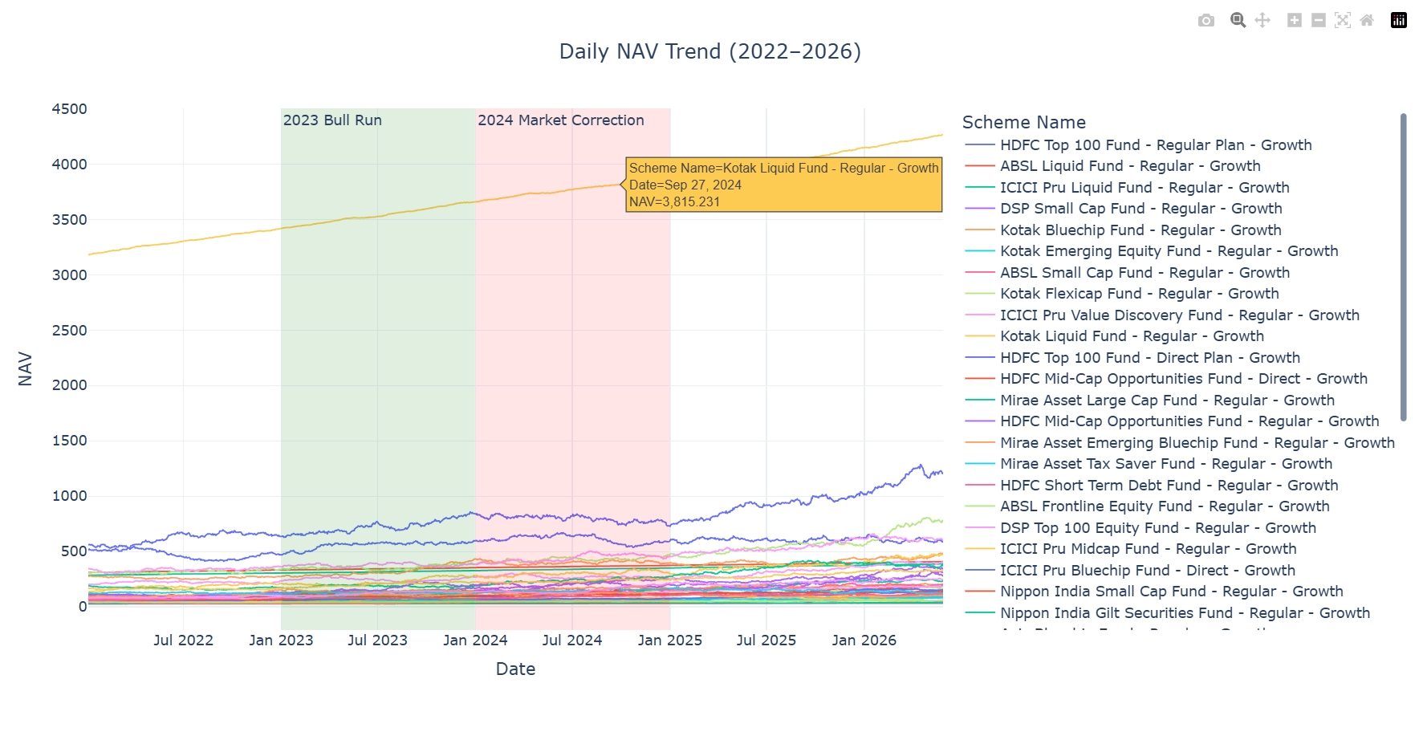
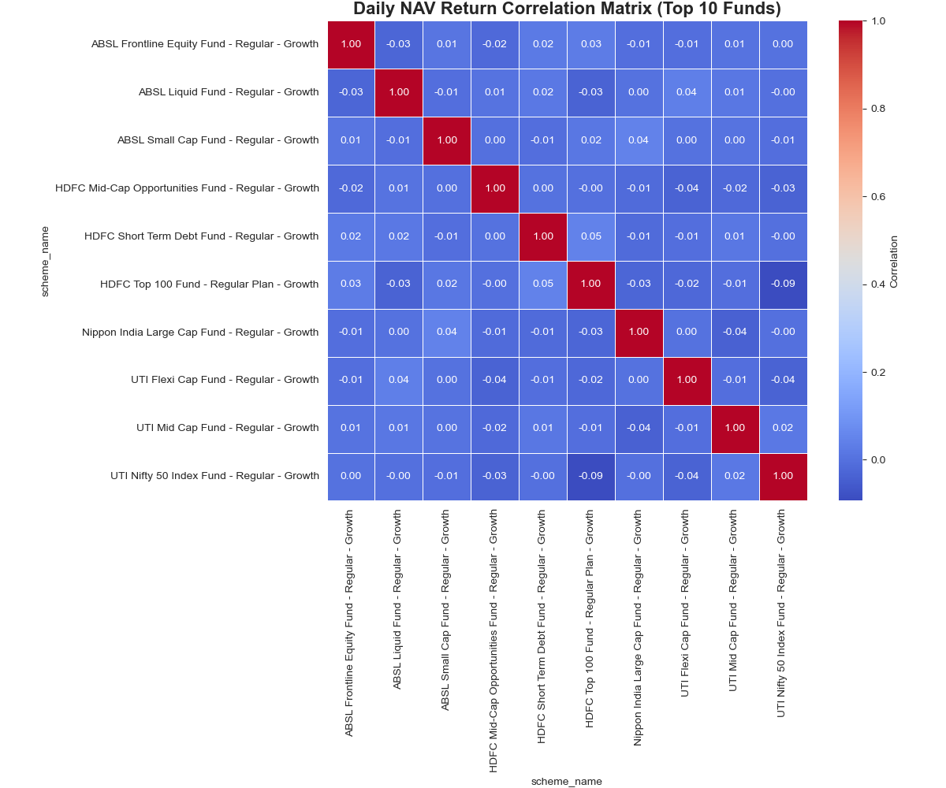
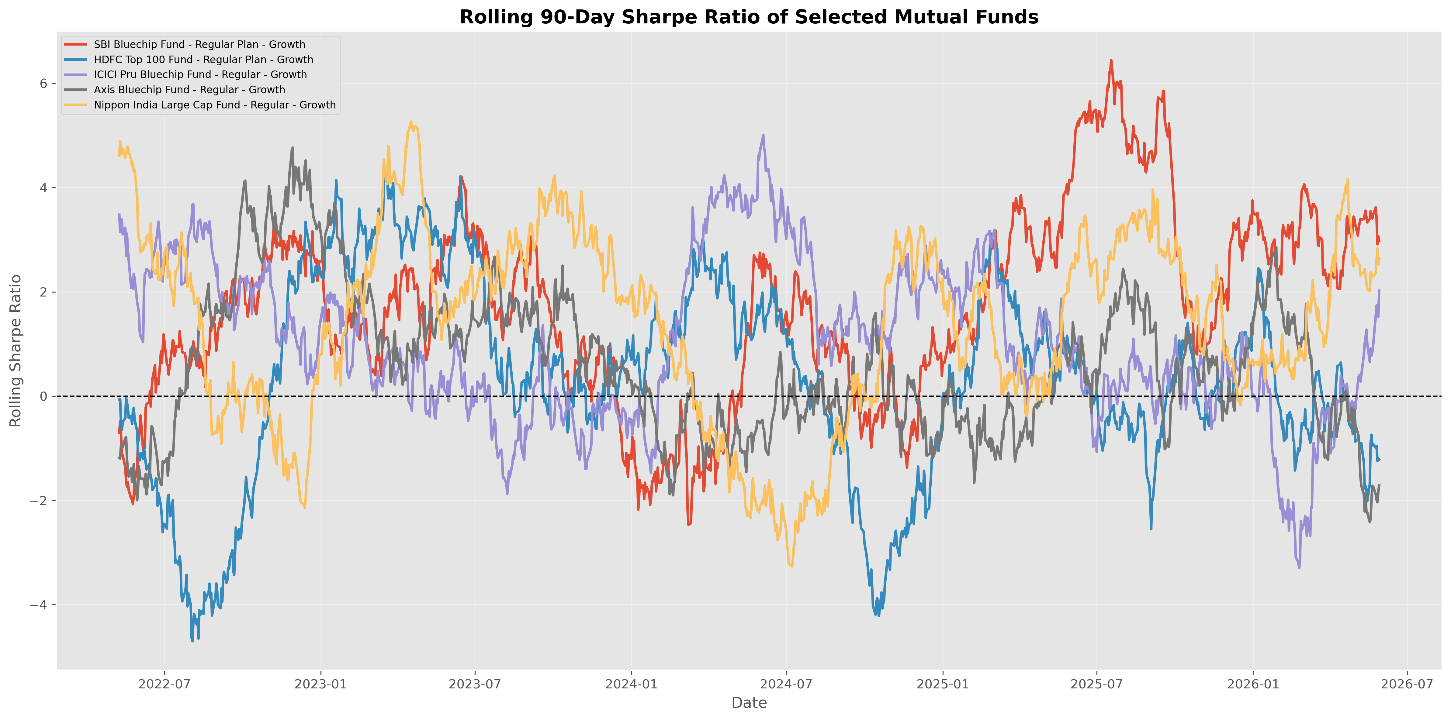
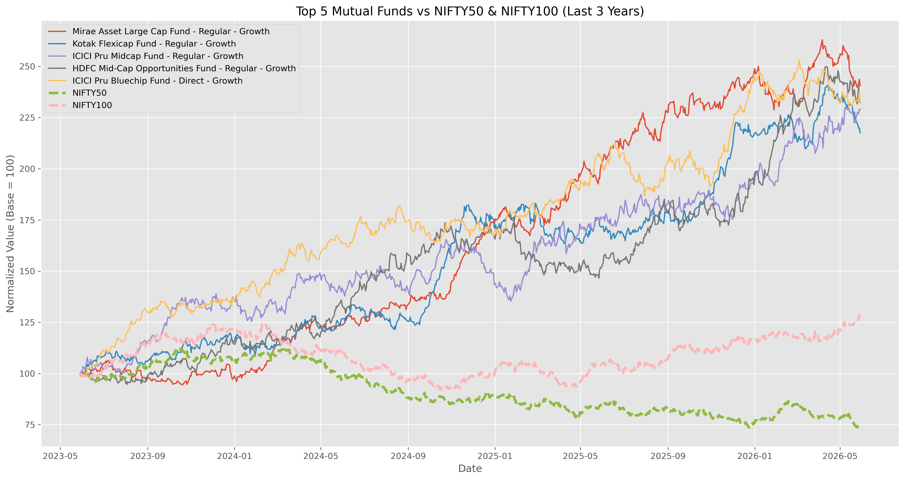
PERFORMANCE ANALYTICS
NAV Trend, Rolling Risk & Return Correlation
BLUESTOCK FINTECH | MUTUAL FUND ANALYTICS PLATFORM
9

Slide 10
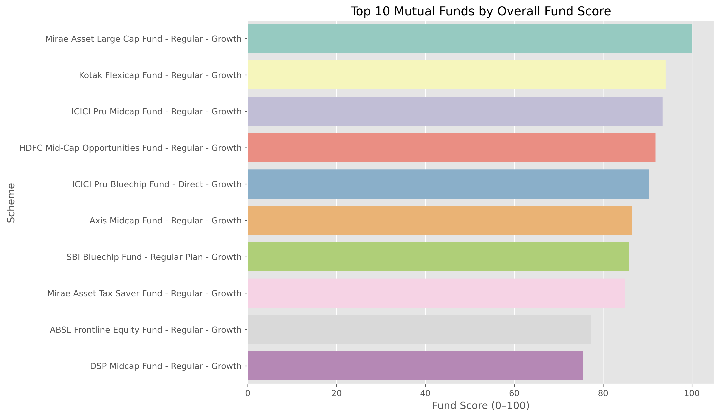
PERFORMANCE ANALYTICS
Composite Fund Scorecard: Blending Return, Risk & Cost
CAGR (NAV_end/NAV_start)^(1/n) − 1, annualised on 252 trading days
Sharpe (Rp − Rf) / σp × √252, Rf = 6.5% RBI repo proxy
Sortino Same numerator, downside-only volatility denominator
Alpha / Beta OLS regression of fund returns on Nifty 100
Max Drawdown min(NAV / running_max(NAV) − 1)
Scorecard 30% return + 25% Sharpe + 20% Alpha + 15% cost + 10% drawdown
#1 Mirae Asset Large Cap Fund — Score 100/100, Sharpe 1.45, 3Y CAGR ~34%
BLUESTOCK FINTECH | MUTUAL FUND ANALYTICS PLATFORM
10

Slide 11
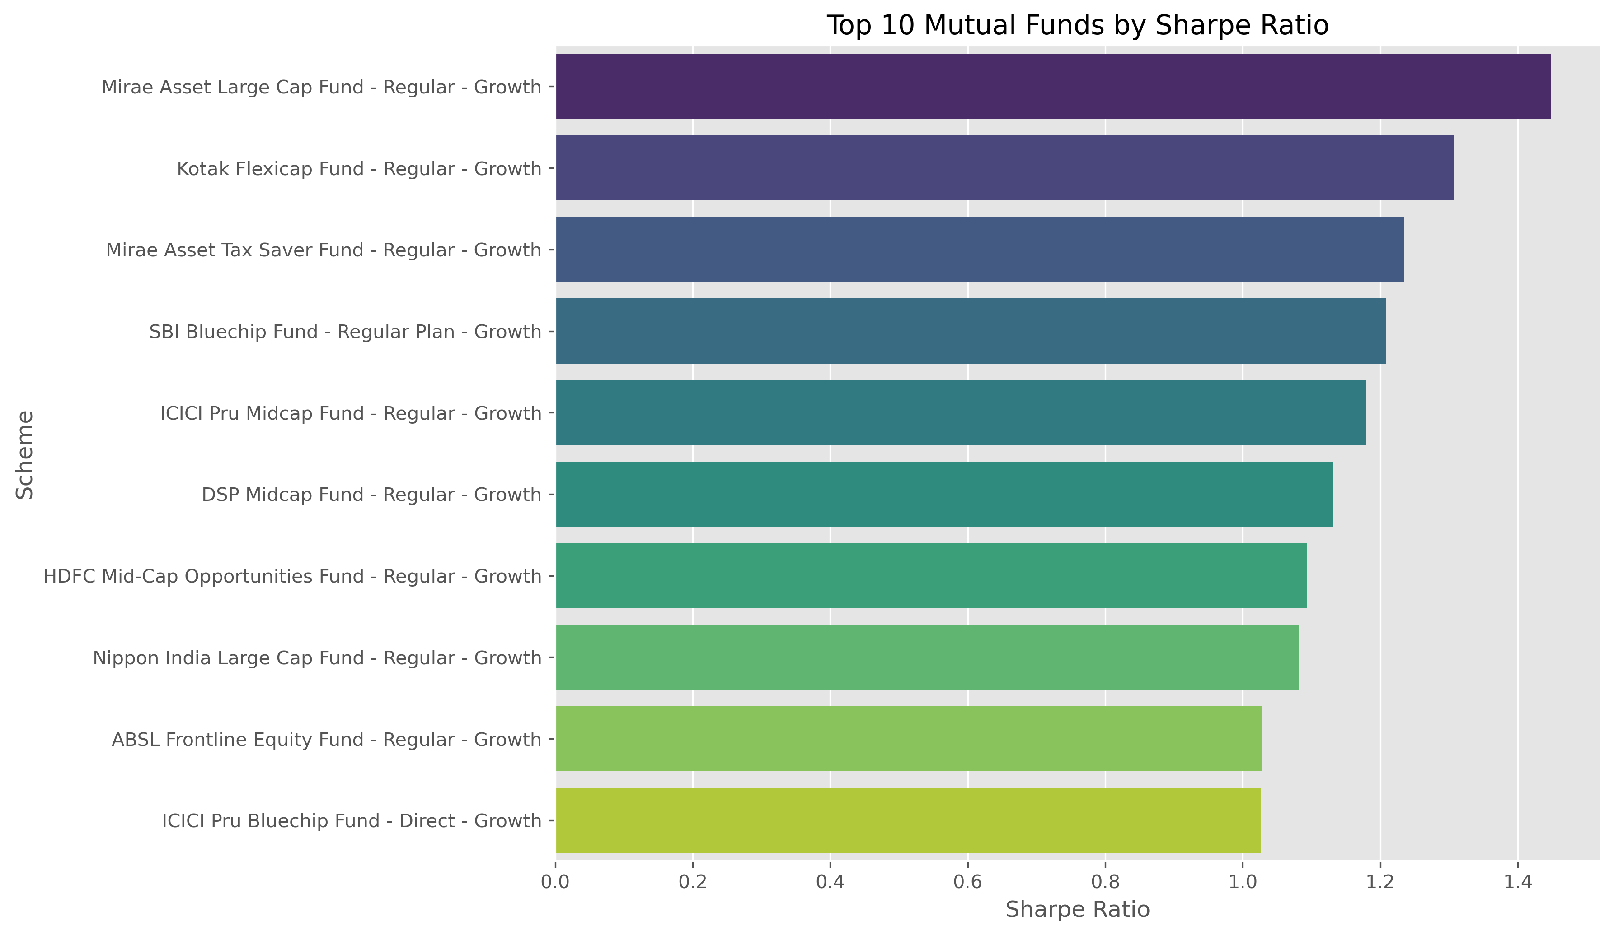
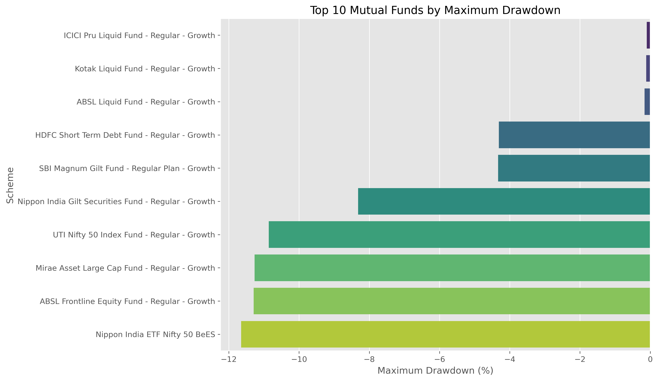
PERFORMANCE ANALYTICS
Risk-Adjusted Returns & Drawdown by Fund
Mirae Asset Large Cap leads both Sharpe (1.45) and Sortino (2.39) ratios
Liquid/Gilt funds show shallowest drawdown; Small/Mid-Cap exceed -25%
BLUESTOCK FINTECH | MUTUAL FUND ANALYTICS PLATFORM
11

Slide 12
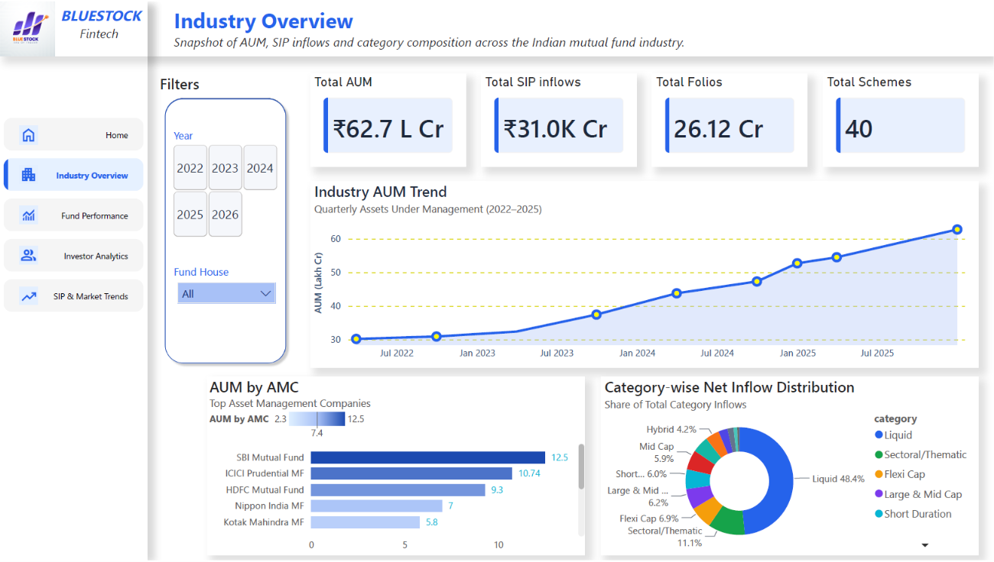
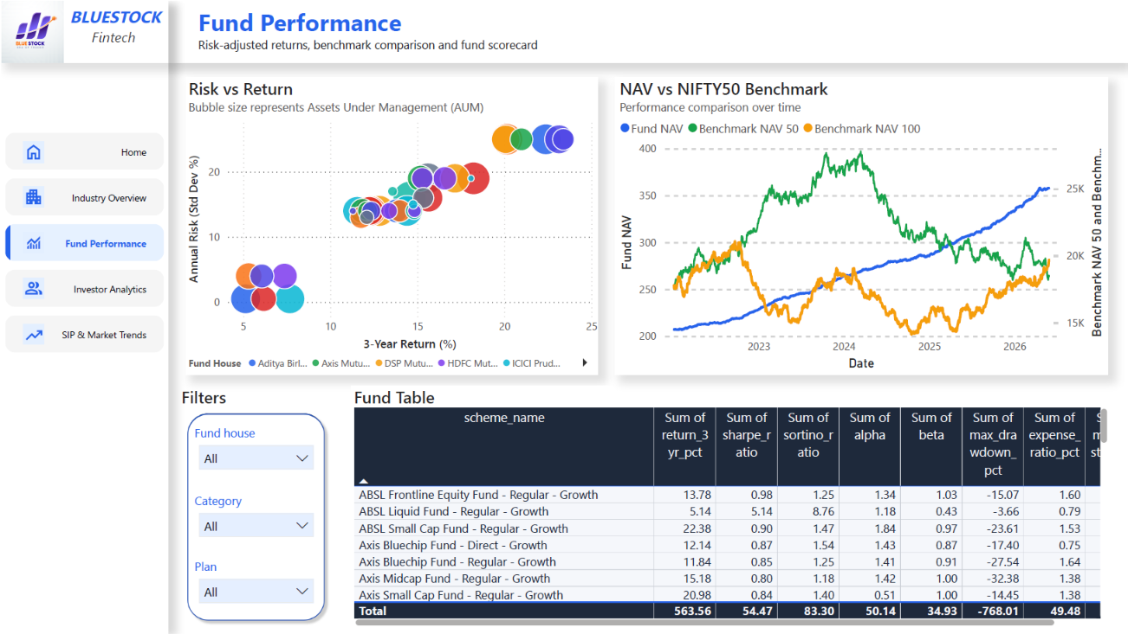
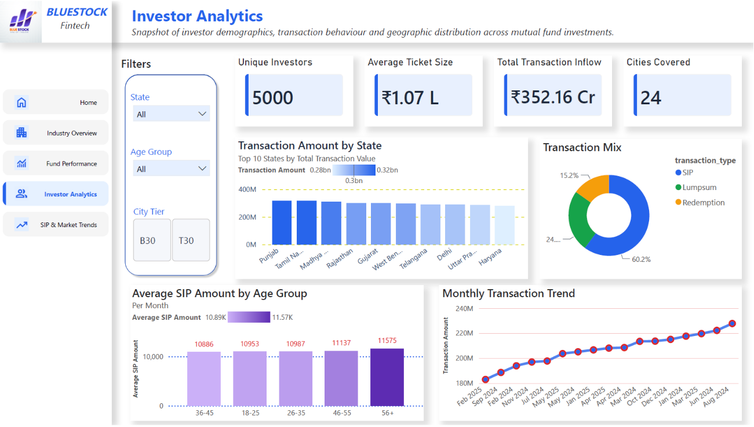
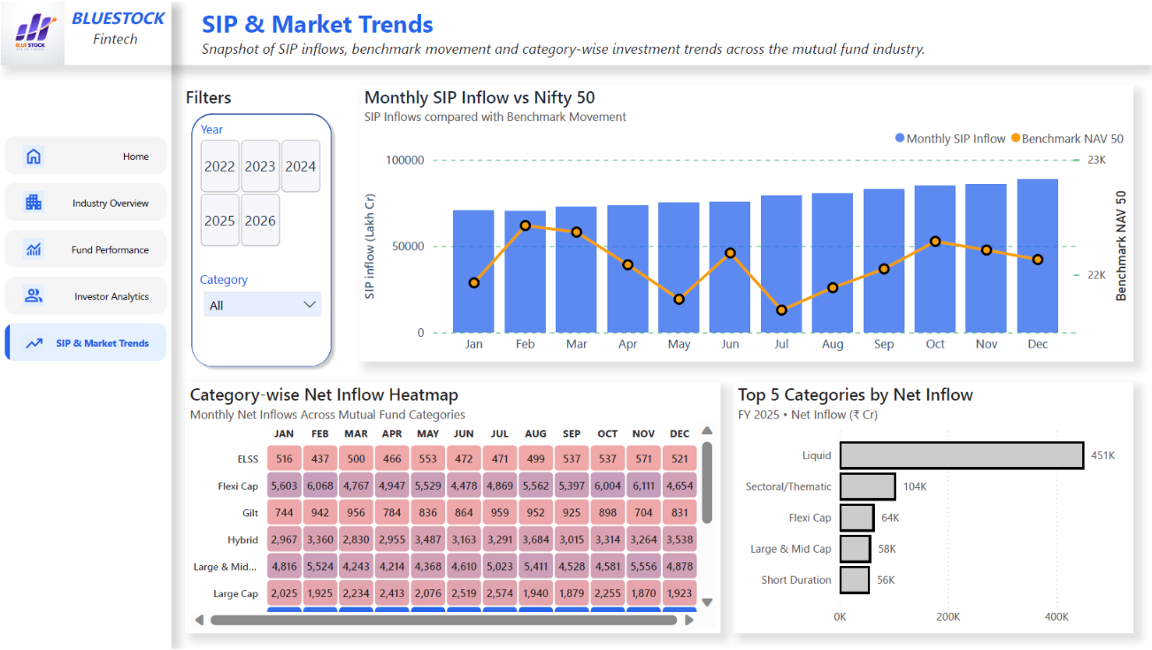
BUSINESS INTELLIGENCE
4-Page Interactive Power BI Dashboard
Industry Overview
Fund Performance
Investor Analytics
SIP & Market Trends
BLUESTOCK FINTECH | MUTUAL FUND ANALYTICS PLATFORM
12

Slide 13
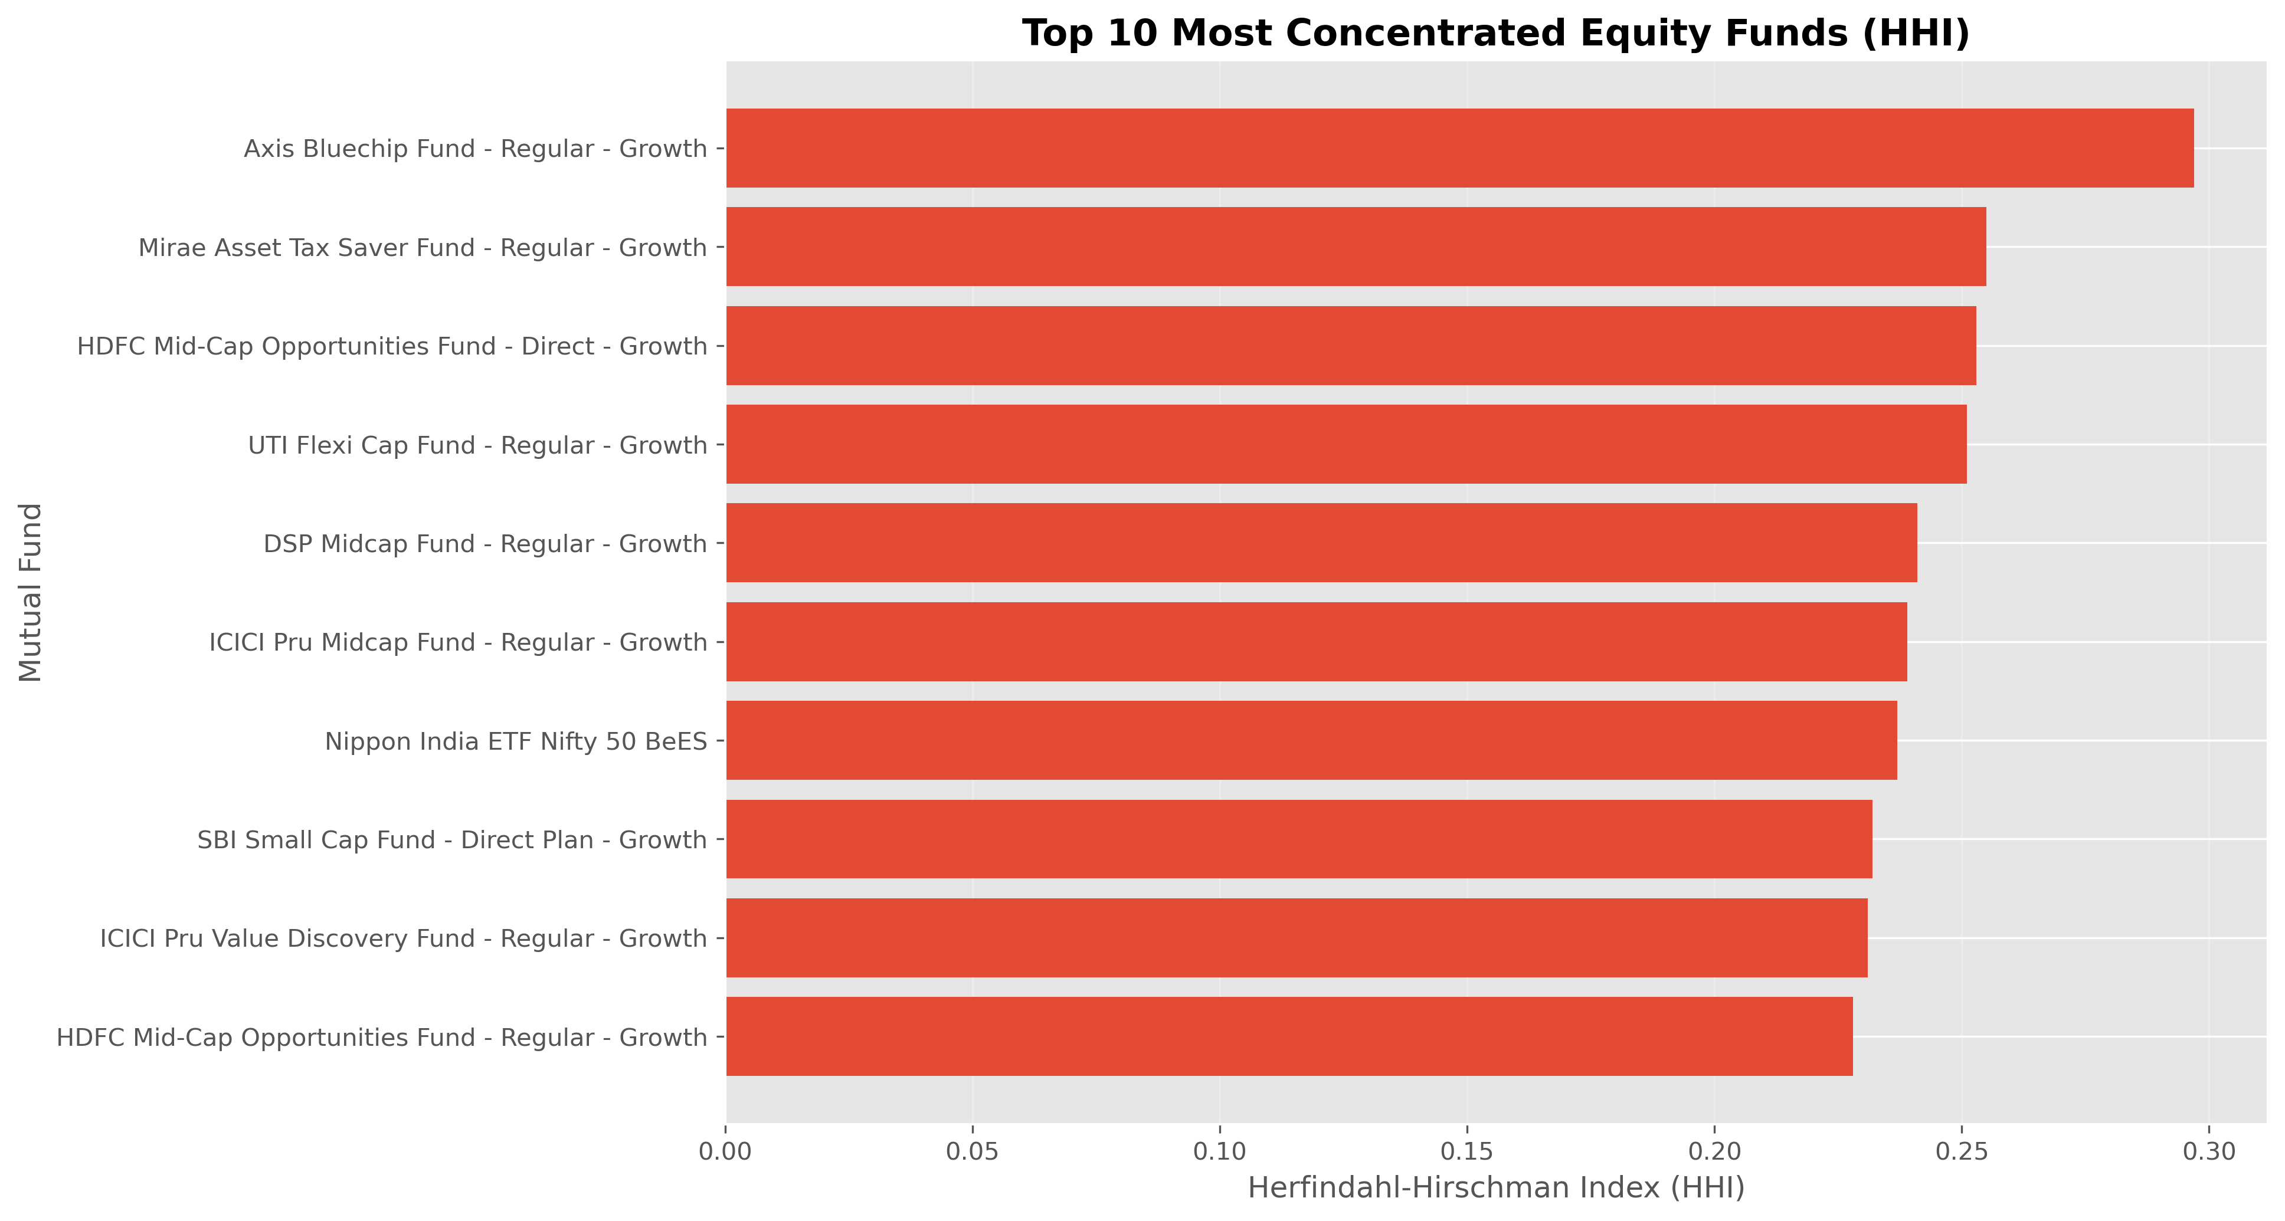
ADVANCED ANALYTICS & RISK
Tail Risk, Investor Cohorts & Sector Concentration
Historical VaR / CVaR (95%) — Highest Tail Risk
Investor Cohort Analysis
Scheme | VaR 95% | CVaR 95%
SBI Small Cap – Direct | -2.69% | -3.24%
Axis Small Cap – Regular | -2.62% | -3.17%
ABSL Small Cap – Regular | -2.60% | -3.25%
Nippon India Small Cap | -2.54% | -3.23%
2025 cohort avg SIP ticket ₹13,505 — 23% higher than the 2024 cohort (₹10,997); both gravitate toward mid/small-cap growth funds.
SIP Continuity — At-Risk Flagging
Investors with 6+ SIPs and >35-day average gap flagged “At Risk” — an actionable retention list for Bluestock's CRM team.
Sector Concentration (HHI)
Axis Bluechip Fund carries the highest sector HHI (0.297) — most concentrated portfolio in the equity universe; useful diversification signal.
Rule-based recommender (recommender.py) maps risk appetite → risk_grade → top-3 funds sorted by Sharpe, fully auditable.
BLUESTOCK FINTECH | MUTUAL FUND ANALYTICS PLATFORM
13

Slide 14
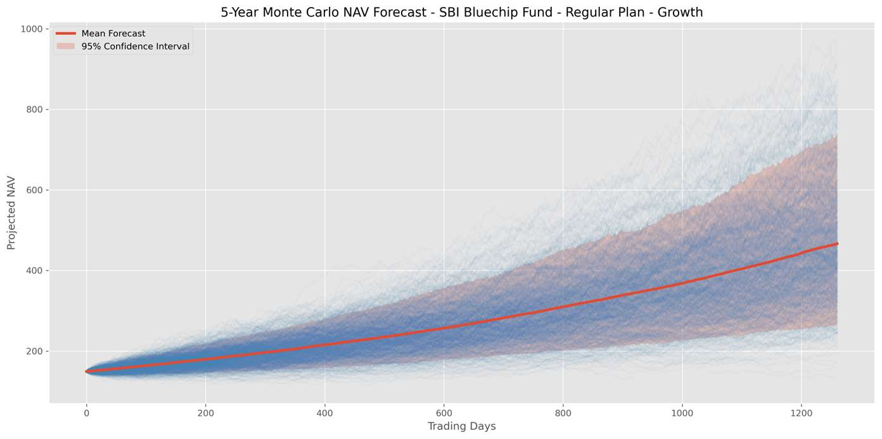
BONUS MODULE 1 · B3
Monte Carlo Simulation — 5-Year NAV Forecast
₹149.32
Starting NAV
₹466.53
Mean Ending NAV
25.59%
Expected CAGR
99.9%
Probability of Growth
Method: Geometric Brownian Motion calibrated to historical drift/volatility; 1,000 simulated 5-year (1,260-trading-day) paths for SBI Bluechip Fund.
BLUESTOCK FINTECH | MUTUAL FUND ANALYTICS PLATFORM
14

Slide 15
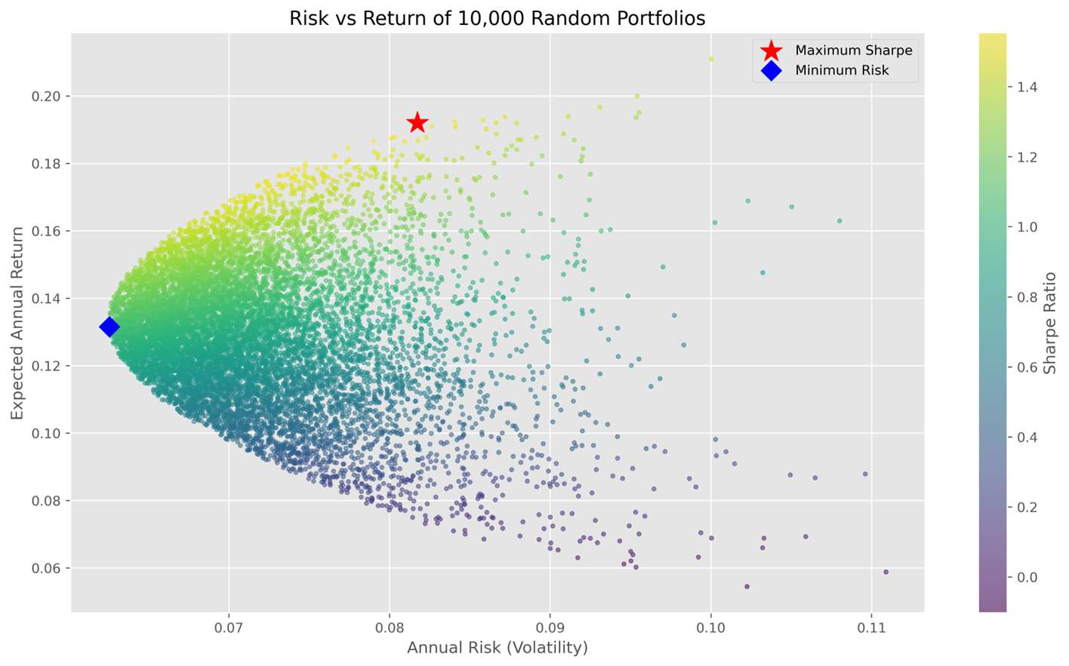
BONUS MODULE 2 · B4
Markowitz Efficient Frontier — Optimal Portfolio
Maximum-Sharpe Portfolio Allocation
SBI Bluechip Fund
49.9%
ICICI Pru Bluechip Fund
28.1%
Kotak Bluechip Fund
19.4%
Axis Bluechip Fund
2.4%
HDFC Top 100 Fund
0.2%
Interpretation: the optimizer weights toward SBI Bluechip for its strong scorecard/Sharpe showing, with ICICI Pru and Kotak Bluechip adding diversification benefit via lower correlation.
BLUESTOCK FINTECH | MUTUAL FUND ANALYTICS PLATFORM
15

Slide 16
BUSINESS INSIGHTS
Key Findings for Bluestock Fintech
1
2
3
Best all-round fund
Market leader
SIP momentum
Mirae Asset Large Cap — Score 100/100, Sharpe 1.45, Sortino 2.39
SBI Mutual Fund AUM ₹12.5L Cr, ₹1.76L Cr ahead of ICICI Prudential
₹31,002 Cr all-time-high monthly inflow, Dec 2025
4
5
6
Tail risk concentration
Defensive sleeve validated
Disciplined investing
Small-Cap funds top both VaR and CVaR rankings
Liquid/Gilt funds show shallowest drawdown (-9.8%) & lowest tracking error
60.2% of transaction value is SIP vs 24.6% Lumpsum, 15.2% Redemption
7
8
9
Broad-based geography
Retention opportunity
Portfolio construction
Punjab, Tamil Nadu, MP lead, but top-10 states are evenly spread
At-risk SIP investors (35+ day gaps) flagged for CRM re-engagement
Markowitz-optimal 5-fund mix ~50% SBI Bluechip + diversifiers
BLUESTOCK FINTECH | MUTUAL FUND ANALYTICS PLATFORM
16

Slide 17
CONCLUSION & FUTURE SCOPE
This project delivered a complete, production-style mutual fund analytics platform — from a reproducible ETL pipeline and star-schema data warehouse to risk-adjusted performance analytics and an interactive Power BI dashboard. All 7 core deliverables and 2 bonus modules (Monte Carlo Simulation, Markowitz Optimization) were completed, turning raw AMFI data into decision-ready insights for fund selection, risk management, and investor engagement.
Future Scope
Scheduled ETL: weekday cron job auto-fetching live NAV at 8 PM
Streamlit web app as a no-licence Power BI alternative
Automated HTML weekly performance-summary emails
ML-based fund recommender (expense ratio, horizon, existing holdings)
Live portfolio tracking with real-time XIRR & benchmark comparison
Cloud migration: managed PostgreSQL + hosted dashboard/app
Utsav Ratpiya | Data Analyst Intern, Bluestock Fintech | github.com/Utsav-Ratpiya/Mutual-Fund-Analytics-Bluestock-
Thank you.

