Slide 1

Major project Synopsis Emotional Resonance App
Department of Computer Science and
Engineering
Graphic Era Hill University, Dehradun
Supervisor: Mr. Umang Garg

Slide 2

Emotional Resonance Project
Transforming Mental Health with Technology

Slide 3
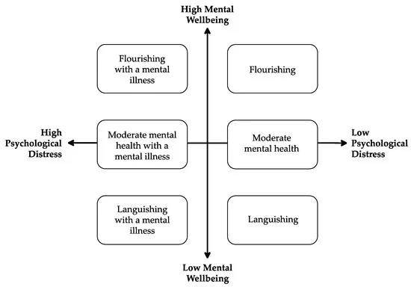
Introduction
Project's Purpose
Rising Mental Health Concerns
Commitment to Accessibility

Slide 4
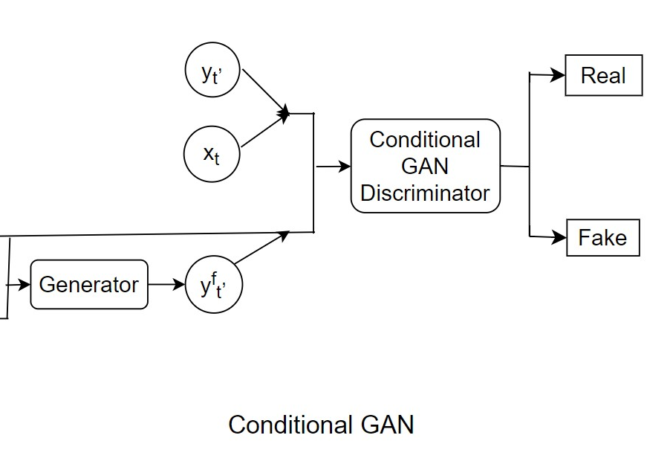
Project Technologies
GANs for Art Generation
Many-to-Many LSTMs for Translation
Many-to-One LSTMs for Sentiment Analysis
Many-to-One LSTMs for Chatbot

Slide 5
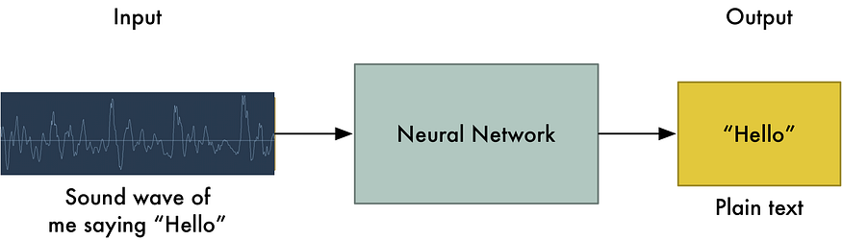
Machine Translation
Many-to-Many LSTM for Translation
Encoder and Decoder LSTMs
English to French Translation Example

Slide 6
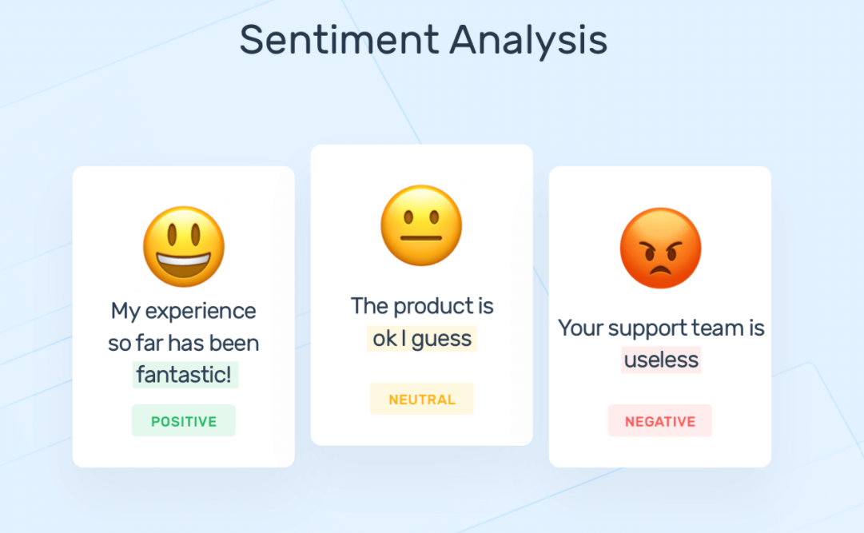
Sentiment Analysis
Dataset and Prelabelled Emotions
Many-to-One LSTM for Emotion Classification.

Slide 7
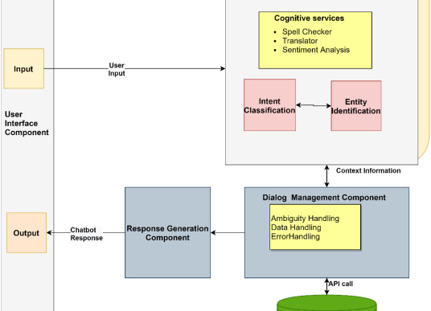
Chatbot Overview
Categorizing Queries
Many-to-One LSTM for Query Categorization.

Slide 8
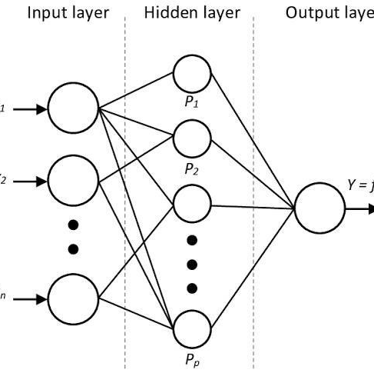
Algorithms and Concepts
Neural Networks Layers (Input, Hidden, Output)
Forward Propagation
Backward Propagation and Gradient Descent
Activation Functions (ReLU, Sigmoid, Tanh)

Slide 9
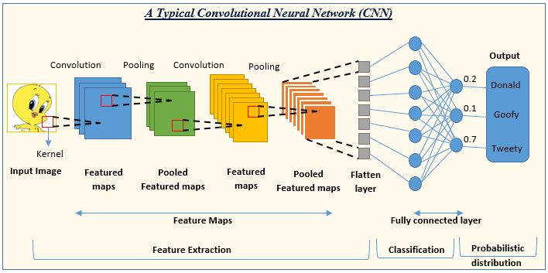
Convolutional Neural Networks
Convolution Operation
Benefits (Sparse Connectivity, Parameter Sharing)

Slide 10
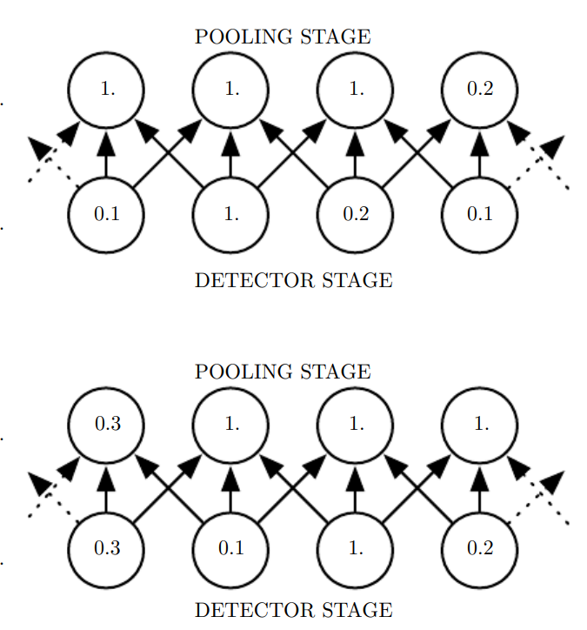
Pooling
Role in Convolution Layer
Reducing Dimensionality and Invariance to Translation

Slide 11
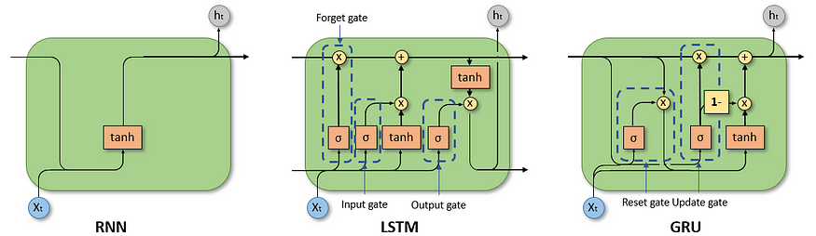
Recurrent Neural Networks (RNN)
Introduction to RNN
Hidden/Memory State Calculation

Slide 12
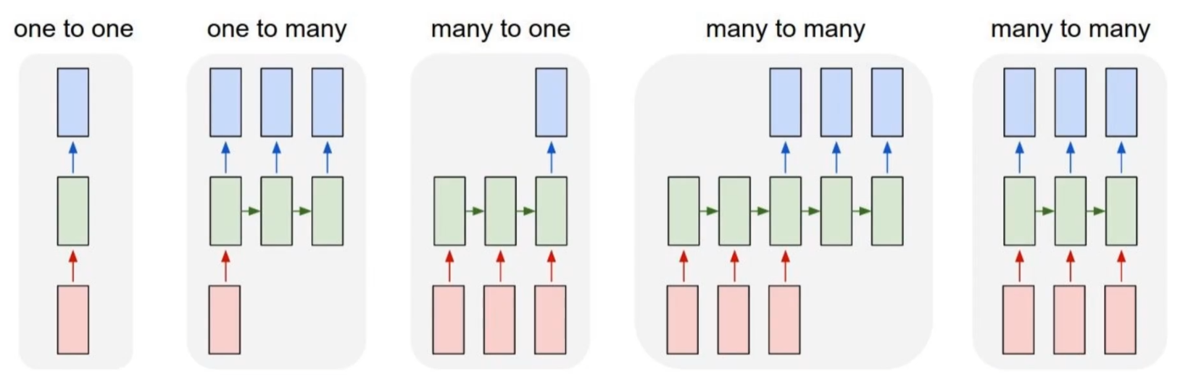
Types of RNN
One-to-One, One-to-Many, Many-to-One, Many-to-Many
Vanishing Gradient Problem

Slide 13
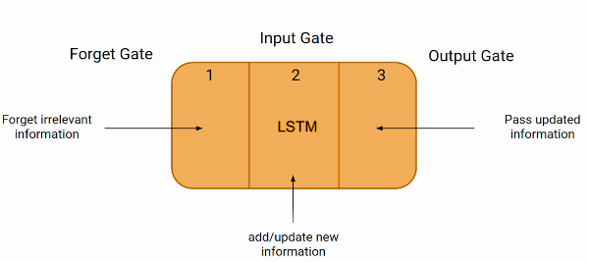
Long Short-term Memory (LSTM)
Solving the Vanishing Gradient Problem
Introduction of Gates in LSTMs

Slide 14
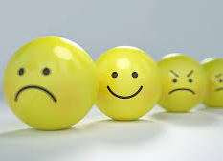
References
Li, Bowen, et al. "Controllable text-to-image generation." Advances in Neural Information Processing Systems 32 (2019).
Ranoliya, Bhavika R., Nidhi Raghuwanshi, and Sanjay Singh. "Chatbot for university related FAQs." 2017 International Conference on Advances in Computing, Communications and Informatics (ICACCI). IEEE, 2017.
Luo, Bei, et al. "A critical review of state‐of‐the‐art chatbot designs and applications." Wiley Interdisciplinary Reviews: Data Mining and Knowledge Discovery 12.1 (2022): e1434.

Slide 15
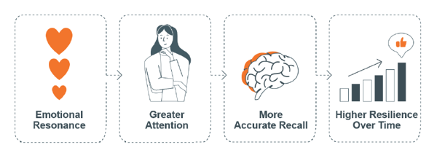
THANK YOU ☺

