Slide 1







FIGHTING MONGOOSES PIONEER NATURAL RESOURCES
EVERARDO
ALLISON
JESSIE
TIBIN
UTSAV
MAX
ALLISON BUSA, EVERARDO GONZALEZ, UTSAV GUPTA – OLIN COLLEGE OF ENGINEERING
JESSIE GUO, MAX LIU – MOUNT HOLYOKE COLLEGE
TIBIN THOMAS – NORTHEASTERN UNIVERSITY
Notes:
Remember: you only have 2 minutes to present so pick what’s important and keep everything else in the appendix.

Slide 2

OBJECTIVES
FIGHTING MONGOOSES PIONEER NATURAL RESOURCES
Allison Busa, Everardo Gonzalez, Utsav Gupta – Olin College of Engineering; Jessie Guo, Max Liu – Mount Holyoke College, Tibin Thomas – Northeastern University
METHODOLOGY
QUESTIONS
Predicting the number of electric vehicles on road in 2050
Finding the relationship between Oil Consumption and number of EVs
GOALS
Open model with flexible parameters
Oil consumption should be directly linked with EV forecast
Global forecast is for number of EV
Used historical data to plot our own curve
The curve was projected into the future to predict the EVs in 2050
Equation between EVs and oil consumption by vehicles was created
The impact of EVs on oil consumption was recognized and a graph was plotted for the same

Slide 3

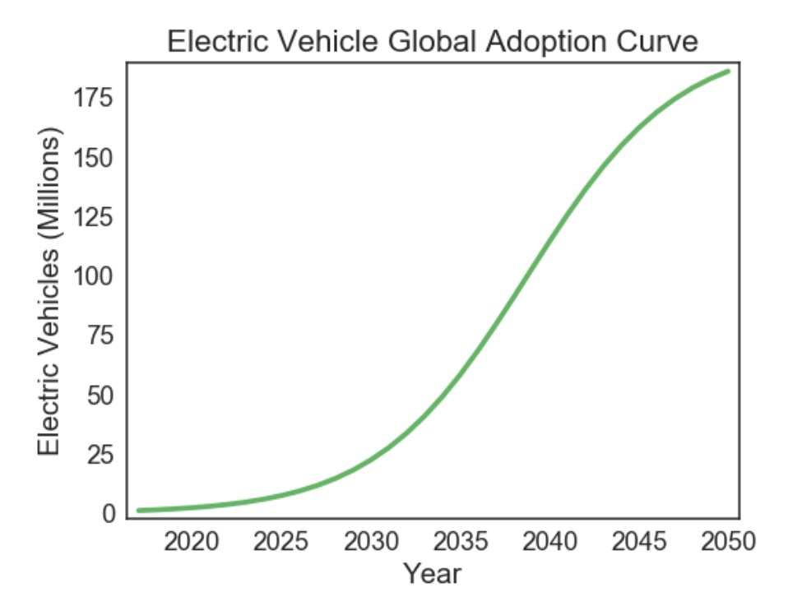
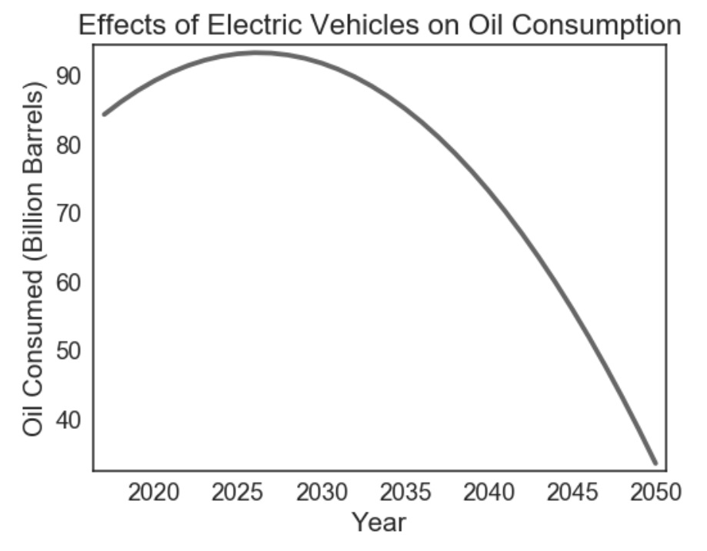
RESULTS
FIGHTING MONGOOSES PIONEER NATURAL RESOURCES
Allison Busa, Everardo Gonzalez, Utsav Gupta – Olin College of Engineering; Jessie Guo, Max Liu – Mount Holyoke College, Tibin Thomas – Northeastern University
CONCLUSIONS
ANALYSIS
EV forecast for 2050 is 199.044 million
Growth of EV result in a decline in oil consumption
SHORTCOMINGS
Limited data available due to paywalls
Inflexible model, cannot adjust for changes in data
WAYS TO IMPROVE
Reverse engineer the model to include the effects of various parameters

Slide 4
CITATIONS
Morgan Stanley Research, “On the Charge”, August 31, 2017, <https://www.docdroid.net/A5uNOPX/on-the-charge.pdf#page=27>
US Energy Information Administration, “Annual Energy Review”, September 17, 2012, <https://www.eia.gov/totalenergy/data/annual/showtext.php?t=pTB0208>

