Slide 1
BAC and Food Model Comparison
Yes, we got this Allen Downey Approved™

Slide 2
Question
Goals:
Model food and alcohol consumption
Use one-compartment model as baseline
Implement three-compartment model
Questions:
How does eating impact theoretical Blood Alcohol Concentration (BAC)?
How much food consumption “balances” n drinks?
How do both models compare?

Slide 3
Methodology
One-compartment Model
“Bag of Blood”
Instantaneous weight gain
Absorption/Elimination functions
Three-compartment Model
Considers organs
Weight gain happens over time
Intake
Intake
Stomach
Small Intestine
Lean Body Mass
Bloodstream
Elimination
Elimination

Slide 4
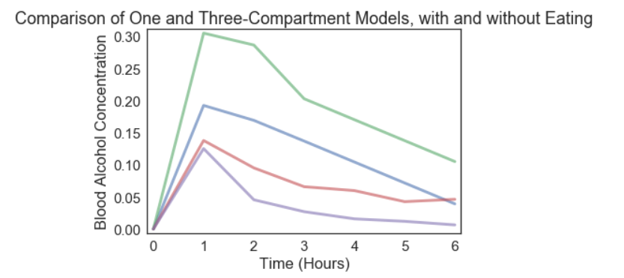
Results
- One-Compartment without eating
- One-Compartment with eating
- Three-Compartment, without eating
- Three-Compartment, with eating

Slide 5
Interpretation
Eating decreases theoretical BAC significantly
Something quantitative about the impact of eating
Three-compartment model is far more comprehensive

