Slide 1
BAC and Food Model Comparison
Yes, we got this Allen Downey Approved™

Slide 2
Question
Goals:
Model food and alcohol consumption
Use one-compartment model as baseline
Implement three-compartment model
Questions:
How does eating impact theoretical Blood Alcohol Concentration (BAC)?
How much food consumption “balances” n drinks?
How do both models compare?

Slide 3
Methodology
One-compartment Model
“Bag of Blood”
Instantaneous weight gain
Absorption/Elimination functions
Three-compartment Model
Considers organs
Weight gain happens over time
Intake
Intake
Stomach
Small Intestine
Lean Body Mass
Bloodstream
Elimination
Elimination

Slide 4
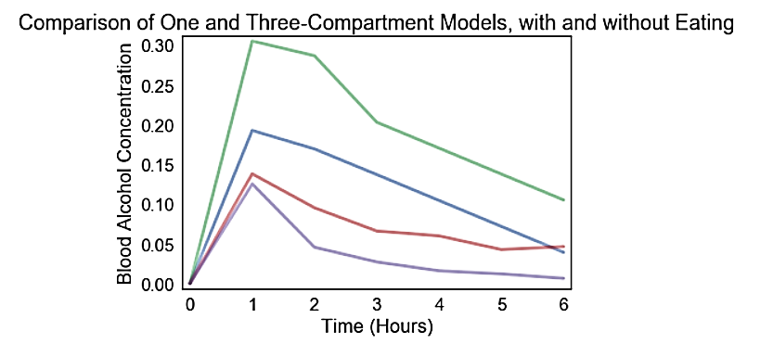
Results
- One-Compartment without eating
- One-Compartment with eating
- Three-Compartment, without eating
- Three-Compartment, with eating

Slide 5
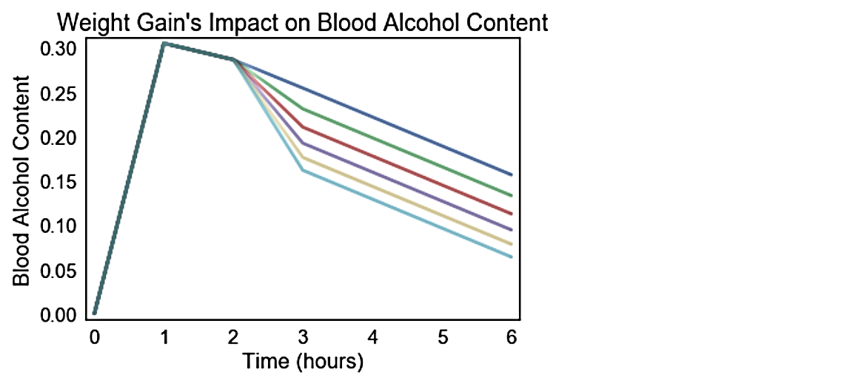
- Initial weight (70 kg)
- Initial weight + 5 (75 kg)
- Initial weight + 10 (80 kg)
- Initial weight + 15 (85 kg)
- Initial weight + 20 (90 kg)
- Initial weight + 25 (95 kg)

Slide 6
Interpretation
Eating decreases theoretical BAC significantly
According to the one compartment model, gain in 2.6 kg decreases BAC by one shot (15 g of pure ethanol)
Three-compartment model is far more comprehensive but more finicky

