Slide 1

SMART INDIA HACKATHON 2026
TITLE PAGE
Problem Statement ID – SIH26137
Problem Statement Title- Quantum-Inspired Intelligent Traffic Route Optimization in Transportation Systems Using Metaheuristic Optimization
Theme- Quantum Technology
PS Category- Software
Team ID- [add your team ID]
Team Name (Registered on portal)- [add your team name]

Slide 2
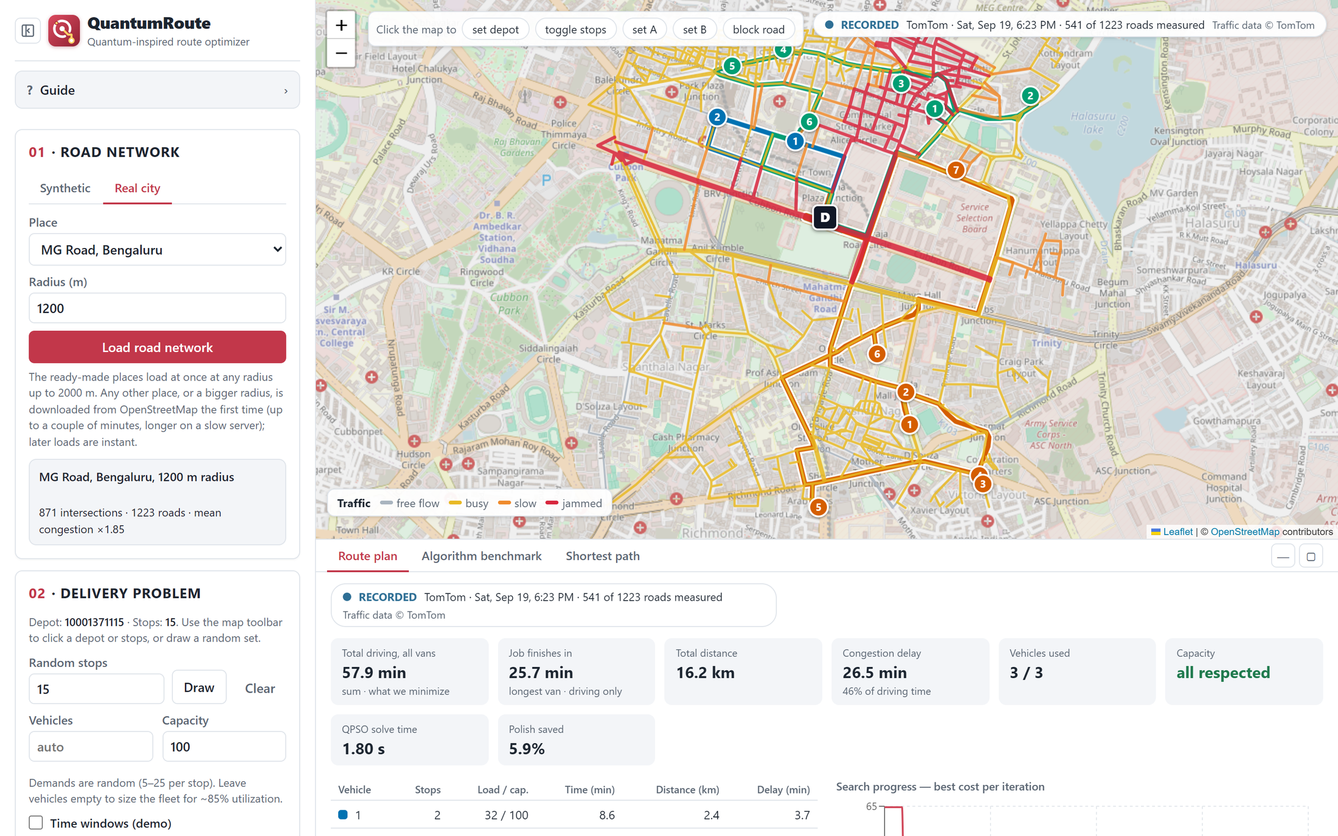
QuantumRoute: Quantum-inspired route optimizer
Your Team Name
Proposed Solution (Describe your Idea/Solution/Prototype)
QuantumRoute is a working web app that plans delivery routes for several vans on real city roads, and re-plans when traffic or roads change.
Solver: QPSO, a quantum-inspired swarm method that runs on an ordinary computer.
Detailed explanation of the proposed solution
Pick a place: four ready-made Indian cities, any place on OpenStreetMap, or a synthetic city.
Add a depot, stops and vans, then set the traffic: live or recorded TomTom, simulated rush hour, or close a road.
Optimize: routes on the map, load, time and delay per van, a convergence curve and a benchmark against other algorithms.
How it addresses the problem
Objective 1: multi-van routing with capacity, plus A-to-B shortest path (exact Dijkstra next to QPSO, PSO and GA).
Objective 2: time, distance and congestion weights, with one-click presets.
Objectives 3 and 4: compared with PSO, a genetic algorithm, OR-Tools and exact optima; up to 150 stops in the app.
Innovation and uniqueness of the solution
Real traffic in the loop, every reading labelled LIVE, RECORDED or SIMULATED.
What-if roads: click a road to close it and every solver plans around it.
A tuned QPSO: step size scaled to problem size, a warm start, and a polish that moves stops between vans.
Backed by results: exact optima, proven benchmark instances and 20 written findings.
MG Road, Bengaluru, recorded TomTom traffic, 15 stops, 3 vans. Route colours are vans and red roads are jammed.
13.6-28.1%
cheaper routes than classical PSO (QPSO raw output, 20 to 50 stops, 9 settings)
1.5%
above the proven optimum after 2 min (route search option, 22 standard instances)
150 of 150
small problems solved to the exact optimum (route search option)

Slide 3





TECHNICAL APPROACH
Your Team Name
Technologies to be used (e.g. programming languages, frameworks, hardware)
Methodology and process for implementation (Flow Charts/Images/ working prototype)
Backend | Python 3.11, FastAPI, NumPy, NetworkX, OSMnx
Frontend | React 18, TypeScript, Vite, Leaflet map, Recharts
Data | OpenStreetMap roads, TomTom Traffic Flow API
Reference solvers | Google OR-Tools, exact dynamic programming
Packaging | Docker (one command), REST API with OpenAPI docs
Hosting | Render, free tier
Testing | 431 automated tests
Hardware | Any laptop CPU. No GPU or quantum device.
1 Road network
OpenStreetMap (4 Indian cities or any place) or a synthetic city, as a weighted directed graph: intersections are nodes, roads are arcs.
2 Traffic layer
Live or recorded TomTom readings, simulated random or rush hour, and closed roads change the arc weights.
3 Delivery problem
Depot, up to 150 stops, vans, capacity, time windows, and what to minimize: time, distance, congestion or a mix.
4 Solver
QPSO with a warm start, then a polish. Alternatives: PSO, genetic algorithm, nearest neighbour, route search.
5 Output
Routes on the map, per-van table, convergence curve, benchmark and A-to-B shortest path.
Encoding: each particle is a vector of random keys. Sorting the keys gives the visiting order, which is cut into vans by capacity.
Update rule: no velocity. Each step samples a new position around a point between the particle's best and the swarm's best; the jump size shrinks over time, exploring first and refining later.
Fitness: weighted time, distance and congestion, plus penalties for overload and lateness. 40 particles, 800 iterations; a default plan takes about a second on a laptop.

Slide 4
FEASIBILITY AND VIABILITY
Your Team Name
Analysis of the feasibility of the idea
Already built and running: public website, source on GitHub, one Docker command to start it.
Ordinary hardware: a default plan takes about a second on a laptop. No quantum device.
Free, open data: OpenStreetMap roads and TomTom's free tier (2,500 requests a day).
Indian cities included: Delhi (Connaught Place), Noida (Sector 18), Bengaluru (MG Road) and Mumbai (CST/Fort) load at once and work offline.
Checked in the open: 431 automated tests, and every claim traces back to a result file.
Portable: the same Docker image runs on a laptop, a server or a free cloud host.
Potential challenges and risks | Strategies for overcoming these challenges
Routing is NP-hard, so exact methods stop scaling. | Metaheuristics with a warm start and a polish, checked against exact optima (small problems) and proven optima (standard instances).
Local search narrows the gap between metaheuristics. | We show raw and polished results side by side, keep QPSO as the default, and offer a route search option for the best plans.
Live traffic needs internet, a key and has a daily quota. | Recorded replays, reuse of a recent reading, and a badge that always says LIVE, RECORDED or SIMULATED.
Sensors do not cover every road (541 of 1,223 measured on MG Road). | Unmeasured roads are estimated from measured neighbours, and the badge reports how many were measured.
A road closes and a stop becomes unreachable. | The road is removed for every solver, and the app names the cut-off stops instead of drawing a nonsense route.
Free hosting is slow (about a tenth of a CPU). | The public demo is limited to the ready-made cities and says so. Docker or a laptop runs at full speed.

Slide 5



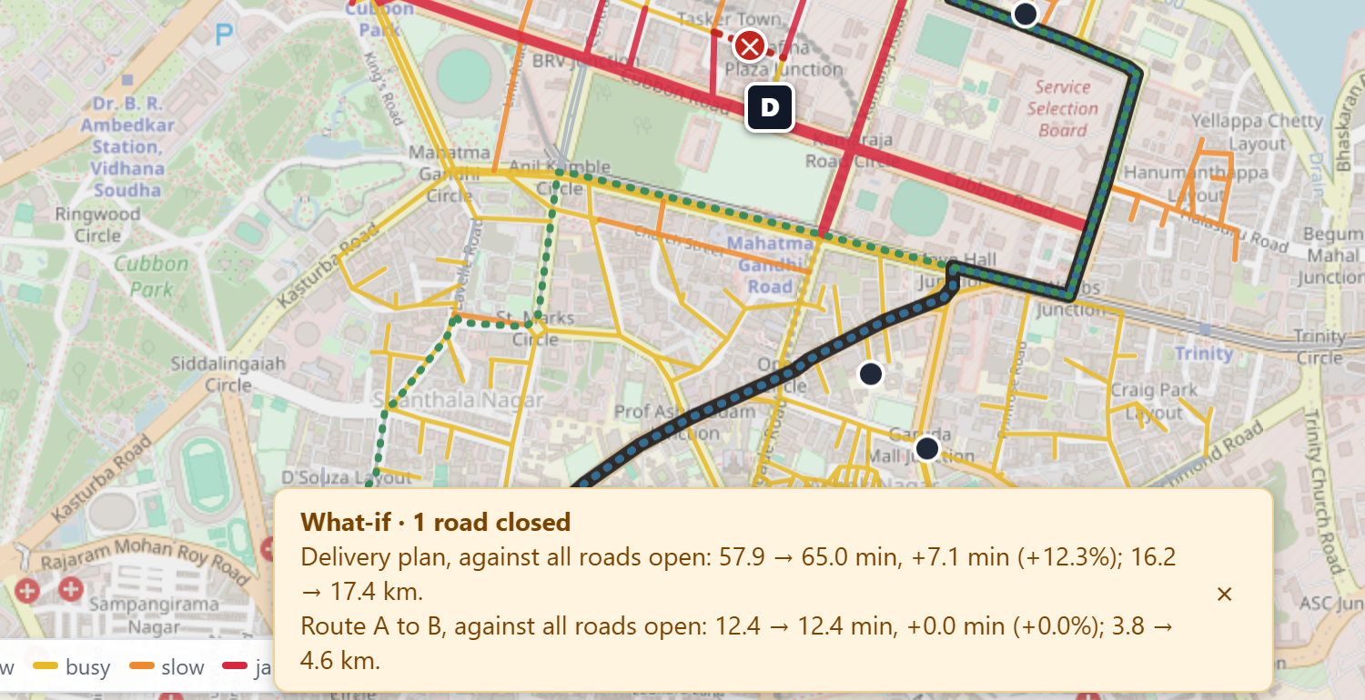



IMPACT AND BENEFITS
Your Team Name
Potential impact on the target audience
Why traffic-aware planning matters (measured in the prototype)
Delivery and logistics fleets
Plans that see traffic and van capacity, and an answer to "what if this road closes?" in seconds.
72 to 103% longer
The same 15-stop job under recorded evening traffic on MG Road, against free flow (12 random draws, mean 93%).
32 to 60% longer
The same job under simulated rush hour on a synthetic map (12 random draws, mean 51%).
City traffic and transport authorities
A way to test closures and congestion on a real road network before they happen.
6 to 7% fewer km
Asking only for the fewest kilometres saves that distance but adds 13 to 15% driving time and about 60% more congestion delay (30 and 60 stops).
Researchers and students
A reproducible test bench for quantum-inspired optimization, with the mathematics written out.
A third of stops late
when time windows are ignored. Pricing lateness puts vans on time for 26 to 36% more driving.
Benefits of the solution (social, economic, environmental, etc.)
Economic
Environmental
Social
Fewer van-minutes and kilometres
Capacity-checked plans
Every choice priced in real minutes and km
Less driving, less idling in jams
Congestion delay is reported for every plan
More reliable delivery times
Quicker, better-informed reaction to closures and incidents
Next: custom road-network upload, hard time windows, mixed fleets, live incident feeds.
One road closed on the MG Road plan: 57.9 to 65.0 min (+12.3%), compared with the same plan with every road open.

Slide 6



RESEARCH AND REFERENCES
Your Team Name
Details / Links of the reference and research work
Live prototype
https://quantum-inspired-route-optimizer.onrender.com
Source code and docs
[add your GitHub link]
Demo video
[add your video link]
Our experiment | What we measured
QPSO vs classical PSO, 20 to 50 stops, 3 PSO parameter sets, 30 instances each | Raw output 13.6 to 28.1% cheaper. QPSO wins 21 to 30 of 30 in every setting and reaches PSO's final quality in about 1/8 of the iterations at 20 stops, 1/4 at 30 and 1/2 at 50.
150 small problems (10 to 16 stops) with a computed exact optimum | Route search option: optimal on 150 of 150. Default QPSO pipeline: 1.5 to 3.6% above the optimum on average.
22 standard CVRPLIB instances, 100 to 199 customers, proven optima | Route search option: 2.9% above optimal after 10 s and 1.5% after 2 min. OR-Tools after 60 s: 5.5%.
Shortest path, 4 map sizes, 50 pairs each | Dijkstra is exact in under 1 ms. QPSO, PSO and GA find the exact route on 78 to 90% of pairs on a 40-intersection map, 42 to 44% on a 300-intersection map.
Note: on 100 to 199 customers the default QPSO pipeline averaged 10.2% above optimal, which is why the platform also offers the route search for large problems (docs/BENCHMARKS.md, Finding 14). All figures are from our own runs; setups and result files are in the repository.
Mean over 30 random instances per bar. PSO sets A, B and C are three classical parameter settings. All 9 differences are significant (p at most 0.02).
References
Sun, Feng, Xu (2004). Particle swarm optimization with particles having quantum behavior. IEEE CEC.
Kennedy, Eberhart (1995). Particle swarm optimization. IEEE ICNN.
Bean (1994). Genetic algorithms and random keys for sequencing and optimization. ORSA J. Computing.
Prins (2004). A simple and effective evolutionary algorithm for the vehicle routing problem. Comput. Oper. Res.
Vidal (2022). Hybrid genetic search for the CVRP: open-source implementation and SWAP* neighborhood. Comput. Oper. Res.
Uchoa et al. (2017). New benchmark instances for the capacitated vehicle routing problem. EJOR.
Held, Karp (1962). A dynamic programming approach to sequencing problems. J. SIAM.
Boeing (2017). OSMnx: new methods for acquiring, constructing, analyzing, and visualizing complex street networks. Comput. Environ. Urban Syst.
Data and tools: OpenStreetMap (ODbL), TomTom Traffic Flow API, Google OR-Tools.

