Slide 1

Shree Shambhubhai V. Patel College of Computer
Science and Business Management
DocEase
Subject: 501-01 (Advanced Mobile Designing) OF
T.Y.B.C.A. (Sem-5)
SUBMITTED BY:
GUIDED BY:
Utsav N. Dudhat
H.O.D Prof. Riddhi Joshi

Slide 2
Contents
Introduction
Objectives
System Flow Diagram
DFD
ER Diagram
System Design

Slide 3
Introduction
DocEase Application is a system designed primarily for use easy online doctor appointment management application.
This system is fully responsive or mobile friendly and have a good-looking user interface.
DocEase Application have contained two panels:
Doctor Panel
Patient Panel

Slide 4
Doctor Panel
Doctor can register itself with an appropriate field.
Doctor can login with valid credentials.
Doctor can update his / her profile.
Doctor can view his / her appointments with his / her patients.
Doctor can confirm the appointments.

Slide 5
Patient Panel
Patient can register itself with an appropriate field.
Doctor can login with valid credentials.
Patient can update his / her profile.
Patient can view all doctors which are register at doctor panel.
Patient can appoint doctor easily.
Patient can view his / her appointments.

Slide 6
Objectives
Our DocEase app offers convenient booking, reducing phone calls and simplifying appointments.
It enhances access to various healthcare providers, especially in underserved areas, with real-time availability and minimized clinic wait times.
Additionally, it enables secure patient information management, including medical records, for seamless sharing with healthcare professionals.

Slide 7
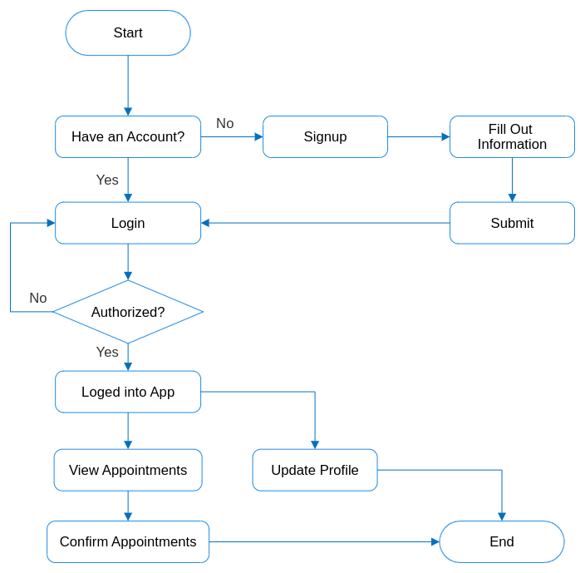
System Flow Diagram
This Diagram is displayed the flow of Doctor side system flow.
This describe how the doctor side app work.

Slide 8
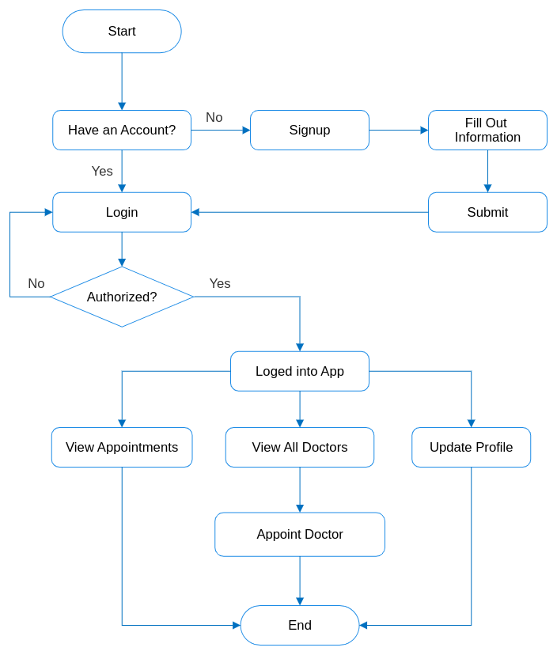
System Flow Diagram
This Diagram is displayed the flow of Patient side system flow.
This describe how the patient side app work.

Slide 9
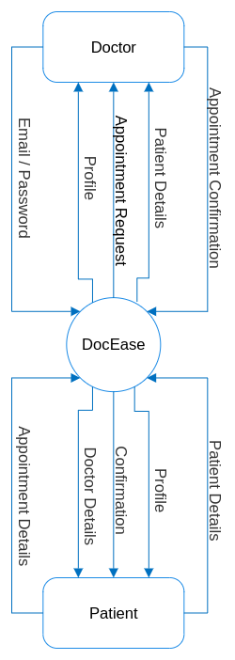
DFD/UML Diagram
This Diagram is context level DFD of DocEase.

Slide 10
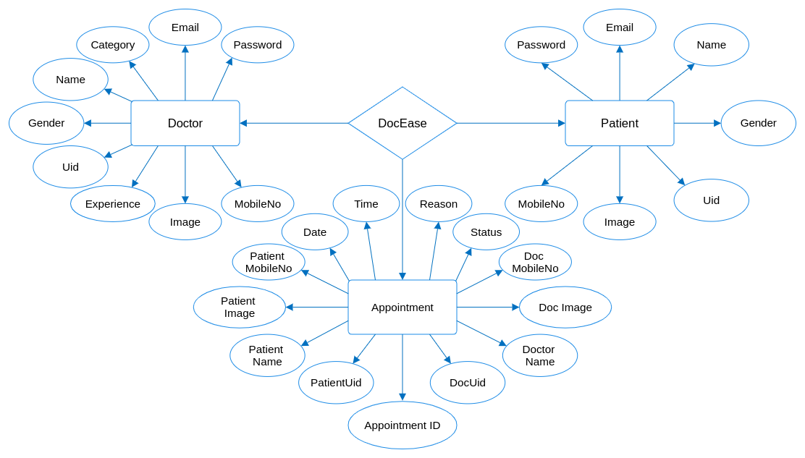
ER Diagram
This diagram show the data flow and connections within our DocEase App.

Slide 11
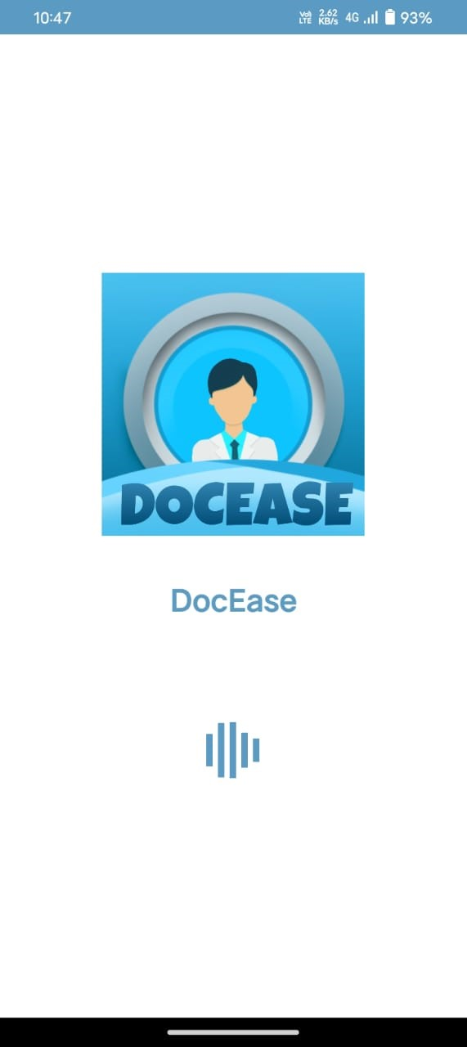
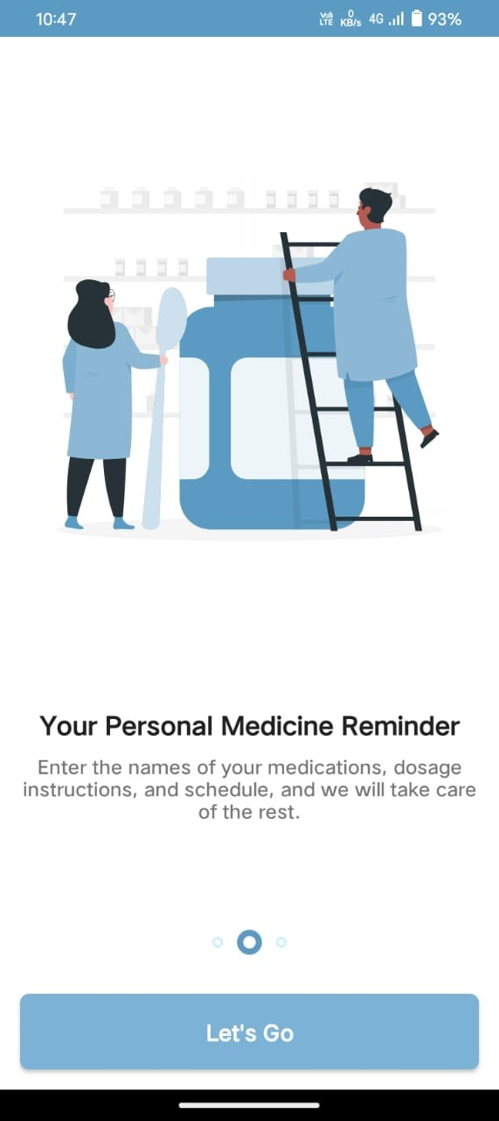
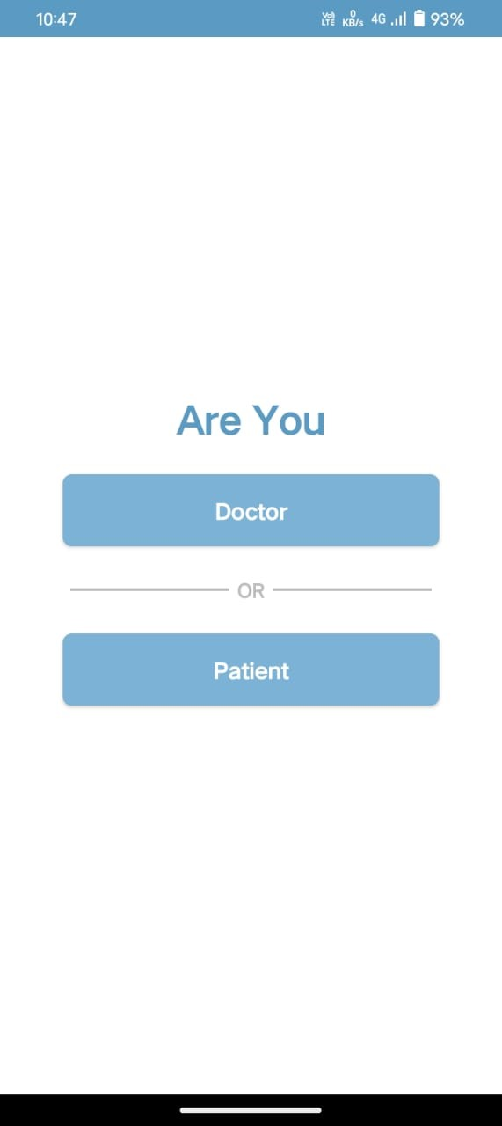
System Design
Splash Screen
Role Screen
Onboarding Screen

Slide 12
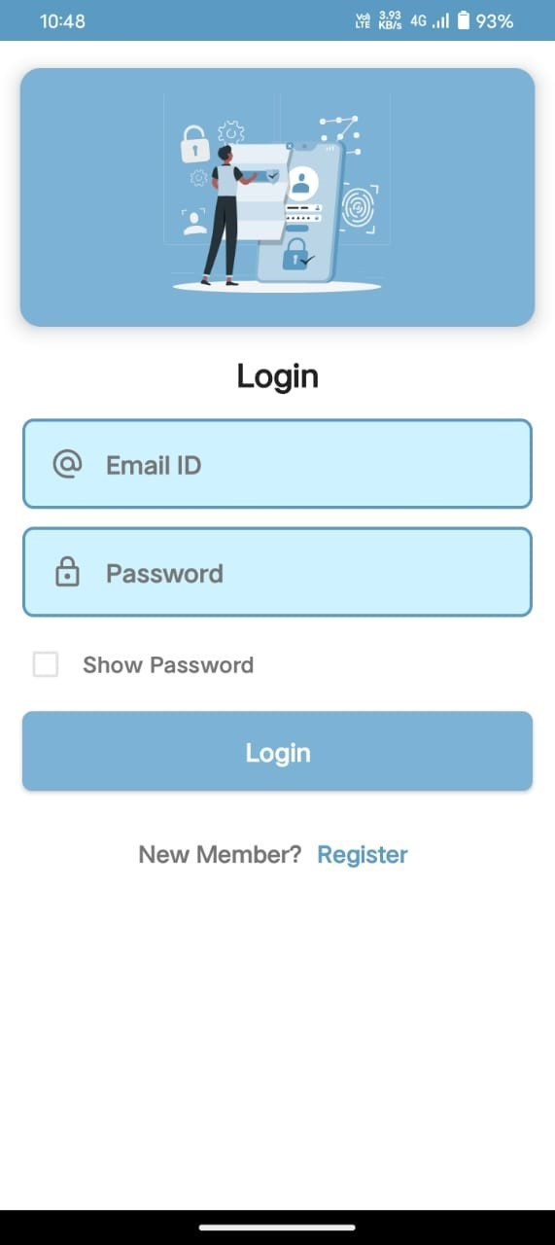
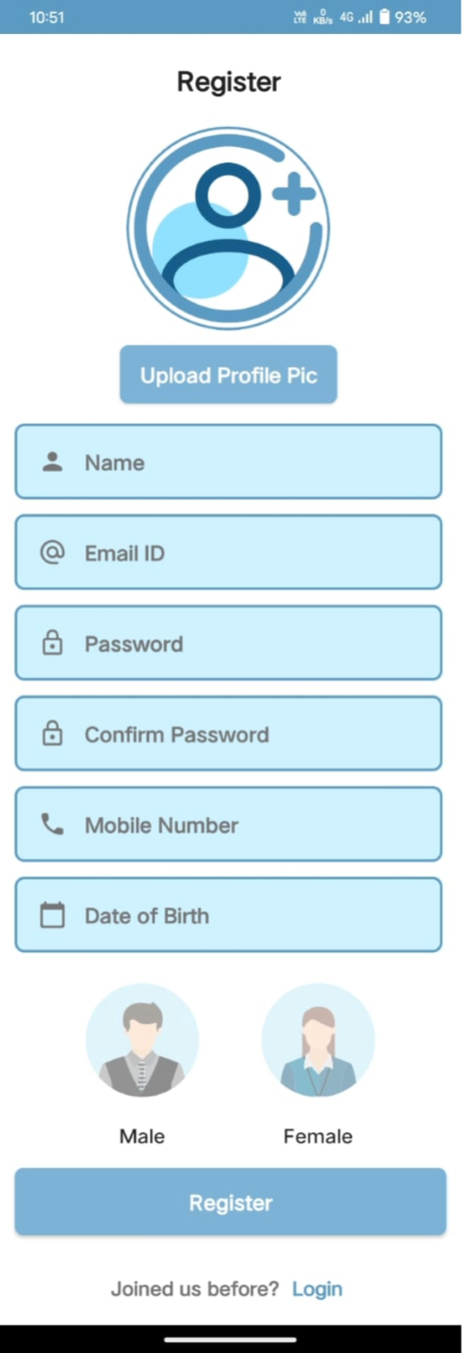
Patient Side App
Login Screen
Registration Screen

Slide 13
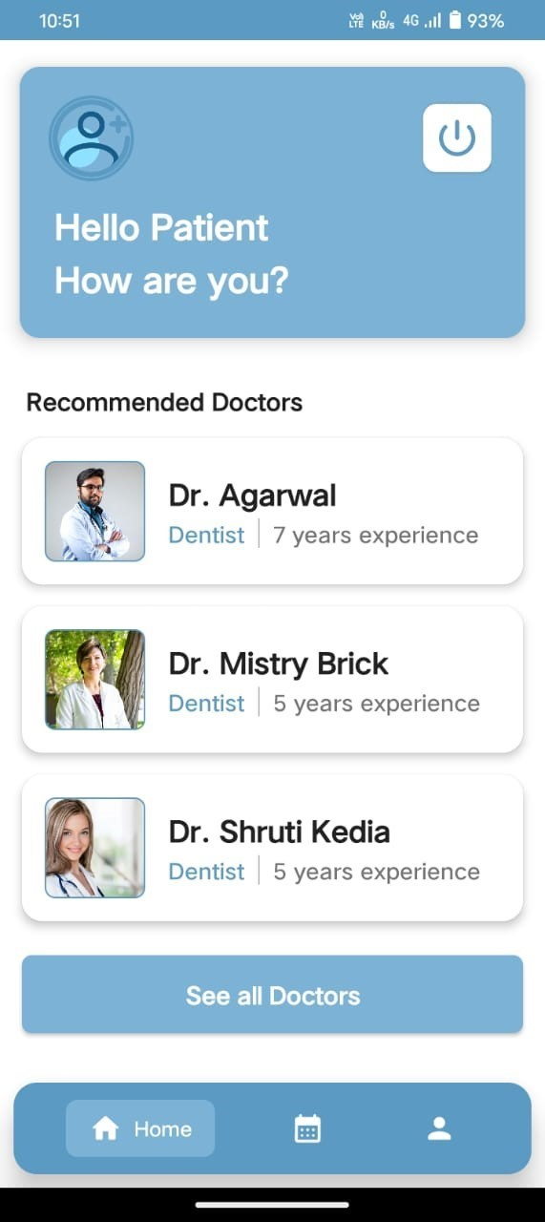
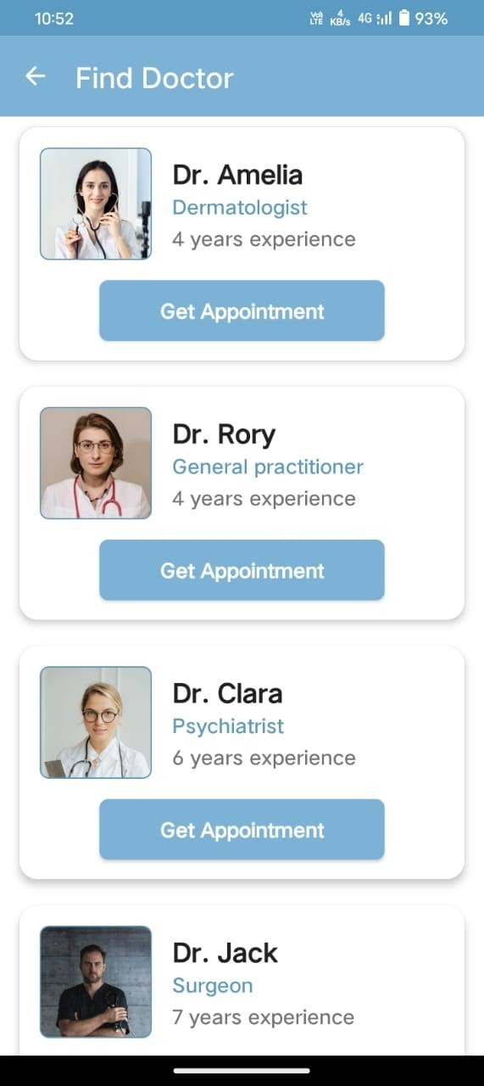
Home Screen
All Doctor Screen

Slide 14
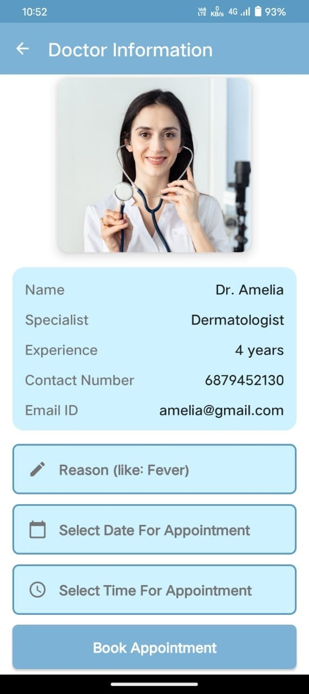
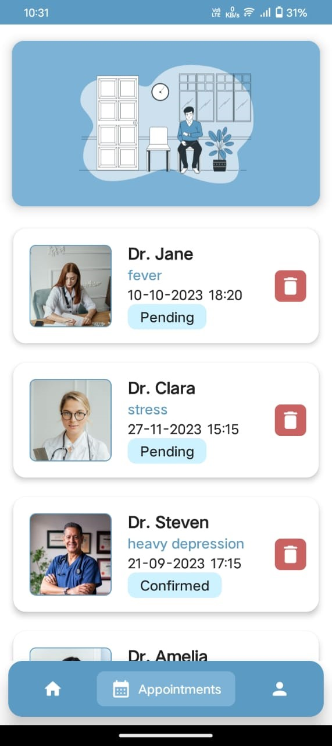
Book Appointment Screen:
All Appointments Screen

Slide 15
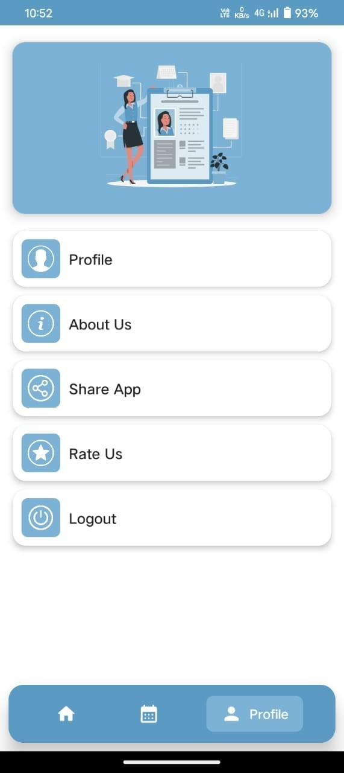
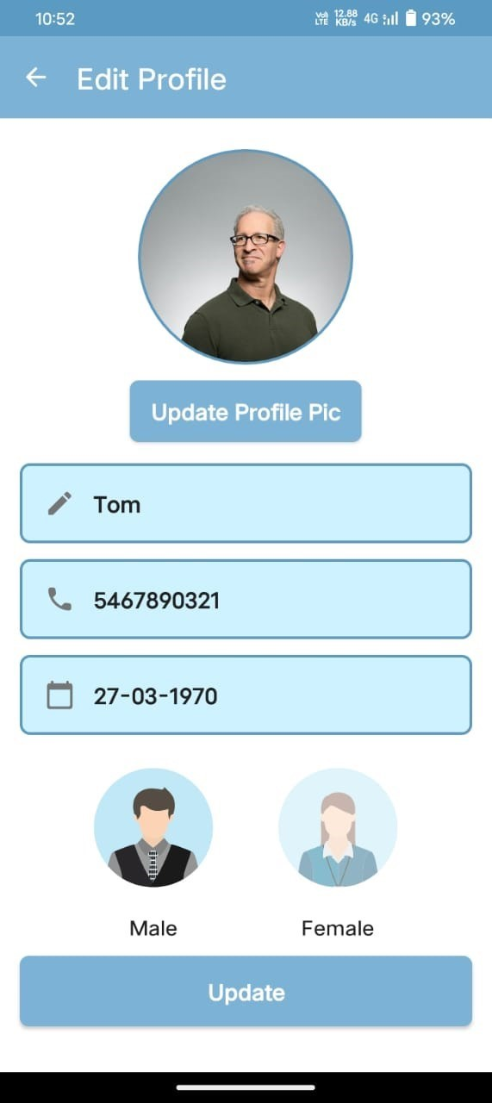
Profile Screen:
Update Profile Screen

Slide 16
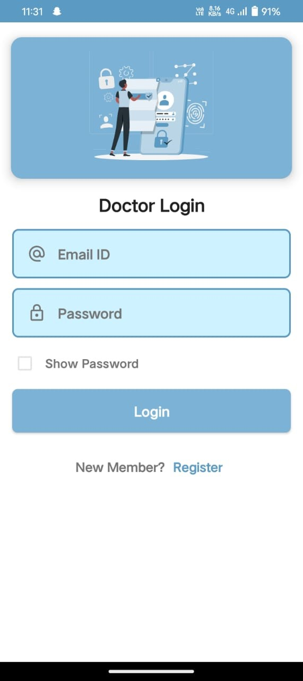
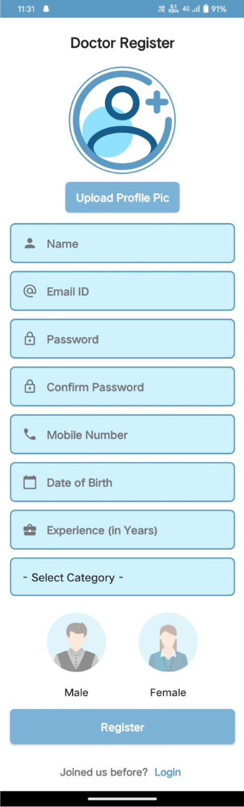
Doctor Side App
Login Screen
Registration Screen

Slide 17
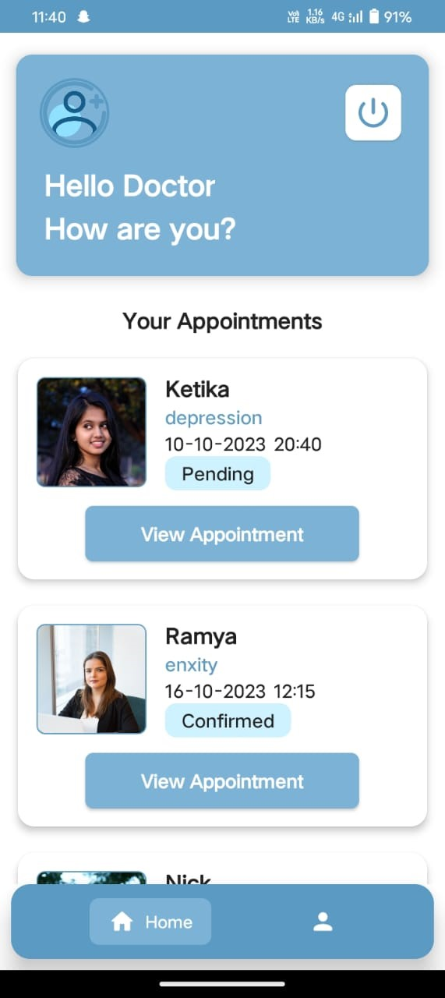
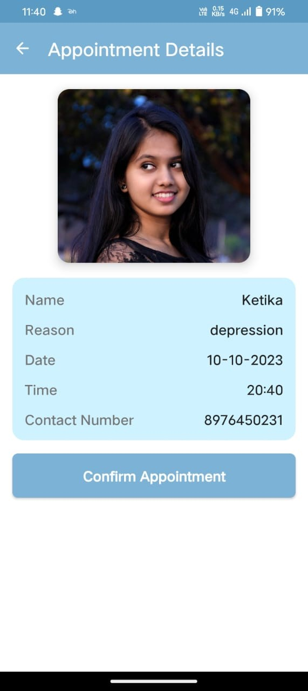
Home Screen:
Pending Appointment Screen

Slide 18
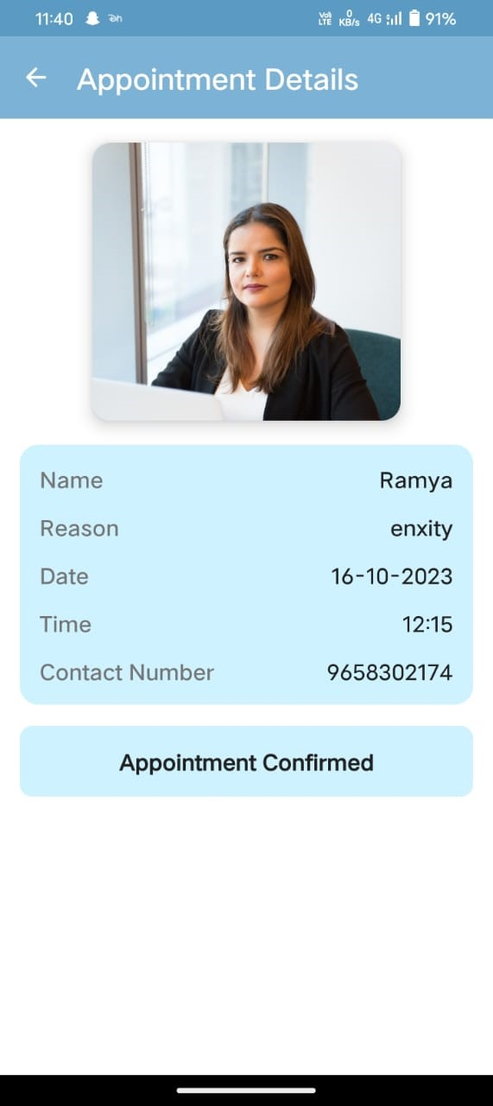
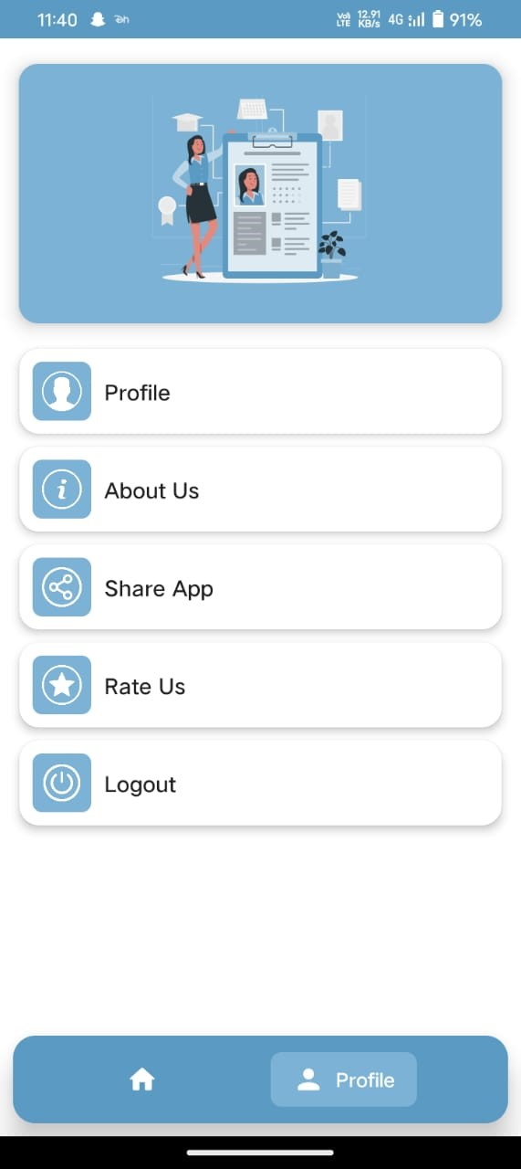
Confirmed Appointment Screen:
Profile Screen

Slide 19
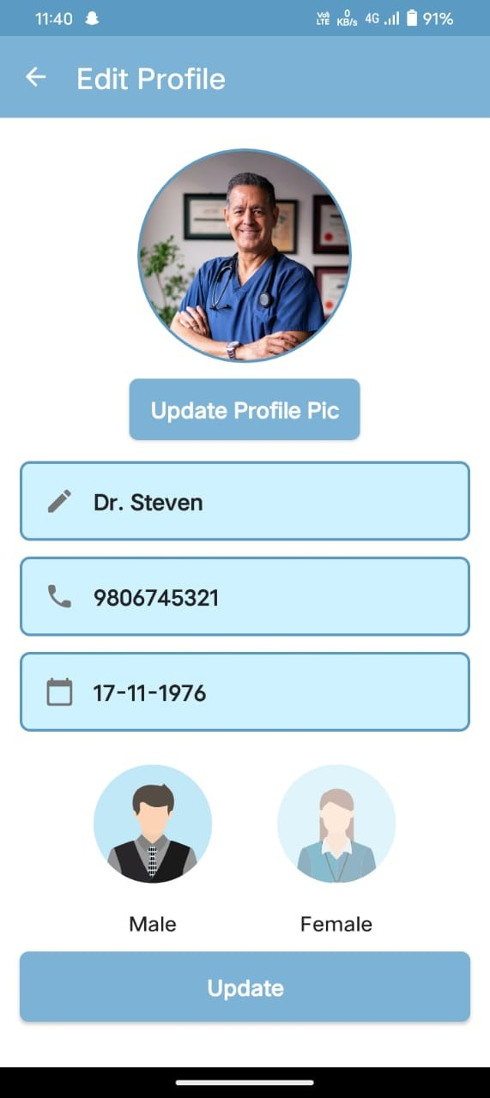
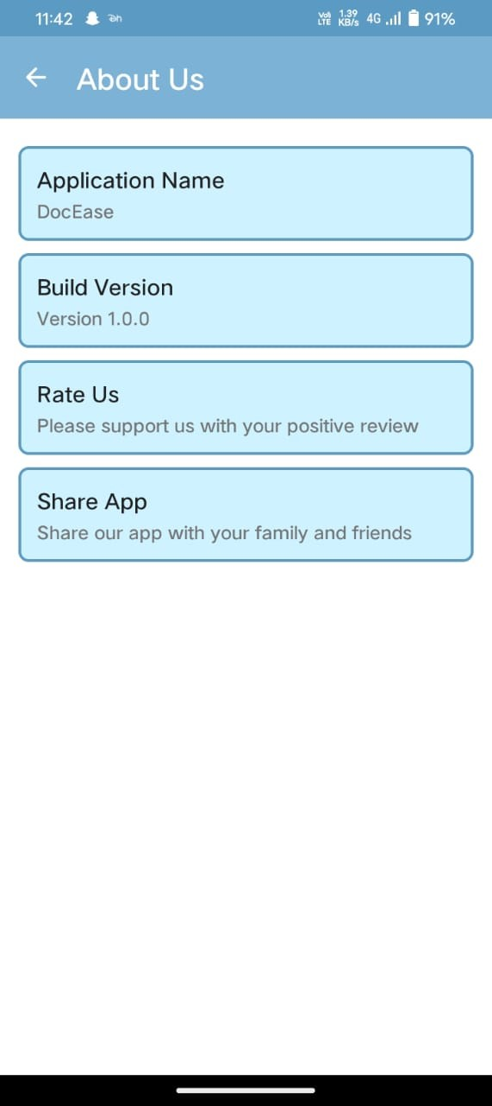
Update Profile Screen:
About Us Screen

Slide 20
References
https://firebase.google.com/docs
https://developer.android.com/docs
https://github.com/
https://stackoverflow.com/
https://www.behance.net/

