Slide 1




SMART INDIA HACKATHON 2026
TITLE PAGE
  Problem Statement ID –
  Problem Statement Title-
  Theme- Disaster Management
  PS Category- Software
  Team ID-
  Team Name- GeoGuardians
Blackout Emergency
Coordinator

Slide 2
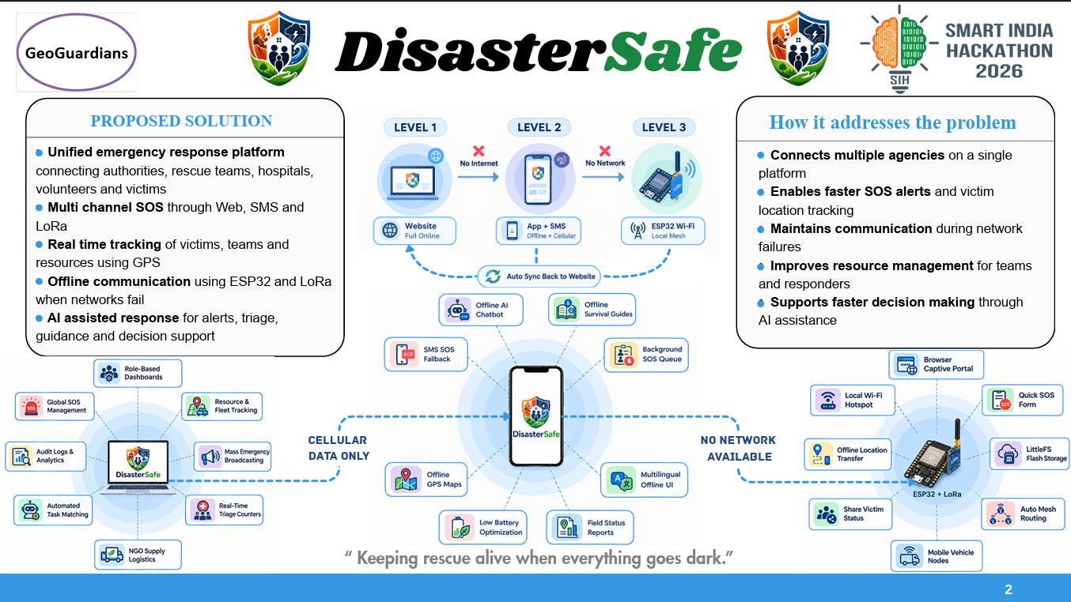

Slide 3


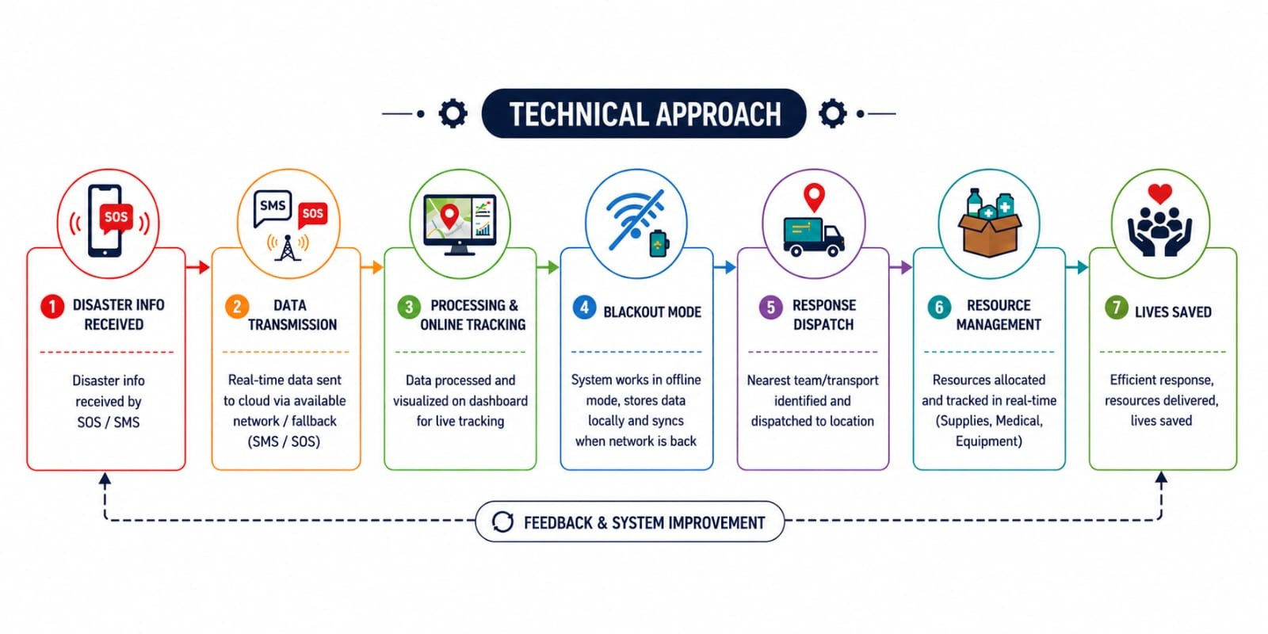


TECHNICAL APPROACH
Team
GeoGuardians
LEVEL 1 🌐 ONLINE
LEVEL 2 📶 SEMI-ONLINE
LEVEL 3 📡 OFFLINE
Languages: JavaScript / TypeScript • Python
Frontend: React / React Native
Backend: Node.js / PHP • REST API
Data & Connectivity: MySQL • GPS/Maps • WebSockets • Live APIs
AI: LLM + RAG • Recommendation Engine
Languages: JavaScript / TypeScript
Mobile: React Native
Backend: Node.js / PHP • REST API
Data: Local/Emergency Database
AI: Quantized LLM • Local RAG
Languages: C / C++ • HTML / CSS / JavaScript
Hardware: Arduino Core / ESP-IDF
Local Server: ESPAsyncWebServer
Storage: LittleFS
Communication: RadioHead / LoRaWAN Mesh
OFFLINE
3
Notes:
3

Slide 4
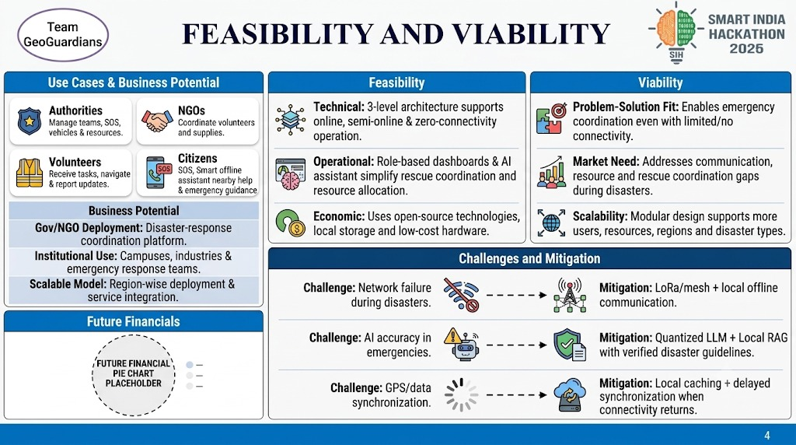

Slide 5
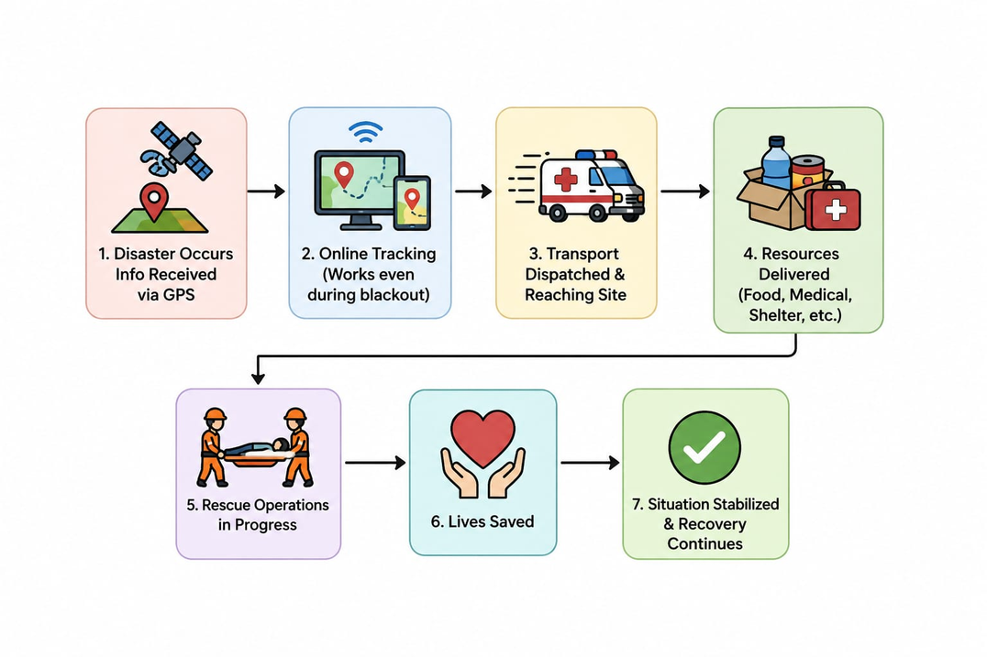

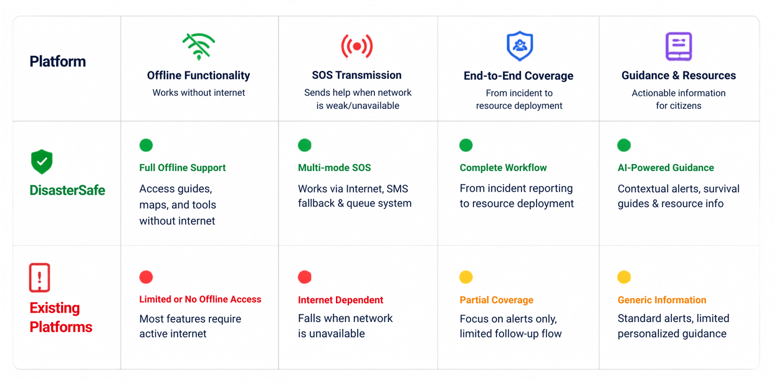
IMPACT AND BENEFITS
Team
GeoGuardians
Potential Impact
on Target Audience
Benefits of the Solution
🌐 Social: Faster rescue, better coordination & improved public safety.
💰 Economic: Reduces resource wastage, response costs & operational delays.
🌱 Environmental: Optimizes resource/vehicle deployment and reduces unnecessary movement.
🚑 Emergency Response: Faster SOS handling, live tracking & smart resource allocation.
📡 Connectivity: Continues functioning in online, semi-online & zero-connectivity zones.
🤖 Technological: AI-assisted decisions, offline intelligence & scalable architecture.
Offline
🎯 Victims / Citizens: Faster SOS response, nearby help, shelters & emergency guidance.
🚒 Authorities: Better team, vehicle and resource allocation with live tracking.
🤝 NGOs: Efficient volunteer and resource coordination across affected areas.
🦺 Volunteers: Clear task assignments, navigation and real-time field reporting.
SOS/SMS
Offline AI assistance
5
5
Notes:
5

Slide 6
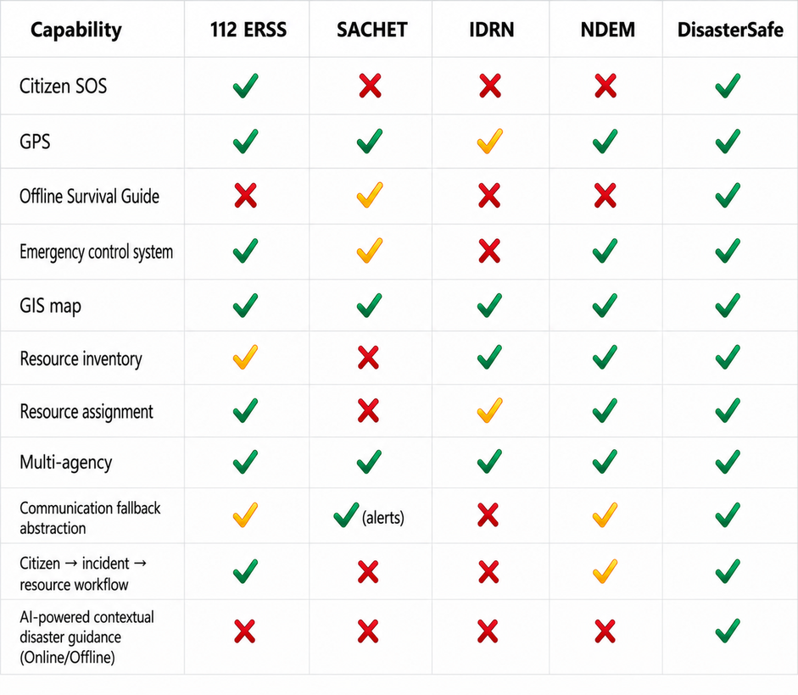


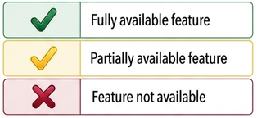



RESEARCH AND REFERENCES
Team
GeoGuardians
Crowdsourced Disaster Management — Citizen Data via Mobile Devices
RescueRing — Disaster SOS, Mapping, Volunteers & Resources
Cicek & Kantarci (2023) — Crowdsensing in Disaster Management: Review & Challenges
https://github.com/arpith20/Disaster-Management-Using-Crowdsourcing
https://github.com/RescueRing
https://www.mdpi.com/1424-8220/23/3/1699
Key Research
Insights
GPS-Based Disaster Reporting: Location-aware incident reporting.
Link - https://www.sciencedirect.com/science/article/pii/S2590061719300523
GIS-Based Disaster Management: Incident sharing & responder coordination.
Link - https://www.sciencedirect.com/science/article/abs/pii/S0268401219311296
Pocket RAG: Offline AI for emergency guidance.
Link - https://arxiv.org/abs/2602.13229
Existing Government
Platforms
112 ERSS: Emergency reporting and response
SACHET: Geo-targeted disaster alerts & safety information
IDRN: Disaster-resource inventory and availability
Our System: Offline-first access, GPS SOS, offline AI guidance & incident queuing, with online synchronization for coordinated response.
6
Notes:
6

