Slide 1

COLLECTION LIBRARY AND CONTEXT MANAGERS
-- In PYTHON
By:
Utsav Mehta

Slide 2
Collection Library

Slide 3
Basics:
What is a module?
A module in Python is simply a collection of functions and global variables written in Python. The file containing this set of statements has a .py extension.
What is a Library?
A library is a set of MODULES combined under a common name.
What is an Object?
Everything is in Python treated as an object, including variable, function, list, tuple, dictionary, set, etc.

Slide 4
What are Containers?
A Container is an object that is used –
to store different objects
provide a way to access the contained objects
iterate over them
Some of the built-in containers are etc.
(tuple,)
[list]
{dict : ionary}

Slide 5
What is collection module?
The collection Module in Python is a built-in module that provides different types of containers.
Python collections module was introduced to improve the functionalities of the built-in collection containers like lists, dictionary etc.
They help in reducing the amount of code and are more time efficient.

Slide 6
Having said all that, the containers provided by collection module are --
Counters (modification of dictionary)
OrderedDict (modification of dictionary)
DefaultDict (modification of dictionary)
ChainMap (modification of dictionary)
DeQue (modification of list)
UserDict (modification of dictionary)
UserList (modification of list)
UserString (modification of strings)
NamedTuple (modification of Tuple)

Slide 7
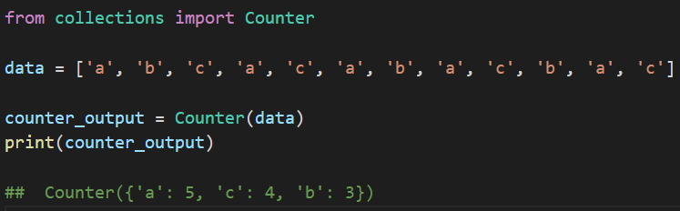
Briefs:
Sample code for Counters:
Counters:
A counter is a sub-class of the dictionary. It is used to keep the count of the elements in an iterable in the form of an unordered dictionary where the key represents the element in the iterable and value represents the count of that element in the iterable.
ChainMap
A ChainMap encapsulates many dictionaries into a single unit and returns a list of dictionaries.
Deque:
Deque (Doubly Ended Queue) is the optimized list for quicker append and pop operations from both sides of the container. It provides O(1) time complexity for append and pop operations as compared to list with O(n) time complexity.

Slide 8
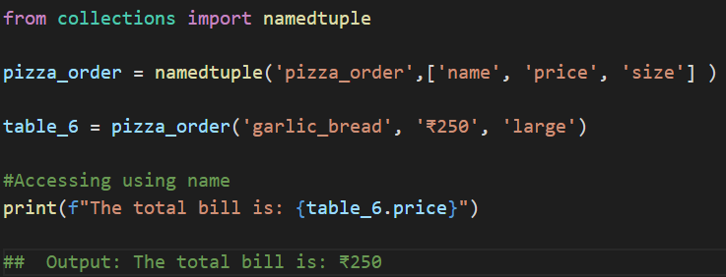
Briefs:
Sample code for namedtuple:
NamedTuple
A NamedTuple returns a tuple object with names for each position which the ordinary tuples lack.
For example, consider a tuple names pizza_order.
Suppose for calling price instead of remembering the index position you can actually call the element by using the price argument, then it will be really easy for accessing tuples element.
UserDict, UserList, UserString
They act as wrappers around the basic data types and are used to provide some additional functionality to them.
DefaultDict
A DefaultDict is also a sub-class to dictionary. It is used to provide some default values for the key that does not exist and never raises a KeyError.

Slide 9

The containers in the Collections module can be really useful for business-level projects and models and can add soo much extra usability to generic python containers, with higher optimization and execution speed.
Conclusion:
COLLECTION MODULES

Slide 10
Context Managers

Slide 11
What are Context Managers?
Context managers allow you to allocate and release resources precisely when you want to.
They help to setup connections to files/networks and once we are done using them for our purpose, they automatically end the connection once our block of code ends.
Thus they make our code optimized and prevent memory leaks.

Slide 12
Why Context Managers?
The primary motivation behind context managers is resource management.
When a program wants to get access to a resource on the computer, it asks the OS for it, and the OS, in turn, provides it with a handle for that resource. Some common examples of such resources are files and network ports.
What's important to understand is that these resources have limited availability, for example, a network port can be used by a single process at a time, and there are a limited number of ports available.
So whenever we open a resource, we have to remember to close it, so that the resource is freed. But unfortunately, it's easier said than done.

Slide 13


What may happen when someone doesn’t use them:
When you open connections and forget to close…
Meanwhile, others:

Slide 14
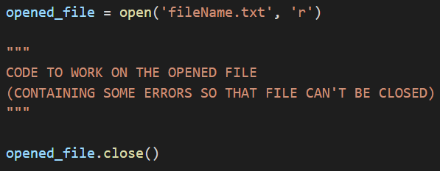
A Simple file-opening-closing code:
Here we are opening a file named readme.txt, reading the file and then when we're done with it, closing the file by calling close().
Now at first glance this might seem okay, but actually, it's not robust at all.
If anything unexpected happens between opening the file and closing the file, causing the program to fail to execute the line containing the close statement, there would be a resource leak.
These unexpected events are what we call exceptions, a common one would be when someone forcefully closes the program while it's executing.

Slide 15
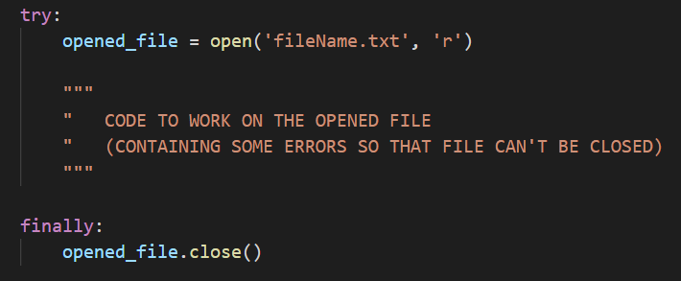
One way to improve the previous code:
Python always makes sure the code in the finally block is executed, regardless of anything that might happen.
This is the way programmers in other languages would handle resource management, but Python programmers get a special mechanism that lets them implement the same functionality without all the boilerplate.

Slide 16
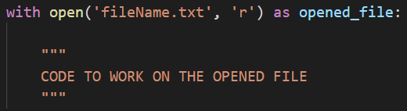
Same code with a context manager:
The most widely used example of context managers is the with statement.
The above code opens the file, writes some data to it and then closes it.
If an error occurs while writing the data to the file, it tries to close it.
The main advantage of using a with statement is that it makes sure our file is closed without paying attention to how the nested block exits.

Slide 17
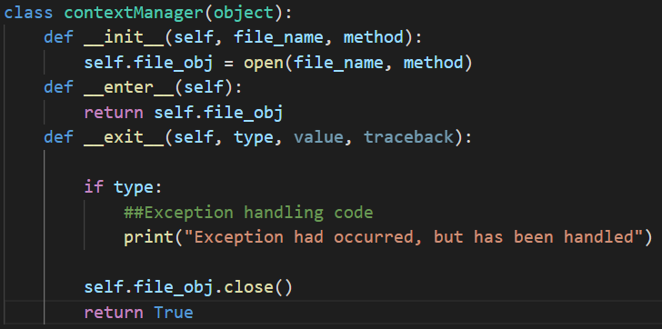
Implementing our own context manager: (as a class)
__enter__ is the method that gets called when we open the resource, or to put it in a slightly more technical way — when we "enter" the runtime context
the __exit__ method contains instructions to properly close the resource handler, so that the resource is freed for further use by other programs in the OS.
Our __exit__ method accepts three arguments. They are required by every __exit__ method which is a part of a Context Manager class.

Slide 18
Let’s talk about what happens under-the-hood:
The with statement stores the __exit__ method of the File class.
It calls the __enter__ method of the File class.
The __enter__ method opens the file and returns it.
The opened file handle is passed to file_obj.
The rest of the code, handling the file, is executed.
The with statement calls the stored __exit__ method.
The __exit__ method closes the file.
Note: type, value, traceback are not used in the code here, but are used for handling exceptions.

Slide 19
Conclusion:
The context manager is usually used in scenarios where resources are used such as opening and closing files, using thread locks, and closing database connections.
It can ensure that used resources are released quickly and effectively improve the security of the program.
CONTEXT
MANAGERS

Slide 20

< THANK YOU >
Any Questions?
Link to the code:
https://github.com/UtsavMehta1902/Collection-module-and-context-managers.git

