Slide 1


2x2 Rubik’s cube solver
-By-
Mohammed Shanouf Valijan Ansari – 2021300004
Utsav avaiya – 2021300005
Allen Andrew – 2021300006
(Se-computer engineering branch-a1 batch)

Slide 2
To be discussed-
Project structure
Data structure used
Incorporation of arrays into the project
Implementation of queues in the project
Overview of the solution generation methodology
Algorithms for the various stages
Example of implementation
Overview of the code implementation

Slide 3
Project structure-
The project was implemented as a web-application
Hyper text markup language(HTML) was used to provide a skeleton to the website
Styling was done through the use of cascading style sheets(CSS)
Pure/Vanilla JavaScript was used for writing the logic of the project
Event listeners were used to handle the input and output of the program

Slide 4
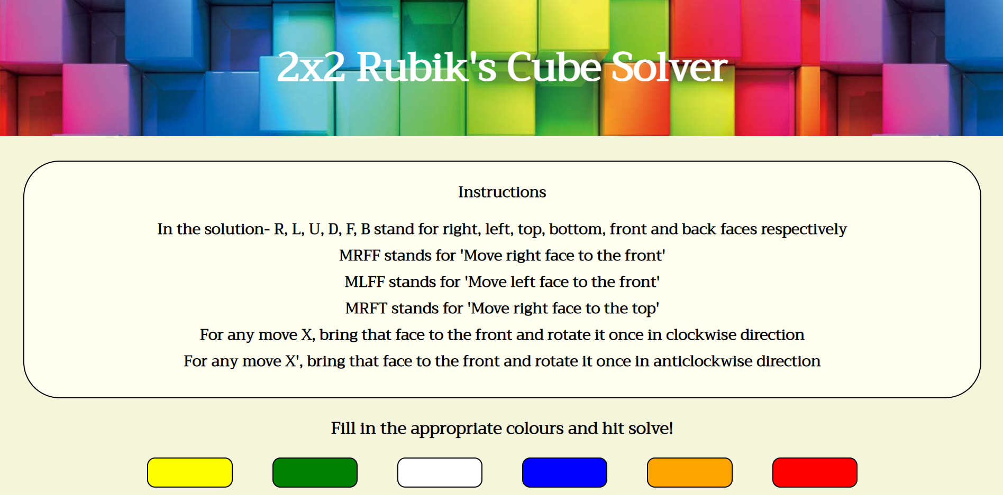
A glimpse of the web-application-

Slide 5
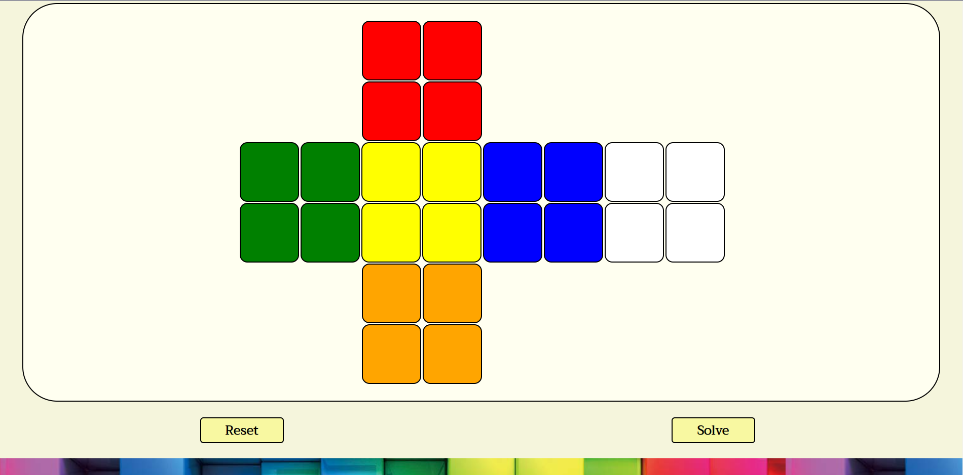
A glimpse of the web-application-

Slide 6
Data structure used-
Queue data structure was used for the implementation of the project
It was used to handle the solution moves of the given scrambled cube input
As a side note, arrays were used to handle the information of the cube

Slide 7
Incorporation of arrays into the project-
Arrays were used to store the colour of each part of each piece of the cube
Using arrays is beneficial as the data set of the cube is fixed
In total, 6 arrays- one for each face, were used
These arrays were updated through out the program so as to reflect the final state of the cube after determination of a solution
They helped in the confirmation of proper solution

Slide 8
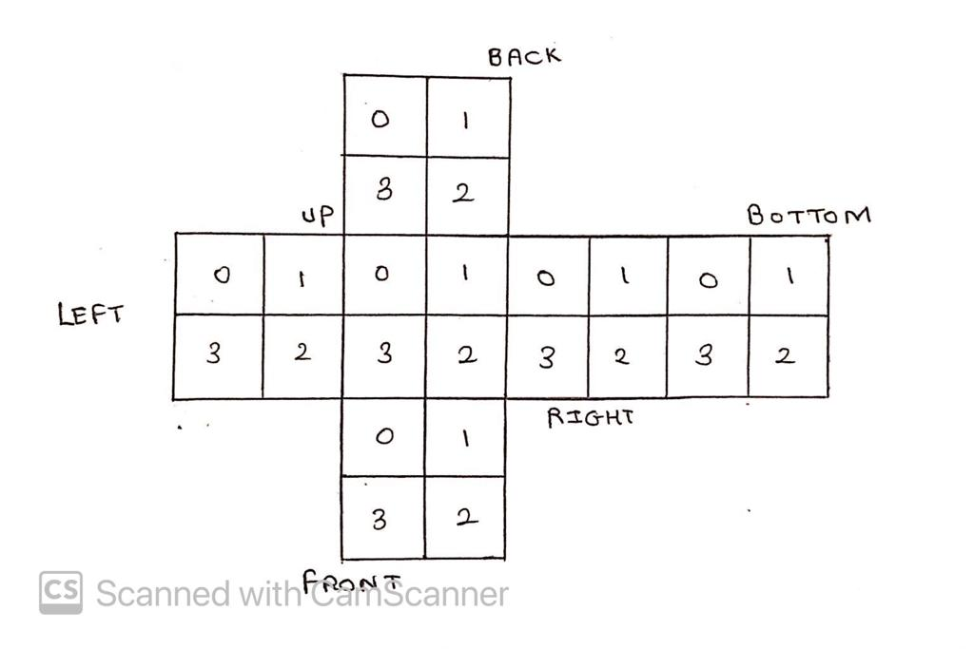
Conceptual view of the arrays used-

Slide 9
Implementation of queues in the project-
Queues were basically used to keep a sequential track of the solution of a particular scrambled cube configuration
They were mainly used in the second and third stage of solution generation
First in first out property of queue helps to maintain an order in the set of moves required to solve a particular configuration

Slide 10
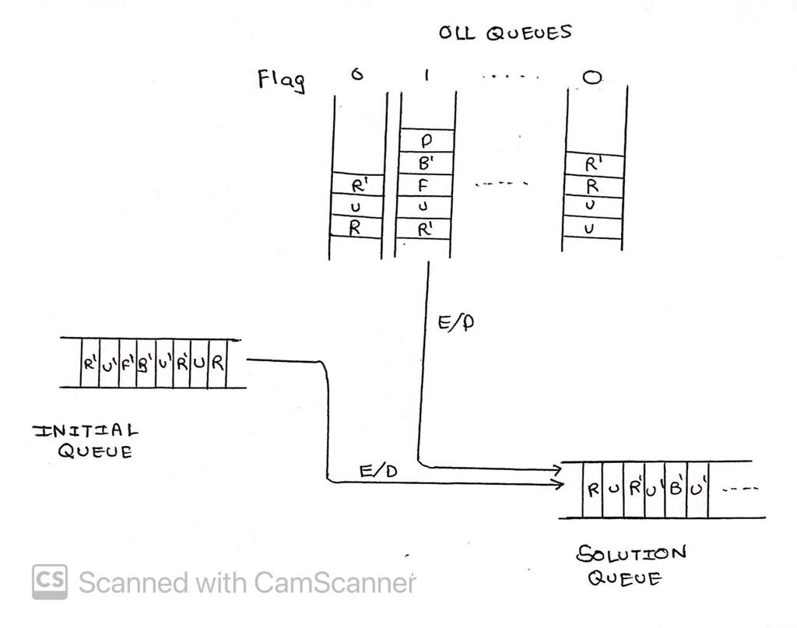
Conceptual view of the queues used-

Slide 11
Overview of the solution generation methodology-
Primarily, move functions were written so as to imitate the changes in the cube configuration when a particular move is performed on the cube
Solution was generated in three stages
Stage-1 dealt with solving the white surface of the cube
Stage-2 dealt with solving the yellow surface of the cube, also known as orientation of the last layer(OLL)
Stage-3 dealt with arranging the pieces of both the layers, also known as permutation of both the layers(PBL), so as to reach the solved configuration

Slide 12
Algorithm for stage-1-
Rotate the base layer till a non-white surface appears at the bottom of the right-front piece of the cube
Search for a piece which contains white surface and bring it directly above the location mentioned in the previous step
Insert it in the provided location
Repeat till the base layer is solved

Slide 13
Algorithm for stage-2-
Check if the yellow surface is solved
If solved, move to the next stage
Else, check for the presence of one of the seven possible patterns of yellow surfaces on the cube and perform the required moves respectively

Slide 14
Algorithm for stage-3-
Check if the cube is already solved
If solved, end the solution generation process
Else, check for the presence of one of the six possible configurations for the last stage and execute the moves required
Repeat till the cube is solved

Slide 15
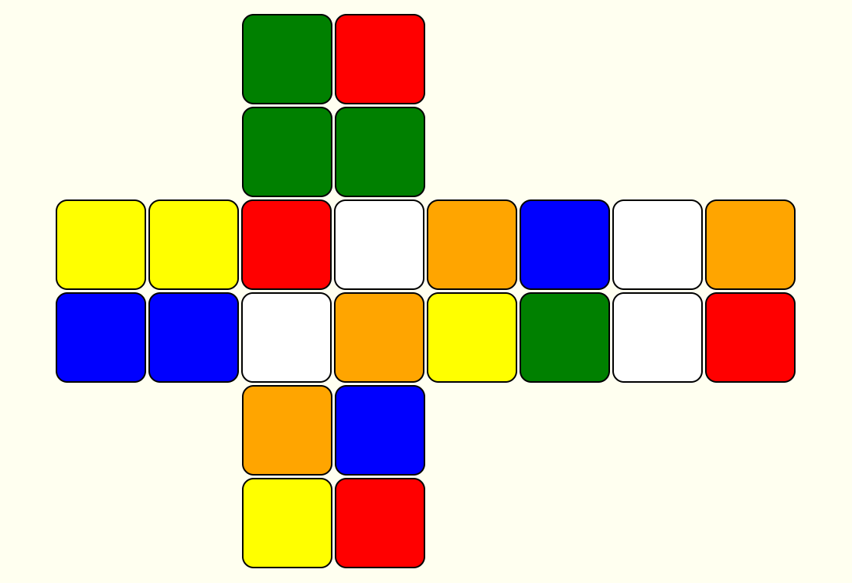
Example of implementation(Scramble)-

Slide 16
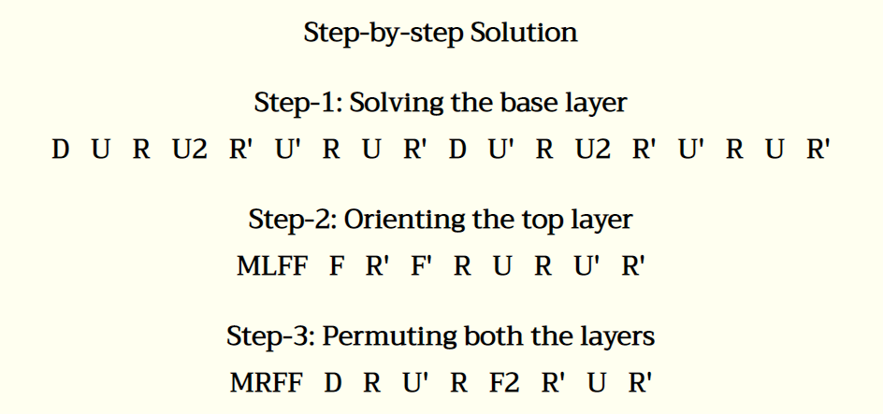
Example of implementation(solution)-

Slide 17
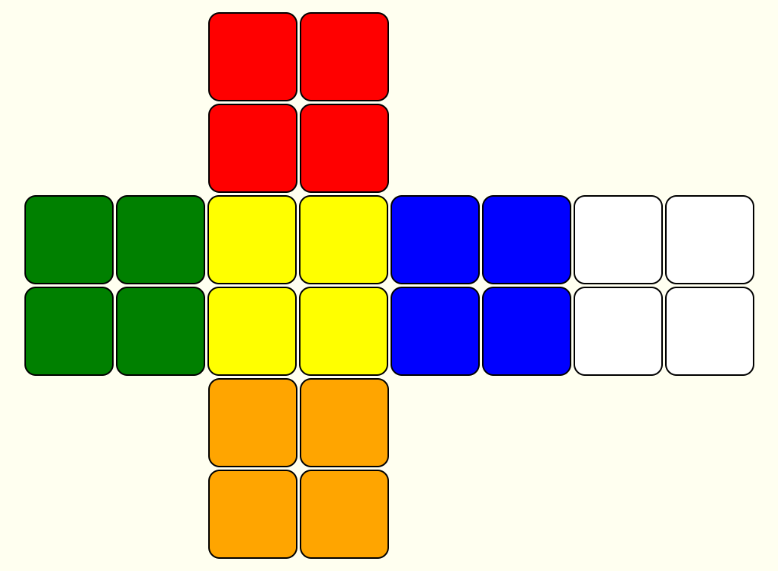
Example of implementation(scramble)-

Slide 18
Example of implementation(solution)

Slide 19
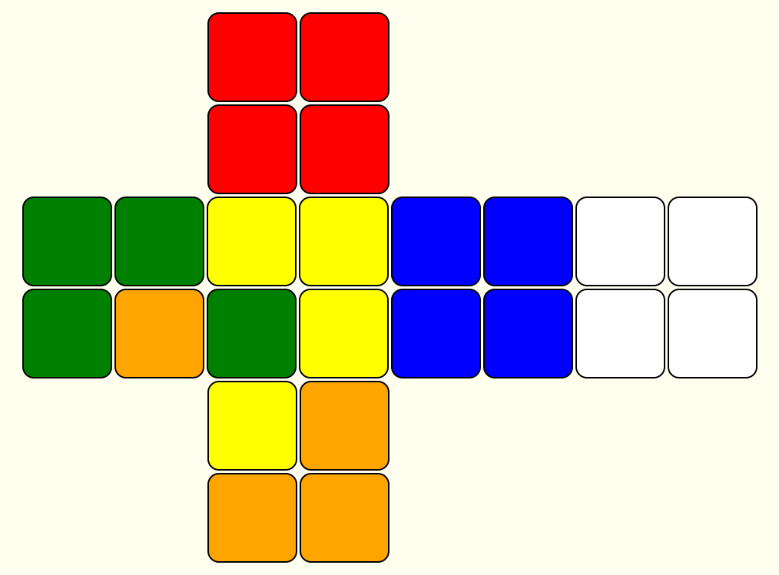
Example of implementation(scramble)-

Slide 20
Example of implementation(solution)

Slide 21
Overview of the code implementation-
Important sections of the HTML file are displayed first
A glimpse of CSS file is displayed further to explain the designing of the web-application
Functions that were written for the logic implementation are included as well, written in JavaScript

Slide 22
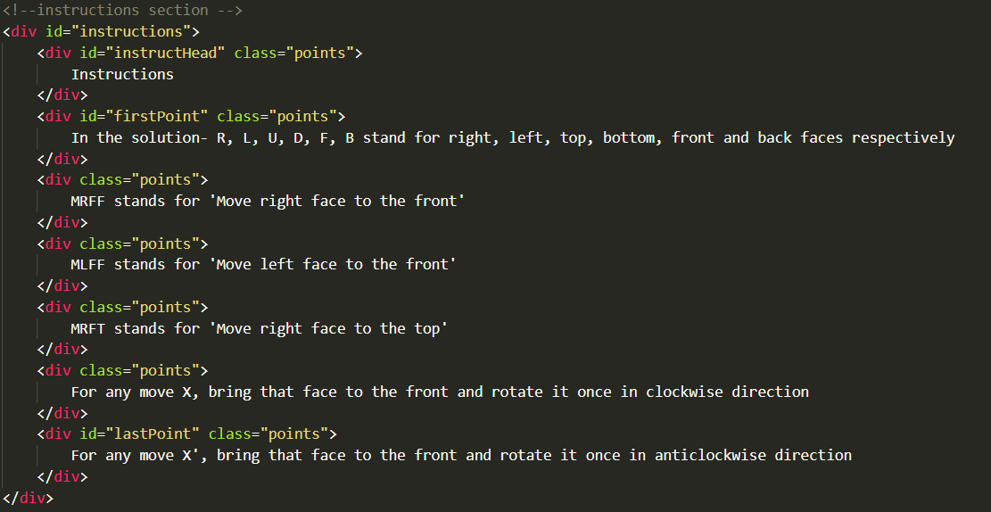
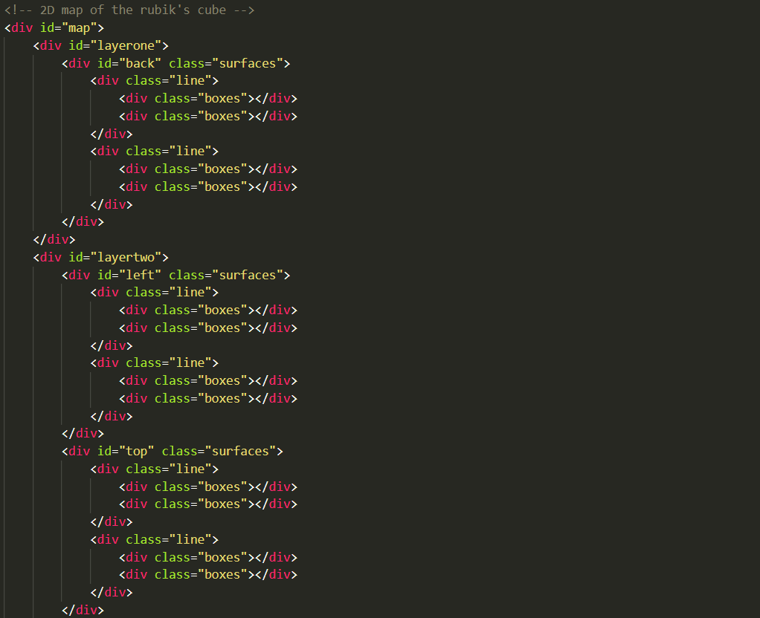
HTML Code for creating the structure of Instruction box and 2d map of the cube-

Slide 23
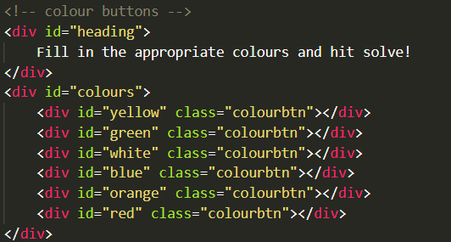
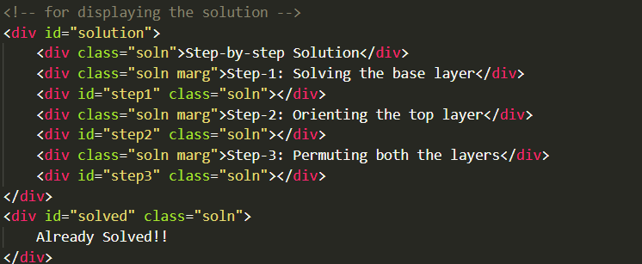
HTML code for creating the structure of colour buttons and solution box-

Slide 24
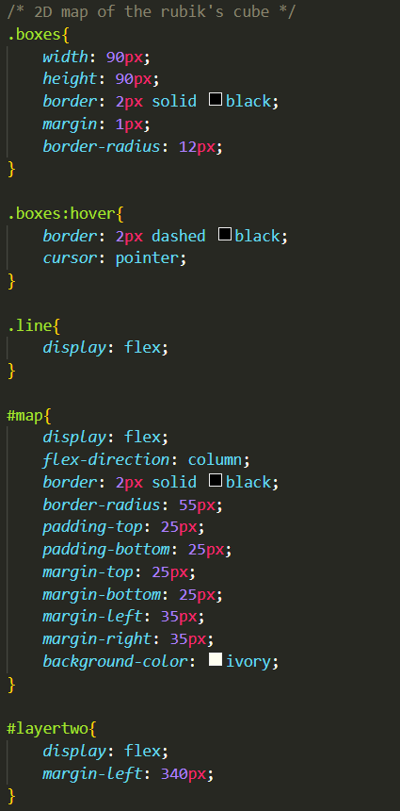
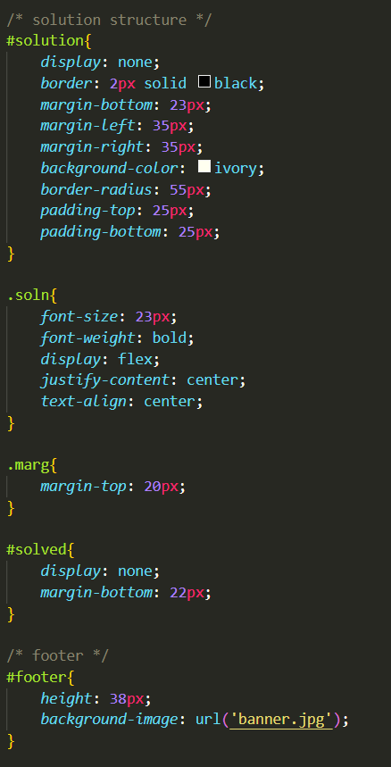
CSS code for designing the 2d map of the cube and solution box-

Slide 25
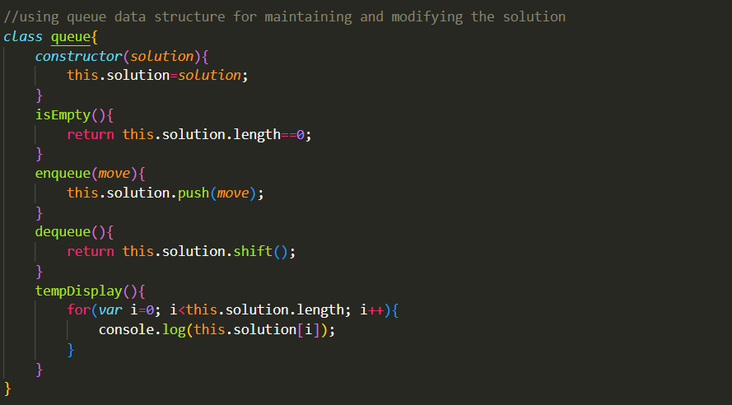
Creating a JavaScript class for queue data structure-

Slide 26
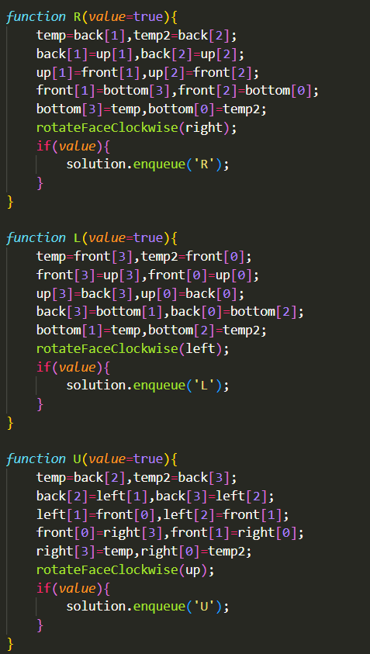
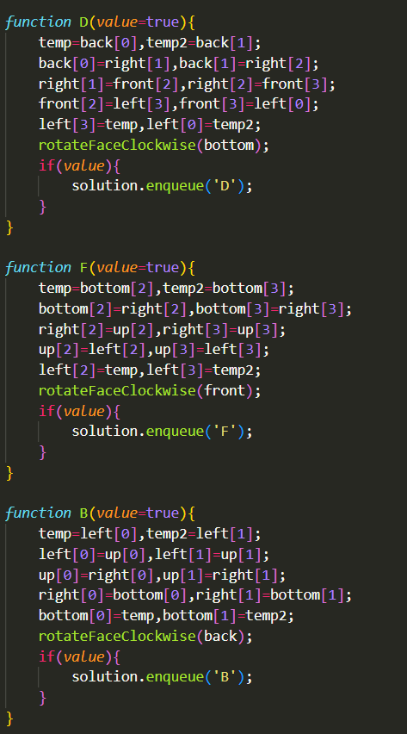
Move functions of the cube-

Slide 27
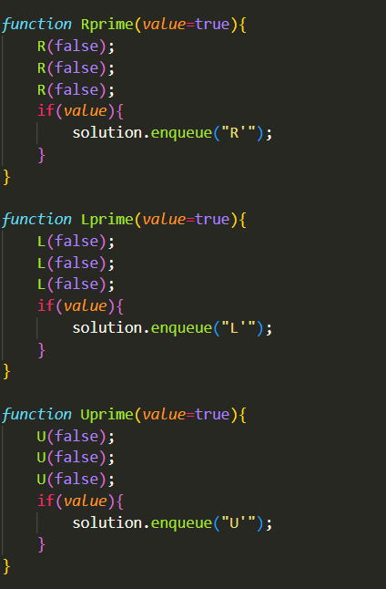
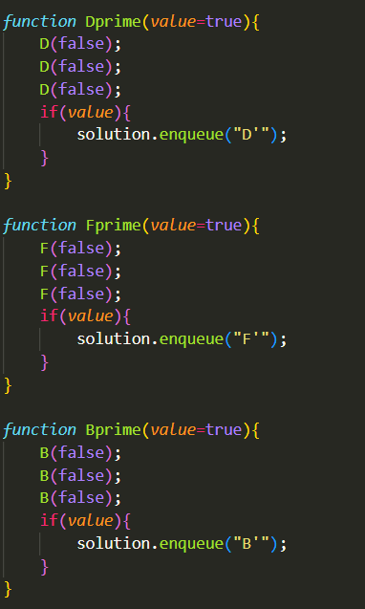
Move functions of the cube-

Slide 28
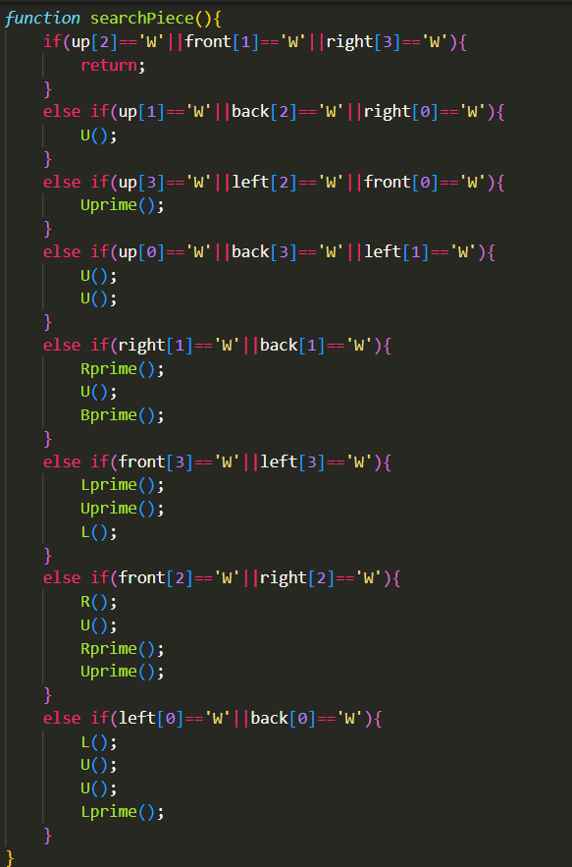
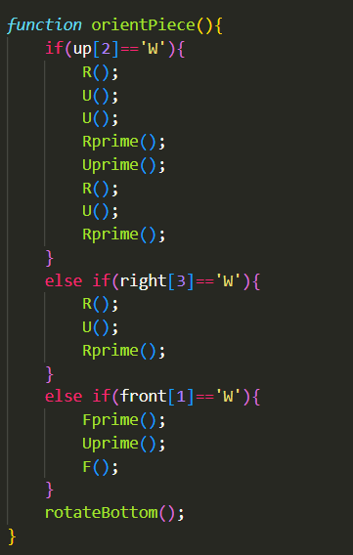
Functions for searching and orienting a piece for stage one solution-

Slide 29
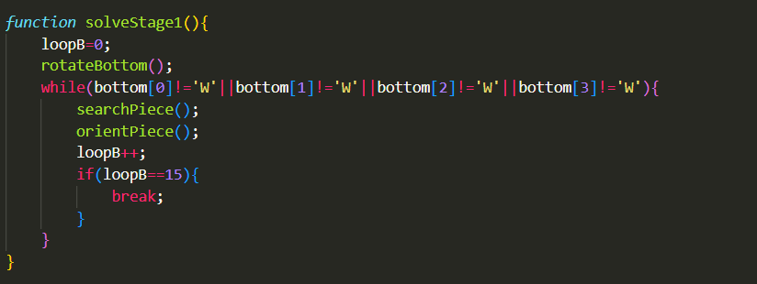
Function for stage one solution-

Slide 30
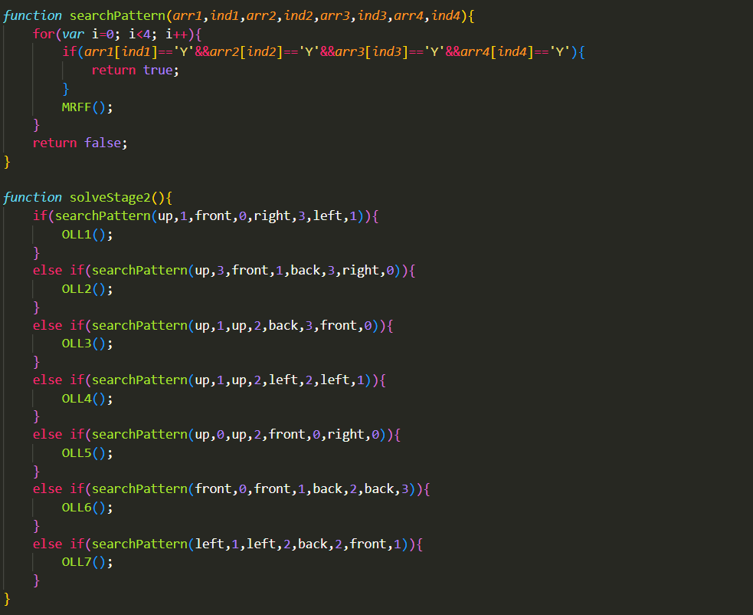
Functions for pattern recognition and stage two solution-

Slide 31
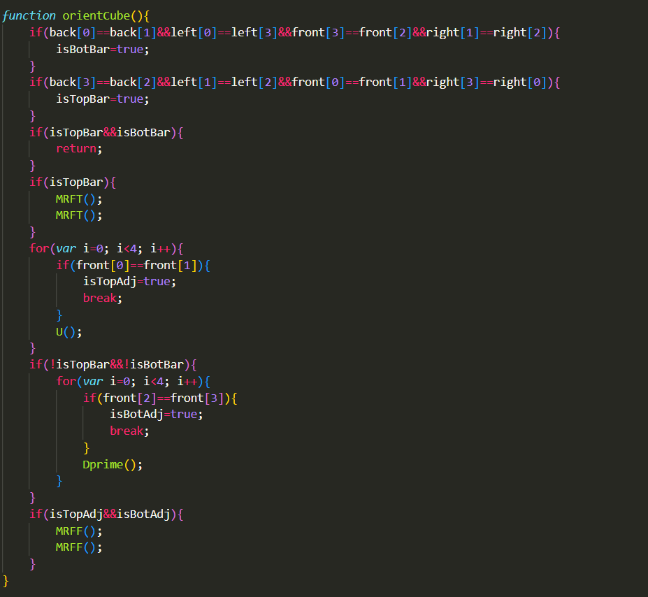
Function for orienting the cube for final pattern recognition-

Slide 32
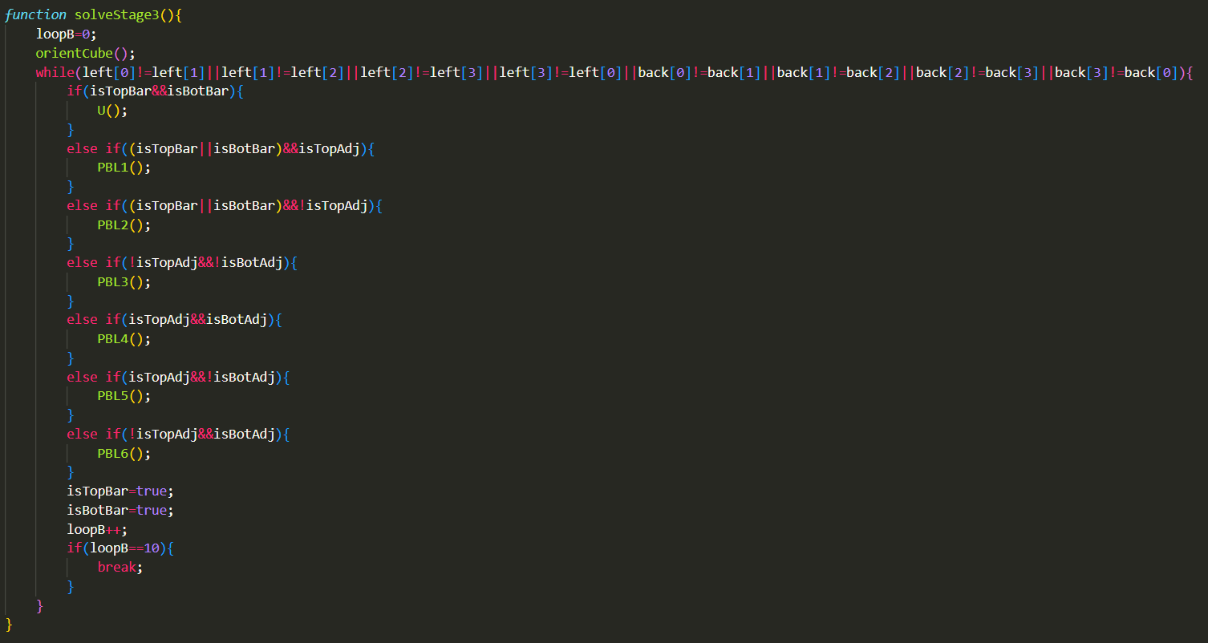
Function for stage three solution

Slide 33
Thank you

