Slide 1
BTP2
UTSAVI GOHIL | 22CS30058

Slide 2
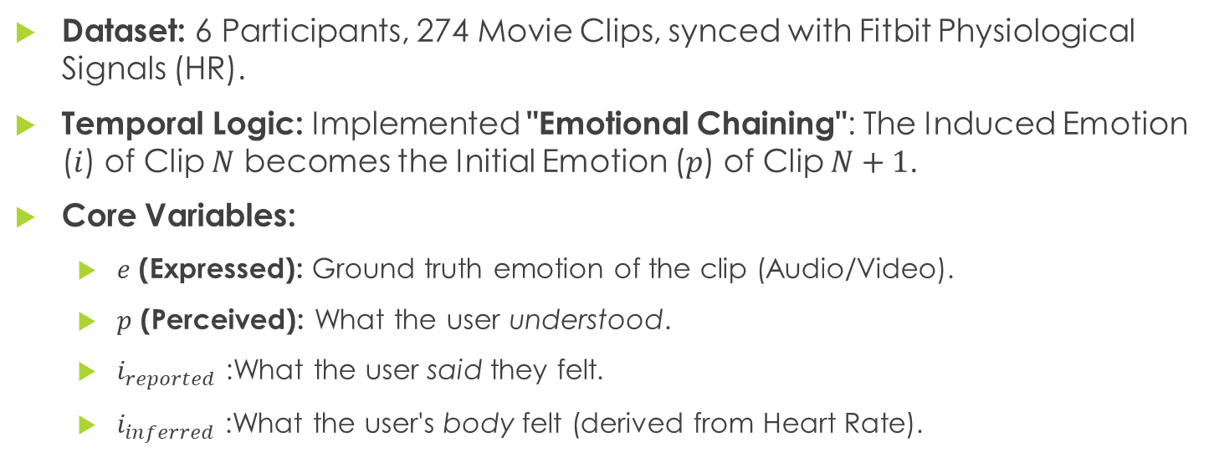
Project Scope & Dataset Objective: Constructing a validated Video Library for Emotional Drift (Therapeutic Application).
Dataset: 6 Participants, 274 Movie Clips, synced with Fitbit Physiological Signals (HR).
Temporal Logic: Implemented "Emotional Chaining": The Induced Emotion ($i$) of Clip $N$ becomes the Initial Emotion ($p$) of Clip $N+1$.
Core Variables:
$e$ (Expressed): Ground truth emotion of the clip (Audio/Video).
$p$ (Perceived): What the user understood.
$i_{reported}$ :What the user said they felt.
$i_{inferred}$ :What the user's body felt (derived from Heart Rate).

Slide 3
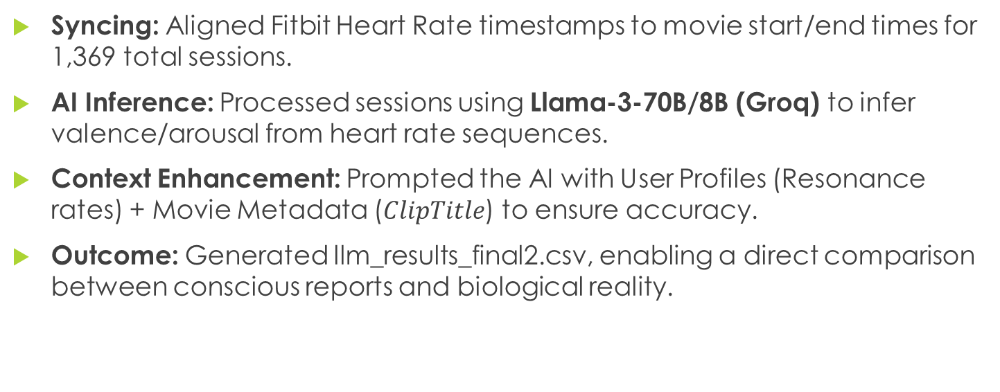
Data Processing & Physiological Inference Methodology: Converting raw signals into emotional data points.
Syncing: Aligned Fitbit Heart Rate timestamps to movie start/end times for 1,369 total sessions.
AI Inference: Processed sessions using Llama-3-70B/8B (Groq) to infer valence/arousal from heart rate sequences.
Context Enhancement: Prompted the AI with User Profiles (Resonance rates) + Movie Metadata ($ClipTitle$) to ensure accuracy.
Outcome: Generated llm_results_final2.csv, enabling a direct comparison between conscious reports and biological reality.

Slide 4
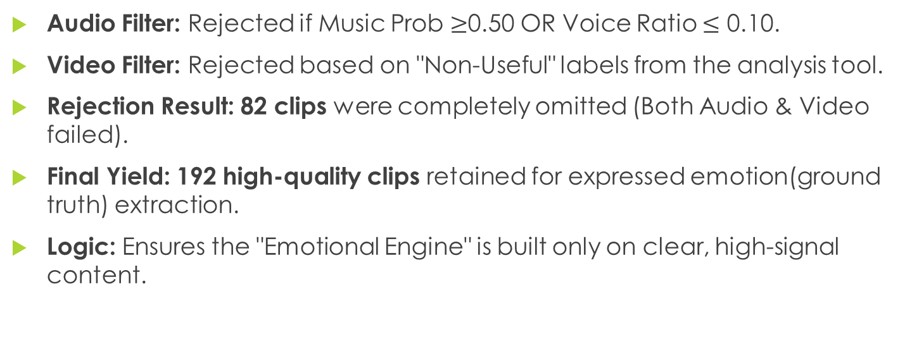
Technical Filtering (Usefulness Logic) Methodology: Pre-screening clips to remove technical noise (Case 1).
Audio Filter: Rejected if Music Prob $≥$0.50 OR Voice Ratio $≤$ 0.10.
Video Filter: Rejected based on "Non-Useful" labels from the analysis tool.
Rejection Result: 82 clips were completely omitted (Both Audio & Video failed).
Final Yield: 192 high-quality clips retained for expressed emotion(ground truth) extraction.
Logic: Ensures the "Emotional Engine" is built only on clear, high-signal content.

Slide 5
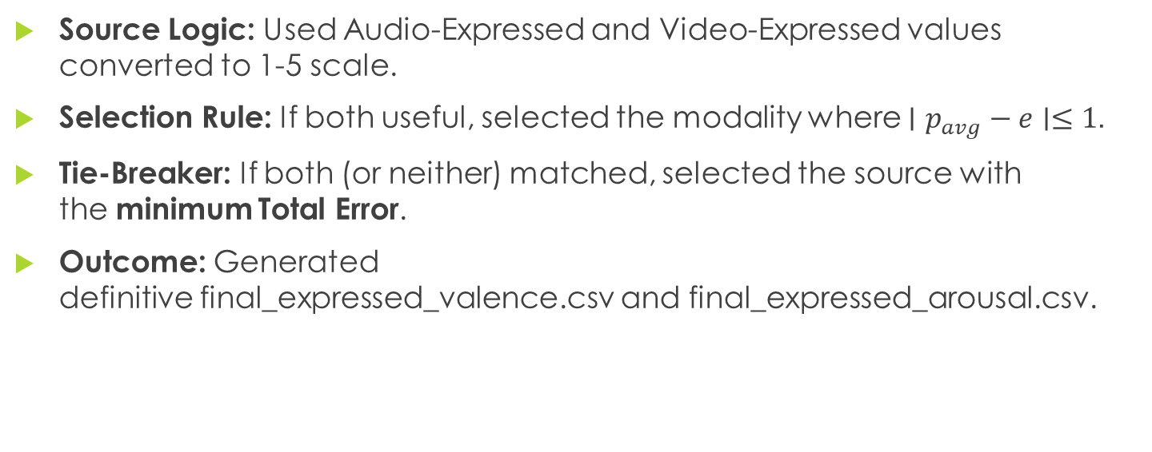

Establishing Ground Truth ($e$) Methodology: Determining the definitive $e$ value (1-5 scale) for the 192 valid clips.
Source Logic: Used Audio-Expressed and Video-Expressed values converted to 1-5 scale.
Selection Rule: If both useful, selected the modality where $∣p_{avg}−e∣≤1$.
Tie-Breaker: If both (or neither) matched, selected the source with the minimum Total Error.
Outcome: Generated definitive final_expressed_valence.csv and final_expressed_arousal.csv.

Slide 6
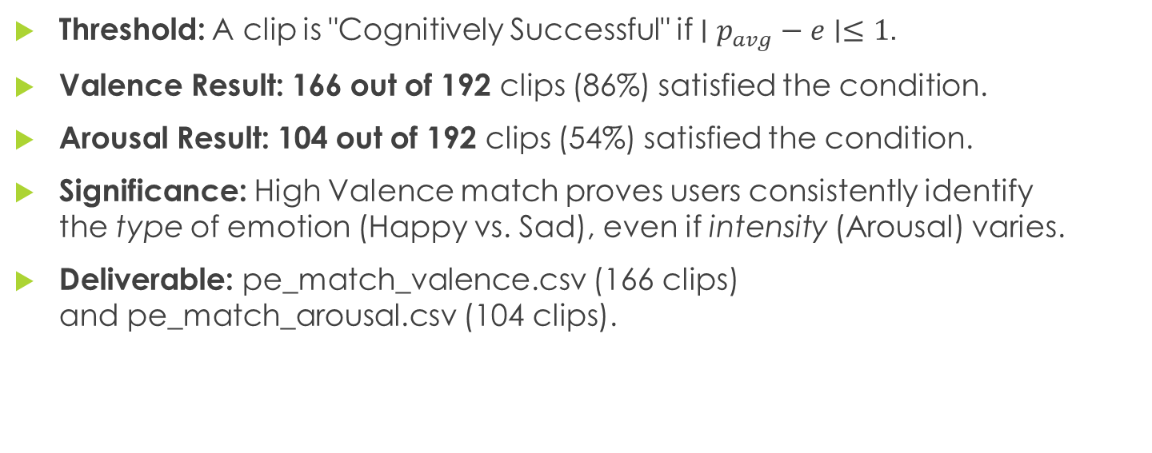
Cognitive Success Analysis ($p$vs $e$) Objective: Quantifying how well the library "communicates" intended emotions.
Threshold: A clip is "Cognitively Successful" if $∣p_{avg}−e∣≤1$.
Valence Result: 166 out of 192 clips (86%) satisfied the condition.
Arousal Result: 104 out of 192 clips (54%) satisfied the condition.
Significance: High Valence match proves users consistently identify the type of emotion (Happy vs. Sad), even if intensity (Arousal) varies.
Deliverable: pe_match_valence.csv (166 clips) and pe_match_arousal.csv (104 clips).

Slide 7
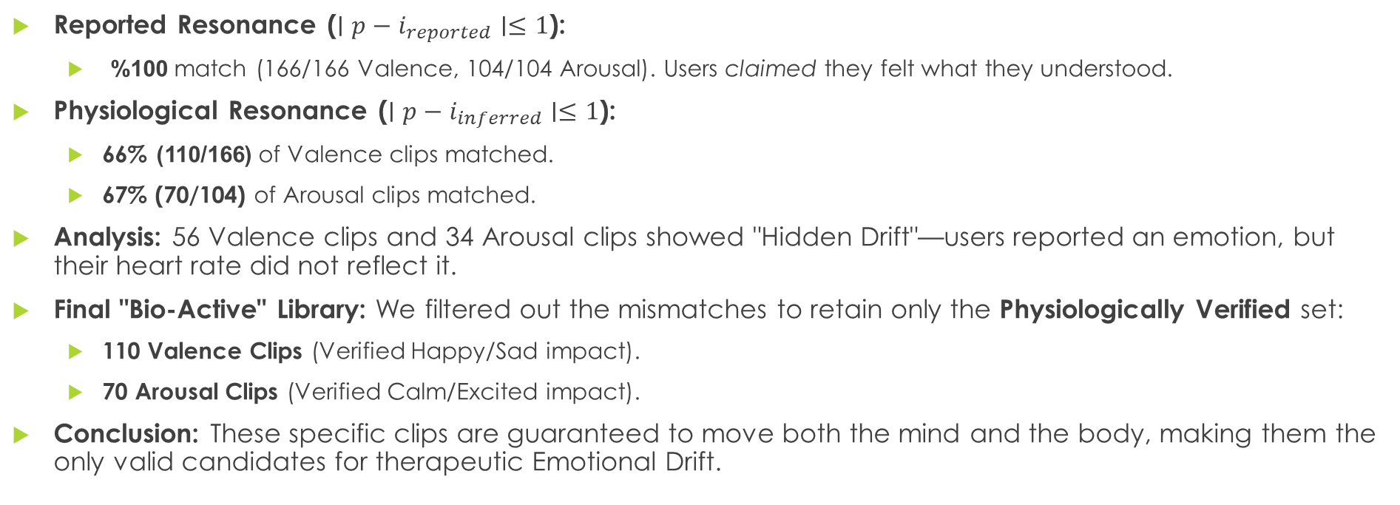

The "Mind vs. Body" Gap ($p$vs $i$) Objective: Comparing Self-Reported Resonance vs. Physiological Resonance.
Reported Resonance ($∣p−i_{reported}∣≤1$):
100% match (166/166 Valence, 104/104 Arousal). Users claimed they felt what they understood.
Physiological Resonance ($∣p−i_{inferred}∣≤1$):
66%(110/166) of Valence clips matched.
67% (70/104) of Arousal clips matched.
Analysis: 56 Valence clips and 34 Arousal clips showed "Hidden Drift"—users reported an emotion, but their heart rate did not reflect it.
Final "Bio-Active" Library: We filtered out the mismatches to retain only the Physiologically Verified set:
110 Valence Clips (Verified Happy/Sad impact).
70 Arousal Clips (Verified Calm/Excited impact).
Conclusion: These specific clips are guaranteed to move both the mind and the body, making them the only valid candidates for therapeutic Emotional Drift.

