Slide 1

TradeSphere: AI-Powered Stock Market Analysis
Intelligent market intelligence by Tech Vision — redefining how investors analyze, predict, and act.

Slide 2

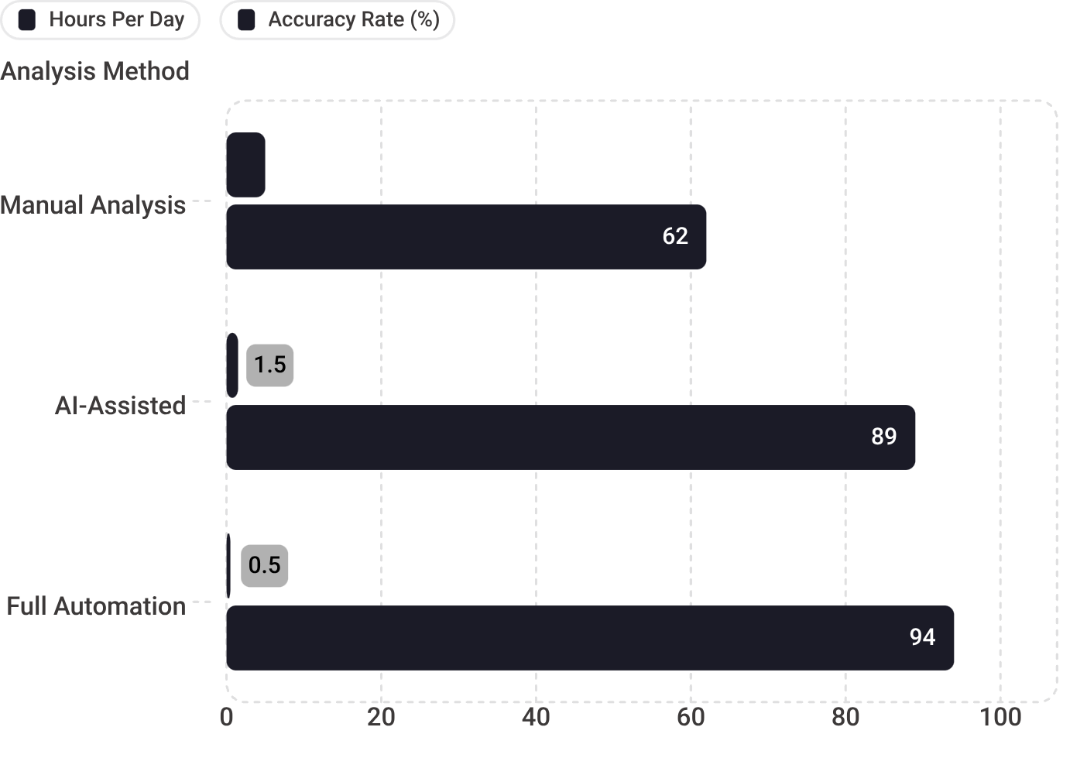

The Problem: Manual Analysis Bottleneck
⏱ 5+ Hours Daily
📉 Expertise Gap
Retail investors spend the majority of their day manually reviewing charts — time that rarely converts to better outcomes.
Technical indicators like RSI, MACD, and Bollinger Bands require years of experience to interpret correctly under pressure.
⚡ Markets Outpace Humans
🌊 Information Overload
Price-sensitive events resolve in milliseconds. Manual decision-making simply cannot keep pace with modern market velocity.
Hundreds of data signals, news feeds, and indicators compete for attention — leading to paralysis and missed opportunities.
Full automation reduces daily analysis time by 90% while lifting accuracy from 62% to 94% — a decisive efficiency advantage.

Slide 3
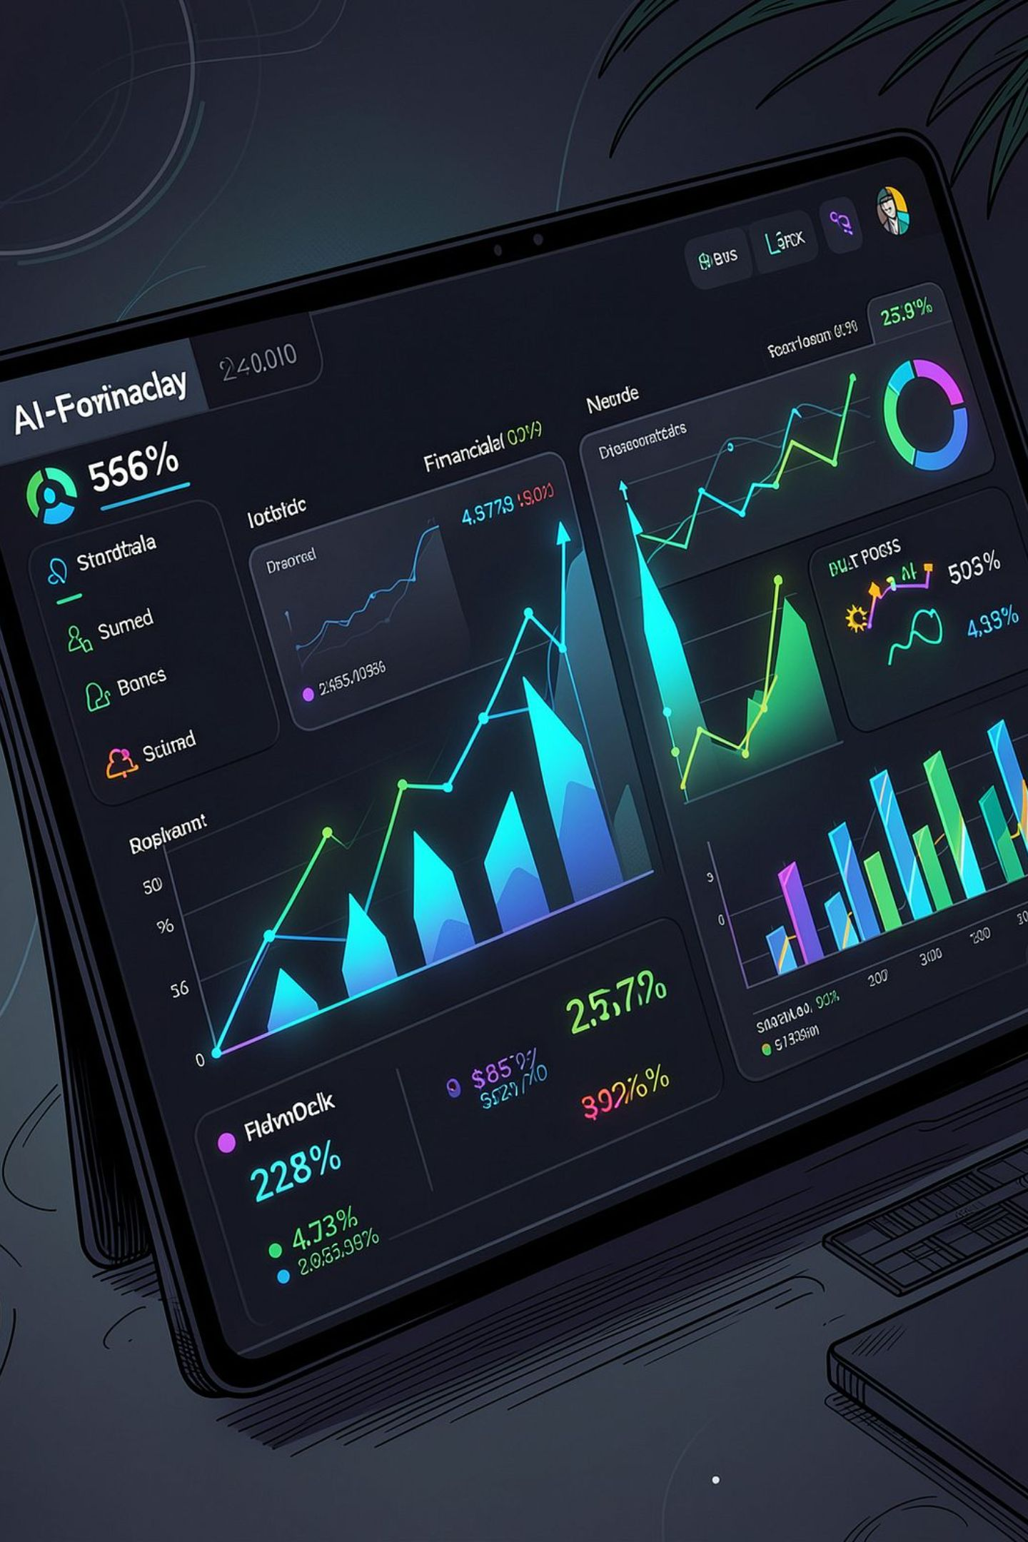
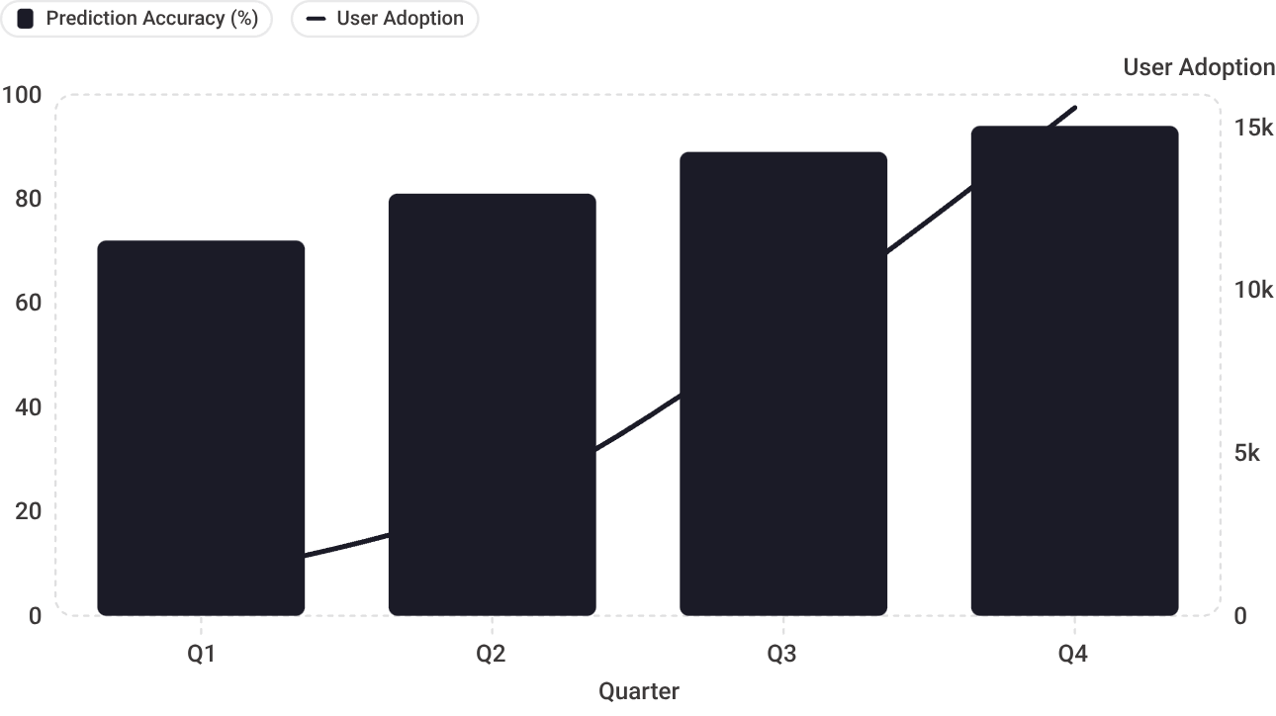
The Solution: TradeSphere AI Engine
Real-Time Analysis
ML-powered technical indicator scanning across live market feeds — no manual effort required.
500+ Stocks Monitored
Automated pattern recognition runs continuously across a broad universe of equities and instruments.
89–94% Accuracy
Predictive buy/sell alerts backed by continuously refined ML models trained on market history.
Intuitive Dashboard
Clean, data-driven interface designed for confident, rapid decision-making at any experience level.
Accuracy climbed from 72% → 94% as the model matured, driving user adoption from 1,200 to 15,600 within a single year.

Slide 4
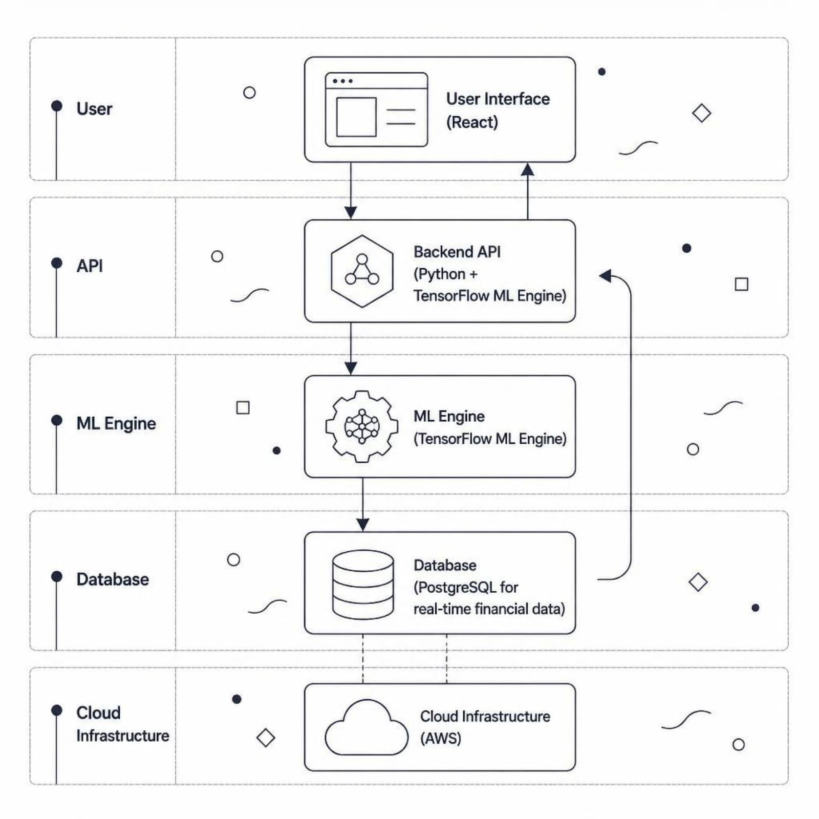





Tech Stack: Enterprise-Grade Architecture
How It All Connects
TradeSphere is built on a modern, scalable architecture where every layer is optimized for performance, reliability, and intelligence.
Backend
Frontend
Database
Infrastructure
Python + TensorFlow — high-performance ML model training and inference at scale.
React — responsive, component-driven UI delivering real-time data with a seamless user experience.
PostgreSQL — reliable relational storage optimized for high-frequency financial data ingestion.
AWS — elastic cloud infrastructure ensuring global scalability, uptime, and disaster resilience.

