Slide 1

TABLEAU
A DATA ANALYTICS AND VISUALIZATION TOOL

Slide 2
TABLEAU INTRODUCTION
Tableau is an excellent data visualization and business intelligence tool used for reporting and analyzing vast volumes of data. It is an American company that started in 2003—in June 2019, Salesforce acquired Tableau.
It helps users create different charts, graphs, maps, dashboards, and stories for visualizing and analyzing data, to help in making business decisions.
Tableau Desktop helps to create reports, dashboards, and stories using different charts and graphs. The workbooks and the dashboards created using Tableau Desktop can be shared locally or publicly.

Slide 3
FEATURES OF TABLEAU
Tableau supports powerful data discovery and exploration that enables users to answer important questions in seconds
No prior programming knowledge is needed; users without relevant experience can start immediately with creating visualizations using Tableau
It can connect to several data sources that other BI tools do not support. Tableau enables users to create reports by joining and blending different datasets
Tableau Server supports a centralized location to manage all published data sources within an organization

Slide 4
CONNECTING TO THE DATA
Tableau is capable of connecting with a wide range of data sources. It can connect to files present in your system, such as Microsoft Excel, text files, JSON, PDF, etc. It can also work on data present on a database server, such as Microsoft SQL Server, MySQL, Oracle, Teradata, etc. There are other saved data sources that Tableau can connect with. It also can connect and fetch data from cloud sources, like AWS, Azure SQL Data Warehouse, and Google Cloud SQL.

Slide 5
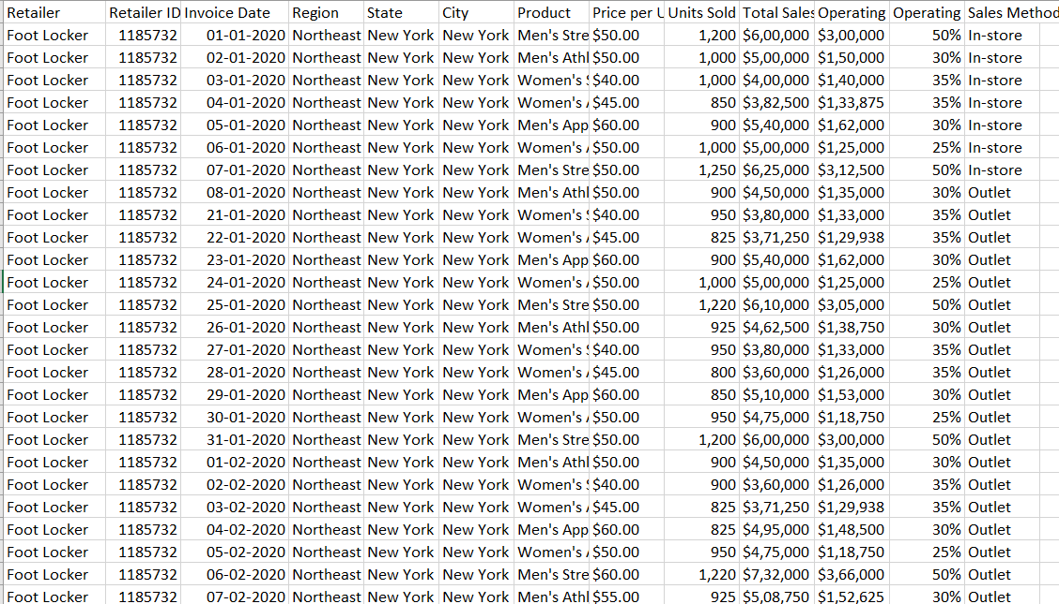
ADIDAS DATASET – SAMPLE SET

Slide 6
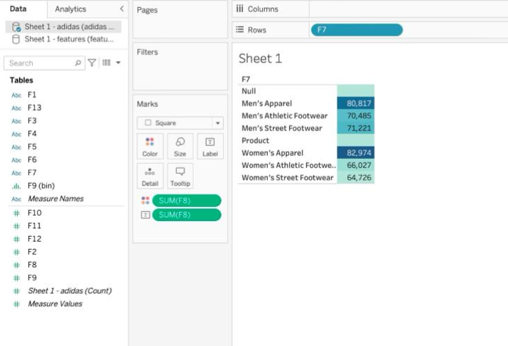
OUTLINE OF VISUALIZATION

Slide 7
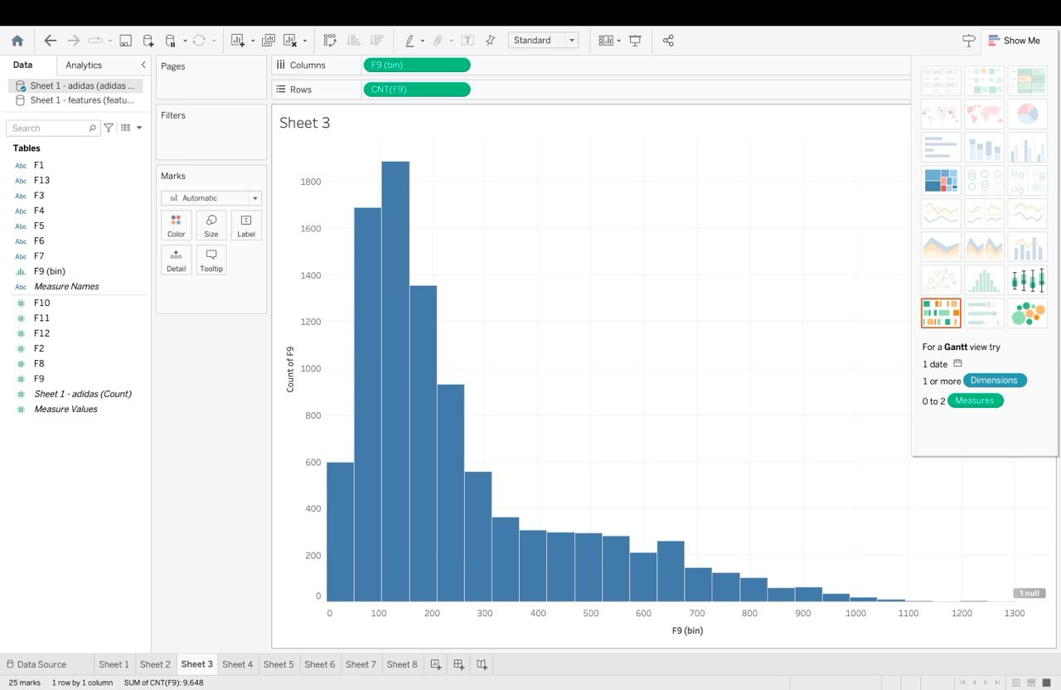
OUTPUT- HISTOGRAM

Slide 8
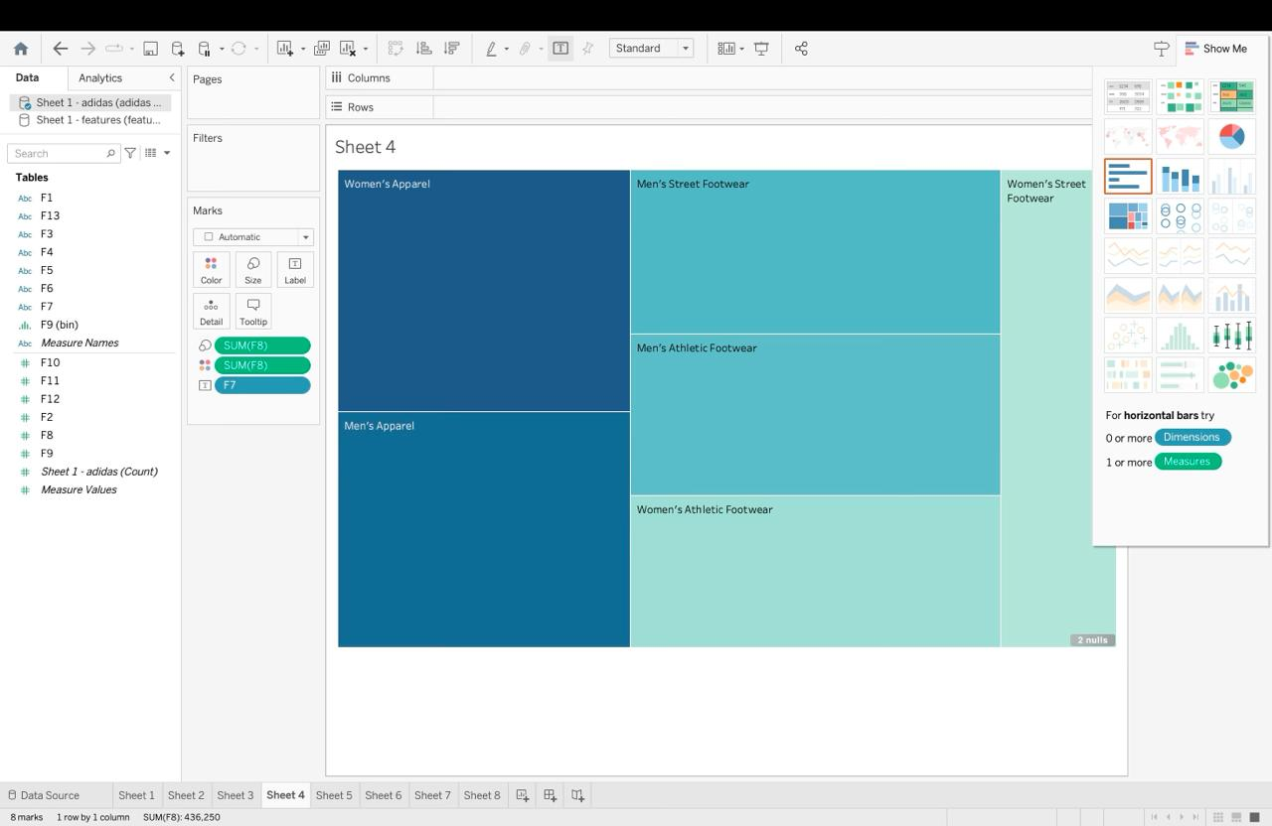
OUTPUT-HEATMAP

Slide 9
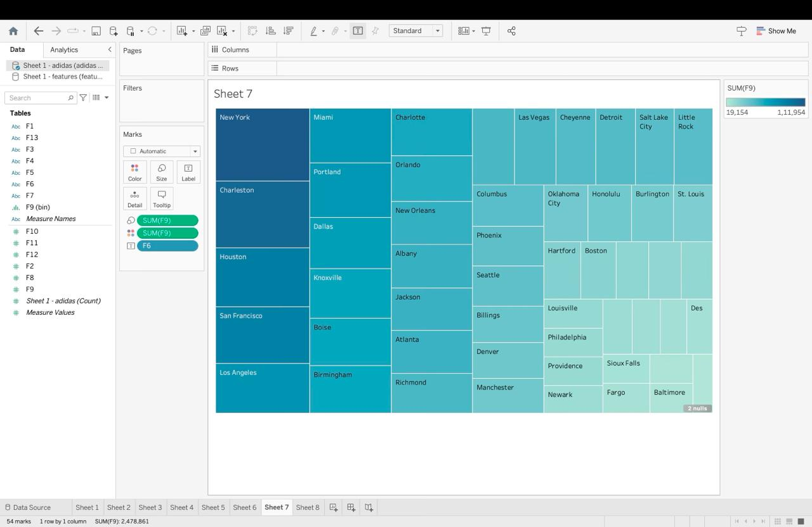
HEATMAP

Slide 10
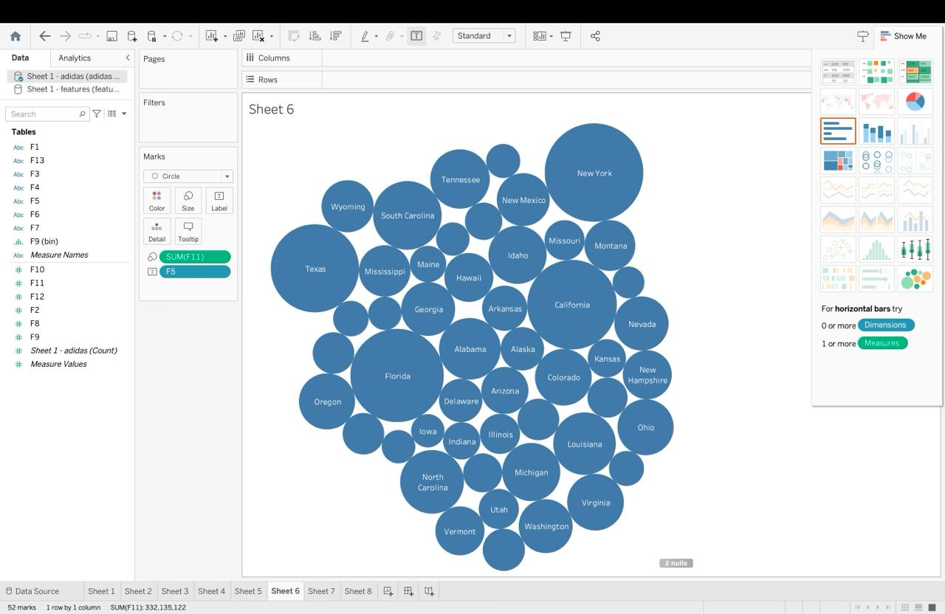
OUTPUT-BUBBLED CHARTS

Slide 11
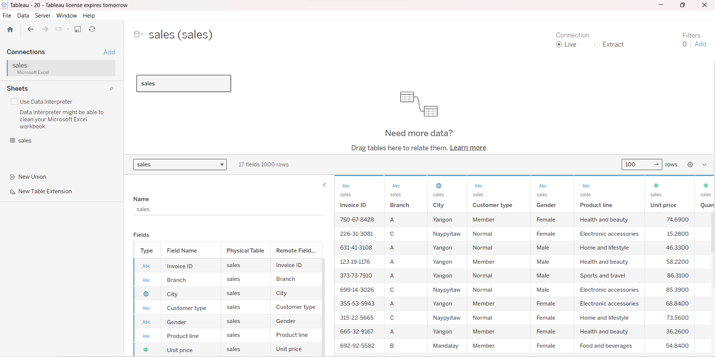
SALES DATASET

Slide 12
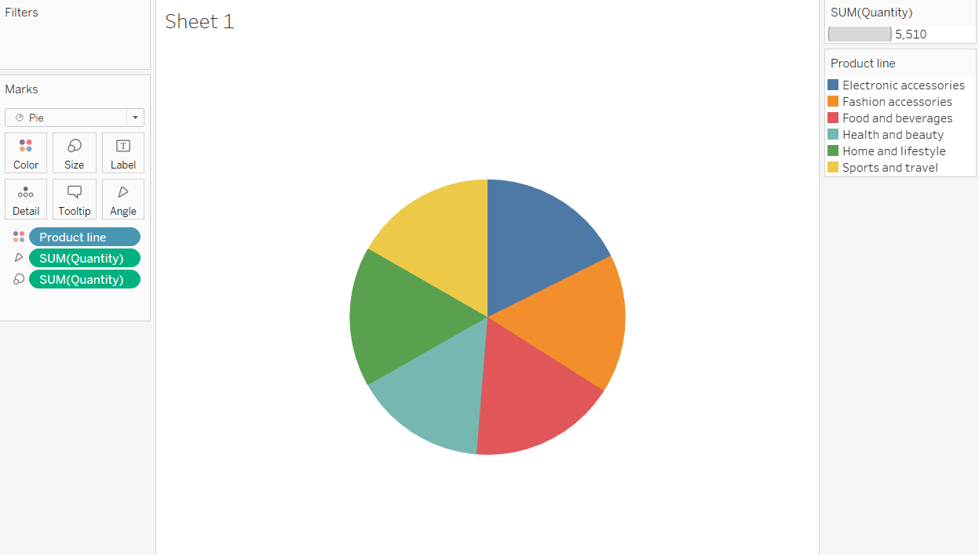
OUTPUT- PIE CHART

Slide 13
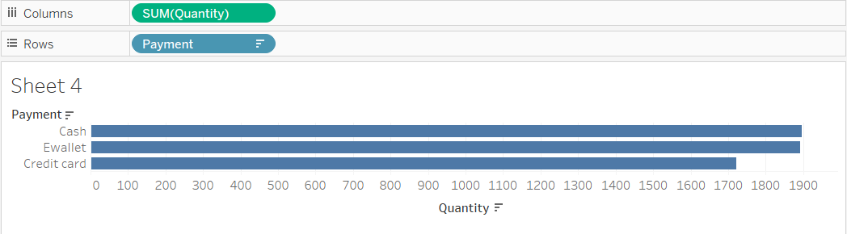
OUTPUT- HORIZONTAL BARS

Slide 14
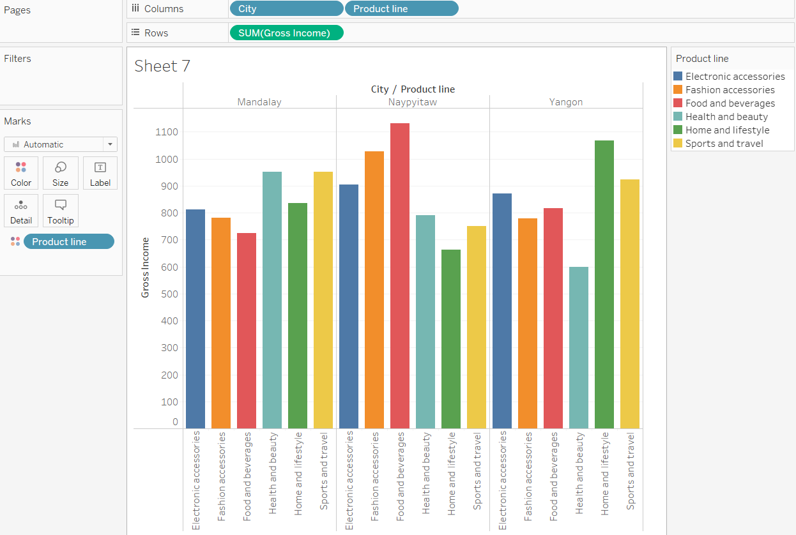
OUTPUT- SIDE-SIDE BARS

Slide 15
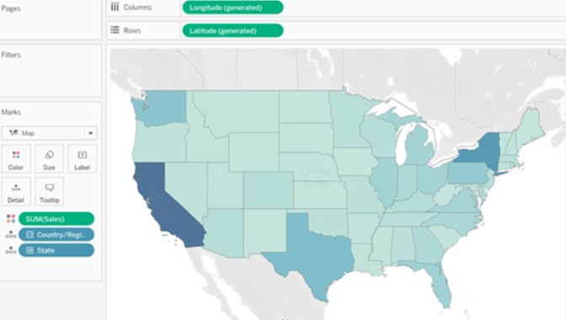
GEOGRAPHICAL PLOT

Slide 16
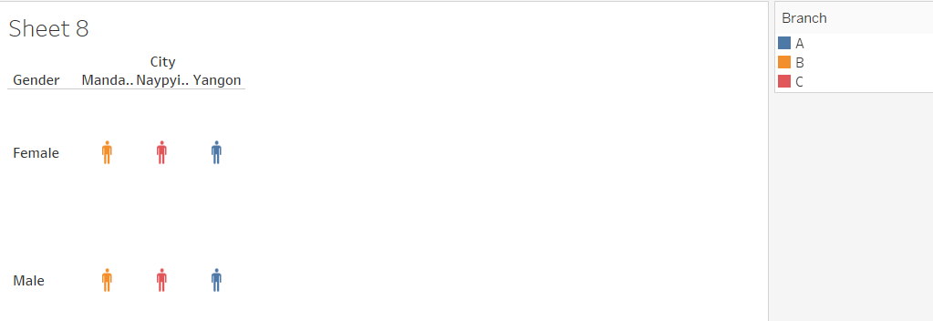
OUTPUT- PICTOGRAMS

Slide 17
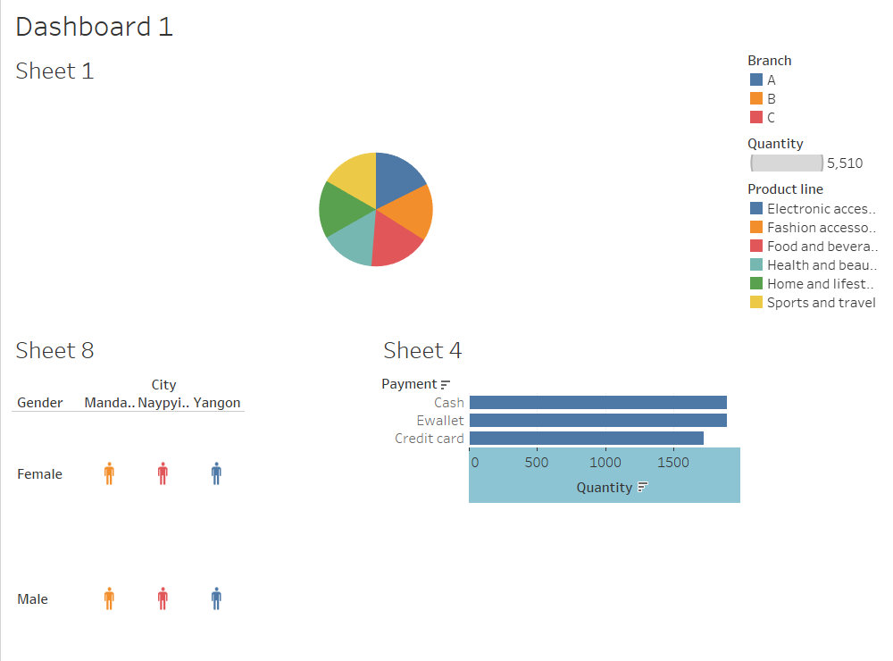
CREATION OF DASHBOARD

Slide 18
CONCLUSION
Thus, various visualization charts have been plotted using Tableau tool. It helps in easy analysis of data and to gain insights from the dataset using the charts. Creation of dashboard helps in visualization of all charts in a single view. Analyst use tableau widely for its characteristic being simple and efficient to use.

