Slide 1

Forecasting Solar to Plan the Site Battery
DKASC Alice Springs · Assessment 3 Technical Demonstration
Abhisek Tamang
S396739
Data Engineer
Sarin Uprety
S394012
Data and Feature Engineer
Uttam Shrestha
S396560
Project Lead
Yogesh Basnet
S394043
Modelling and Visualisation Lead
PRT661 Data Science Practice · Charles Darwin University · Semester 2, 2026 · Group 4

Slide 2

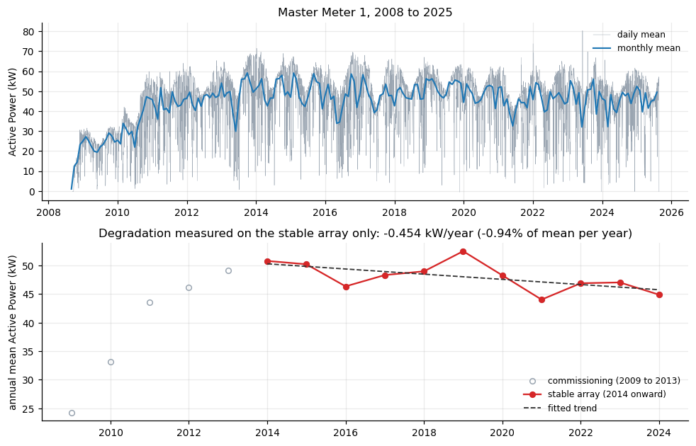


2
Overview: the problem we are solving
Abhisek
The site
DKASC Alice Springs: a solar array and, since 2024, a site battery (354 kWh, measured from its own data).
The data
Master Meter 1 data every 5 minutes from 2008 to 2025 (1.77 million rows) and site telemetry data for 2024 and 2025 (battery, solar, demand, and grid).
The decision
Each night: how much cheap off peak grid energy should the battery store for tomorrow's expensive evening peak?
Generation history at the site (A2, Figure 1)
PRT661 · Group 4 · Assessment 3

Slide 3

3
Objectives: from A2 to A3
Abhisek
Delivered in A2
A3 objectives
Data pipeline from 19 raw extracts to a 30 feature hourly store
Forecasts of 1 h and 24 h ahead using gradient boosting outperform three baselines
80% prediction intervals, but at 24 h they only covered 70.6% of hours in the latest test period.
The actual battery decision was not yet modelled.
1
Make the uncertainty credible: an 80% range that actually encompasses 80% of the values.
2
Model real site and battery from telemetry
3
Make the forecast a nightly battery decision and quantify the value.
4
Deliver it through Jira tasks, branches and reviewed pull requests
PRT661 · Group 4 · Assessment 3

Slide 4
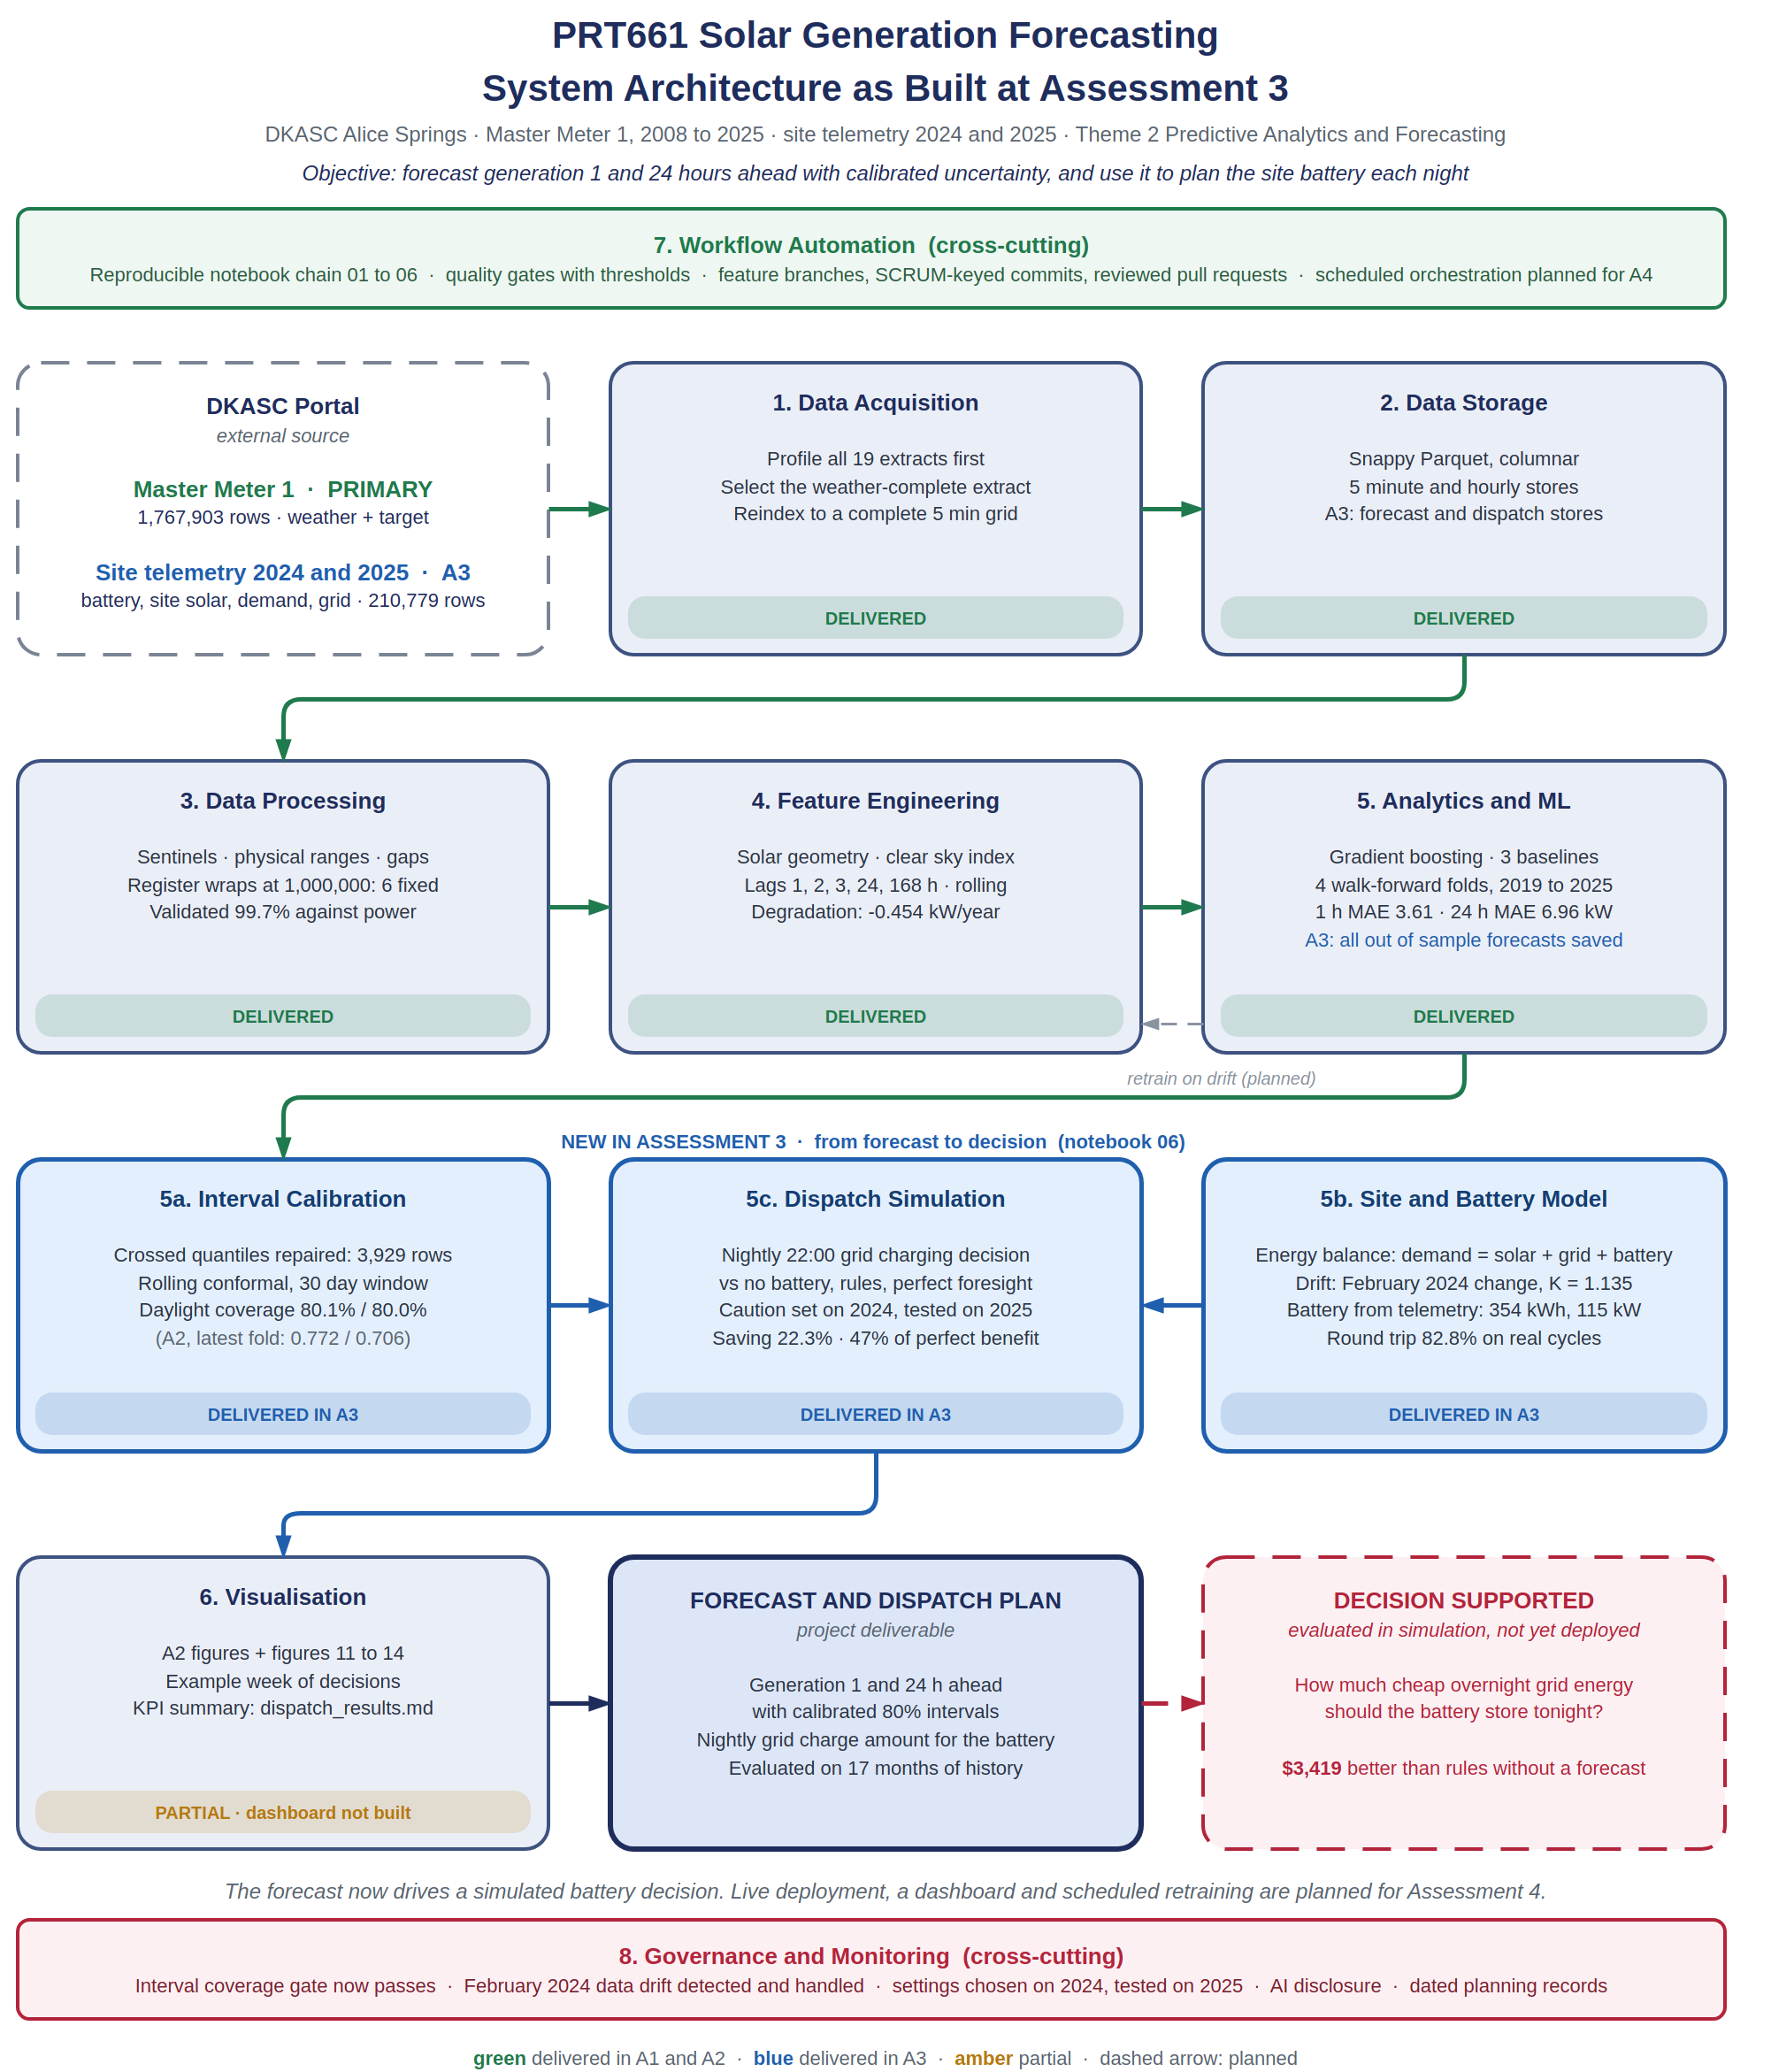
4
Updated system architecture
Abhisek
Two data sources
Master meter 1 for forecast, site telemetry 2024 and 2025 for the battery.
Stages 1 to 5 from A1 and A2
acquisition, storage, processing, features, models
New A3 layer (blue)
Interval calibration, site and battery model, dispatch simulation
Honest status
Planned for A4: dashboard, scheduled runs and retraining
PRT661 · Group 4 · Assessment 3

Slide 5
5
A2 recap: the data pipeline
Abhisek
1,767,903
19
6
rows of 5 minute data in Master Meter 1
406 column names reconciled, yearly extracts profiled.
The register wraps repaired and validated against power with 99.7% accuracy.
30
8
Parquet
hourly features, leakage safe
Quality gates with thresholds
columnar store at the 5 minute and hourly level
PRT661 · Group 4 · Assessment 3

Slide 6
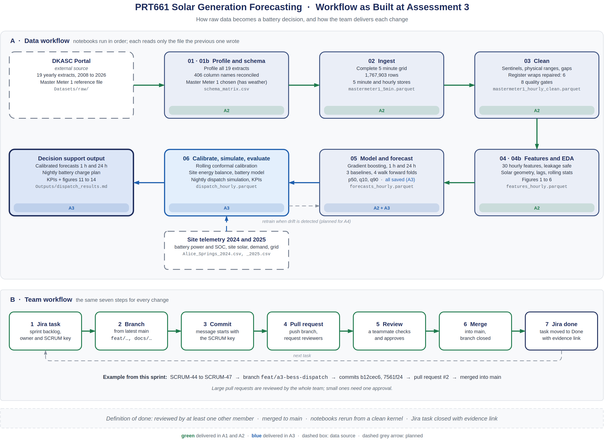
6
Workflow: data to decision, and how we work
Sarin
A: notebooks 01 – 06 execute sequentially; only the previous notebook writes to its respective notebook.
The blue boxes are new to A3: notebook 06 and the saved forecasts from 05
B: All changes are done using the same 7 steps as for Jira task to merge
Example: SCRUM-44 to 47, branch, pull request #2, merged
PRT661 · Group 4 · Assessment 3

Slide 7
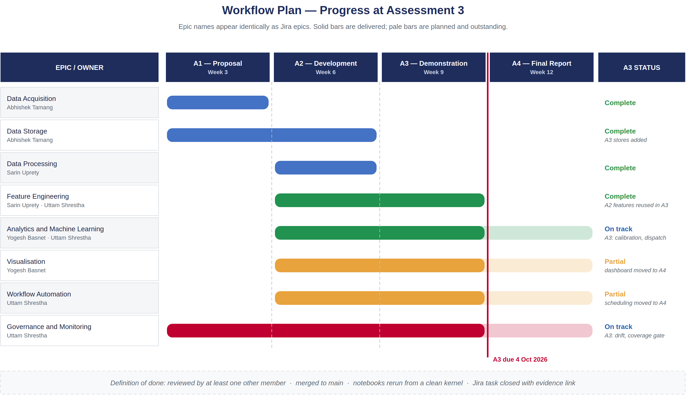
7
Implementation progress at A3
Sarin
16
A3 tasks in Jira Sprint 3
PR #2
A3 analysis merged into main
6 of 8
epics complete or on track
PRT661 · Group 4 · Assessment 3

Slide 8
8
A2 recap: models and the open problem
Sarin
Model | 1 h MAE | 1 h R² | 24 h MAE | 24 h R²
Gradient boosting | 3.61 kW | 0.980 | 6.96 kW | 0.913
Seasonal naive | 7.74 kW | 0.887 | 7.74 kW | 0.887
Persistence | 13.90 kW | 0.866 | 7.74 kW | 0.887
Climatology | 11.07 kW | 0.889 | 11.07 kW | 0.889
Carried into A3
70.6%
of daylight hours inside the 24 h 80% interval, latest test period 2024 to 2025 (target 80%)
The interval was too narrow: in 10 trials the interval was correct only 7 times but in 10 trials it had 80% confidence. A battery planning based on this would be overconfident.
Mean of four walk forward folds, 2019 to 2025
PRT661 · Group 4 · Assessment 3

Slide 9
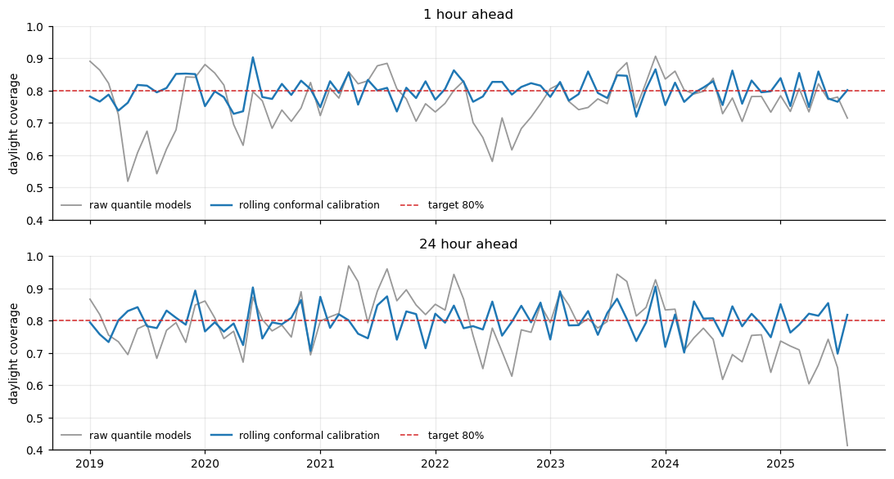
9
A3 Part A: calibrating the forecast intervals
Sarin
80.1% · 80.0%
daylight coverage 1h and 24h for all four folds, target 80%
Fixed 3929 forecasts where the low edge was above the high edge
Rolling conformal calibration: expand or contract over the past 30 days of errors
Only uses data known at the moment, no look ahead
Latest period, 24 h: 70.6% before, 79.3% after
Every fold now 79.3% to 81.0%
Monthly daylight coverage, raw (grey) vs calibrated (blue)
Method: Rolling Adaptation for Conformalised Quantile Regression
PRT661 · Group 4 · Assessment 3

Slide 10
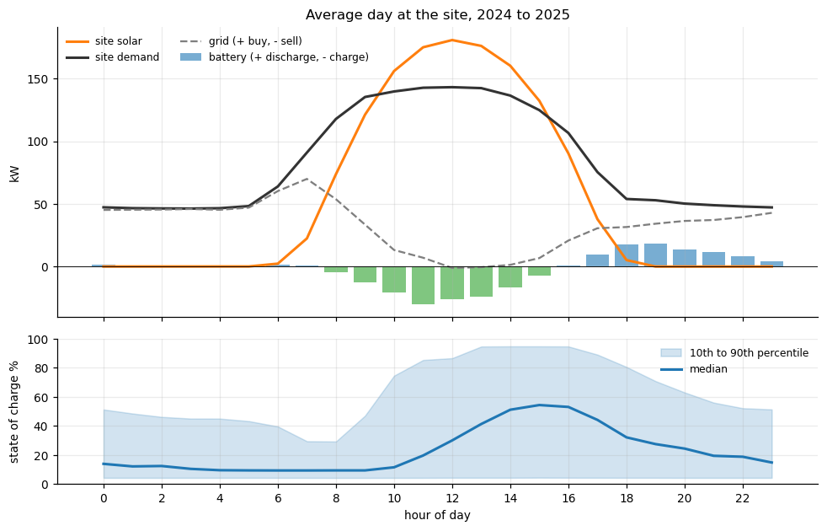
10
A3 Part B: the site, its battery, and data drift
Uttam
demand = solar + grid + battery
The energy balance test corrected the sign of all meters (96% of hours within 2 kW)
354 kWh
115 kW
82.8%
battery capacity via telemetry
charge and discharge power
Round trip efficiency in real cycles.
Data drift, end of February 2024
The site was reconfigured: site solar divided by Master Meter 1 dropped from 2.21 to approximately 1.1. Analysis begins from 1 March 2024 and the scale used is K = 1.135 (correlation 0.995 after that).
PRT661 · Group 4 · Assessment 3

Slide 11
11
A3 Part C: the nightly battery decision
Uttam
At 22:00 every night
battery space minus tomorrow's forecast solar surplus = grid energy to buy tonight
$3,419
saved beyond the best rule with no forecast
47%
of the benefit perfect foresight would give
Illustrative time of use tariff: $0.15 off peak, $0.25 shoulder, $0.40 peak, $0.07 feed in
PRT661 · Group 4 · Assessment 3

Slide 12
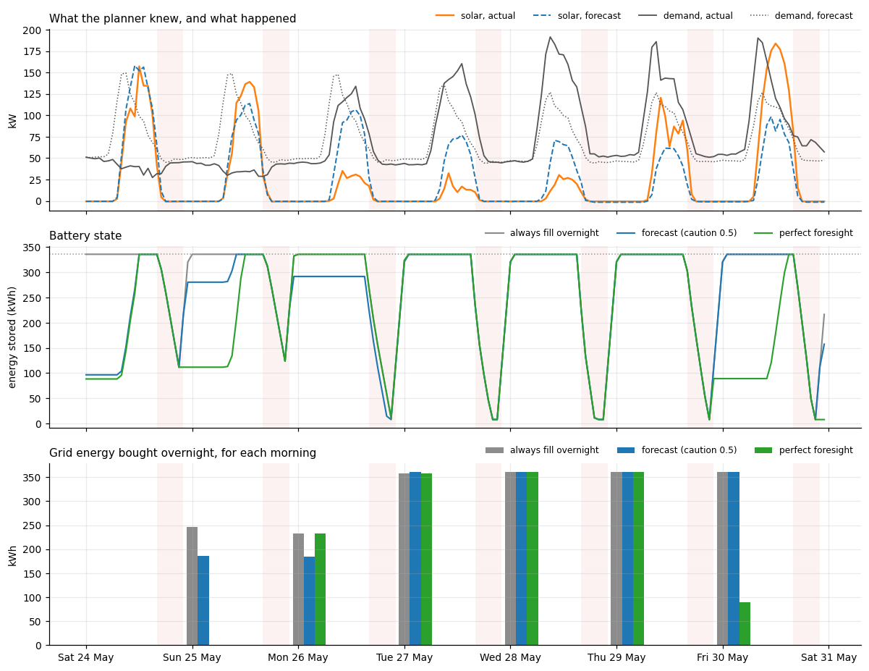



12
Demonstration of the current system
Uttam
Jupyter · notebook 06
calibration table, example week (Figure 14), final KPI table
GitHub · pull request #2
commits with SCRUM keys, notebooks, figures, diagrams in the repo
Jira · Sprint 3
A3 tasks with owners and status
PRT661 · Group 4 · Assessment 3

Slide 13

13
Technical challenges and how we solved them
Yogesh
Crossed interval edges
Overconfident intervals
Problem: Went low edge on high edge in 3,929 forecasts, primarily at night.
Fix: Re-order the two sides, the median remains the same.
Problem: In the most recent time period, 24 h range covered 70.6% rather than 80%.
Fix: Rolling conformal calibration (there: 79.3%, overall: 80.0%)
Data drift
Unknown signs, logger outages
Problem: Solar ratio reduced by half from end of February 2024 due to site reconfiguration.
Fix: Start in March 2024, scale fitted on March only
Problem: Meters are not specifying direction of positive, SOC read 0 in 7% of hours.
Fix: Energy balance test corrected for sign; excluded outage hours.
PRT661 · Group 4 · Assessment 3

Slide 14
14
What is the limiting factor
Yogesh
The weak link is "demand"
Perfect demand increases plan to 85%, perfect solar to 52%
Caution barely matters
Chosen on 2024, tested on 2025: 48% to 50% for caution 0 to 1
The larger the battery, the greater the value
Forecast gain over rules: 2.2 at half size, 3.9 at double
Swaps by one piece at a time, based on perfect information, using the median plan (41%). The caution selected on 2024 is 47% identical to slide 11.
PRT661 · Group 4 · Assessment 3

Slide 15
15
Future work before A4
Yogesh
1
2
3
4
5
Better demand forecast
weekday and weekend patterns, temperature
Optimiser instead of a rule
plan charging and discharging together
Store more solar
113.6 MWh was cheaply exported rather than stored
Drift monitoring and retraining
Automatically detects changes, such as February 2024.
Final report and dashboard
Week 12: A4 professional report
PRT661 · Group 4 · Assessment 3

Slide 16
Summary
80%
354 kWh
22.3%
calibrated intervals that mean what they say
The battery is modelled using its own data.
saving with a forecast planned battery
GitHub github.com/Uttam1618/PRT661-solar-forecasting
Jira uttamshrestha1618.atlassian.net, project SCRUM
Thank you

