Slide 1
Title: Detecting Workplace Burnout from Glassdoor Reviews Using NLP and Machine Learning
Course: AIT 582-DL1
Bhargavi Jammi Prem Pasupuleti Srinija Tummalapally Uttam Yeramella
https://mason.gmu.edu/~stummal2/AIT582DL1team5/

Slide 2
Introduction
Burnout is chronic workplace stress
Leads to emotional exhaustion, low productivity
Opportunity: Analyze online reviews to detect burnout
Tools used: NLP, ML, Sentiment Analysis
Srinija Tummalapally
G01197875

Slide 3
Dataset
Source: Kaggle – 1M reviews.
Sampled: 20,000 cleaned reviews.
Includes:
Structured fields (ratings, employment status)
Unstructured text (pros, cons)
Preprocessing: null removal, symbol mapping, sentiment score generation, etc.
Srinija Tummalapally
G01197875

Slide 4
Problem Statement
Can employee burnout be predicted using text reviews?
Challenge: unstructured, noisy, subjective data
Goal: extract useful patterns from reviews
Srinija Tummalapally
G01197875

Slide 5
From Research to Reality: Lessons Learnt and Our Contributions
Existing research shows NLP and ML are effective in detecting burnout from text (e.g., social media, forums).
Studies used models like Naïve Bayes, SVM, and topic modeling (LDA).
Limitations found:
Heavy reliance on social media (less workplace-specific)
Lack of real employee review data
Limited explainability in models
Srinija Tummalapally
G01197875

Slide 6
Literature Review - Burnout and Mental Health & Sentiment Analysis Research
Burnout is defined by the WHO as an occupational syndrome.
Key studies:
Bakker et al. (2018): Burnout develops over time; it needs early detection.
Shivaprasad (2017), Fang & Zhan (2015): Used sentiment analysis for review classification.
We build on their models but apply them in the employee feedback context.
Srinija Tummalapally
G01197875

Slide 7
Research Questions
Can burnout levels be predicted using review text?
What topics correlate with high burnout?
Does adding sentiment and topic modeling improve accuracy?
What features are most predictive?
Bhargavi Jammi
G01514840

Slide 8
Hypotheses
H1: Burnout can be classified from textual features.
H2: Issues like poor management & long hours relate to high burnout.
H3: Sentiment + topic modeling = better classification.
H4: Negative sentiment correlates with high burnout.
H5: LDA topic modeling boosts performance.
H6: Sentiment & topics are strong burnout predictors.
Bhargavi Jammi
G01514840

Slide 9
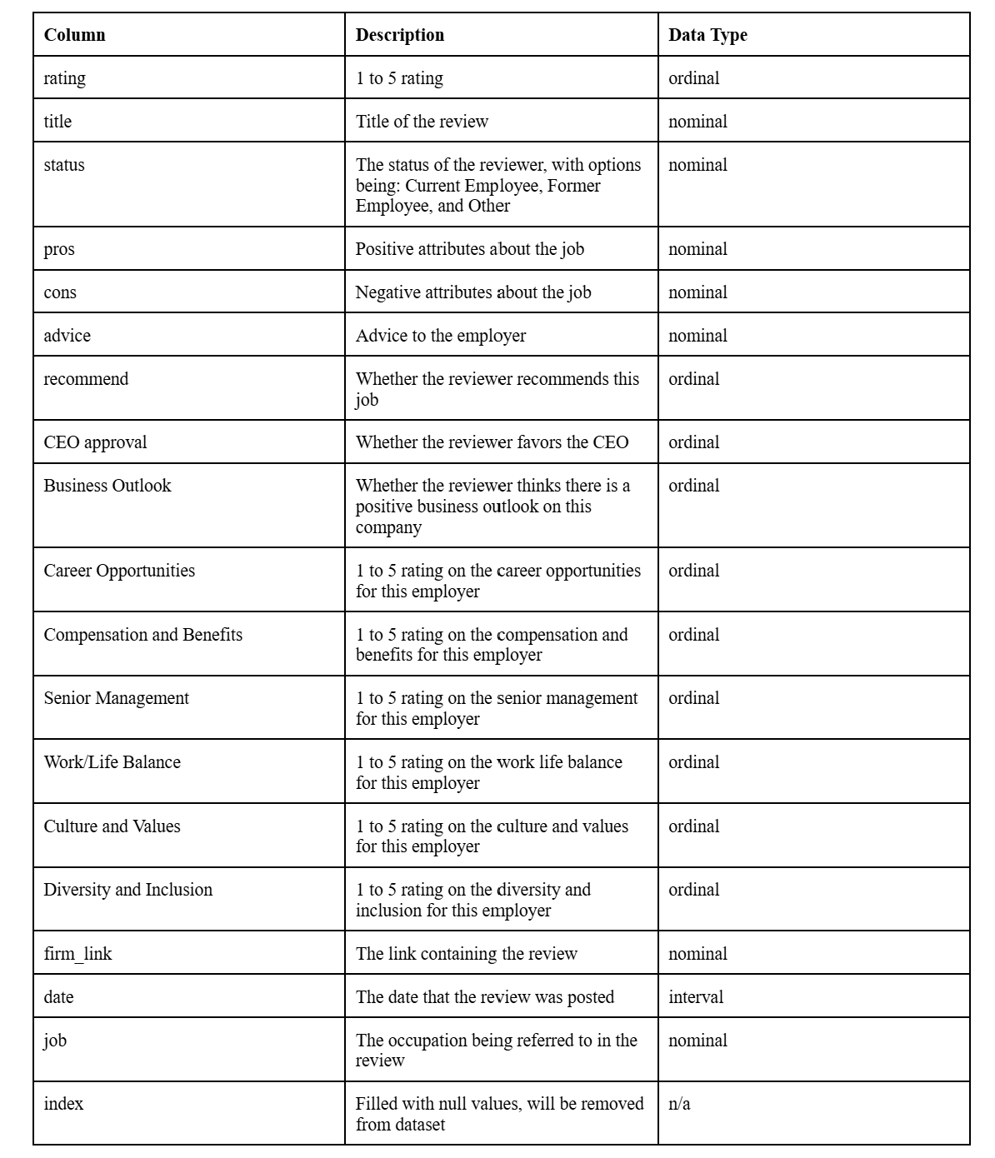
Exploratory Data Analysis & Data Preprocessing
Converted text ratings to numeric.
Removed NULLs and irrelevant columns.
Extracted:
Employment status (split fields)
Year of review
Company name
Used VADER for sentiment analysis on ‘pros’ and ‘cons’.
Bhargavi Jammi
G01514840

Slide 10
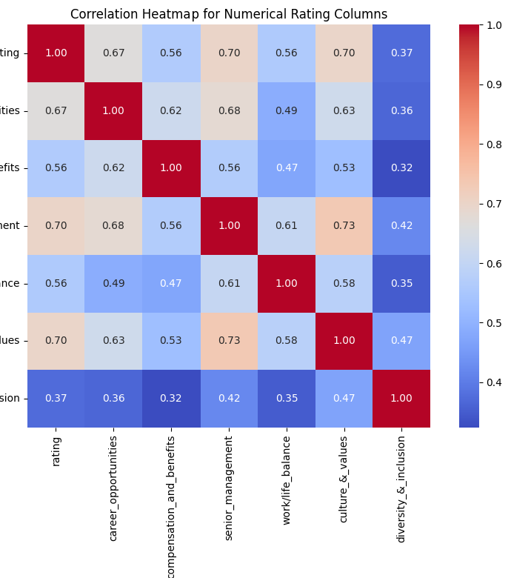
Correlation Heatmap
Found strong correlations:
Work-life balance, compensation, and senior management ratings correlate with overall rating.
These ratings inform burnout level classification.
Bhargavi Jammi
G01514840

Slide 11
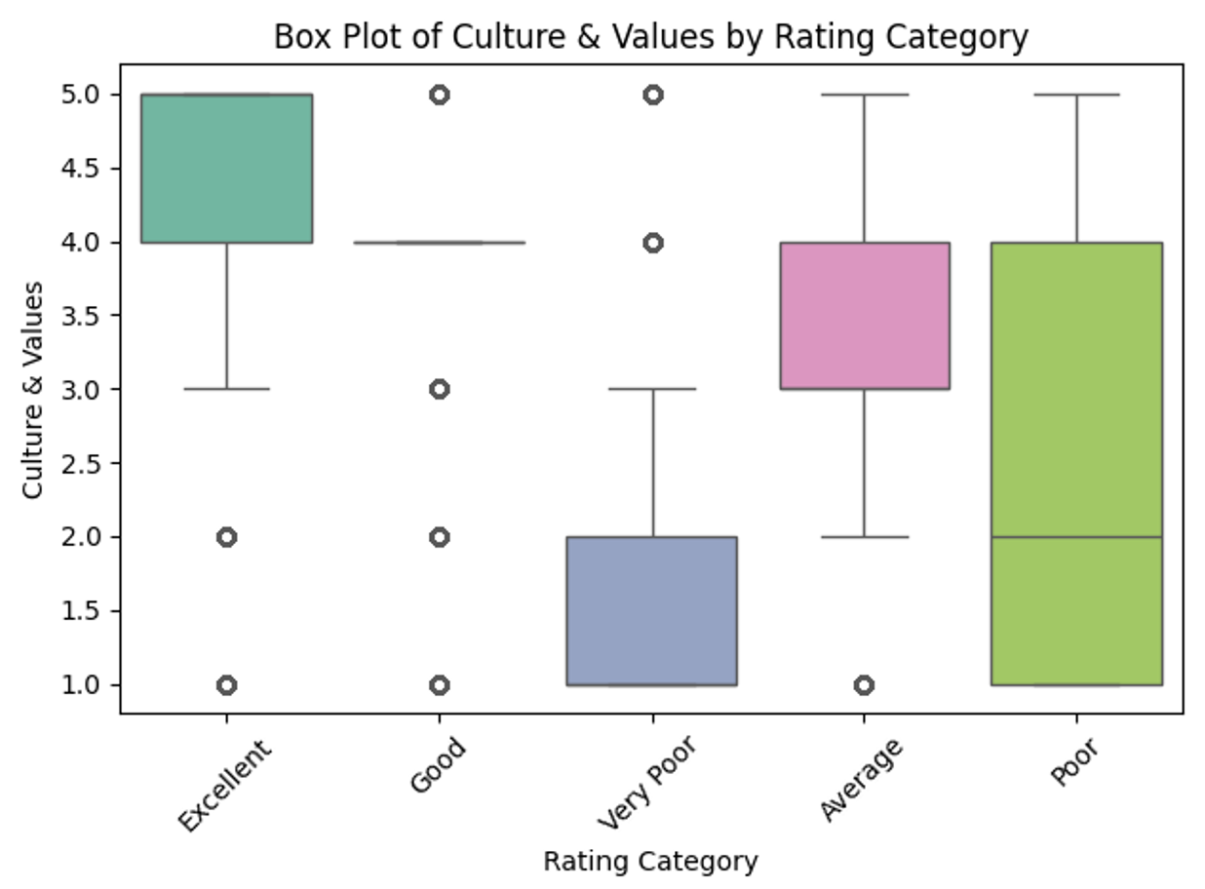
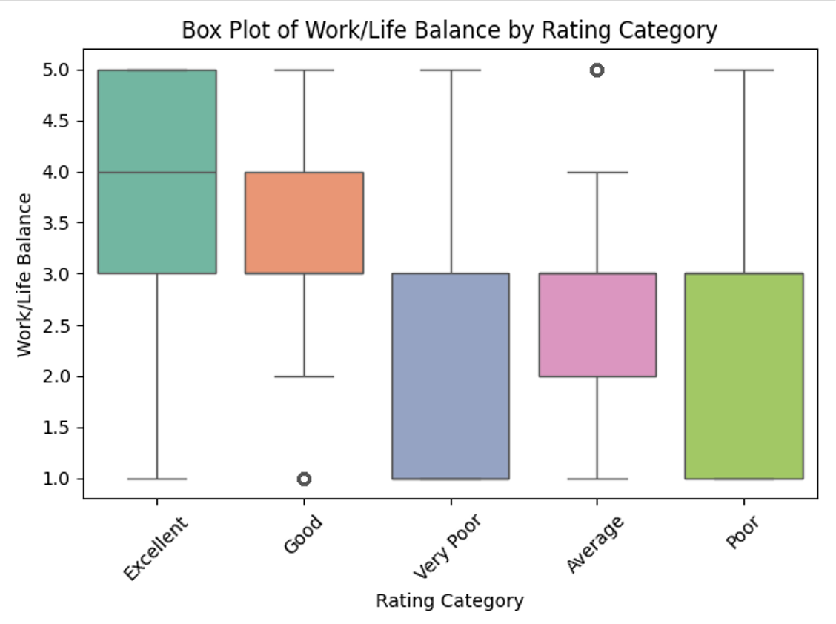
Boxplot Culture & Values
Culture & Values
High burnout reviews had lower median scores in “culture & values”.
Confirms it’s a relevant burnout feature.
Work-Life Balance
High burnout group gave significantly lower work-life balance scores.
Suggests dissatisfaction in life-work harmony.
Prem Pasupuleti
G01510830

Slide 12
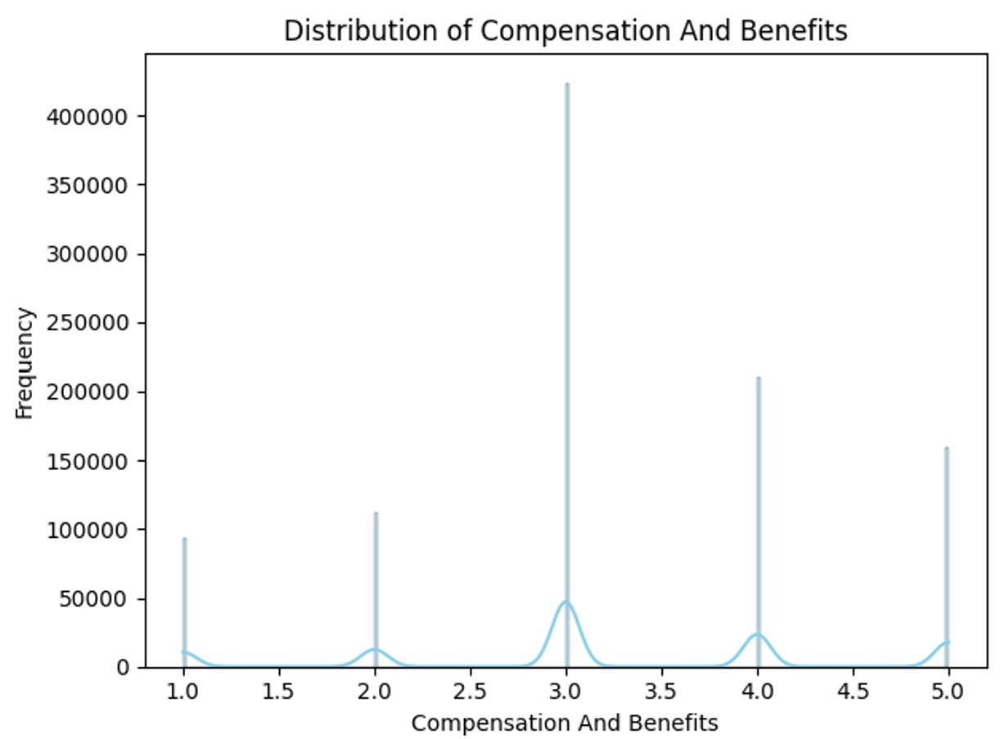
Histogram
Most users rated compensation near 4.
But high burnout group caused a noticeable drop.
Prem Pasupuleti
G01510830

Slide 13
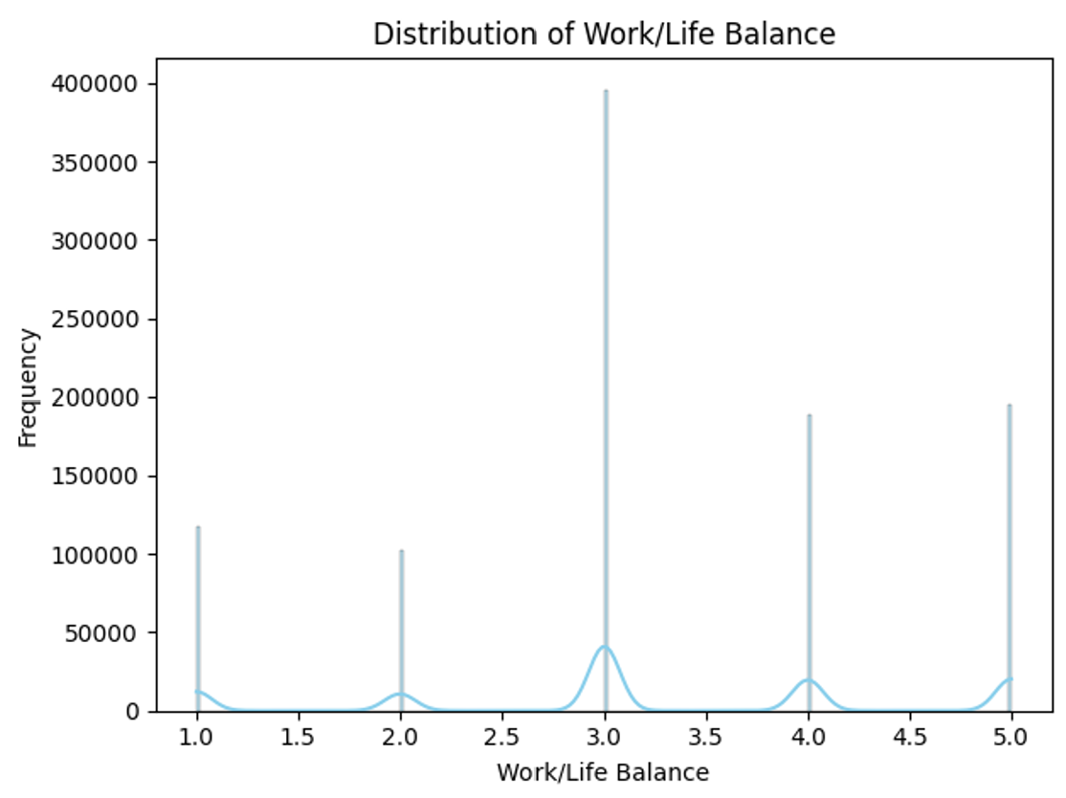
KDE – Work-Life Balance
Kernel Density Estimate (KDE) shows:
Most users score around 4.
Burnout group dips significantly, proving it's a burnout predictor.
Prem Pasupuleti
G01510830

Slide 14
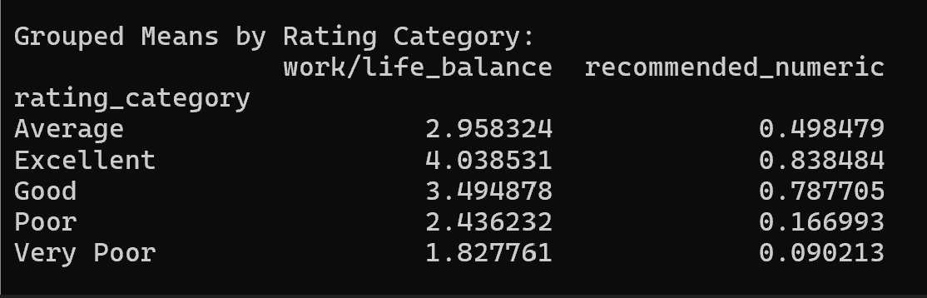
Grouped Means
High burnout group showed lowest scores in:
Work-life balance
CEO approval
Recommendation
Structured ratings align with sentiment trends.
Prem Pasupuleti
G01510830

Slide 15
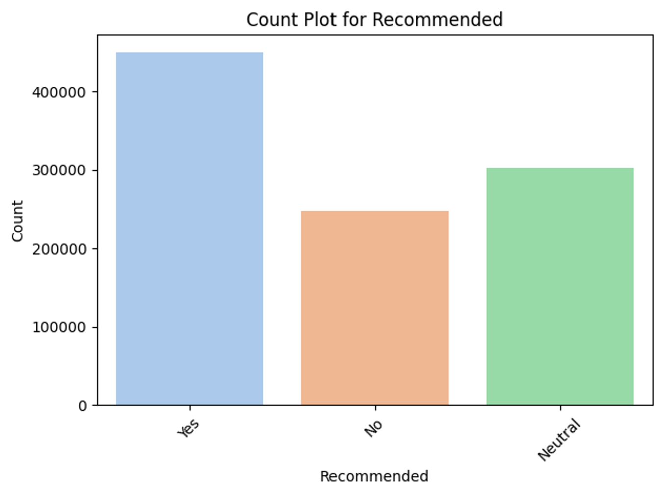
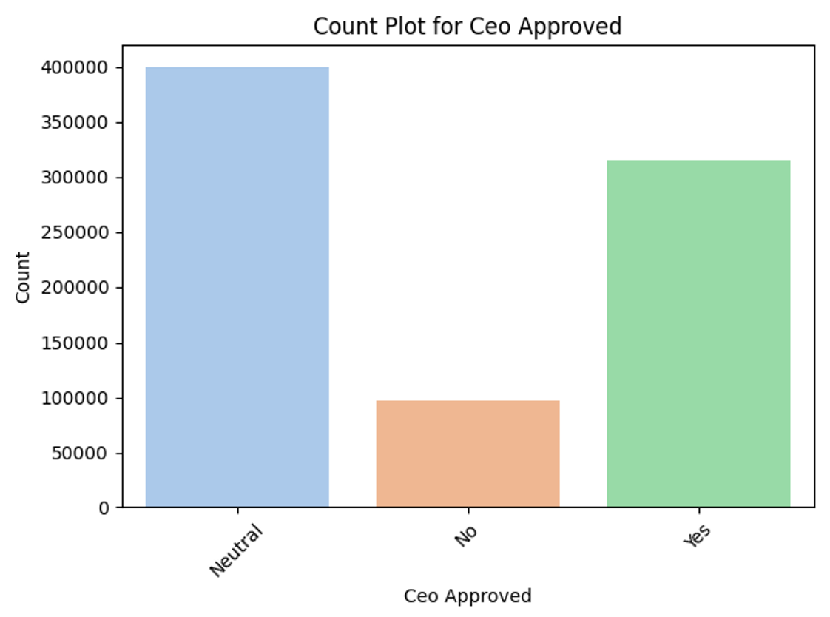
Count Plot – Recommendation & CEO Approval
People experiencing burnout are less likely to recommend the company.
“Yes” answers drop in high-burnout group.
Negative relationship between burnout and CEO approval.
Trust and leadership matter for well-being.
Prem Pasupuleti
G01510830

Slide 16
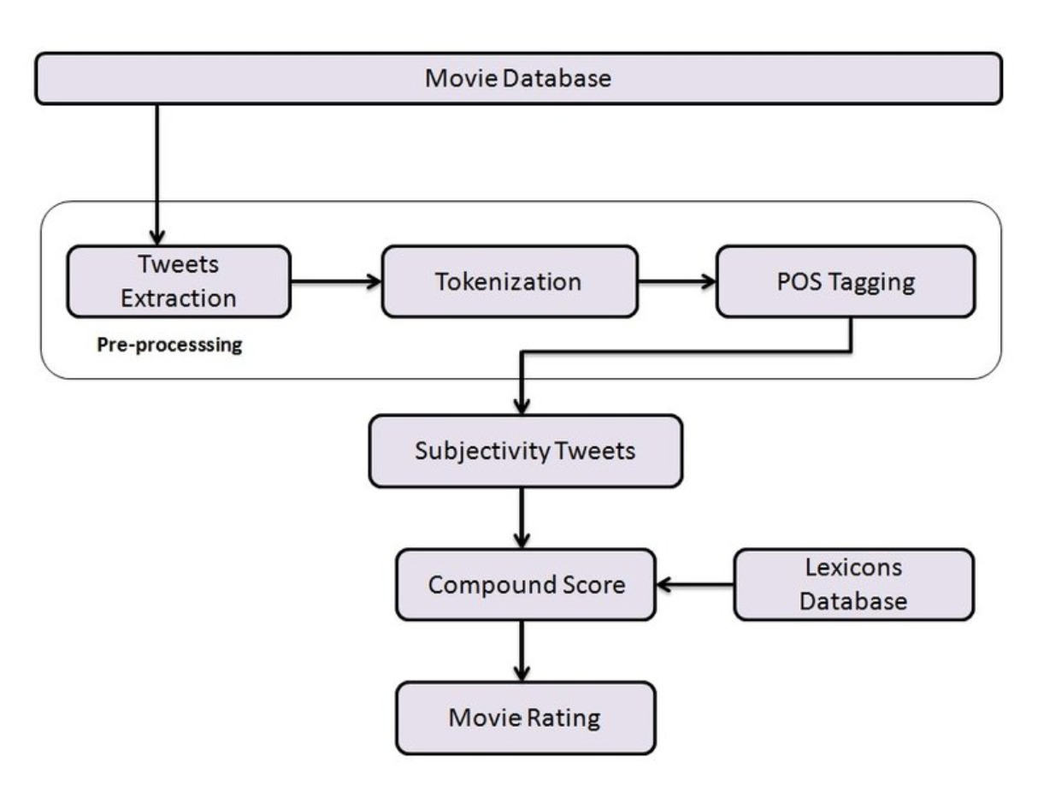
Sentiment Analysis (VADER)
VADER returns compound sentiment scores [-1 to +1].
Applied to “pros” and “cons”.
Reviews with more negative cons were mostly high burnout.
Prem Pasupuleti
G01510830

Slide 17
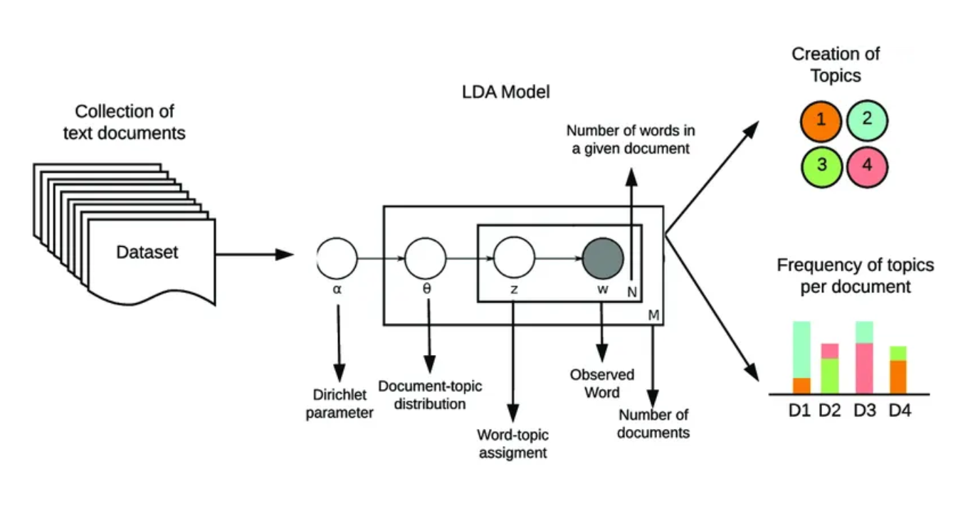
Topic Modeling (LDA)
Used Latent Dirichlet Allocation (LDA) on “cons”.
Extracted 5 dominant themes:
Poor leadership
Long hours
Poor pay
Job insecurity
Toxic culture
Prem Pasupuleti
G01510830

Slide 18
Classification Models
SVM (best performance): robust on sparse data.
Naïve Bayes: fast, interpretable baseline.
Random Forest: handles non-linear relationships.
Uttam Yeramella
G01478812

Slide 19
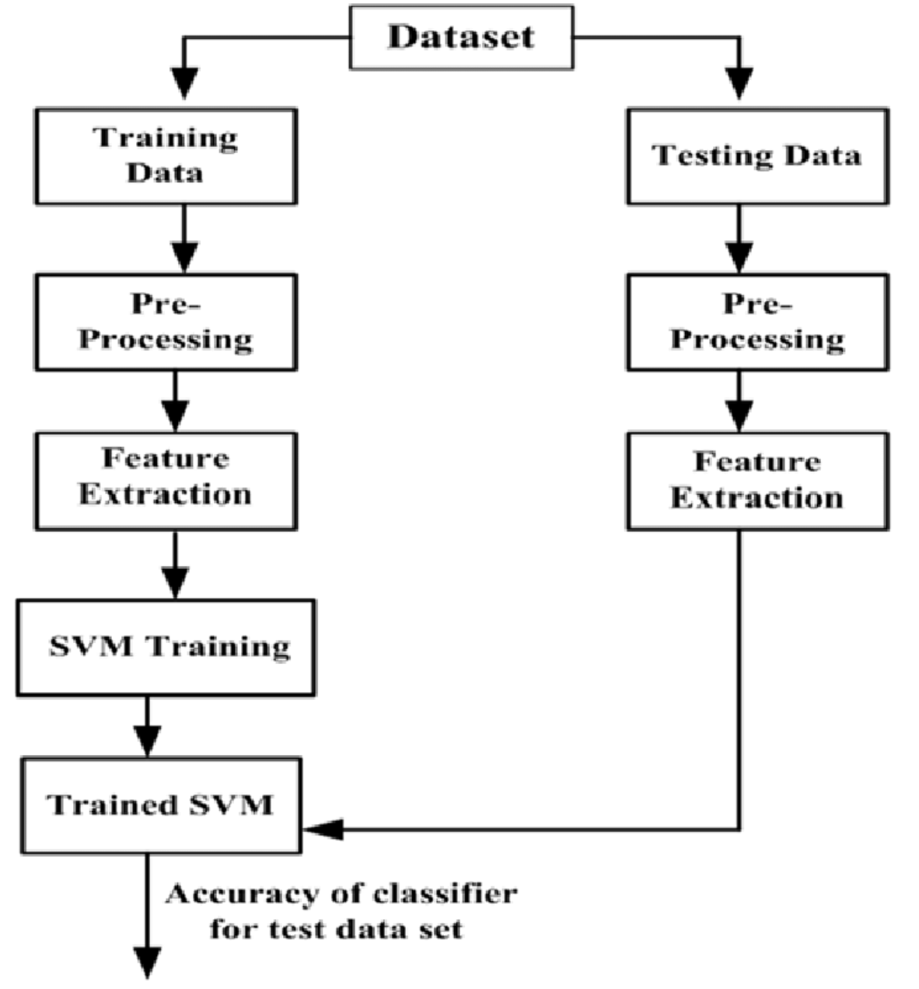
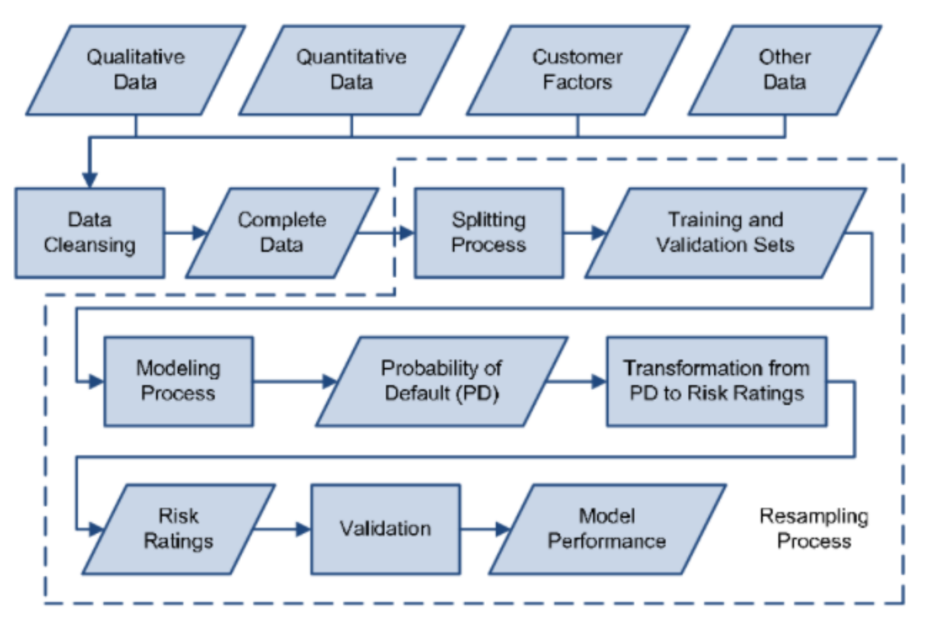
Classification Models - Visualizations
Uttam Yeramella
G01478812

Slide 20
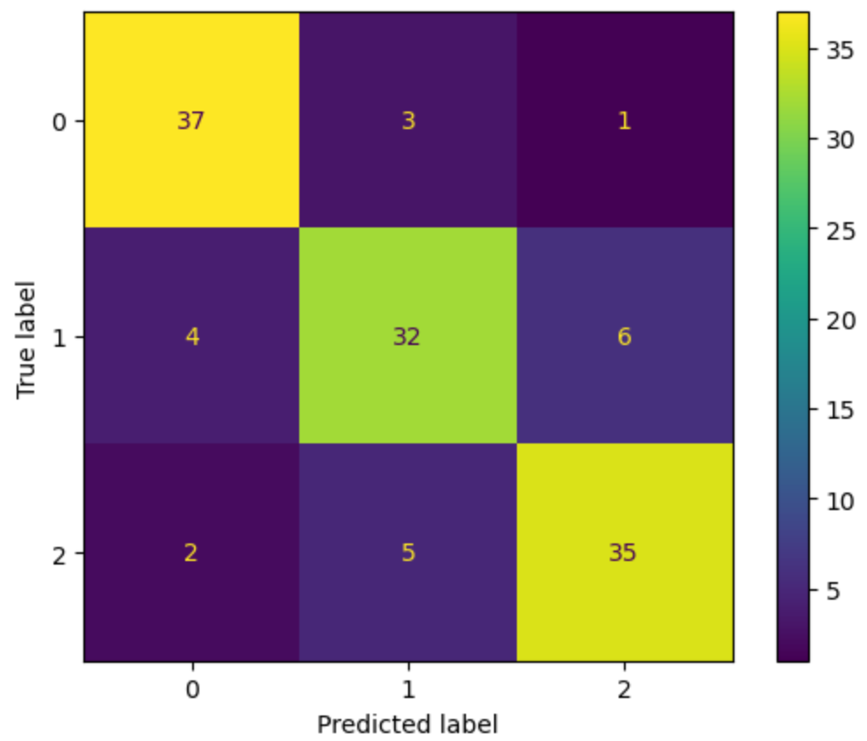
Evaluation Results
Removed ‘rating’ field to prevent data leakage.
Applied SMOTE for class balance.
Final performance:
SVM: F1 = 0.83
Moderate burnout detection jumped from 0 → 0.70+
All models scored F1 > 0.75
Confusion Matrix for SVM
Uttam Yeramella
G01478812

Slide 21
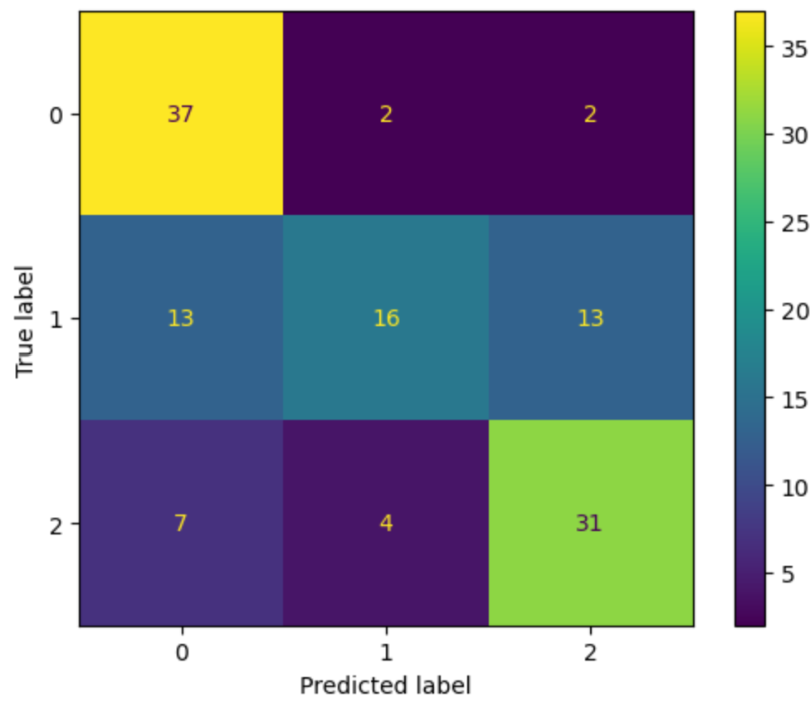
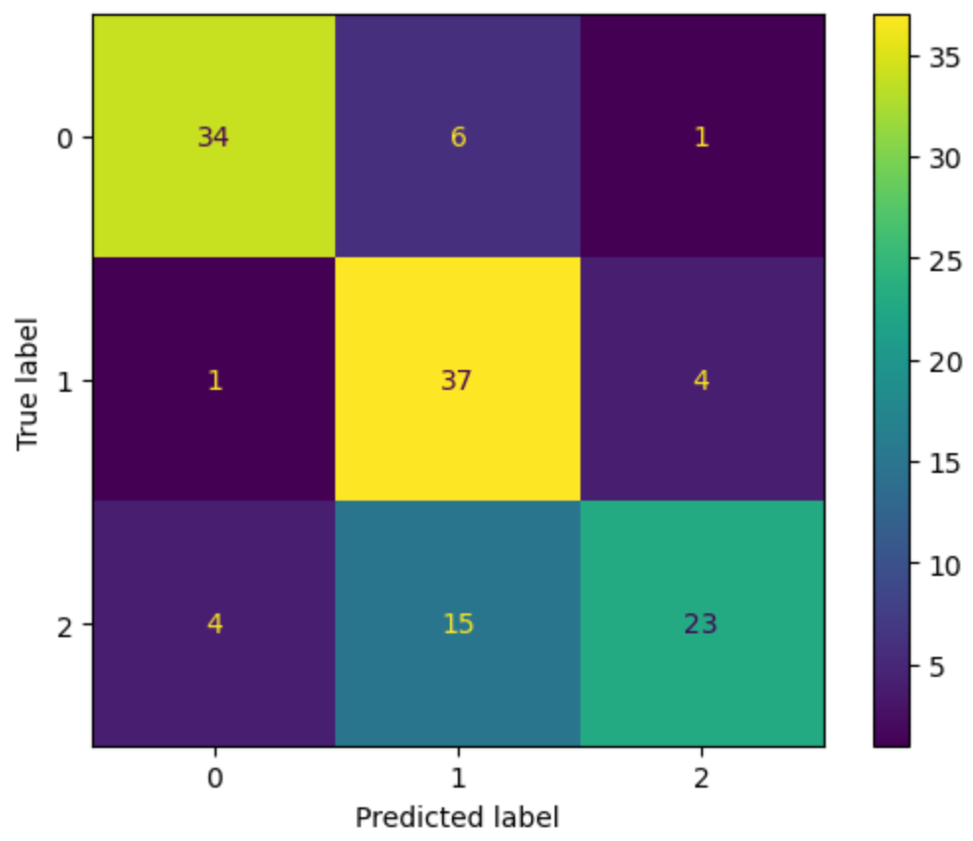
Evaluation Results
Confusion Matrix for GNB
Confusion Matrix for RF
Uttam Yeramella
G01478812

Slide 22
Conclusion
Key Takeaways:
Burnout can be effectively detected using Natural Language Processing and Machine Learning techniques on employee review data.
Glassdoor reviews provided a rich, real-world dataset covering diverse workplace experiences.
Sentiment analysis (VADER) and topic modeling (LDA) helped uncover hidden burnout patterns in textual reviews.
Among all models, SVM achieved the best performance with an F1 score of 0.83, demonstrating high accuracy across burnout levels.
The results confirmed our hypotheses: negative sentiment and certain themes (e.g., poor leadership, long hours) strongly correlate with high burnout.
Impact:
Our model provides a scalable and interpretable solution for organizations to monitor employee well-being.
It can assist HR departments and job seekers in evaluating company culture and warning signs of toxic work environments.
Uttam Yeramella
G01478812

Slide 23
Challenges Faced
Unstructured Text Data
Reviews were inconsistent and informal, requiring extensive preprocessing for meaningful analysis.
No Direct Burnout Labels
We inferred burnout levels from ratings, introducing ambiguity and complexity in label validation.
Imbalanced Classes
Moderate burnout cases were scarce. We used SMOTE to balance the dataset and improve model fairness.
Risk of Overfitting with Ratings
Ratings closely mirrored labels. To avoid data leakage, we excluded this feature during training.
Topic Interpretation Challenges
LDA themes were sometimes vague or overlapping, requiring manual review to assign meaningful labels.

Slide 24
Future Work
Use BERT or other deep learning models for better language understanding.
Include data from Reddit, Indeed, Blind to widen coverage.
Add temporal analysis (burnout trends over years).
Include explainability tools like SHAP.
Build a real-time burnout monitoring dashboard.

Slide 25
We sincerely appreciate your attention. Thank you!

