Slide 1
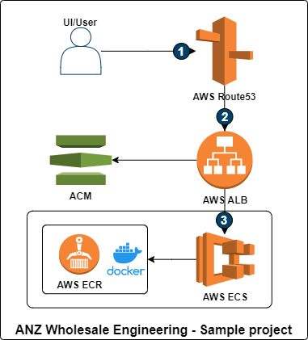
ANZ Wholesale Engineering – Sample Project
Spring boot based REST APIs are created based on provided requirements. The application is deployed into AWS and made available via HTTPs endpoints.
Features are present to obtain paginated and filtered information. H2 in-memory database is used to store demo data that supports the APIs. Method calls are also cached so that multiple calls to database are not made. The APIs are documented using Swagger UI. JPA interface based projections are used to respond with only required attributes.
Actuator endpoints are exposed to determine application health, information and metrics.
API to fetch accounts that belong to a specific user - /users/{id}/accounts
API to fetch transactions for the provided account - /accounts/{accountNumber}/transactions
How to access the application and underlying code
The code of application is checked-in to Github as a public repository, the repository can be accessed by using the following link, https://github.com/Uttam92477/wholesale
The application endpoints are directly accessible using the following links https://anzwholesale.learnerdev.com/users/1/accounts https://anzwholesale.learnerdev.com/accounts/a1/transactions
The application can also be started locally. The commands and prerequisite environment details are provided in the application documentation in README.md file
Solution Design
Key Features | Description | Technology/ Framework used
HTTPs endpoints | The application is deployed in AWS and HTTPs endpoints are available to be consumed. ACM Certificate is attached to load balancer lister to enable HTTPs. | ACM, AWS ECS, AWS ECR, AWS ALB, Route53
Pagination | Request parameter based page querying is available. Supported queries pageNo, pageSize | Spring boot - Pageable
Filters | Transaction type filter is available for querying transactions. Query param - transactionType | Spring boot
Actuator endpoints | The default health, info and metrics actuator endpoints are enabled and more can be enabled if required | Spring boot actuator
Swagger | Application specification is available both as swagger JSON spec and swagger UI at /swagger-ui and /v2/api-docs | springfox swagger
H2 DB and seeding | Automatic demo database is created at startup and required data is seeded so that demo works as expected | H2 DB, Spring JPA
Cache | The method responses are cached so that we don’t query DB frequently | Spring boot – Cacheable
Flow | Description
1 | The API is exposed through Route53 using a custom sub-domain. UI/API user can access the API by making a HTTPs call to the endpoint
2 | The Route53 A record routes traffic to an application load balancer. The application load balancer uses certificate provided by ACM to enable HTTPs listener
3 | The load balancer sends the traffic to the API hosted as AWS ECS service by means of a target group

