Slide 1


Slide 2
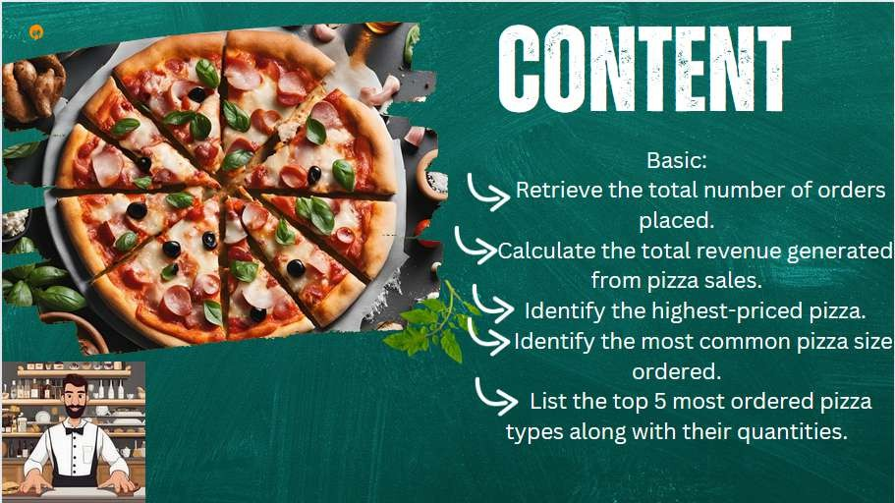

Slide 3
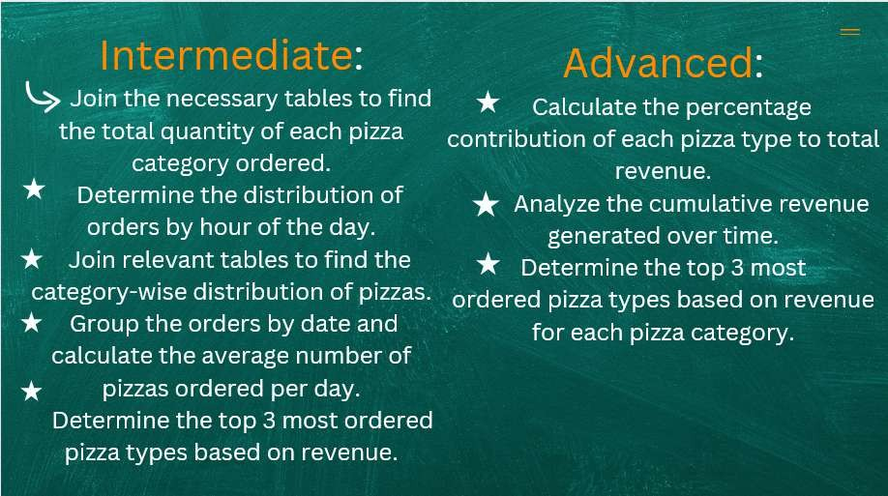

Slide 4
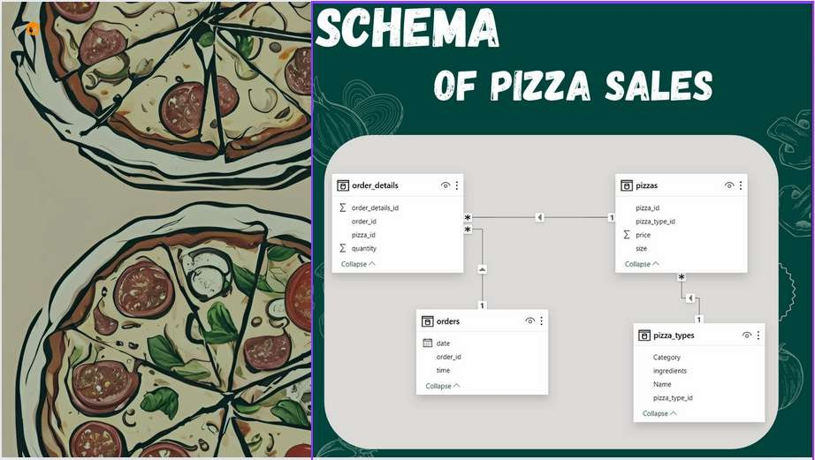

Slide 5



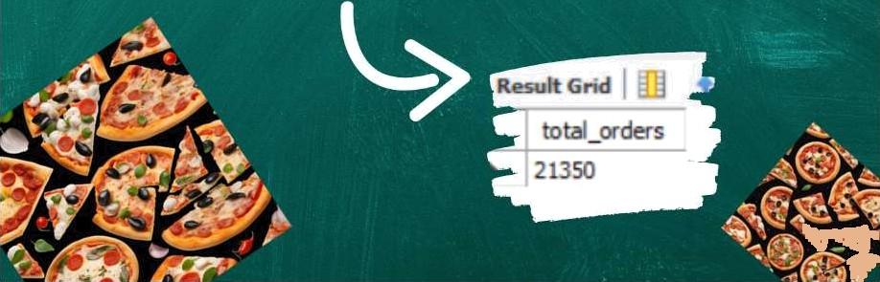
s ct ec*.
. (ocde c id ) as total ocder s + cm ocdees ;

Slide 6
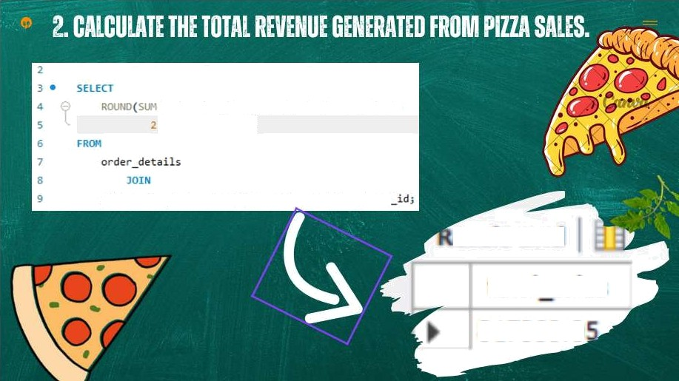
(orde r detai1s . quanti ty “ p Tzzas .pnlce) ,
) AS tota1 salc
pi uza s Ole p S-zas .p1;• za id = orde• deI a i 1 s . pla za
total sales
8 178/ï0.0

Slide 7
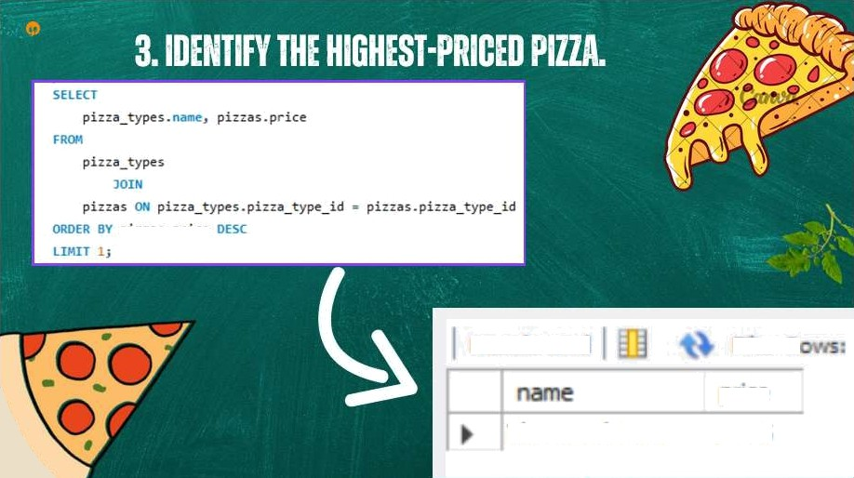

Resuh God
price 35.95
The Greek Pizza

Slide 8
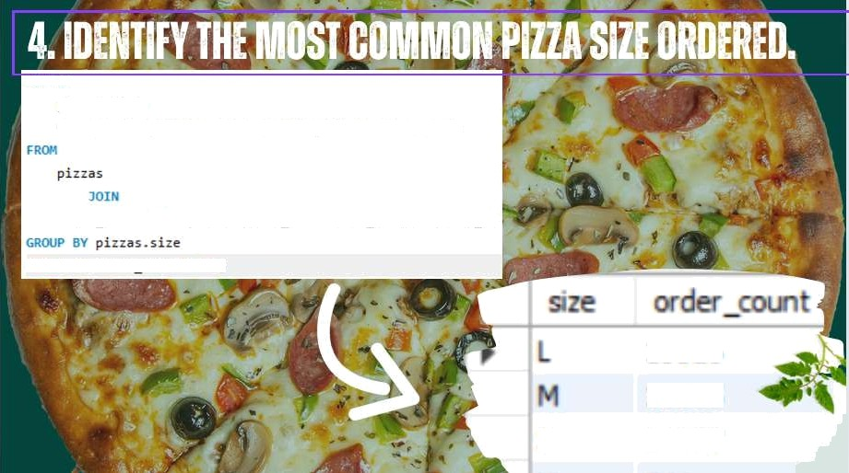
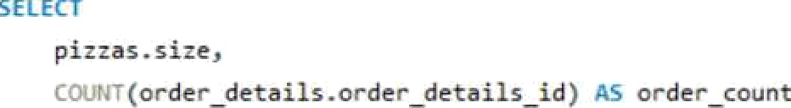
9 S8I
S8EST
S
ZET¥I

Slide 9
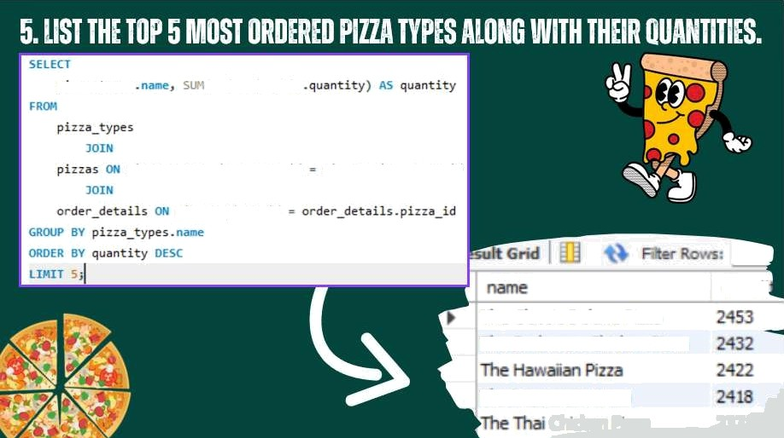
p in.a cypes
(cr de= det ai 1 s
p1z za_t\'pes . p1zza_type_1d
plzza s . p iz za_t ype_id
pi--as.pia-o id
quanb
The Classic Deluxe Pizza
The Barbecue Chicken P zza
The Pepperorii Pizza

Slide 10
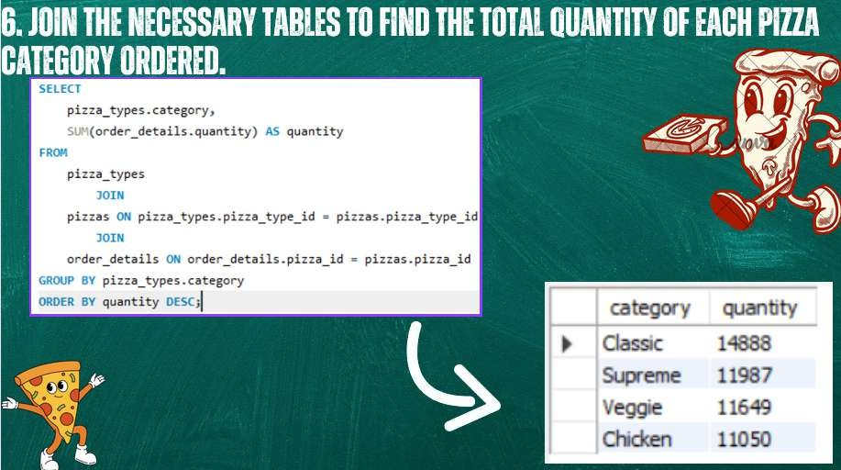

Slide 11
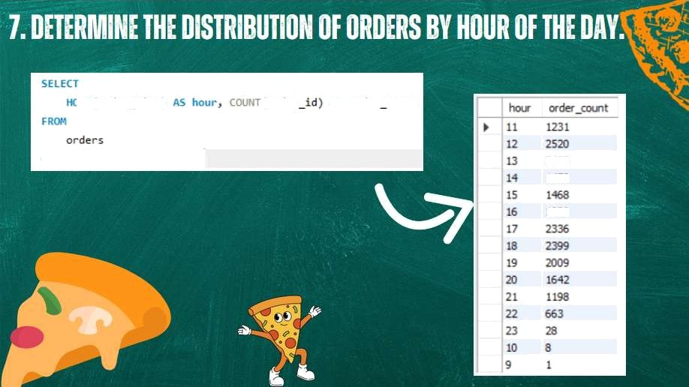


›'.: fł ( c r de'- II me )
(prder
Aa crder count
1920

Slide 12
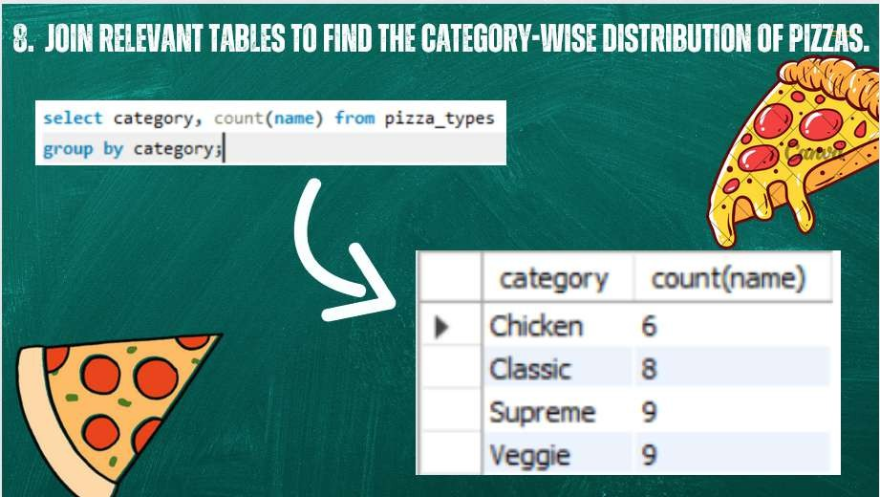

Slide 13
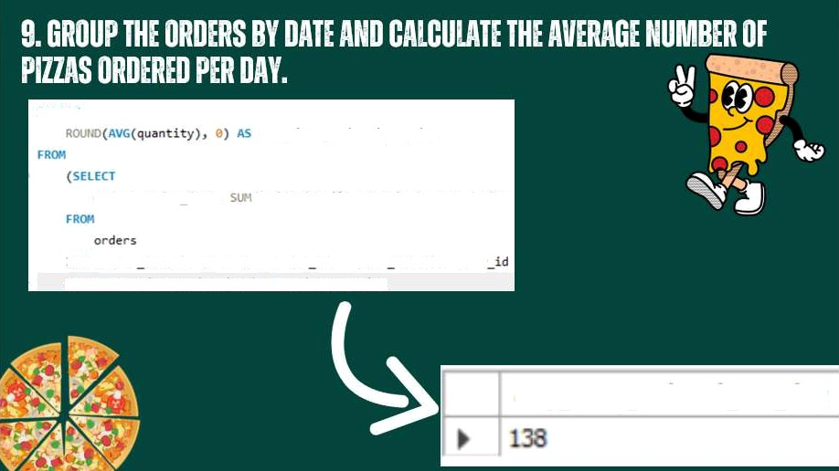
SELtCT
avg p i zr: a o dered per day
or de r s . onder date ,
(cnden det a ils. quant it y) •’ S quant ity
!‹!1 H arde - details ''›*J onde-s .order id - order detall s . o-der 6ROUP gY orders .order date) CS orden quant ity
a 'g_p‹zza ordered_per day

Slide 14
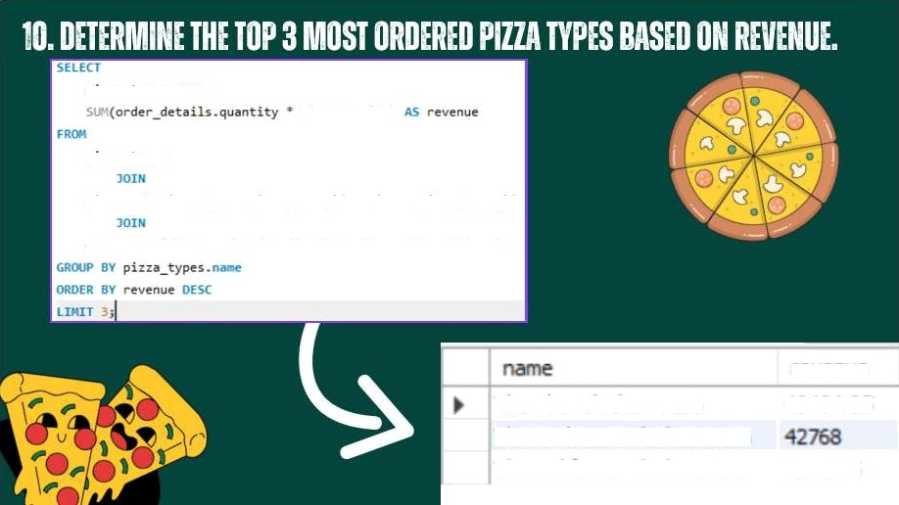
pt: :a s. pr ice )
p1z-a types
pi z zas 0'I qi z la
type s - p i :z a type id - pi sha s - pi sha type id
order
det ai 1 s :'i
order det a i1 s . p1z:a id =
piz zas . p iz:a id
revenue 13131. 25
The Thai Ch‹cxen Plzza
The Barbecue Chicken P|zza
The Califgrnia Chicxcn Pizza
+tX9.5

Slide 15
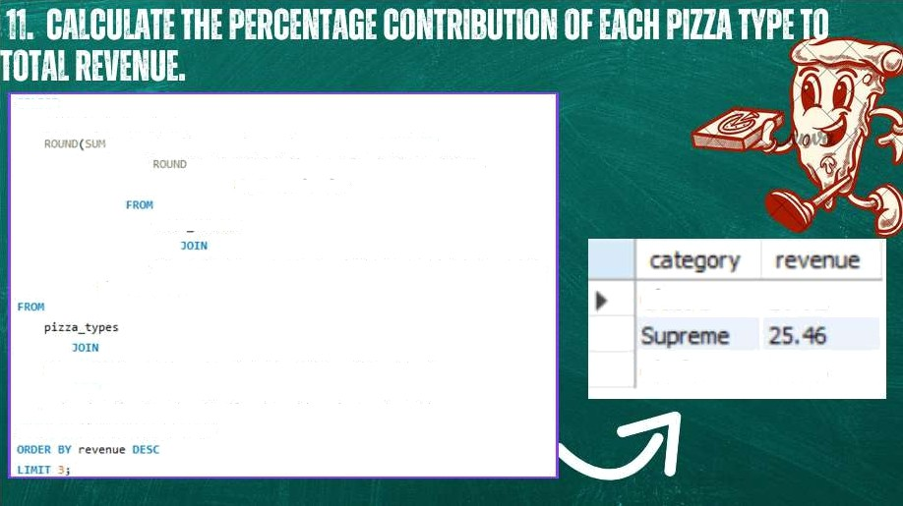
•
(o rde r
det ai I s . qvan t i ty ' pi z za s . pri ce) / ( S*' r f:6 !
' ) dS lota 1 sa le s
orde'r de tai Zs
Classic
26.91
pi: :as r'" p i::a types pi: :a type id - p i::es . pi: :e type id
IOlN
anden de t a i 1s t ** o-der deta iIs . pizza *d = pizzas . pizza id
‹: -f°Hf’ F› pi -z a_type s . ca tegony
Chicken
23.96

Slide 16
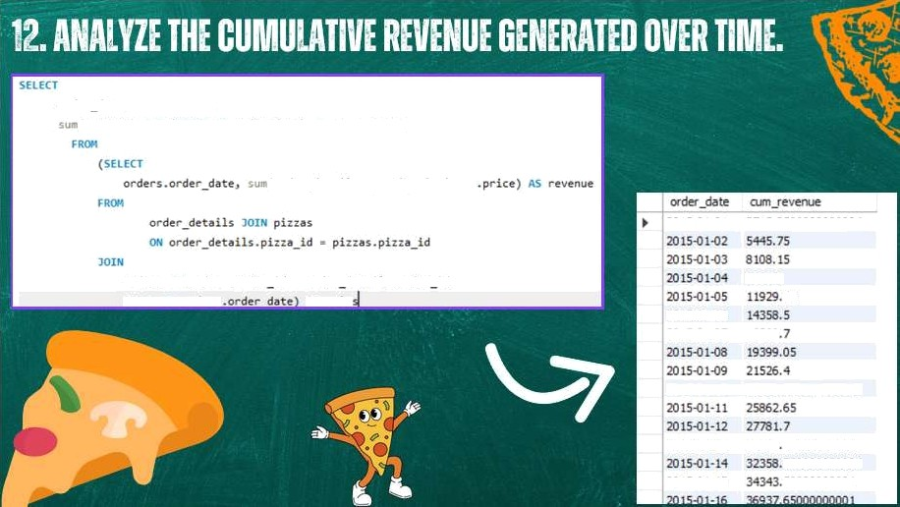
20 Ł54 I-0 ł
27Ł3.9500000000001
9863.6
2OI5OL06
20 IS•0 I •07
16560
20 IS-0 I-ł0
23990.3 &00000002
20 IS4 I- l3
29831 300000000003
7D0O0O000O04
800Q00Q00Q1
20 tS.0 I. 15

Slide 17
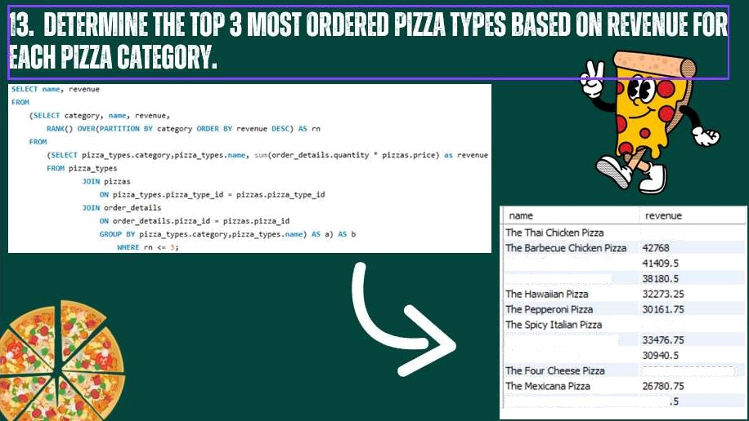
4]404.25
szæs.as

Slide 18


