Slide 1
Online Retail Sales Analytics
Interactive-style dashboard screenshots for resume/portfolio

Slide 2
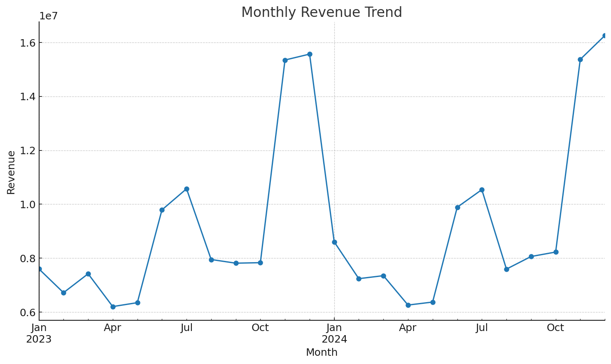
Monthly Revenue Trend
Seasonality visible with higher revenue during Nov–Dec; mid-year promo uplift in Jun–Jul.

Slide 3
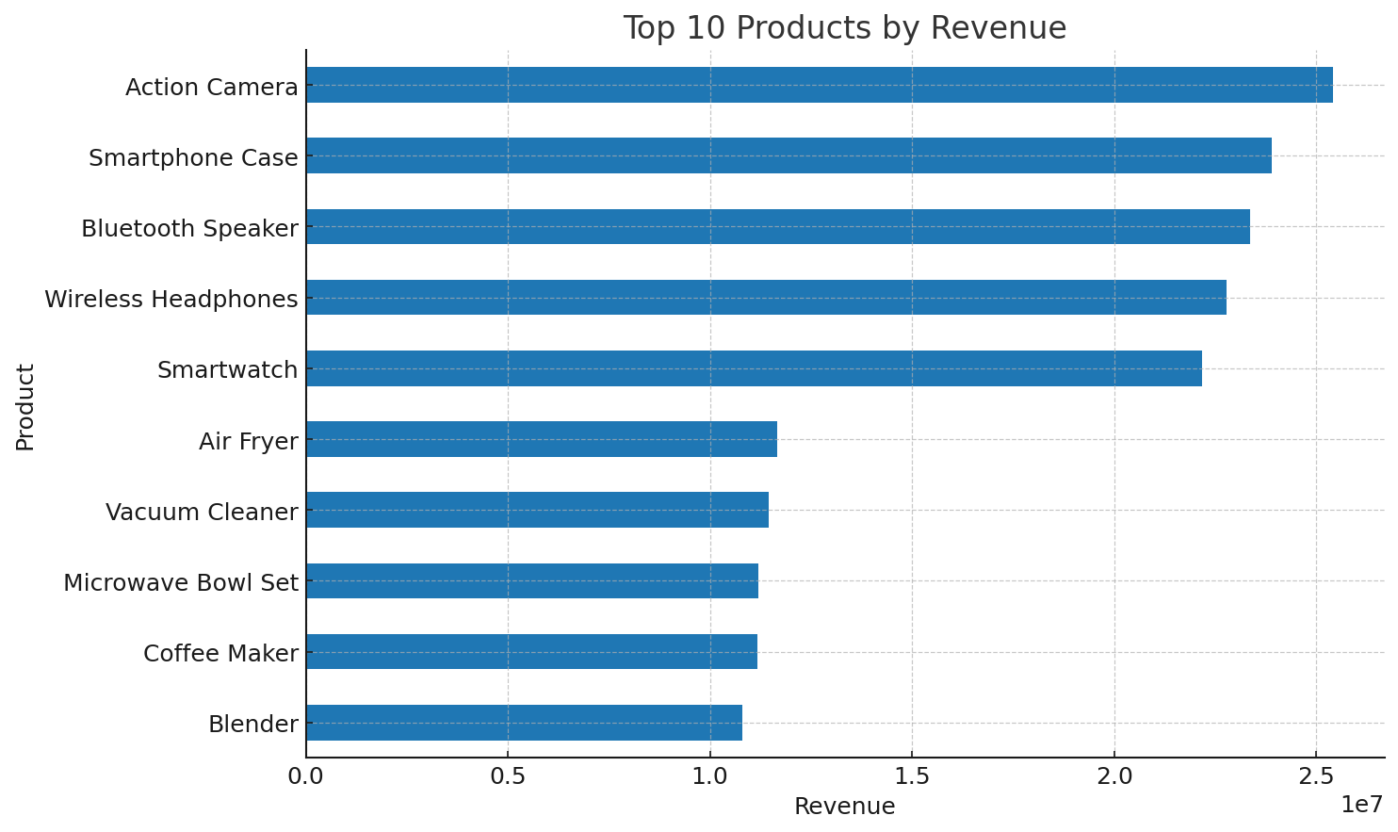
Top 10 Products by Revenue
Focus inventory and ads on top performers; test bundles for long tail products.

Slide 4
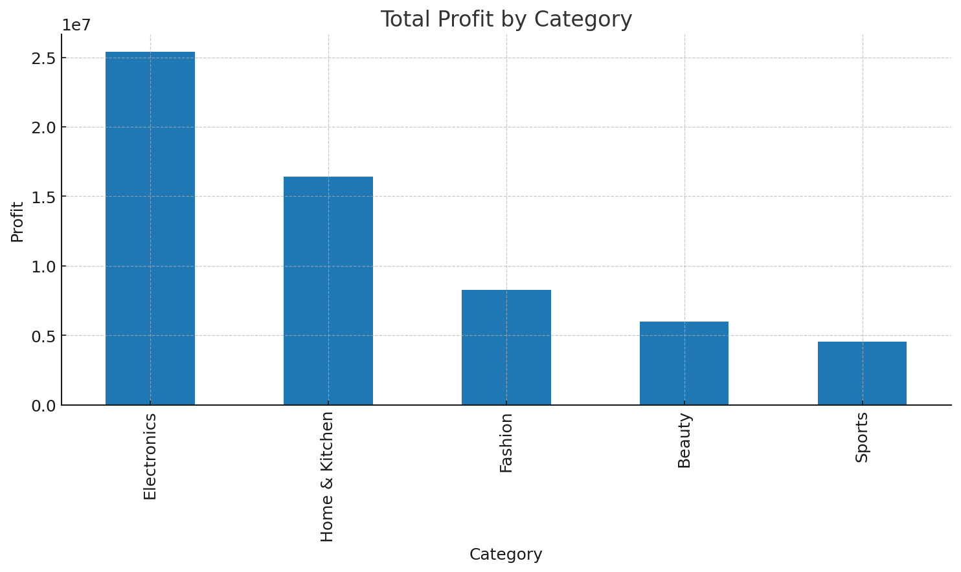
Profit by Category
Electronics drives revenue; Beauty/Fashion show strong margins.

Slide 5
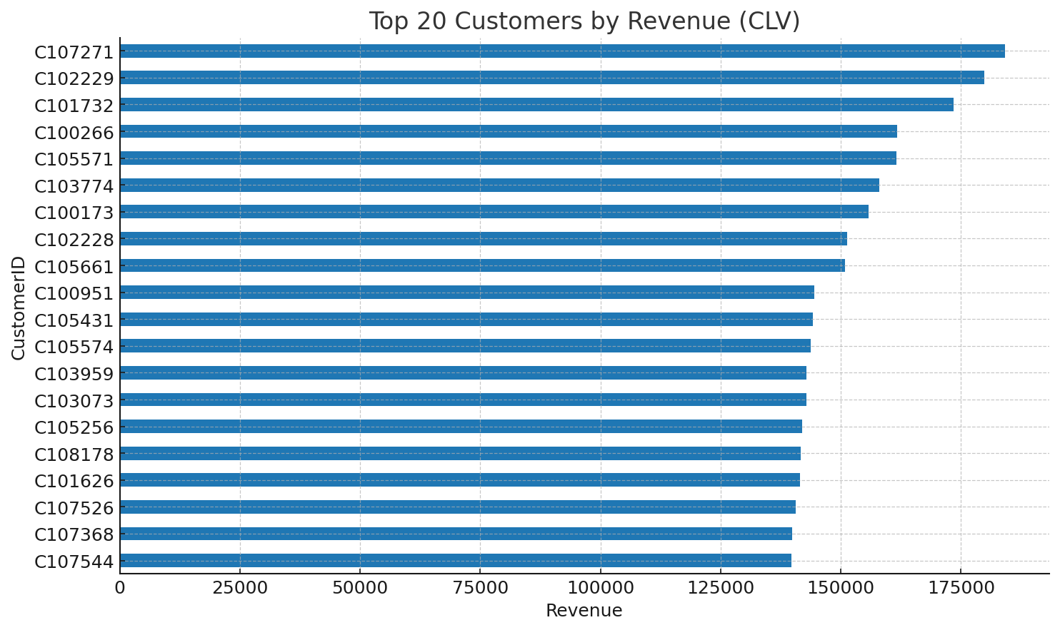
Top 20 Customers (CLV)
Target high-value customers with loyalty and exclusive offers.

Slide 6
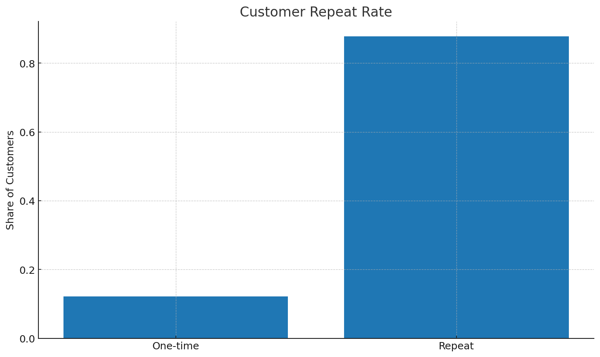
Customer Repeat Rate
Significant one-time buyer segment—scope for retention campaigns.

Slide 7
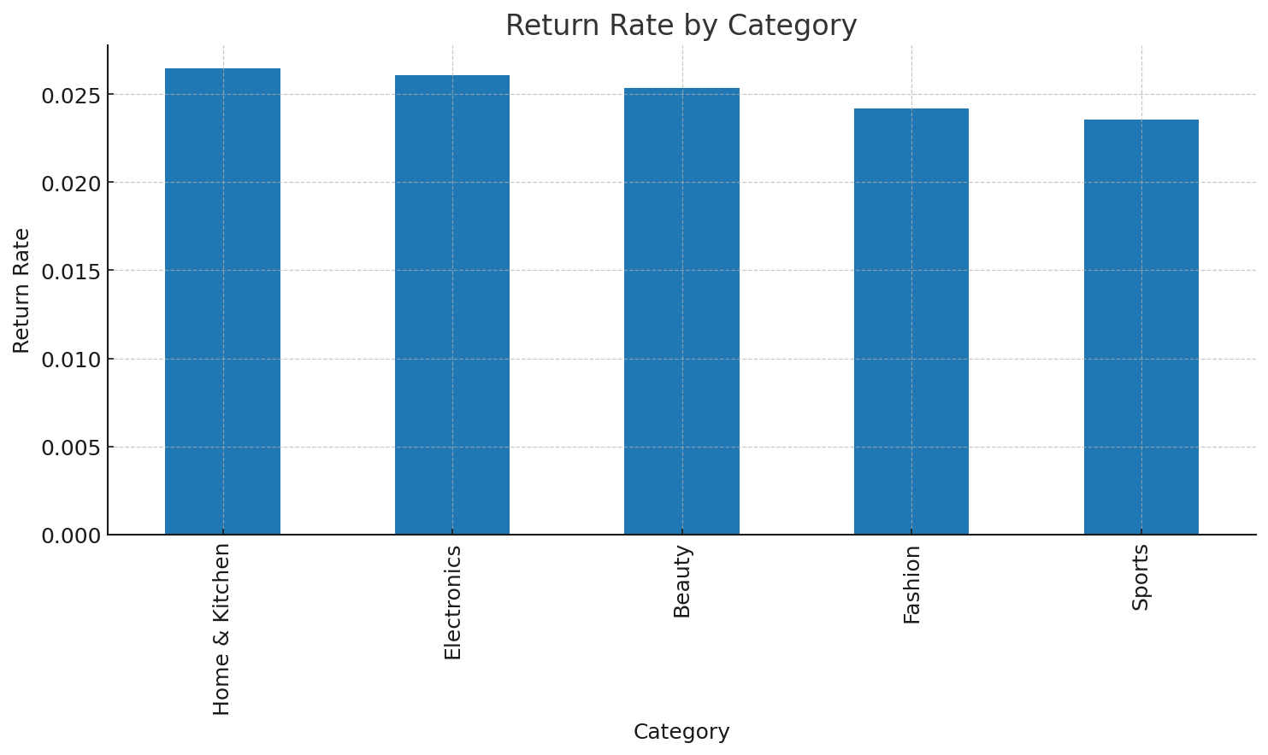
Return Rate by Category
Track returns and adjust quality checks and product pages.

