Slide 1
Hospital Management System Group 03
Presented By,
Group-03

Slide 2
Content
Introduction
Manual System
Objective
Features
Benefits
Application Design
Schematic Diagram
Database Design
Table Structures
Technologies Used
Advantages
Applications
Future Improvements
Conclusions

Slide 3

Introduction
The Hospital Management System (HSM) is designed for any hospital to replace their existing manual or passed system. This Application targets is to provide complete solution for hospital and health care system.
A hospital management system is a Application that assists health care providers in properly doing their jobs and managing information linked to health care. They manage the data related to all departments of hospital such as admin, doctor, patient.

Slide 4
In today’s world, the management of healthcare starts from the hands of the patients through their mobile phones and facilitates the needs of the patient.
HMS was introduced to solve the complications coming from managing all the paper works of every patient associated with the various departments of hospitalization with confidentiality.
HMS provides the ability to manage all the paperwork in one place, reducing the work of staff in arranging and analyzing the paperwork of the patients. HMS does many works like:
1) Maintain the medical records of the patient
2) Maintain the contact details of the patient
3) Keep track of the appointment dates

Slide 5
Existing System / Manual System
Hospitals currently use a manual system for management and maintenance of critical information.
The current System requires numerous paper forms with data stores spread throughout the hospital management infrastructure.
Multiple copies of the same information exist in the hospital and may lead to inconsistencies in data in various data stores.

Slide 6
Manual system Disadvantages
Lack of immediate retrievals.
Lack of immediate information storage.
Lack of prompt updating.
Preparation of accurate and prompt reports.

Slide 7
Objective
Main objectives of a HMS is:
Define hospital Management System.
Recording information about the Patients.
Maintaining information about the doctors.
Reduce hospital operating costs.
Maintaining of Data Records.
Multi user Function.

Slide 8
Features
Useful for large, medium hospital and nursing homes.
Easy to get Appointment.
Users can view about hospital, doctors .
Saving paper work.
Friendly user interface

Slide 9
Benefits
Minimize hand Written work from appointment to patient discharge.
It is a huge time saver and really facilitates proper communication among the management, doctors and the patients.
It helps us to minimize works and take care of the functionality of hospital.
Overall cost reduction.

Slide 10
Application Design
Hospital Management System(HMS) is divided into 5 modules:
1) Admin Module
2) Doctor Module
3) Patient Module
4) Appointment Module
5) Invoice Module

Slide 11
Admin
Admin can view all appointments details.
Admin can view booked appointments details.
Admin can view unbooked appointments details.
Admin can view appointment by id details.

Slide 12
Doctor
Doctor can see all doctors.
Doctor can remove doctor/update doctor
Doctor can see all permanent doctors.
Doctor can see all hold doctors.
Doctor can see doctor by id.
Doctor can see doctor by specialization.

Slide 13
Patient
Patient can an view doctor's details.
Patient can view their booked appointment status.
Patient can book appointments.
Patient can view Invoice.

Slide 14
Invoice
Admin and Patient can save the invoice.
Admin can update invoice.
Admin can delete invoice.
Admin can see all invoices.
Admin can get all invoice by id.

Slide 15
Appointment
Admin and patient can view all the appointments.
Admin can update /delete the appointments.
Admin can get the appointments status.

Slide 16
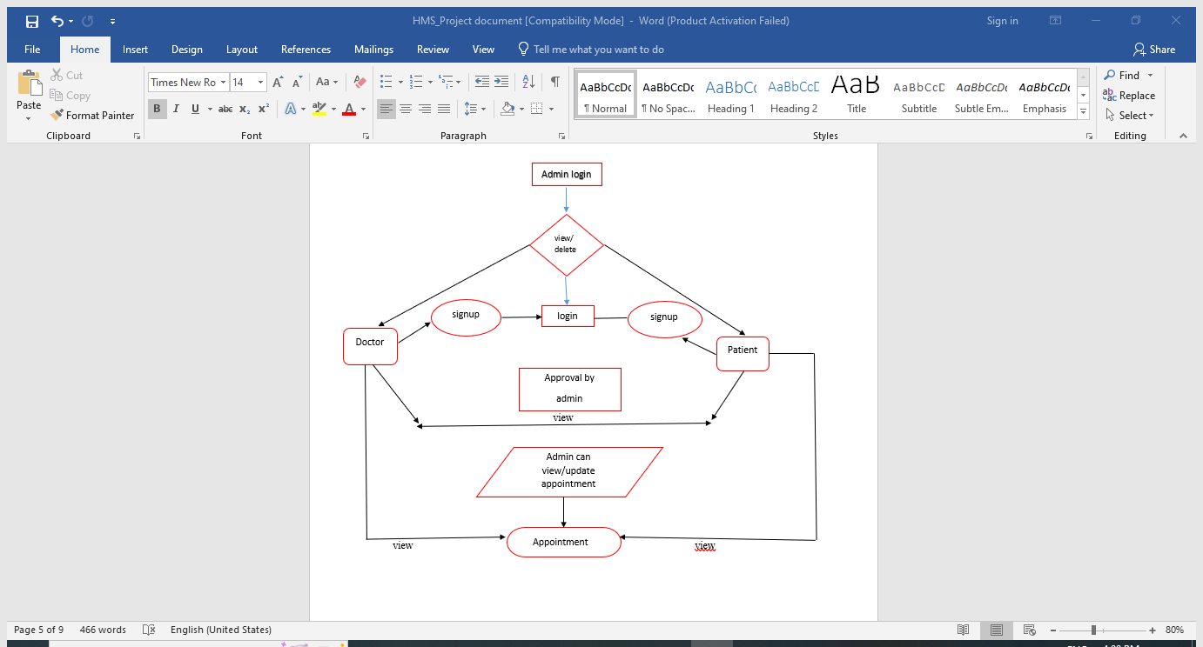
Schematic Diagram

Slide 17
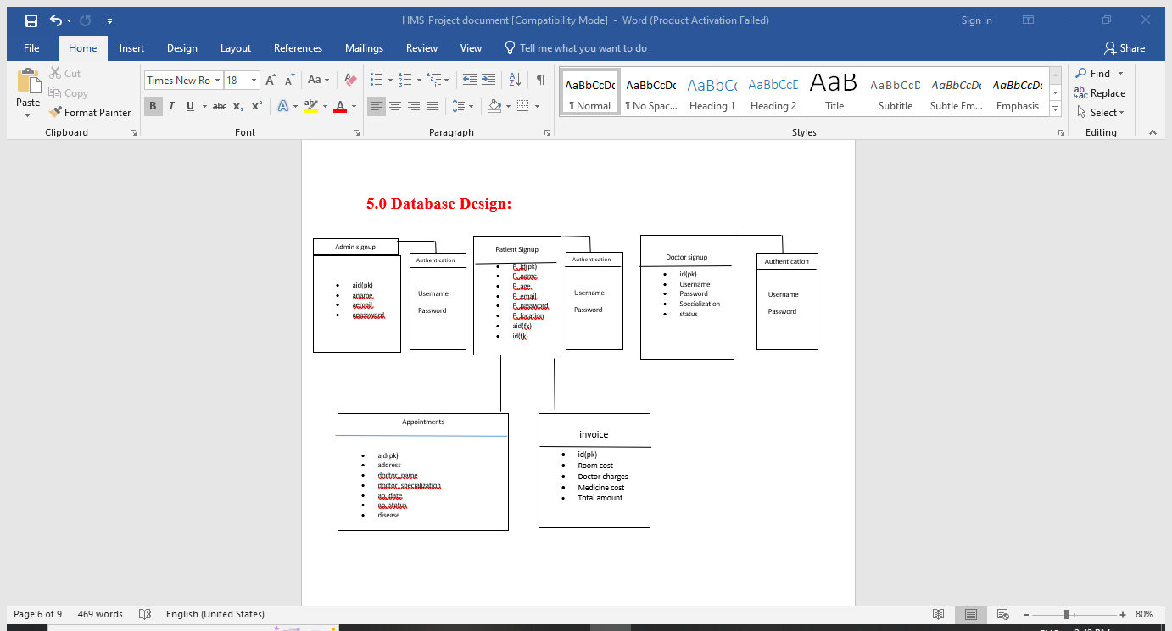
Database Design

Slide 18
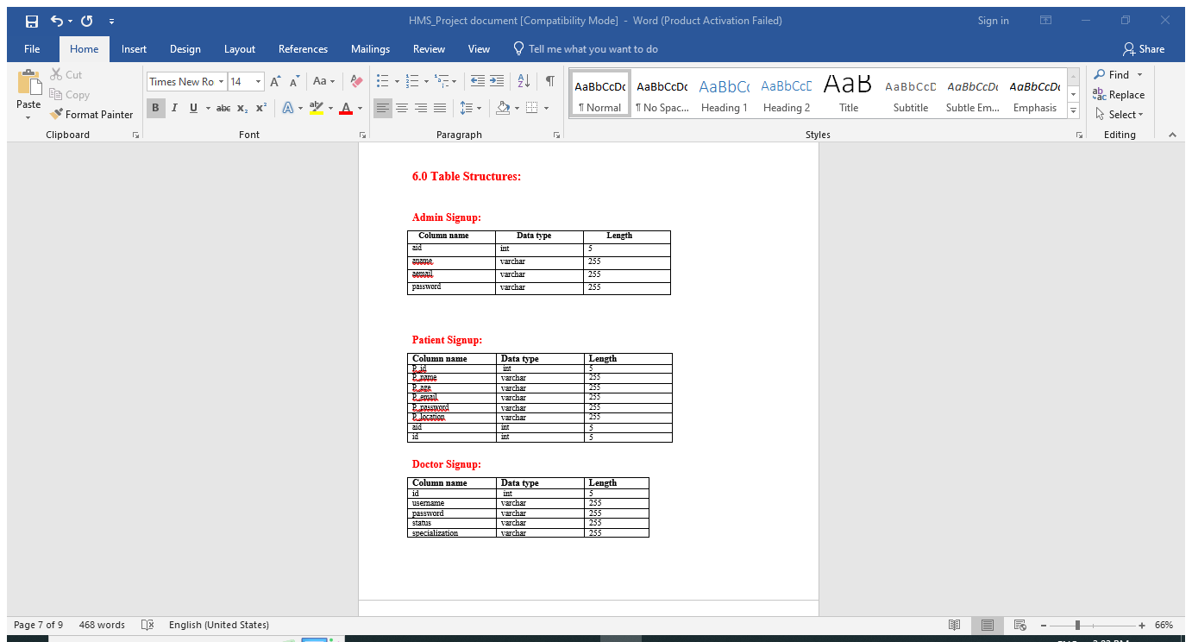
Table Structures

Slide 19
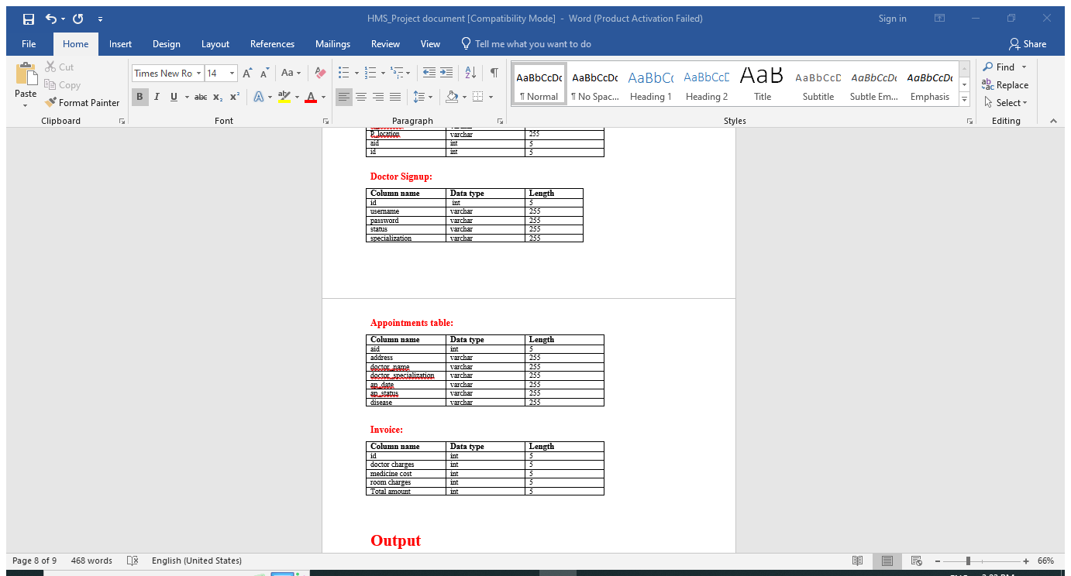
Table Structures

Slide 20


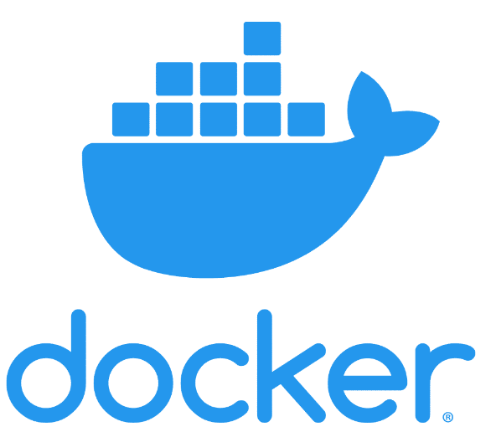

Technologies Used
Server Side: SpringBoot, Spring Cloud, Spring Data JPA
Database: MySQL
Server: Eureka Server
DevOps: GitHub, Docker

Slide 21
Source code and demonstration

Slide 22
Advantages
Time-saving Technology
Improved Efficiency by avoiding human errors
Cost effective and easily manageable
Saving paper work
Friendly user interface
Easy access to patient data with correct patient history
Data security.

Slide 23
Applications
HMS can be useful for large, medium hospital and nursing homes.
Can give facility different type of enquires.
Management can maintain data regarding patient, doctors easily and it can be updated easily.
User friendly.
Immediate data access.

Slide 24
Future Improvements
Some of the modules can be implemented such as:
1)Report Management.
2) Laboratory Management
3) Security Enhancement.
4) Pharmacy Management.

Slide 25
Conclusions
Hospital management systems allows us the ability to optimize and digitize all the processes within the institution, which will help to improve customer service, reduce process costs. Implementation of hospital management system project helps to store all the kinds of records.
provide coordination and user communication, implement policies, improve day-to-day operations. HMS provides the ability to manage all the paperwork in one place, reducing the work of staff in arranging and analyzing the paperwork of the patients.

Slide 26


