Slide 1

Manufacturing RFQ Management
Team-8
241344 – Sai Srujan Emula
235119 – Navya Madhiraju
241598 – UttejKumar Avula

Slide 2
System Architecture Diagram
Supplier Microservice
Fabricate App
Authorization
Plant Microservice
Admin
RFQ Microservice

Slide 3
Development & Designing

Slide 4
MICROSERVICES
JWTAuth Microservice : to handle authentication of the Supplier
Supplier Microservice : to handle supplier related services
Plant Microservice : to handle stock replenishment of plant
RFQ Microservice : to get the RFQ details from plant and supplier

Slide 5
AUTHORIZATION MICROSERVICE
REST ENDPOINTS
/getToken - to login the employee and generate jwt token
/getuname - to validate the jwt token

Slide 6
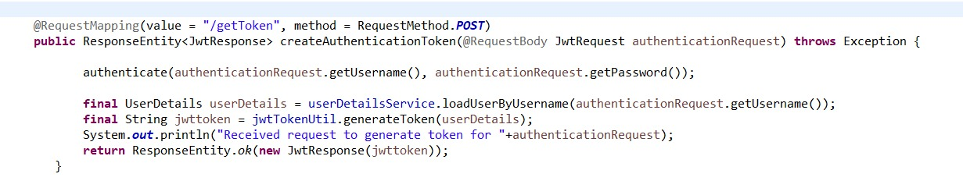
Rest Controller

Slide 7
SUPPLIER MICROSERVICE
REST ENDPOINTS
/supplier/getAllSupplier - to view supplier details
/supplier/getSupplierOfPart/{part_id} - to view supplier details by part id parameter
/supplier/addSupplier - to add the new supplier
/supplier/editSupplier - to edit the supplier details
/supplier/updateFeedback - to update the feedback

Slide 8
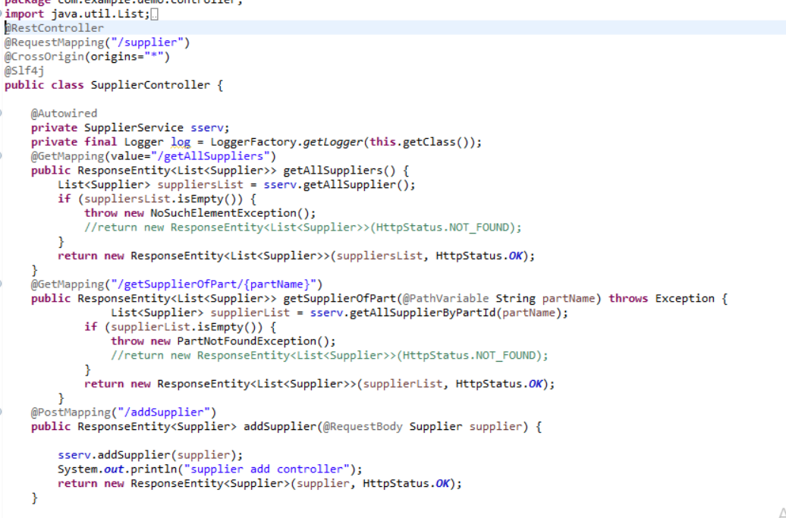

Slide 9
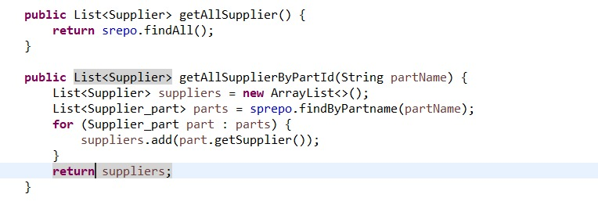
Supplier Service

Slide 10
PLANT MICROSERVICE
REST ENDPOINTS
/plant/viewPartsReOrder - to view parts that needs to be reorder
/plant/viewStockInHand/{part_id} - to view stock details
/plant/updateMinMaxQuantity/{part_id}/{min}/{max} - to post updated min, max count

Slide 11
RFQ MICROSERVICE
REST ENDPOINTS
/rfq/getRFQOfPlant/{part_id} - to get the RFQ details of parts based on part id
/rfq/getPotentialVendorsOfRFQ/{rfq_id} - to get the list of vendors who has the feedback rating above 7

Slide 12
USER INTERFACE

Slide 13
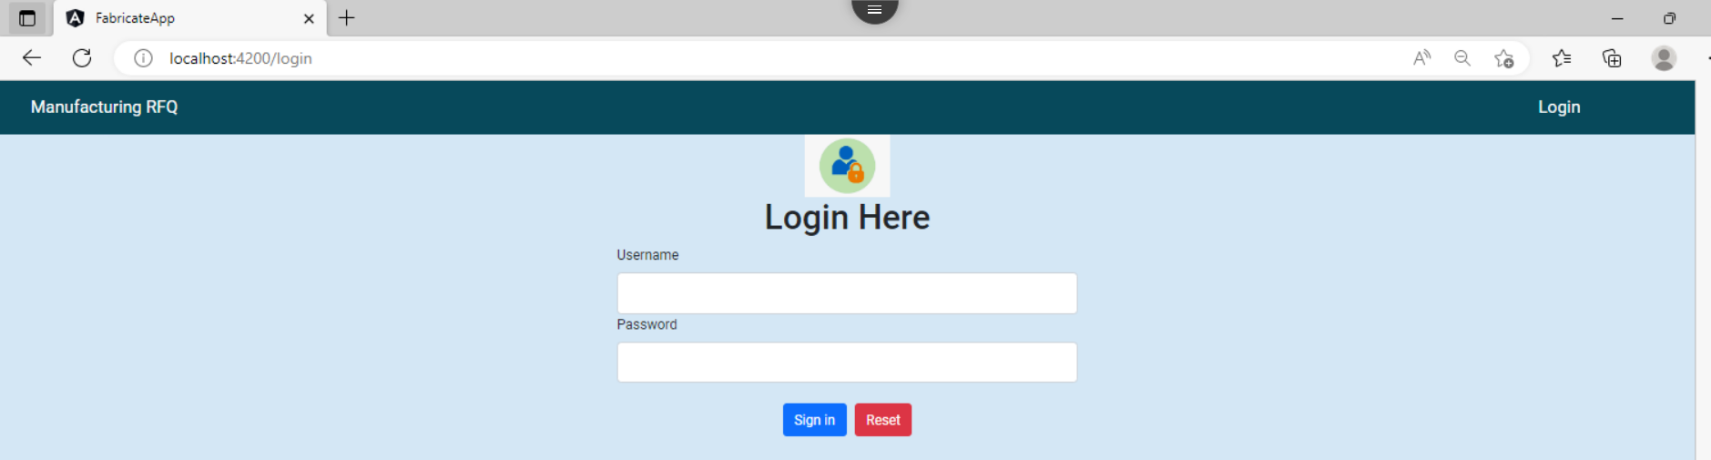

Slide 14
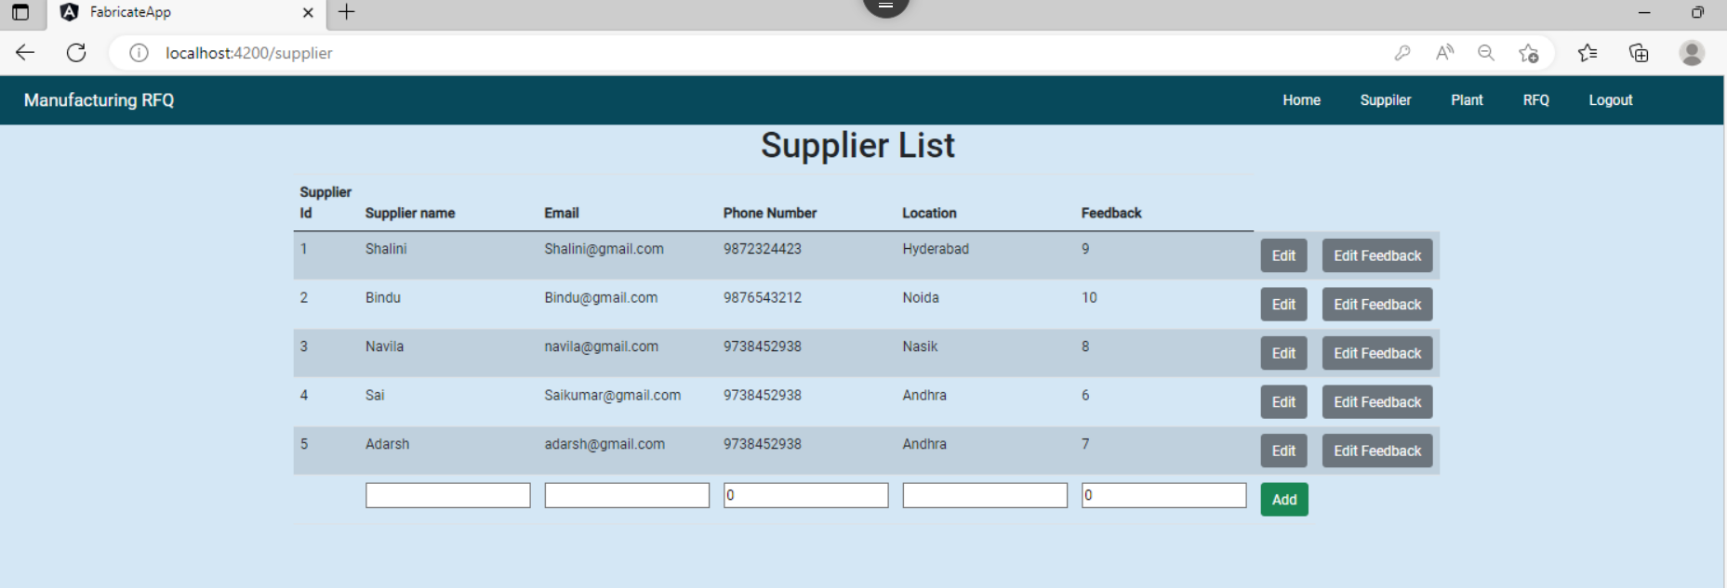

Slide 15
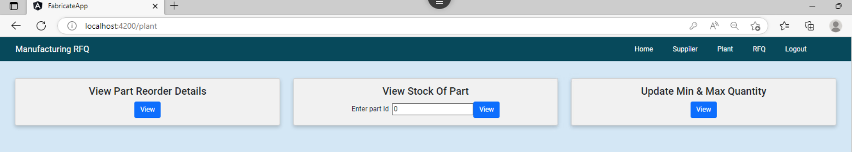

Slide 16
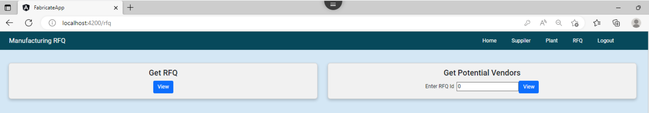

Slide 17
THANK YOU

