Slide 1
Text Classification/Clustering & Topic Modeling
Using Embeddings from Pretrained LLMs
Semantic Text Analysis and Topic Discovery Using Pretrained LLM Embeddings
Generative AI Course Project (Topic #10) — Group of 5 Members

Slide 2
1. Problem Statement & Motivation
Unstructured text repositories require automated classification, clustering, and topic discovery.
Traditional lexical methods (BoW, TF-IDF) fail when sentences use synonyms without shared words.
Example: 'AI is transforming healthcare' vs. 'Machine learning improves medical diagnosis' -> TF-IDF = 0.00!
Calling massive generative LLMs (GPT-4) per document is slow and expensive for large corpora.
Solution: Use dense 384D embeddings from pretrained Transformer bi-encoders (all-MiniLM-L6-v2) on CPU.

Slide 3
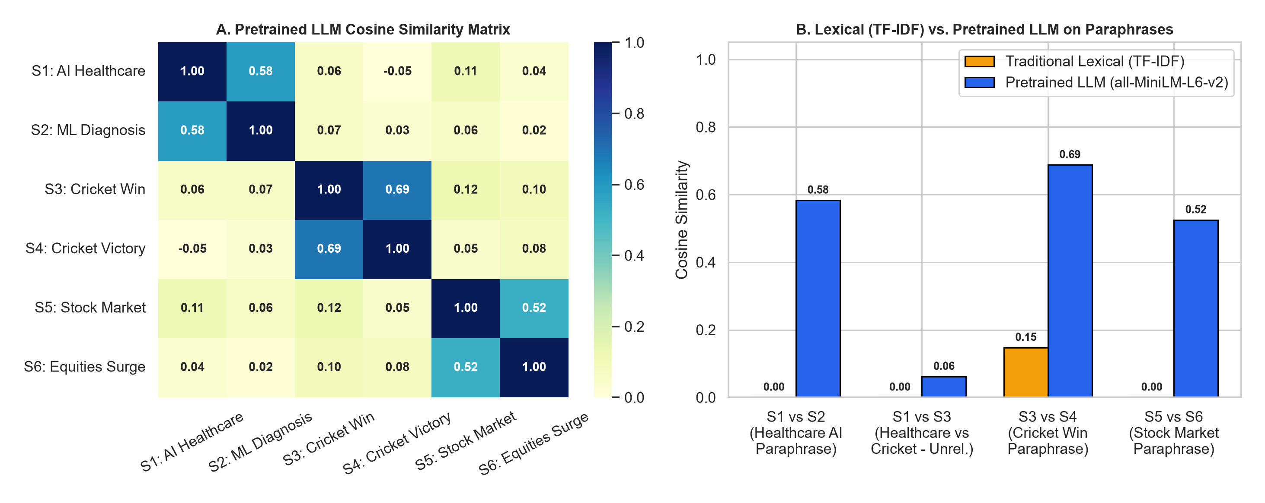
2. Theoretical Background & GenAI Relevance
Built on Transformer Multi-Head Self-Attention (Vaswani et al., 2017) — the backbone of Generative AI.
Sentence-BERT (Siamese Bi-Encoder) maps sentences into 384D vectors via Mean Pooling + L2 Normalization.
On the unit hypersphere (||v||=1), Euclidean distance is equivalent to Cosine Similarity.
Serves as the representation layer for Retrieval-Augmented Generation (RAG) and semantic memory.

Slide 4
3. Unified System Architecture
Input Layer: 1,000 Balanced Documents across 5 Categories (Sports, Tech, Finance, Politics, Healthcare).
Preprocessing Layer: Strips HTML/headers while preserving grammar for Transformer self-attention.
Embedding Layer: Pretrained all-MiniLM-L6-v2 (6-layer, 384D) vs. paraphrase-MiniLM-L3-v2 & TF-IDF.
Downstream Modules: (1) Classification, (2) K-Means Clustering, (3) c-TF-IDF Topic Discovery.
Presentation Layer: Interactive 5-page Streamlit Dashboard + 2D PCA/t-SNE visualizations.

Slide 5
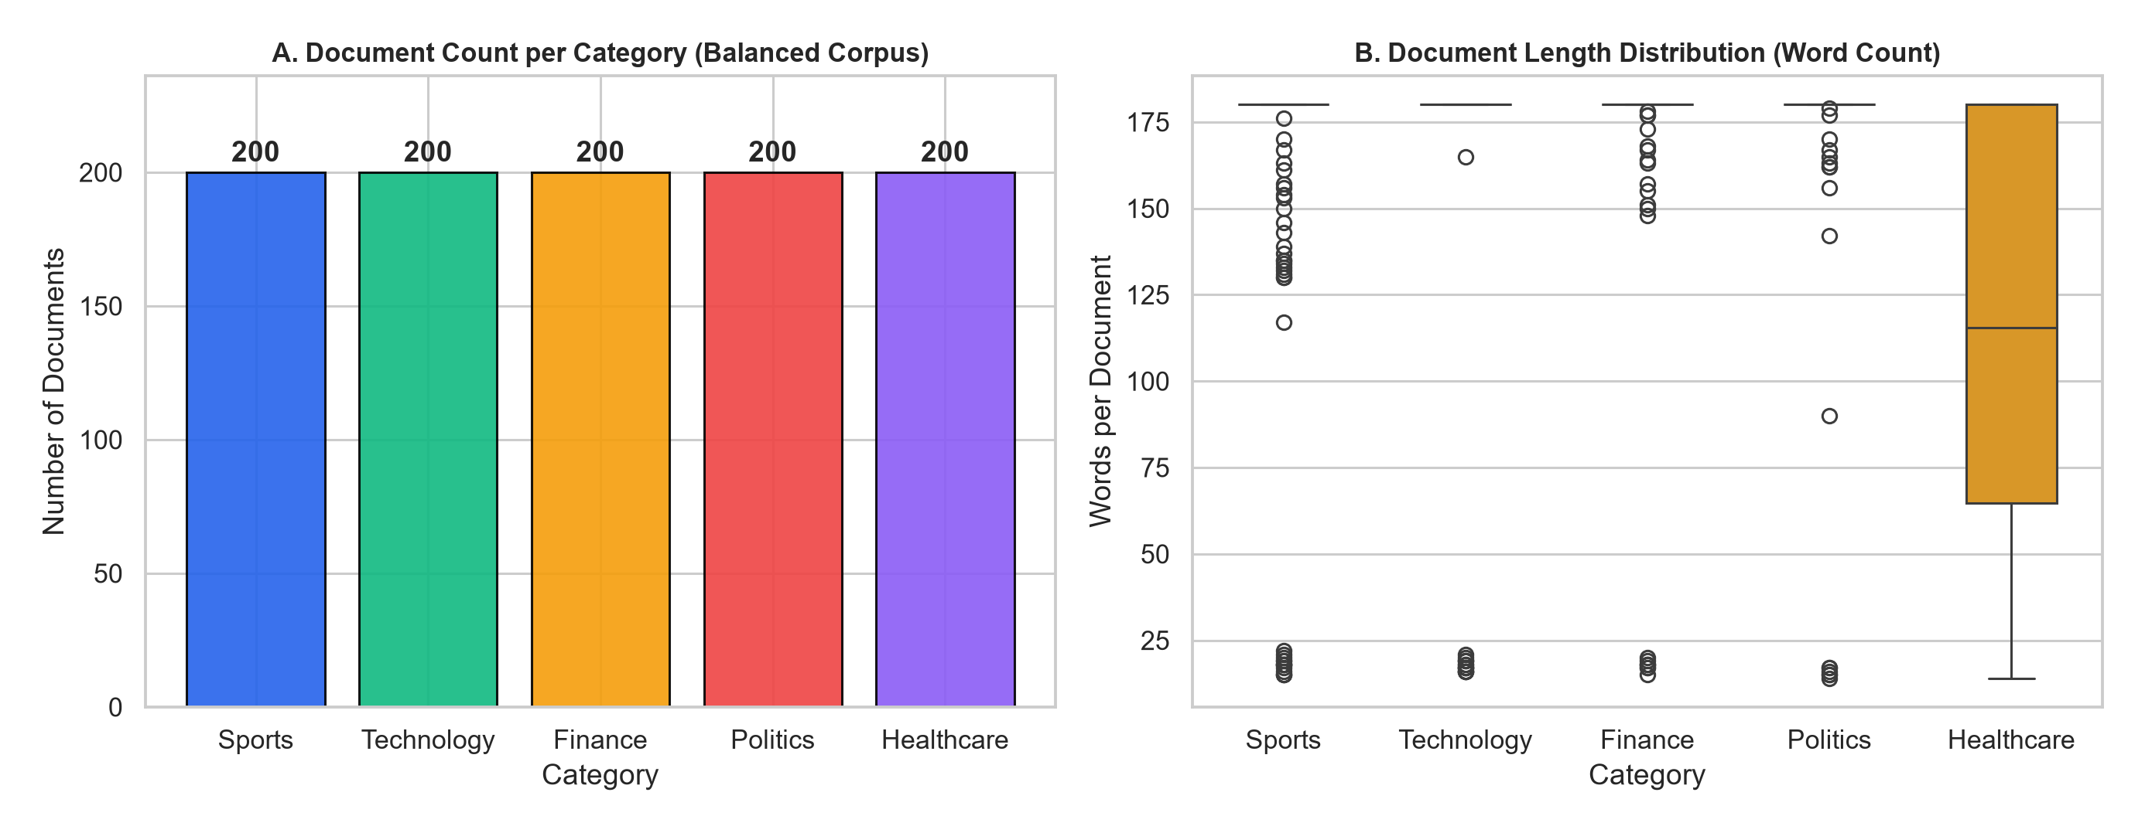
4. Dataset Selection & Preprocessing (Member 1)
Combined BBC News & 20 Newsgroups (sci.med) benchmarks + modern domain anchors.
1,000 total documents (200 per class across Sports, Technology, Finance, Politics, Healthcare).
Stratified 75% Train (750 docs) / 25% Test (250 docs) + 25-sentence Paraphrase Generalization set.
Cached locally in data/dataset.csv for 100% reproducible offline execution.

Slide 6
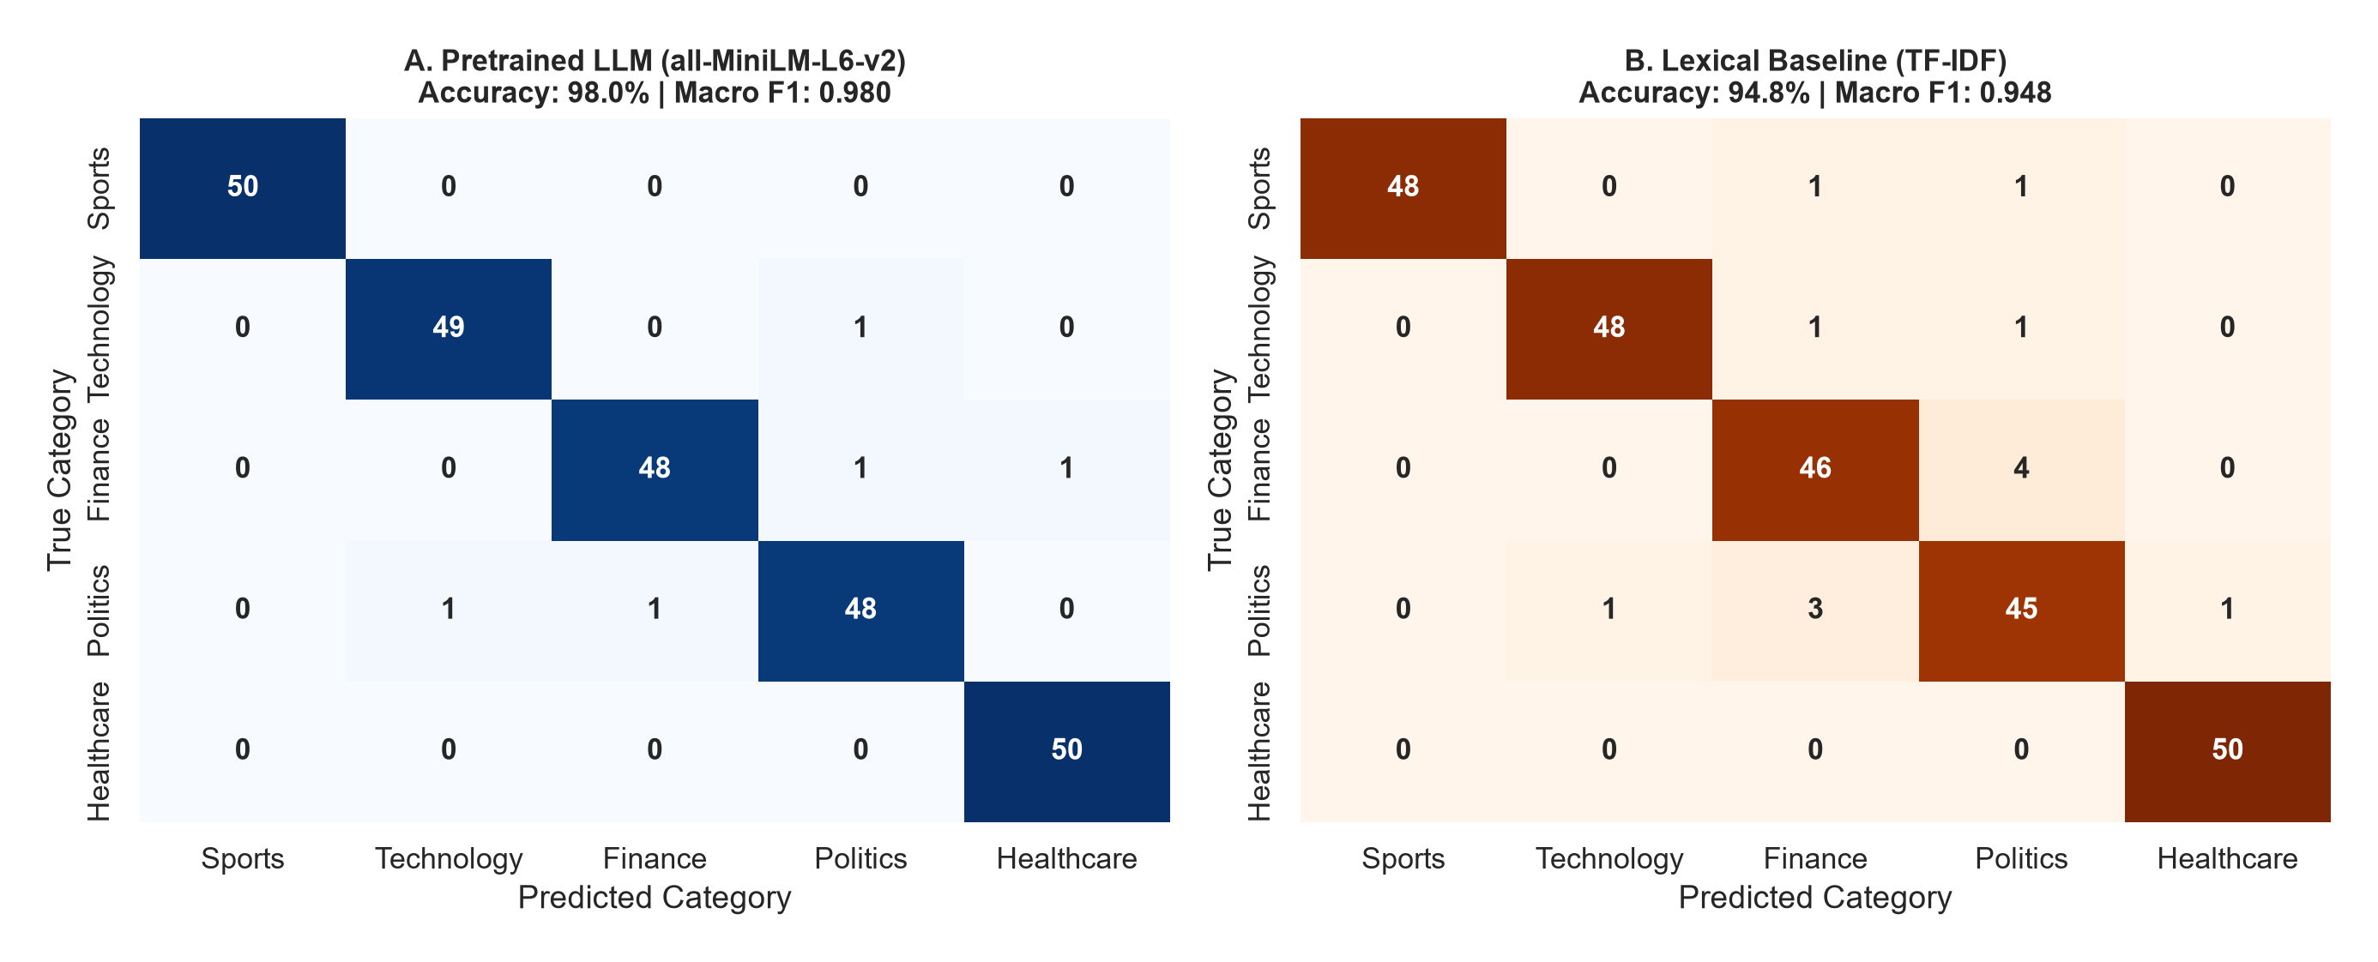
5. Module 1: Supervised Text Classification (Member 3)
Trains lightweight classifiers (Logistic Regression, Linear SVM, Random Forest) on frozen 384D embeddings.
Test Accuracy: 98.0% (Macro F1: 0.980) with all-MiniLM-L6-v2.
Paraphrase Generalization Accuracy: 100.0% (LLM) vs. 96.0% (TF-IDF).
Supports real-time confidence scoring and top-3 nearest document retrieval.

Slide 7
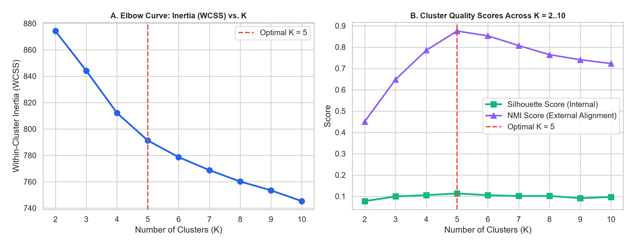
6. Module 2: Unsupervised K-Means Clustering (Member 3)
Groups unlabeled documents purely from 384D embedding geometry using K-Means++.
Evaluated K = 2..10 using Elbow Method (Inertia) and Cosine Silhouette Score -> Optimal K = 5.
Achieves NMI = 0.875 and ARI = 0.903 (vs. TF-IDF NMI = 0.694).
Automatically aligns clusters to emerging themes and extracts centroid-nearest exemplars.

Slide 8
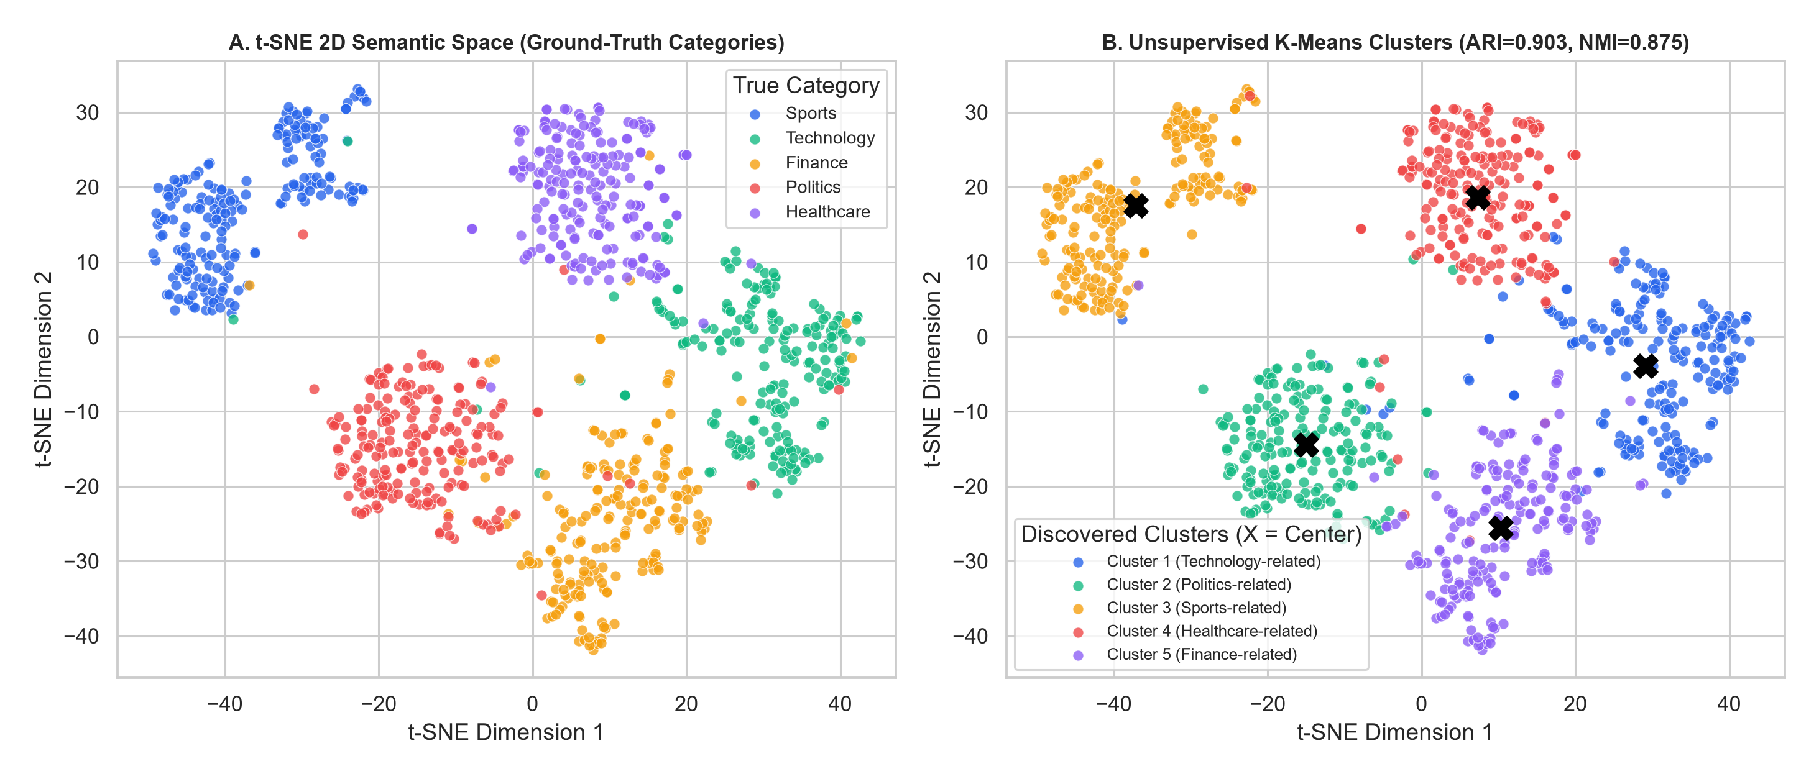
7. Visualizing the 384D Semantic Space in 2D (Member 4)
Reduced 384D vectors to 2D using PCA (linear variance) and t-SNE (non-linear neighborhood manifold).
Documents naturally self-organize into 5 well-separated semantic islands.
Black 'X' markers denote unsupervised K-Means centroids aligning with ground-truth domains.

Slide 9
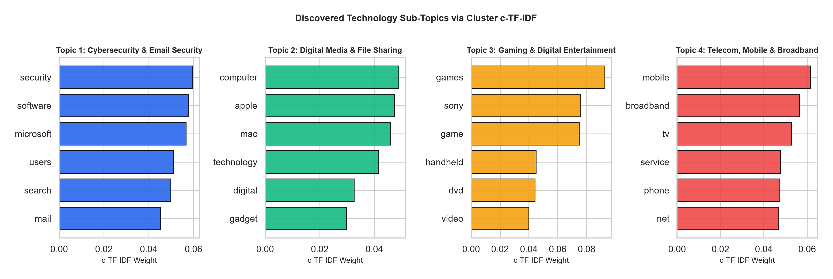
8. Module 3: Automated Topic Discovery via c-TF-IDF (Member 4)
Uses BERTopic's Class-based TF-IDF (c-TF-IDF) over semantic clusters to extract interpretable themes.
Discovers 4 sub-topics inside Technology: AI, Cybersecurity, Cloud Computing, Robotics.
Topic Diversity: 100.0% | Intra-Topic Semantic Coherence: 0.470.

Slide 10
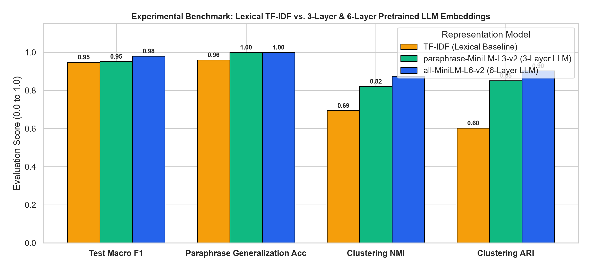
9. Comparative Experimental Benchmark
Compared Lexical TF-IDF vs. 3-Layer MiniLM-L3 vs. 6-Layer MiniLM-L6 across all tasks.
Pretrained LLM embeddings outperform TF-IDF across classification, paraphrase generalization, and clustering.
MiniLM-L3 offers 1.7x faster encoding, while MiniLM-L6 achieves the highest semantic quality.

Slide 11
10. Streamlit Dashboard & 5-Member Contributions (Member 5)
Interactive 5-page Streamlit Web UI (app.py) with <15ms offline inference.
Member 1: Dataset & Preprocessing (src/data_loader.py)
Member 2: Pretrained Embeddings & Similarity (src/embeddings.py)
Member 3: Classification & K-Means Clustering (src/models.py)
Member 4: c-TF-IDF Topic Discovery & Visualizations (src/topic_visualizer.py)
Member 5: Streamlit UI Integration, Experiments & Documentation (app.py)

Slide 12
11. Limitations, Applications & Conclusion
Limitations: 256-token context window truncation; pre-specified K in K-Means; static domain weights.
Applications: Automated ticket routing, enterprise document organization, clinical/financial triage, RAG.
Conclusion: Pretrained Transformer embeddings deliver robust, explainable, CPU-efficient semantic text analysis across classification, clustering, and topic discovery.

