Slide 1
STATISTICAL ATTACK RESISTANT MULTI-BIT STEGANOGRAPHY USING MOBILE KEYPAD CHARACTER ENCODING
¹Uttiya Ghosh, ²Smritikana Maity, ³Imon Mukherjee
^{1,2}B. Tech Student, St. Thomas’ College of Engineering and Technology
³Assistant Professor, St. Thomas’ College of Engineering and Technology
11th April, 2015
INTERNATIONAL CONFERENCE ON TELECOMMUNICATION TECHNOLOGY & MANAGEMENT (ICTTM-2015) (APRIL 11-12, 2015)

Slide 2
Topics
Introduction
Steganography
Difference between Steganography, Cryptography and Water Marking
Brief Idea
Mobile keypad character encoding
Randomization
Embedding Process
Basic process
Algorithm
Retrieval Process
Basic process
Algorithm
Testing Results
Comparison with other methods
MSE, PSNR and BER values of our method
StirMark Analysis

Slide 3
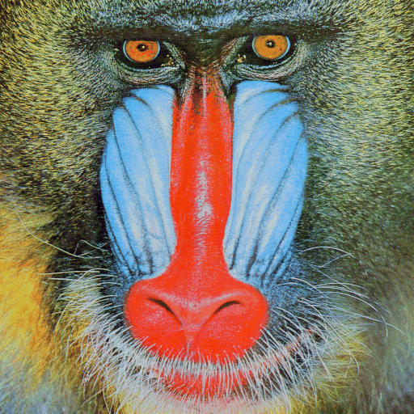
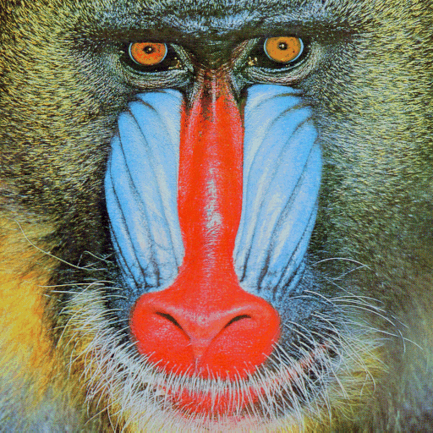

Steganography

Slide 4
Topics
Introduction
Steganography
Difference between Steganography, Cryptography and Water Marking
Brief Idea
Mobile keypad character encoding
Randomization
Embedding Process
Basic process
Algorithm
Retrieval Process
Basic process
Algorithm
Testing Results
Comparison with other methods
MSE, PSNR and BER values of our method
StirMark Analysis

Slide 5
Mobile keypad character encoding
C.C. B.C. | 000 | 001 | 010 | 011 | 100 | 101 | 110 | 111
0000 | 1 | ` | ! | @ |  | $ | % | ^
0001 | a | b | c | A | B | C | 2
0010 | d | e |  | D | E | F | 3 | *
0011 | g | h | i | G | H | I |  | (
0100 |  | k | l | J | K | L | 5 | )
0101 | m | n |  | M | N |  | 6 | _
0110 | p |  | r | s | P | Q | R | S
0111 | t | u | v | " | U | V | 8 | 7
1000 | w | x | y | z | W | X | Y
1001 | ~ | 9 | 0 | - |  | = | { | }
1010 | [ | ] |  | | | : | ; | “ | ‘
1011 | space |  | > | . | , | ? | / | #
1100 |  | ’ | ‘ | ´ | — | & | ¥ | €
1101 | ¤ | ¿ | ¡ | new line | f | 4 |  | °
1110 |  | © | O | q | T | Z | + | \
1111 | ® | < | ” | j | o |  | £ | carriage return

Slide 6
Versatility of the codes table
Keypad count →
C.C. B.C. | 000 | 001 | 010 | 011 | 100 | 101 | 110 | 111
0000 | space
0001 | . | , | ‘ | ? | ! | “ | 1
0010 | a | b | c | A | B | C | 2
0011 | d | e | f | D | E | F | 3
0100 | g | h | I | G | H | I | 4
0101 | j | k | L | J | K | L | 5
0110 | m | n | o | M | N | O | 6
0111 | p | q | r | s | P | Q | R | S
1000 | t | u | v | " | U | V | 8
1001 | w | x | y | z | W | X | Y | Z
1010 (*) | ~ | 9 | 0 | - |  | = | { | enter
1011 (#) | ( | ) |  | | | : | ; | “ | ‘
1100
1101
1110
1111
Keypad number
↓
For only mobile data

Slide 7
Randomization
α₁=0001 | α_{k+1}=… | α₂=0000 | α₃=0110
 |  |  |  | α₄=0100 | …
… | … | α_{k}=0100
→

Slide 8
Topics
Introduction
Steganography
Difference between Steganography, Cryptography and Water Marking
Brief Idea
Mobile keypad character encoding
Randomization
Embedding Process
Basic process
Algorithm
Retrieval Process
Basic process
Algorithm
Testing Results
Comparison with other methods
MSE, PSNR and BER values of our method
StirMark Analysis

Slide 9
Text message arrangement
T₁ | T₂ | …. | T_{i} | T_{i+1} | …. | T_{l}
(229)₁₀
Mobile keypad character code
M₁ | M₂ | ….. | M_{i} | M_{i+1} | ….. | M_{l}
(1110100)₂

Slide 10
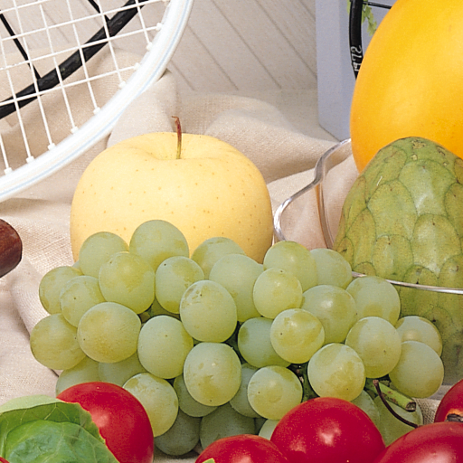
ω_{1,1} | ω_{1,2} | … | ω_{1,w}
ω _{2,1} | ω _{2,2} | … | ω _{2,w}
… | … | … | …
ω _{h,1} | ω _{h,2} | … | ω _{h,w}
Binary representation of a pixel value.
r₇ | r₆ | ... | r₀ | g₇ | g₆ | ... | g₀ | b₇ | b₆ | ... | b₀
Red component
Green component
Blue component
7 bits of the mobile keypad character code:
x₆ | x₅ | x₄ | x₃ | y₂ | y₁ | y₀
To be embedded in red component
To be embedded in green component

Slide 11
Block Code
∂_{α}= abs {(x₆ - r₃)*2³ + (x₅ - r₂)*2² + (x₄ - r₁)*2¹ + (x₃ - r₀)*2⁰}, where abs denotes absolute difference
Δ_{α} = (x₆ + r₃)*2³ + (x₅ + r₂)*2² + (x₄ + r₁)* 2¹ + (x₃ + r₀)*2⁰.
x₆ * 2³ + x₅ * 2² + x₄ * 2¹ + x₃ * 2⁰ , if ∂_{α} ≤ abs (15 - Δ_{α});
α=
(x₆ ʘ 0) * 2³ + (x₅ ʘ 0) * 2² + (x₄ ʘ 0) * 2¹ + (x₃ ʘ 0) * 2⁰, otherwise

Slide 12
Example:
Pixel value: (229)₁₀ = (1110100)₂ → 0101 (4 bits from LSB)
Block code: = (10)₁₀ = (1010)₂.
∂_{α}= abs {(1 - 0)*2³ + (0 - 1)*2² + (1 - 0)*2¹ + (0 - 1)*2⁰}
=abs(8-4+2-1)
=abs(5)
=5
Δ_{α} = (1 + 0)*2³ + (0 + 1)*2² + (1 + 0)*2¹ + (0 + 1)*2⁰
⁼ 8+4+2+1
= 15
Since,∂_{α} > abs(15 – Δ_{α} )
Therefore, α=(1 ʘ 0) *2³ + (0 ʘ 0) *2² +(1 ʘ 0) *2¹ +(0 ʘ 0) * 2⁰,
= 0+4+0+1
=5
Status code=_1

Slide 13
Character Code
∂_{β}= abs {(y₂ - g₂)*2² + (x₁ - g₁)*2¹ + (x₀ - g₀)*2⁰}, where abs denotes absolute value.
Δ_{β} = (y₂ + r₂)*2² + (y₁ + r₁)*2¹ + (y₀ + r₀)*2⁰.
y₂*2² + y₁*2¹ + y₀*2⁰, if ∂_{β} ≤ abs (7 - Δ_{β});
β=
(y₂ ʘ 0)*2² + (y₁ ʘ 0)*2¹ + (y₀ ʘ 0)*2⁰, otherwise.
The process is similar as the block code embedding process.

Slide 14
Example:
Pixel value: (229)₁₀ = (1110100)₂ → (101)₂ (3 bits from LSB)
Character code: 6 = (110)₂.
∂_{β}= abs {(1 - 1)*2² + (1 - 0)*2¹ + (0 - 1)*2⁰}
=abs(0+2-1)
=abs(1)
=1
Δ_{β} = (1 + 1)*2² + (1 + 0)*2¹ + (0 + 1)*2
= 8+2+1
= 11
Since, ∂_{β} < abs(7 – Δ_{β})
Therefore,β = (1 )*2² + (1)*2¹ + (0 )*2⁰
= 4+2+0
=6
Status code=01

Slide 15
Embedding:
Red component:
Ω_{r} = ω_{r} - mod (ω_{r}, 16) + α, where ω_{r} → cover pixel value.
Eg.: α=0101 and ω_{r} =10111011 so, Ω_{r} =10110101
Green component:
Ω_{g} = ω_{g} - mod (ω_{g}, 8) + β, where ω_{r} → cover pixel value.
Eg.: β=101 and ω_{g} =10111011 so, Ω_{g} =10111101
Blue component:
Ω_{b} = ω_{b} - mod (ω_{b,} 4) + ɤ, where ω_{r} → cover pixel value.
Eg.: ɤ=01 and ω_{b} =10111011 so, Ω_{b} =10111001

Slide 16
Input: An image of size h×w.
Output: The stego image component containing the secret data.
Convert the text message into mobile keypad character encoded data using mobile keypad character encoding;
Calculate α, β and ɤ using Equation (3), (6) and (7) respectively;
while the entire text is not embedded or there are pixel values of the cover image with no secret information
do
Calculate Ω_{r}, Ω_{g} and Ω_{b} from Equation (8), (9) and (10) respectively;
Calculate the next pixel value position by moving α + 1 pixels from the current position in a circular row major manner;
End
Output the transformed image.

Slide 17
Topics
Introduction
Steganography
Difference between Steganography, Cryptography and Water Marking
Brief Idea
Mobile keypad character encoding
Randomization
Embedding Process
Basic process
Algorithm
Retrieval Process
Basic process
Algorithm
Testing Results
Comparison with other methods
MSE, PSNR and BER values of our method
StirMark Analysis

Slide 18

Retrieval
Ω*_{1,1} | Ω*_{1,2} | … | Ω*_{1,w}
Ω*_{2,1} | Ω*_{2,2} | … | Ω*_{2,w}
… | … | … | …
Ω*_{h,1} | Ω*_{h,2} | … | Ω*_{h,w}
Red component : α* = mod (Ω*_{r}, 16)
Green component : β* = mod (Ω*_{g}, 8)
Blue component : ɤ*= mod (Ω*_{b}, 4)

Slide 19
The block code is obtained from the equation:
α*, if ɤ*=0;
θ=
15 - α*, if ɤ*=1.
and the character code is given by:
β*, if ɤ*=3;
Φ=
7 - β*, if ɤ*=4.
Complete mobile keypad character code is obtained by:
M_{i} = θ×8 + Φ
M₁ | M₂ | … | M_{i} | … | M_{l}
Using mobile keypad character decoding
T₁ | T₂ | … | T_{i} | … | T_{l}

Slide 20
Input: The stego image containing the secret data.
Output: The secret data retrieved from the stego image.
while the entire text is not retrieved
do
Calculate α*, β* and ɤ* values from the pixel value;
Calculate θ and Φ ;
Calculate mobile keypad character codes;
Convert the codes into corresponding characters by mobile keypad character code decoding;
Calculate the next pixel value position by moving α* + 1 pixels from the current position in a circular row major manner;
end
Output the embedded secret message.

Slide 21
Topics
Introduction
Steganography
Difference between Steganography, Cryptography and Water Marking
Brief Idea
Mobile keypad character encoding
Randomization
Embedding Process
Basic process
Algorithm
Retrieval Process
Basic process
Algorithm
Testing Results
Comparison with other methods
MSE, PSNR and BER values of our method
StirMark Analysis

Slide 22
Testing Results
Comparison of our method with other methods
Method described in | Capacity (bits) | Average PSNR (dB)
A | <10738 | <31.43
B | 40017 | 42.68
C | 1166296 | 42.26
D | <370000 | <38.5
E | 334589 | 30.25
Proposed Method | 2097152 | 41.16084
Chang et al. (IEEE Transactions on Information Forensics and Security, 2006)
Medeni et al. (IJCSIS, 2008)
Mandal et al. (IJIST, 2012)
Zhang et al. (IEEE Signal Processing Letters, 2008)
Yang et al. (IET Image Processing, 2009).

Slide 23
Values of MSE, PSNR and BER of different images for our method
Image Names | MSE | PSNR | BER
Lenna | 5.0193 | 41.1243 | 0.1458
Baboon | 4.6478 | 41.4583 | 0.15
Jet | 5.042 | 41.1048 | 0.1455
Peppers | 4.9949 | 41.1455 | 0.1449
Fruits | 5.1994 | 40.9713 | 0.1458

Slide 24
StirMark analysis of proposed technique on cover and stego version of Lenna (512×512)
Test | Factor | Cover (dB) | Stego (dB)
Self Similarities | 1 | 36.322 | 35.0116
Self Similarities | 2 | 48.6309 | 48.5033
Self Similarities | 3 | 32.3915 | 32.3163
PSNR | 10 | 38.3482 | 38.3105
Add Noise | 20 | 9.61381 | 9.63809
Add Noise | 40 | 8.23211 | 8.22795
Add Noise | 100 | 7.43846 | 7.47494
Small Random Distortions | 0.95 | 17.8137 | 10.8045
Small Random Distortions | 1.00 | 17.5981 | 10.5727
Small Random Distortions | 1.05 | 17.4292 | 10.3843
ConvFilter | 1.00 | 11.5344 | 11.497
ConvFilter | 2.00 | -6.92511 | -6.90225
Median Cut | 3.00 | 33.3908 | 33.0182

