Slide 1

CS312 Database Management Systems
School of Computer Engineering and Technology

Slide 2
CS312 Database Management Systems
Course Objectives:
Understand and successfully apply logical database design principles, including E-R diagrams and database normalization.
Learn Database Programming languages and apply in DBMS application
Understand transaction processing and concurrency control in DBMS
Learn database architectures, DBMS advancements and its usage in advance application
Course Outcomes:
Design ER-models to represent simple database application scenarios and Improve the database design by normalization.
Design Database Relational Model and apply SQL , PLSQL concepts for database programming
Describe Transaction Processing and Concurrency Control techniques for databases
Identify appropriate database architecture for the real world database application

Slide 3
Laboratory Assignment No: 01
Case Study on ER

Slide 4
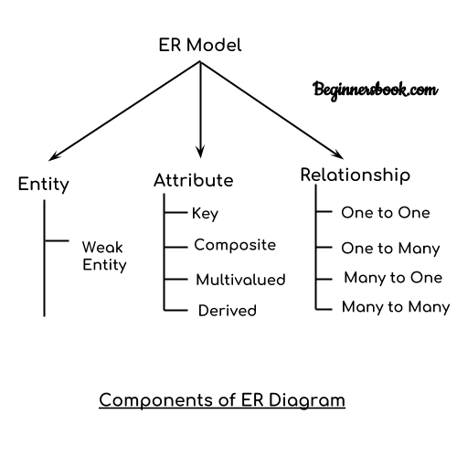
ER Diagram Components

Slide 5
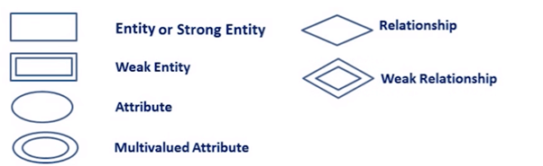
ER- Diagram Notations
ER- Diagram is a visual representation of data that describe how data is related to each other.
Rectangles: This symbol represent entity types
Ellipses : Symbol represent attributes
Diamonds: This symbol represents relationship types
Lines: It links attributes to entity types and entity types with other relationship types
Primary key: attributes are underlined
Double Ellipses: Represent multi-valued attributes

Slide 6
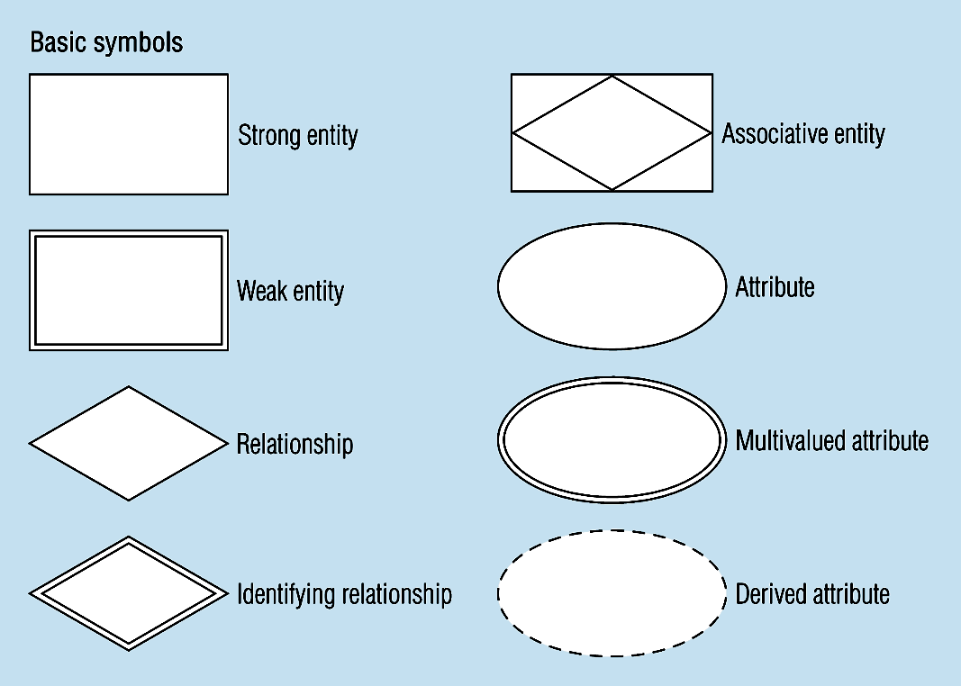
Basic E-R Notation
A special entity that is also a relationship
Entity symbols
Attribute symbols
Relationship symbols
Notes:
8

Slide 7
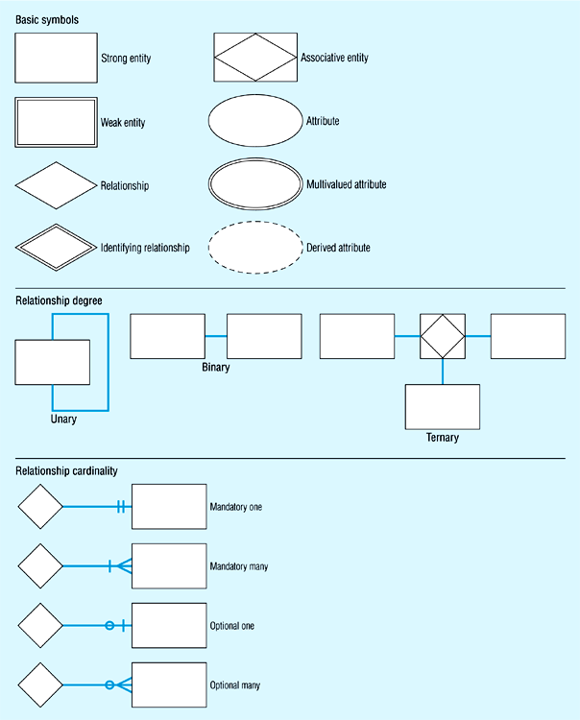
Basic E-R Notation

Slide 8
Steps in designing an ERD for a DBMS
There are four steps in designing an ERD for a DBMS .
Identify Entity and members
Decide relationships and Cardinality and Modality
Draw Entities separately
Connect relationships and entities

Slide 9
Step by Step ERD Example
A University contains many Faculties. The Faculties in turn are divided into several Schools. Each School offers numerous programs and each program contains many courses. Lecturers can teach many different courses and even the same course numerous times. Courses can also be taught by many lecturers. A student is enrolled in only one program but a program can contain many students. Students can be enrolled in many courses at the same time and the courses have many students enrolled.

Slide 10
Step 1 - Identify Entities
The entities in this scenario are
University
Faculty
School
Program
Course
Lecturer
Student

Slide 11
Step 2 - Find relationships
 | University | Faculty | School | Program | Course | Lecturer | Student
University |  | contains
Faculty |  |  | divided Into
School |  |  |  | offers |  | employs
Program |  |  |  |  | contains
Course |  |  |  |  |  |  | taken by
Lecturer |  |  |  |  | taught
Student |  |  |  | Enrolled | enrolled

Slide 12
Step 3 - Draw rough ERD Step 4
University
Contains
Faculty
Divided into
offers
School
Program
Employee
contains
taught
enrolled
Lecturer
Course
enrolled
Student

Slide 13
Step 4 - Cardinality Identification
The university contains many faculties
Each faculty is divided into several schools
Each school offers numerous programs
Each program contains many courses
Each school employs many lecturers
Lecturers can teach many courses
Lecturers can teach the same course many times
Courses can be taught by more than one lecturer
A student is enrolled in only one program
Students can be enrolled in many courses at the same time
Courses have many students enrolled

Slide 14
Step 4 - Cardinality Identification
University
1
Contains
N
Faculty
1
Divided into
1
offers
N
1
School
Program
1
Employee
contains
N
N
taught
N
N
enrolled
Lecturer
Course
N
enrolled
N
N
Student

Slide 15
Step 5 - Define primary keys
The primary keys could be
University – University name
Faculty – Faculty name
School – School name
Program – Program code
Course – Course number
Lecturer – Employee number
Student – Student number

Slide 16
Step 6-Draw key-based and Attribute based ERD
University
University Name
1
Contains
N
Faculty Name
Faculty
1
Divided into
Program Code
1
offers
N
1
School name
School
Program
1
Employee
Course number
contains
Course number
N
N
taught
N
N
enrolled
Lecturer
Course
N
Course number
Employee number
Student number
enrolled
Employee number
Student number
N
N
Student

Slide 17
Draw fully attributes ERD
Student address
Student number
Emergency contact
Student
Student name
Student phone number

Slide 18
Hotel Management System
A hotel management system consist of hotels having name and city. Each hotel contains room having information like room no, type and price. Guest books room in a hotel provide information like name, address. When guest books room in a hotel ,charges are calculated on the basis of Datefrom and DateTo.
Design an ER diagram and convert it to relational model.

Slide 19
Name
City
Type
Price
HotelNo
RoomNo------------
Hotel
Contains
Room
DateFrom
Books
ER Model
DateTo
Guest
GuestNo
GuestName
GuestAddress

Slide 20
Relational Schema
The following tables form part of a database held in a relational DB.
Hotel (HotelNo, Name, City)
Room(RoomNo, HotelNo, Type, Price)
Booking (HotelNo, GuestNo, DateFrom, RoomNo, Dateto,)
Guest(GuestNo, GuestName, GuestAddress)

Slide 21
Schema Diagram of Hotel System
Hotel
Booking
Room
HotelNo
Name
City
RoomNo
HotelNO
GuestNo
DateFrom
DateTO
RoomNo
HotelNO
Name
City
Guest
GuestNo
GuestName
GuestAddress

Slide 22
Schema to table
mysql> create table hotel (hotelno int primary key, name varchar (20) not null, city varchar (15));
mysql> create table rooms (roomno int, type varchar(20),price int,primary key(hotelno,roomno),hotelno int references hotel(hotelno) not null);
or
mysql> create table rooms (roomno int, type varchar(20),price int,primary key(roomno,hotelno),hotelno int not null,foreign key(hotelno) references hotel(hotelno) ON DELETE CASCADE);
mysql> create table guest(Guest_no int primary key,Guest_name varchar(10), Guest_addr varchar(20))
mysql> create table bookings(hotelno int, roomno int, guest_no int references guestl(guestno) , date_from date, date_to date, primary key (hotelno,roomno, guest_no, date _from),foreign key(hotelno,roomno) references room(hotelno,roomno) );

Slide 23
Online Bookstore
Draw the E-R diagram which models an online bookstore.

Slide 24
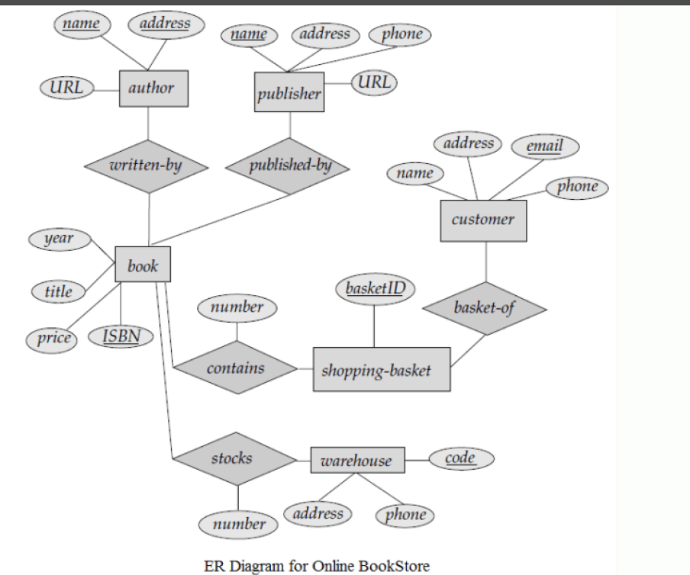
Online Bookstore

Slide 25

E-R Diagram Example
Question : Design a ER Diagram for University Database based on scenario given below :
A university includes information about the course timetable of an academic institution. For each Course the following information is recorded an identification number, name of the course, name of the teacher assigned to teach the course, the number of periods each week it will be taught, the number of
For each teacher the following information is recorded: SSN, name, name of the department he/she works with, skills, the yearly salary. For each class period the following information is recorded: period number, starting time, ending time. For each room the following information is recorded: room number, room type (classroom, office, auditorium, and computer lab), capacity.
The above information is used in order to make the right assignment of a teacher that teaches a particular course to a time period and a classroom.

Slide 26
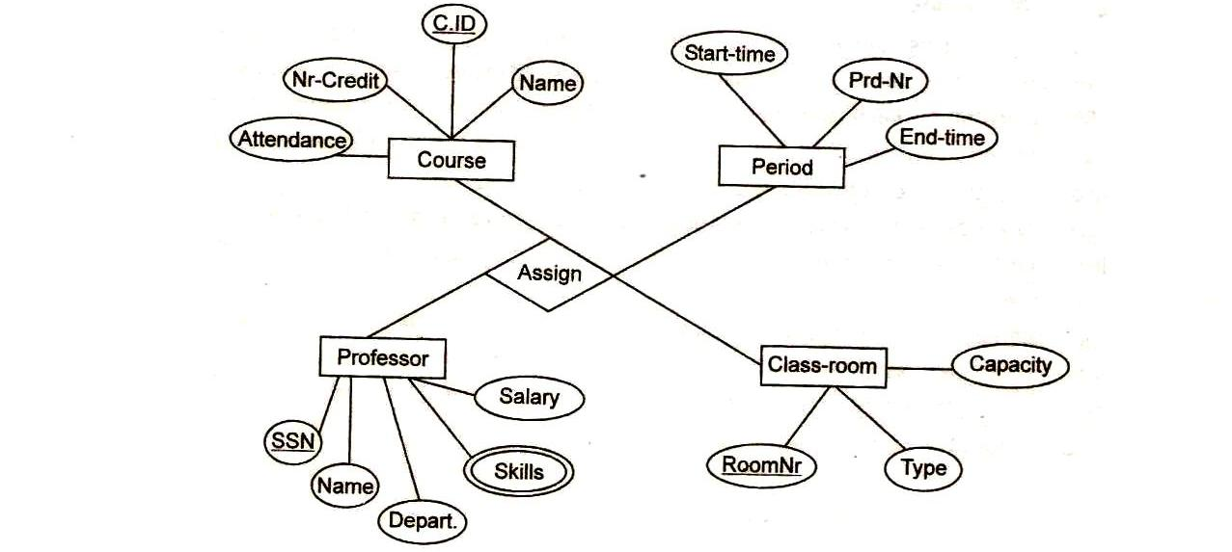
E-R Diagram for University Database

Slide 27
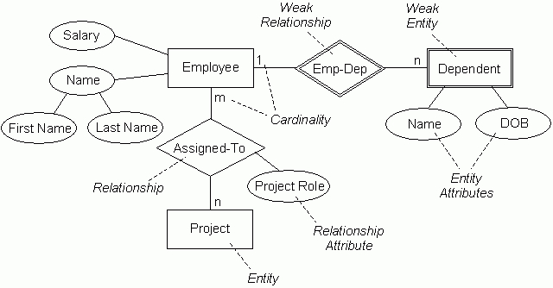
Exercises: Convert to Relation Model

Slide 28
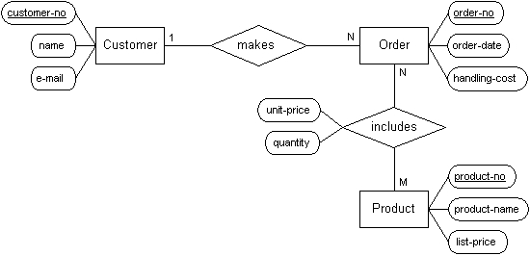
Exercises: Convert to Relation Model

Slide 29
Batch-A Exercises

Slide 30
Construct a clean and concise ER diagram for the NHL database.
Suppose you are given the following requirements for a simple database for the
National Hockey League (NHL):
the NHL has many teams,
each team has a name, a city, a coach, a captain, and a set of players,
each player belongs to only one team,
each player has a name, a position (such as left wing or goalie), a skill level, and a set of injury records,
a team captain is also a player,
a game is played between two teams (referred to as host_team and guest_team)and has a date (such as May 11th, 1999) and a score (such as 4 to 2).
Construct a clean and concise ER diagram for the NHL database.

Slide 31
Construct an E/R Schema for Educational Institute
In an educational institute, there are several departments and students belong to one of them . Each department has a unique department number, a name, a location, phone number and is headed by a professor.
Professors have a unique employee Id, name, phone number. We like to keep track of the following details regarding students: name, unique roll number, sex, phone number, date of birth, age and one or more email addresses.
Students have a local address consisting of the hostel name and the room number. They also have home address consisting of house number, street, city and PIN. It is assumed that all students reside in the hostels.
A course taught in a semester of the year is called a section. There can be several sections of the same course in a semester; these are identified by the section number. Each section is taught by a different professor and has its own timings and a room to meet.
Students enroll for several sections in a semester. Each course has a name, number of credits and the department that offers it. A course may have other courses as prerequisites i.e, courses to be completed before it can be enrolled in.
Professors also undertake research projects. These are sponsored by funding agencies and have a specific start ate, end date and amount of money given. More than one professor can be involved in a project. Also a professor may be simultaneously working on several projects. A project has a unique projectId.

Slide 32
Batch-B Exercises

Slide 33
Construct an ER Diagram for Banking System
The bank is organised into branches. Each branch is located in a particular city and is identified by a unique name. The bank monitors the assets of each branch.
Bank customers are identified by their customer_id value. The bank stores each customer’s name, and the street and the city where thecustomer lives. Customers may have accounts and can take out loans. A customer may be associated with a particular banker; who may act as a loan officer or personal banker for that customer.
The bank offers two types of accounts: savings and checking accounts. Accounts can be held by more than one customer, and a customer can have more than one account. Each account is assigned a unique account number. The bank mantains a record of each account’s balance and the most recent date on which the account was accessed by each customer holding the account. In addition each savings account has an interest rate, and overdrafts are recorded for each checking account.

Slide 34
Continue..
The bank provides its customers with loans. A loan originates at a particular branch and can be held by one or more customers. A loan is identified by unique loan number. For each loan, the bank keeps track of loan amount and the loan payments. Although a loan-payment number does not uniquely identify a particular payment among those for all the bank’s loans, a payment number does identify a particular payment for a specific loan. The date and the amount are recorded for each payment.
Bank employees are identified by their employee_id values. The bank administration stores the name and telephone number of each employee, the names of the employee’s dependents, and the employee_id number of the employee’s manager. The bank also keeps track of the employee’s start date and, thus, length of employment.
.

Slide 35
Batch-C Exercises

Slide 36
COMPANY Database
Requirements of the Company
The company is organized into
DEPARTMENTs. Each department has a name, number and an employee who manages the department. We keep track of the start date of the department manager.
Each department controls a number of PROJECTs. Each project has a name, numberand is located at a single location.
We store each EMPLOYEE’s social security number, address, salary, sex, and birthdate. Each employee works for one department but may work on several projects. We keep track of the number of hours per week that an employee currently works on each project. We also keep track of the direct supervisor of each employee.
Each employee may have a number of DEPENDENTs. For each dependent, we keep track of their name, sex, birthdate, and relationship to employee.

Slide 37
Construct an E-R diagram for a car-insurance
Construct an E-R diagram for a car-insurance company whose customers own one of more cars each. Each car has associated with it zero to any number of recorded accidents.

Slide 38
Batch-D Exercises

Slide 39
Construct an ER Diagram for the registrar’s office
A university registrar’s office maintains data about the following entities:
(a) Courses, including course number, title , credits, syllabus, and prerequisites;
(b) Course offerings, including course number, year,semester, section number, instructor's, timings, and classroom;
(c) Students, including student-id, name, and program; and
(d) Instructors, including identification number, name,department, and title. Further, the enrollment of students in courses and grades awarded to students in each course they are enrolled for must be appropriately modeled.
Construct an E-R diagram for the registrar’s office. Document all assumptions that you make about the mapping constraints.

Slide 40
Construct an E-R diagram for a hospital
Construct an E-R diagram for a hospital with a set of patients and set of medical doctors . Associate with each patient a log of the various tests and examinations conducted.

Slide 41
Thank You!

Slide 42
Hotel Management System
A hotel management system consist of hotels having name and city. Each hotel contains room having information like room no, type and price. Guest books room in a hotel provide information like name, address. When guest books room in a hotel ,charges are calculated on the basis of Datefrom and DateTo.
Design an ER diagram and convert it to relational model.

Slide 43
Name
City
Type
Price
HotelNo
RoomNo------------
Hotel
Contains
Room
DateFrom
Books
ER Model
Date
Guest
GuestNo
GuestName
GuestAddress

Slide 44
Relational Model
The following tables form part of a database held in a relational DB.
Hotel (HotelNo, Name, City)
Room(RoomNo, HotelNo, Type, Price)
Booking (HotelNo, GuestNo, DateFrom, DateTo, RoomNo)
Guest(GuestNo, GuestName, GuestAddress)

Slide 45
Schema Diagram of Hotel System
Hotel
Booking
Room
HotelNo
Name
City
RoomNo
HotelNO
GuestNo
DateFrom
DateTO
RoomNo
HotelNO
Name
City
Guest
GuestNo
GuestName
GuestAddress

Slide 46
Schema to table
mysql> create table hotel (hotelno int primary key, name varchar (20), city varchar (15));
mysql> create table rooms (roomno int, type varchar(20),price int,primary key(hotelno,roomno),hotelno int references hotel(hotelno) not null);
or
mysql> create table rooms (roomno int, type varchar(20),price int,primary key(roomno,hotelno),hotelno int not null,foreign key(hotelno) references hotel(hotelno) ON DELETE CASCADE);
mysql> create table guest(Guest_no int primary key,Guest_name varchar(10), Guest_addr varchar(20))
mysql> create table bookings(hotelno int, roomno int, guest_no int references guestl(guestno) , date_from date, date_to date, primary key (hotelno,roomno, guest_no, date _from),foreign key(hotelno,roomno) references room(hotelno,roomno) );

