Slide 1
To convert .csv file to .json and .txt file to .json

Slide 2
To convert .csv file to .json and .txt file to .json
MySQL script embed JSON as a data type

Slide 3
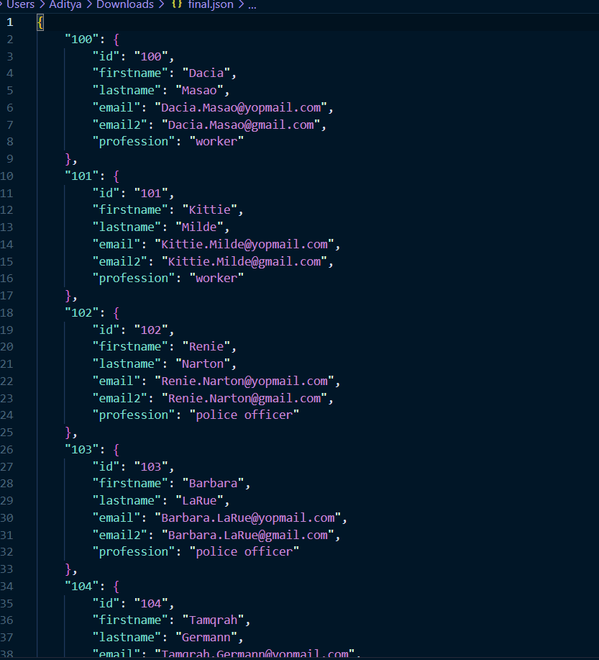
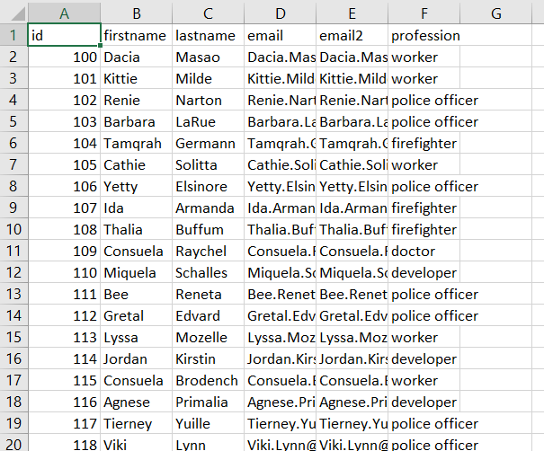
Aim 1 : To convert .csv file to .json file (Approach 2)
Pseudo code :
Step 1 – Import pandas
Step 2 – Read the csv file and store it in a data frame using the read_csv method
Step 3 – Convert the data frame to json file using to_json method.

Slide 4
Code (Approach 1): Input - Output
import pandas as pd
df = pd.read_csv("day.csv")
dk = df.to_json("day.json")

Slide 5
Aim 1 : To convert .csv file to .json file
Pseudo code :
Step 1 – Create a dictionary.
Step 2 - Open a csv reader called DictReader.
Step 3 - Convert each row into a dictionary and add it to dictionary.
Step 4 - Open a json writer and dump data.

Slide 6
Code (Approach 1):
import csv import json def csv_to_json(csvFilePath, jsonFilePath): data = {} with open(csvFilePath, encoding='utf-8') as csvf: csvReader = csv.DictReader(csvf) for rows in csvReader: key = rows['id'] data[key] = rows with open(jsonFilePath, 'w', encoding='utf-8') as jsonf: jsonf.write(json.dumps(data, indent=4)) csvFilePath = r'myFile0.csv' jsonFilePath = r'final.json' csv_to_json(csvFilePath, jsonFilePath)

Slide 7
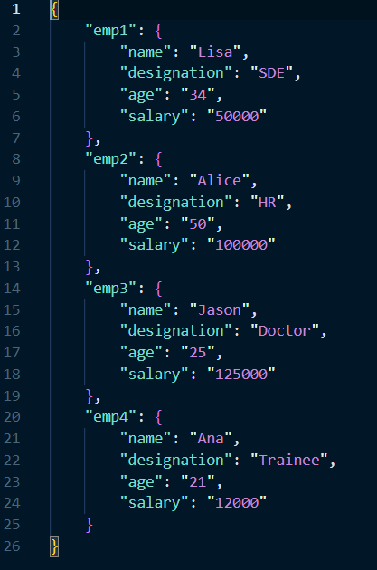
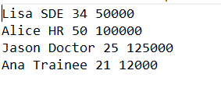
Aim 2 : To convert .txt file to .json file
Pseudo code :
Step 1 – Create a dictionary and fields in the sample .txt file.
Step 2 – Read line by line text from .txt file.
Step 3 - Create an intermediate dictionary for attributes for each record.
Step 4 – Append the intermediate dictionary with the main dictionary.

Slide 8
Code
import json
filename = 'text.txt'
dict1 = {}
fields =['name', 'designation', 'age', 'salary']
with open(filename) as fh:
l = 1
for line in fh:
description = list( line.strip().split(None, 4))
print(description)
sno ='emp'+str(l)
i = 0
dict2 = {}
while i<len(fields):
dict2[fields[i]]= description[i]
i = i + 1
dict1[sno]= dict2
l = l + 1
out_file = open("test2.json", "w“a)
json.dump(dict1, out_file, indent = 4)
out_file.close()

