Slide 1
AT00CK38-3004 Virtualization: Networks and Security
Week 8 Exercise
Unubold Luvsandagva
Student ID: 2406120

Slide 2
Task 1 – The Reference
“Google Chrome” browser on “Windows 11” OS for reference. Using https://browserbench.org/Speedometer3.1/
Google chrome on Host Windows results:
1st run: 26.7
2nd run: 30.9
3rd run: 31.01
AVG: 29.53
Task 2 – Virtual Desktop (cloud)
Using LUT & LAB Desktop portal.
Using virtual desktop was straight forward. First installed “Citrix” Workspace application since it was recommended on school website and logged in with my school credentials.
PS: Used LAB 2D Desktop

Slide 3
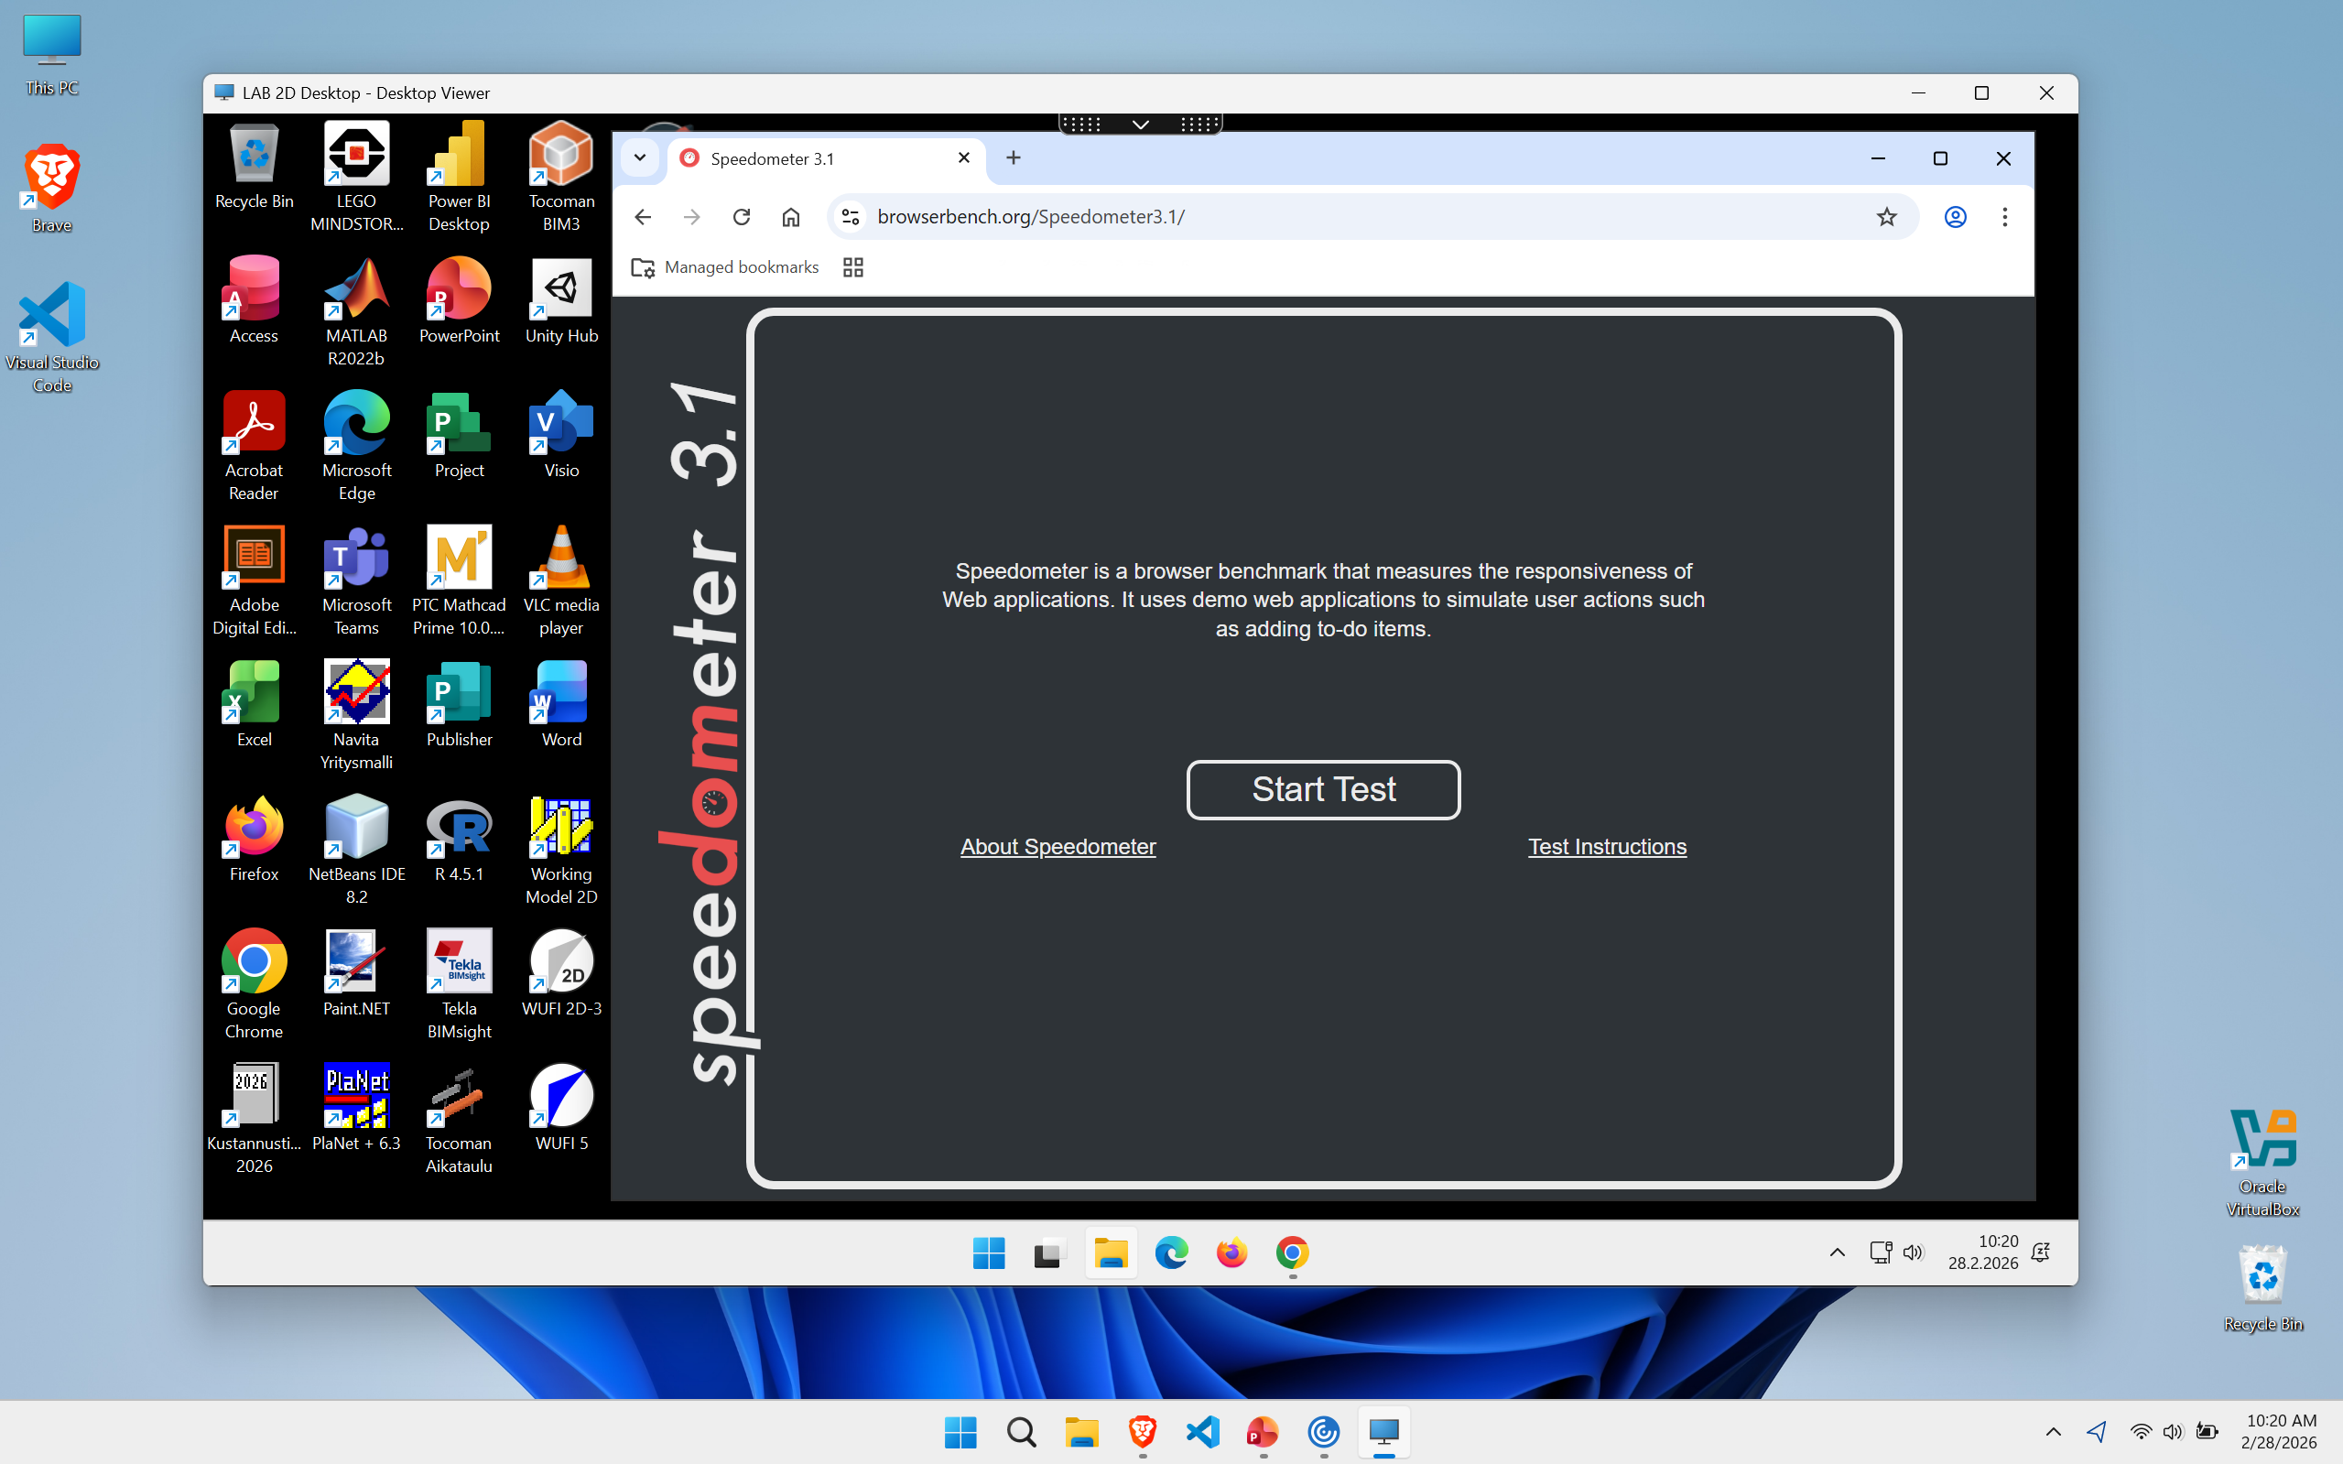
Virtual Desktop:
LAB Virtual Desktop (cloud)
"LAB 2D Desktop"
1st run: 6.8
2nd run: 8.39
3rd run: 8.61
AVG: 7.93

Slide 4
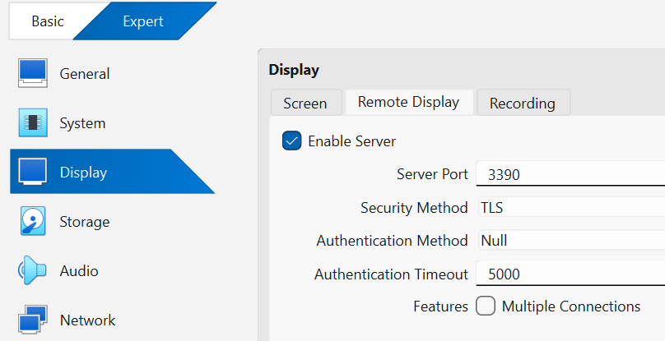
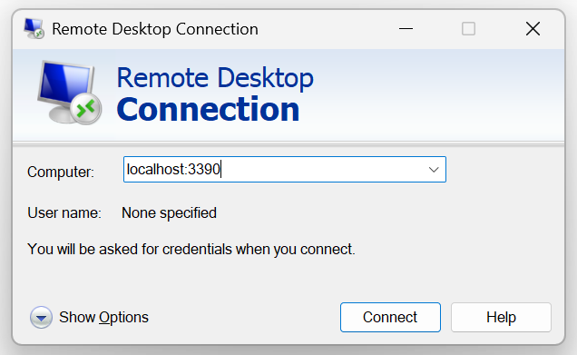
Task 3 – VirtualBox Remote Display Extension (VRDE)
Install the VirtualBox Extension Pack that matches your VirtualBox version, as this is required to use the remote display feature.
After that, open your virtual machine settings in VirtualBox. Make sure to switch to Expert Mode, because the remote display options will not appear otherwise. If remote display menu is there but greyed out, make sure the extension pack is installed properly
Then, go to the Display section and open the Remote Display tab. Finally, enable the server by checking the “Enable Server” option. Here you can also change Server port if you face error on window stating the port is already in use
Then connect to your virtual machine using Remote Desktop Connection on Windows using the server port you put on virtual box settings.

Slide 5
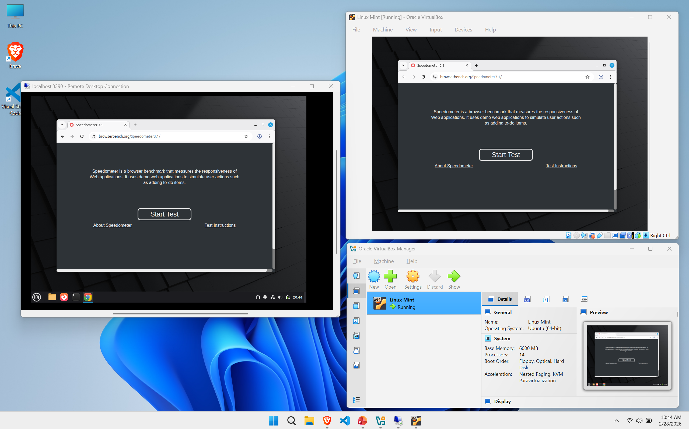
Remote Display:
VirtualBox Remote Display Extension (VRDE)
Linux Mint:
1st run: 11.2
2nd run: 13.7
3rd run: 13.6
AVG: 12.8

Slide 6
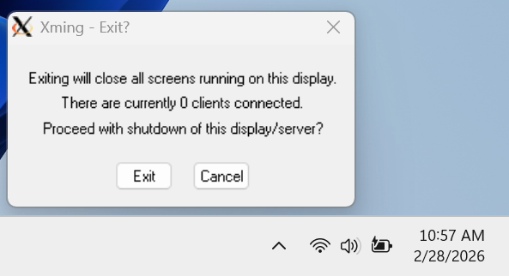
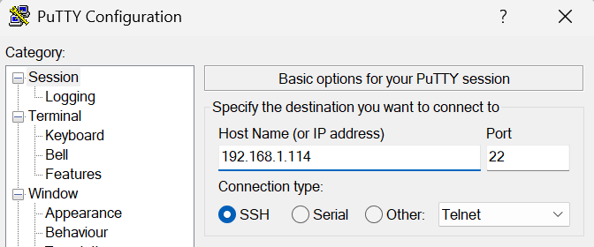
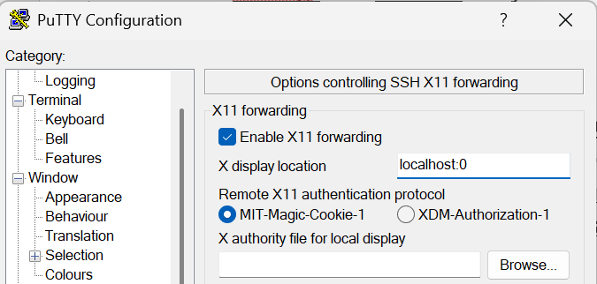
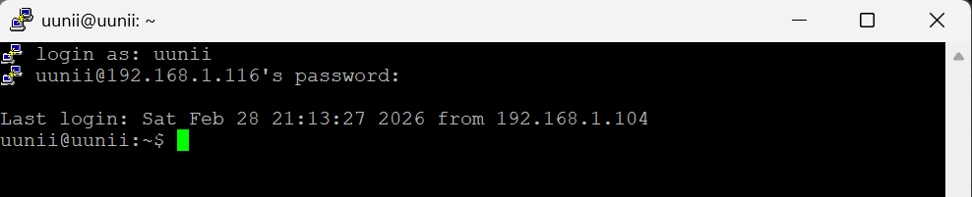
Task 4 - X11 Forwarding
Install Xming and PuTTY on your Windows computer.
In the VirtualBox settings for your virtual machine, go to the Network section and make sure the Bridged Adapter option is selected.
Start your Linux virtual machine (here, I am using Linux Mint) and open a terminal. If it’s the first time running your system, update it by running sudo apt update and sudo apt upgrade to ensure all packages are up to date.
Install the necessary packages for remote X11 forwarding by running sudo apt install xauth openssh-server.
Open ssh config file using sudo nano /etc/ssh/sshd_config, set X11Forwarding yes and X11DisplayOffset 10 and restart the server using sudo systemctl restart ssh
Run ip a to see your ip address, it will be used on putty.
Start Xming on windows and check if its running [1] by clicking on system tray. Then, open PuTTY and enter your Linux VM’s IP address[2] in the Host Name field. Go to Connection → SSH → X11 and enable X11 forwarding, set X display location[3] to localhost:0.
1
2
3
Click Open to start the SSH session, and log in with your Linux VM username and password.

Slide 7
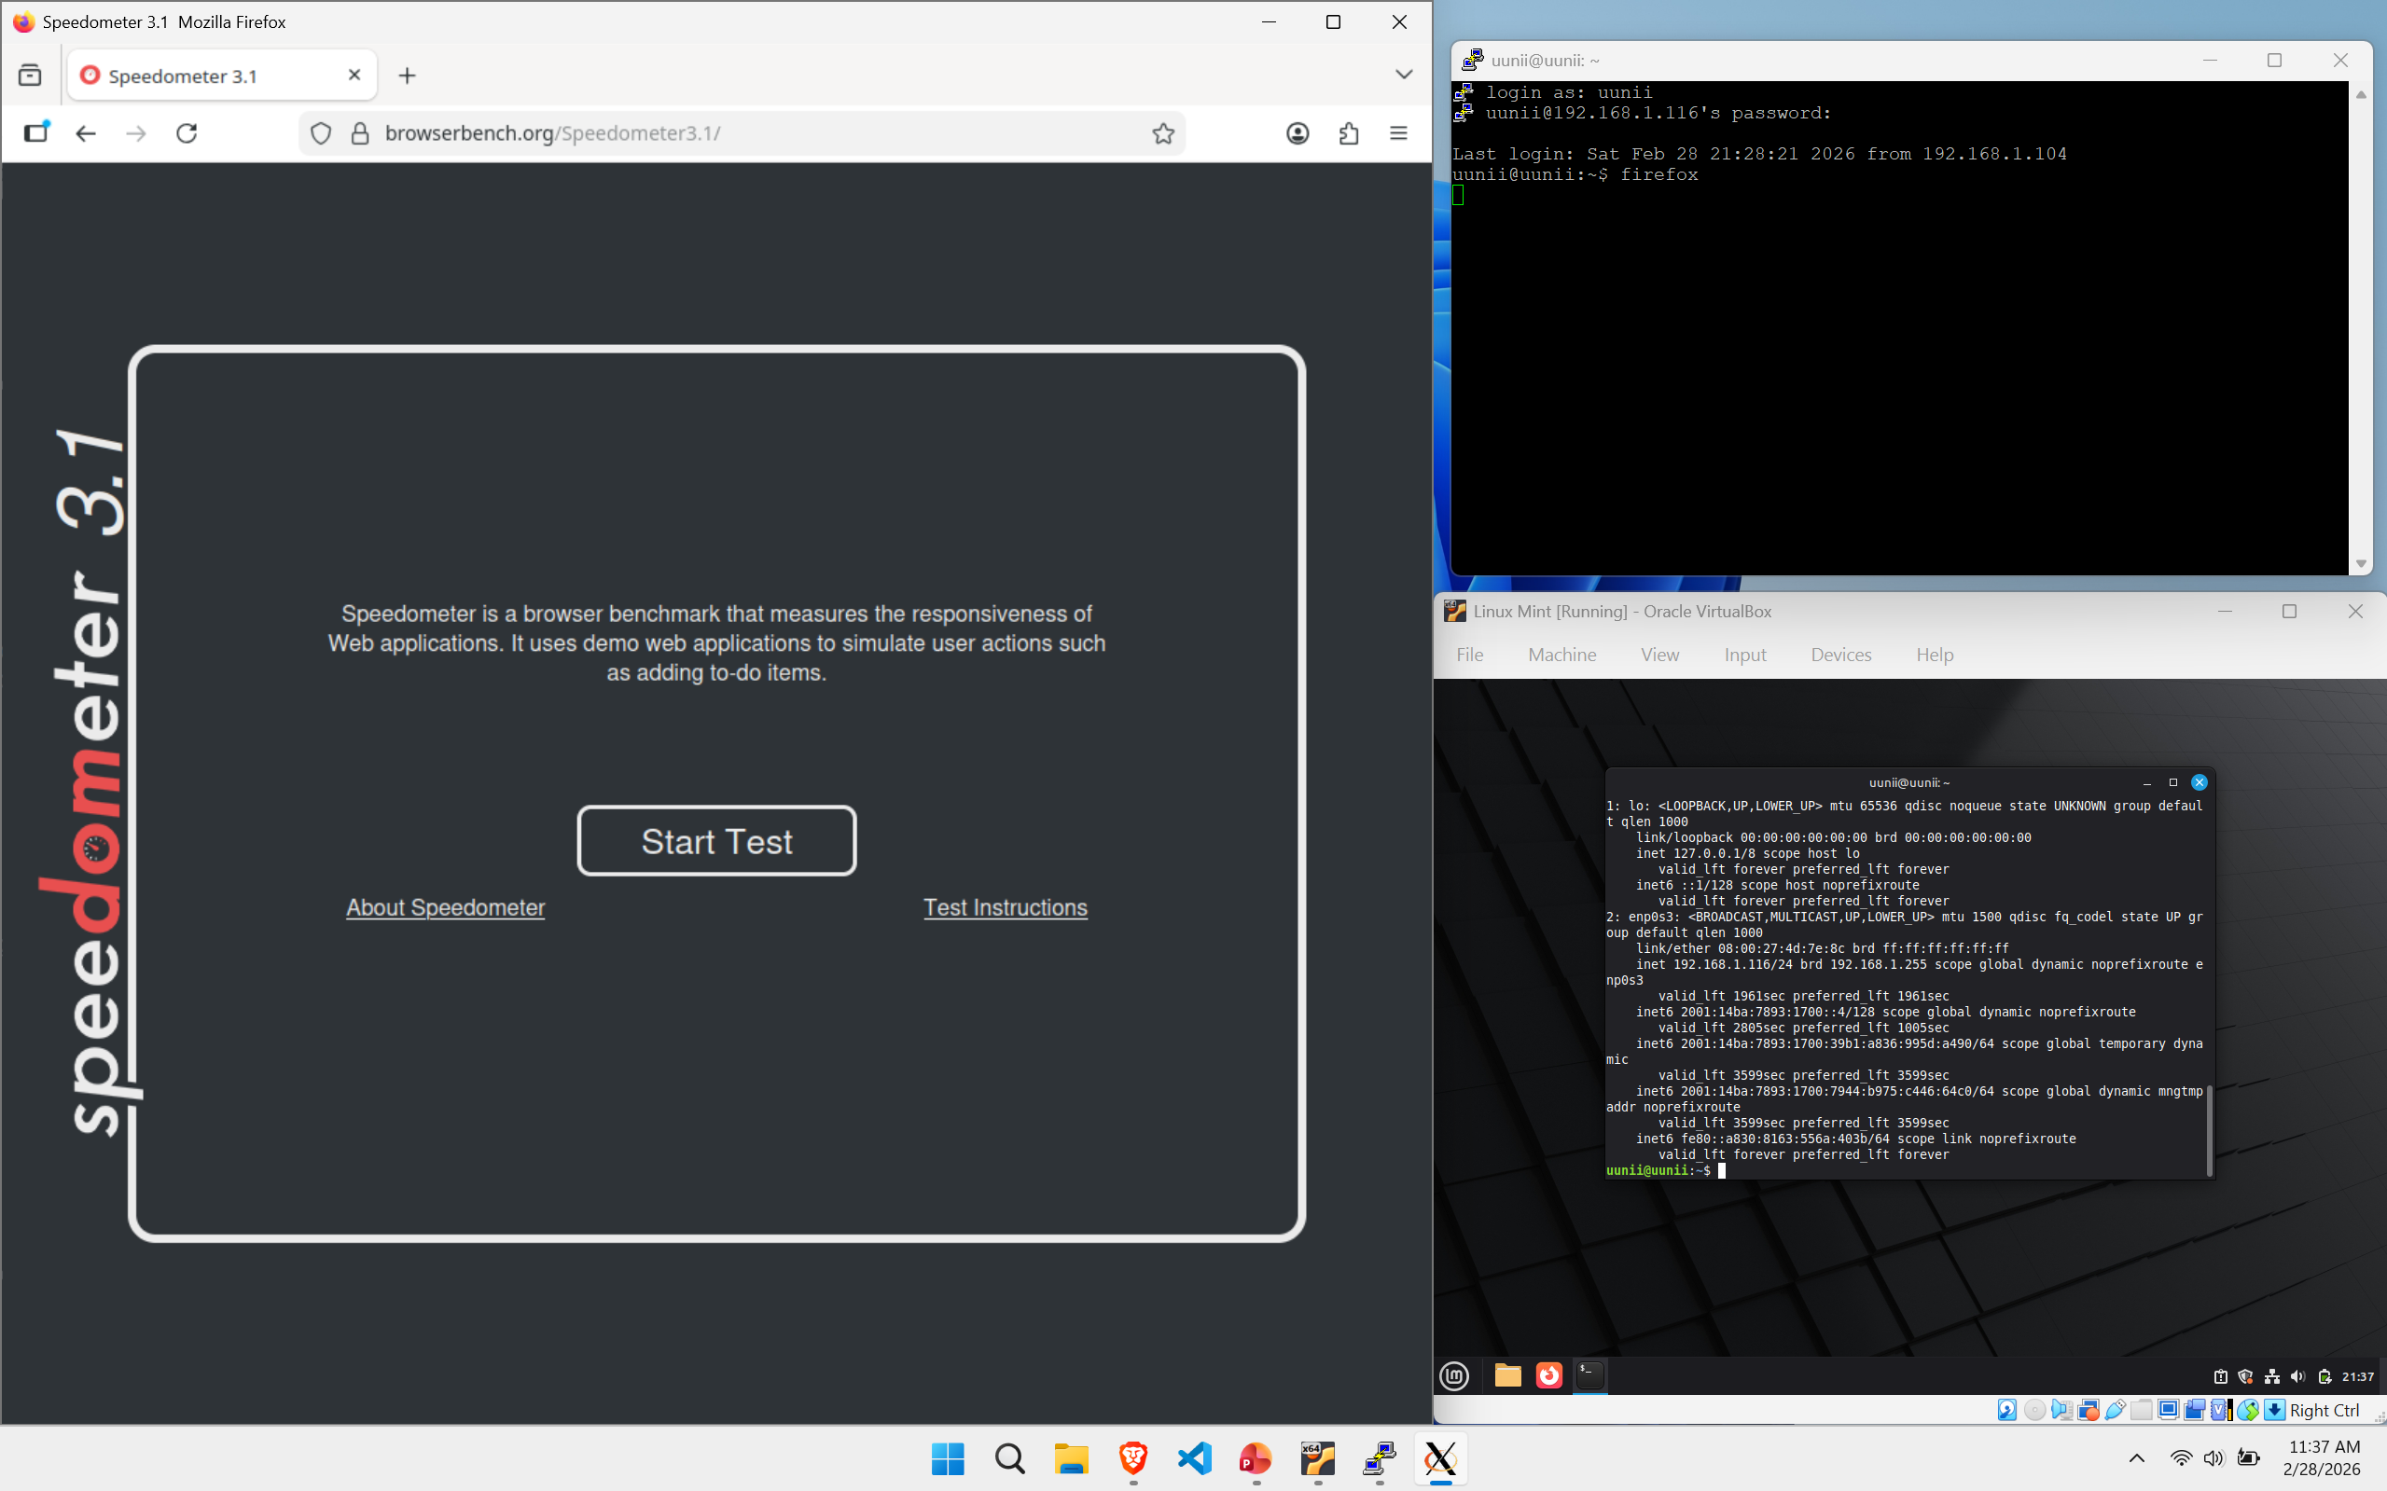
To start a browser, for example, I’m using Firefox, so I simply type firefox and it will open in a separate window. I chose Firefox because Google Chrome was too heavy to run on X11 and faced freezing issue. If you’re using Firefox and still notice lag or freezes, make sure in your VirtualBox settings to enable 3D acceleration and allocate more video memory (VRAM)
Firefox on Linux Mint:
1st run: 13.4
2nd run: 12.6
3rd run: 12.1
AVG: 12.7

Slide 8
Self evaluation
Using school’s virtual desktop using citrix was ideal because I am accessing pre-configured environment with all necessary software already installed and I didn’t have to configure anything on my local machine other than installing its application, but seems like it is more dependent to school server and my internet connection because the benchmark was showing lowest results on this task.
With RDC I have full control over my virtual machine and for me this method is more useful if I want to interact multiple application, using this method on window was pretty straight forward and easy but if I want to interact with specific individual application, X11 forwarding over ssh was more suitable.
Another thing I observed was VRDE allows me to access the virtual machine even when the other os is not full booted which makes it more useful than RDP when its unavailable.
I tried to SSH from Windows Terminal and Command Prompt with X11 forwarding, but I kept getting an error saying that X11 forwarding was not enabled, even though it is enabled on the Linux. I couldn’t figure out what I was doing wrong.

