Slide 1
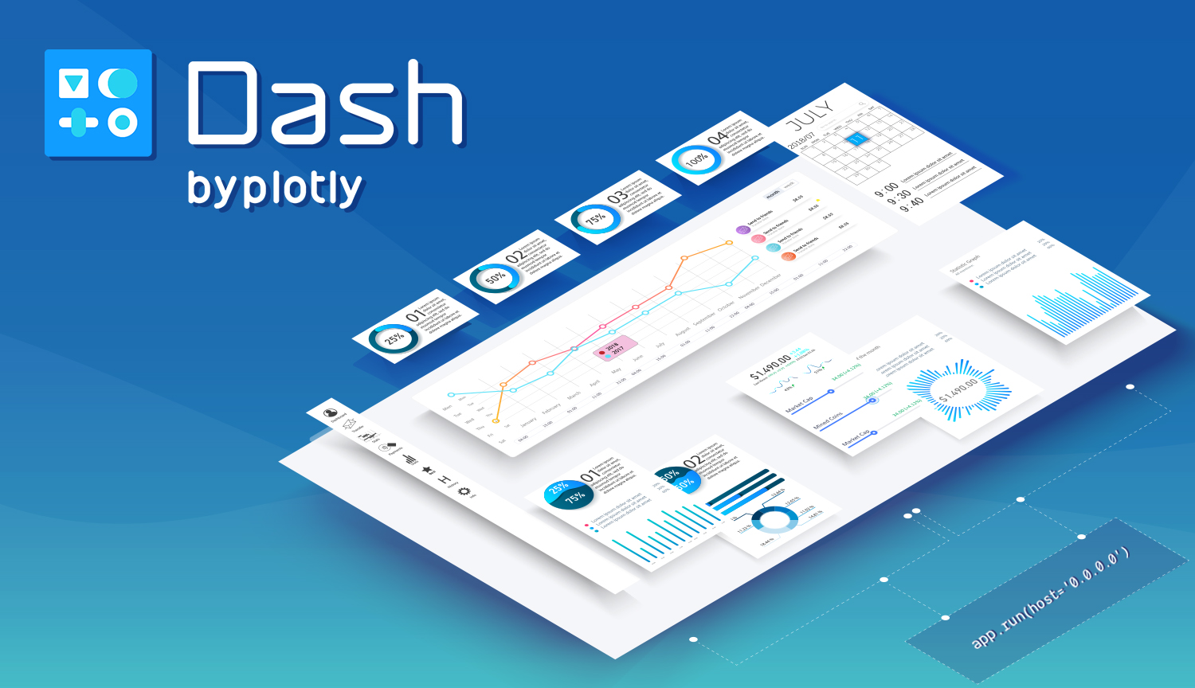
Dash plotly

Slide 2




Joris Huese I Like:
Data Scientist at UvA Business Intelligence
Interdisciplinary background: BSc Bèta Gamma, MSc Behavioral Data Science
Projects we do:
Predicting ECTS
Predicting Dropout
Text mining based elective recommender system
And more, let's
Long road trips in my car
Algorithmic trading
Teaching programming
The Tidyverse
Nature
Mini golf

Slide 3
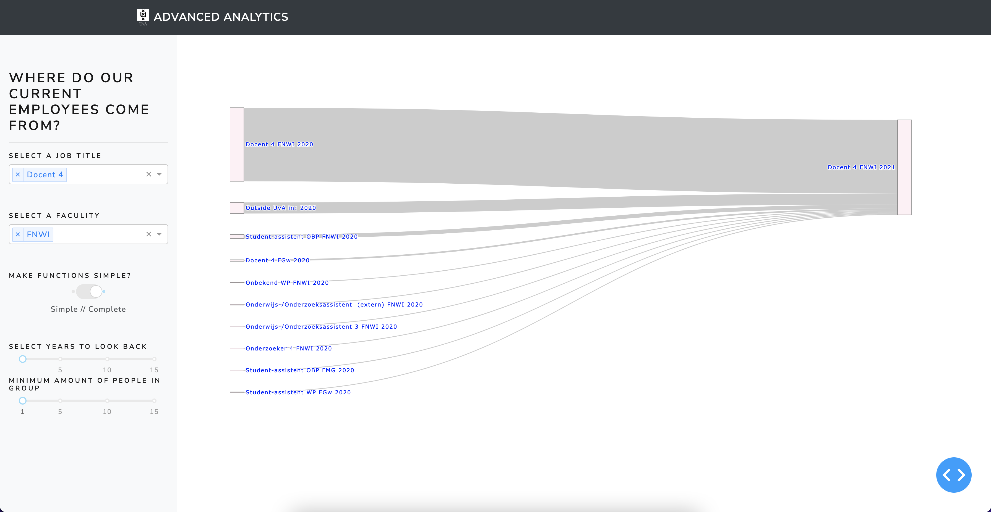
Today

Slide 4
Today
Introduction to Plotly in Python
What is Dash?
Dash basics: Layout
Dash basics: Core components
Interactivity: Dash callbacks for Plotly graphs
Styling: Using CSS to make your dashboard pretty

Slide 5
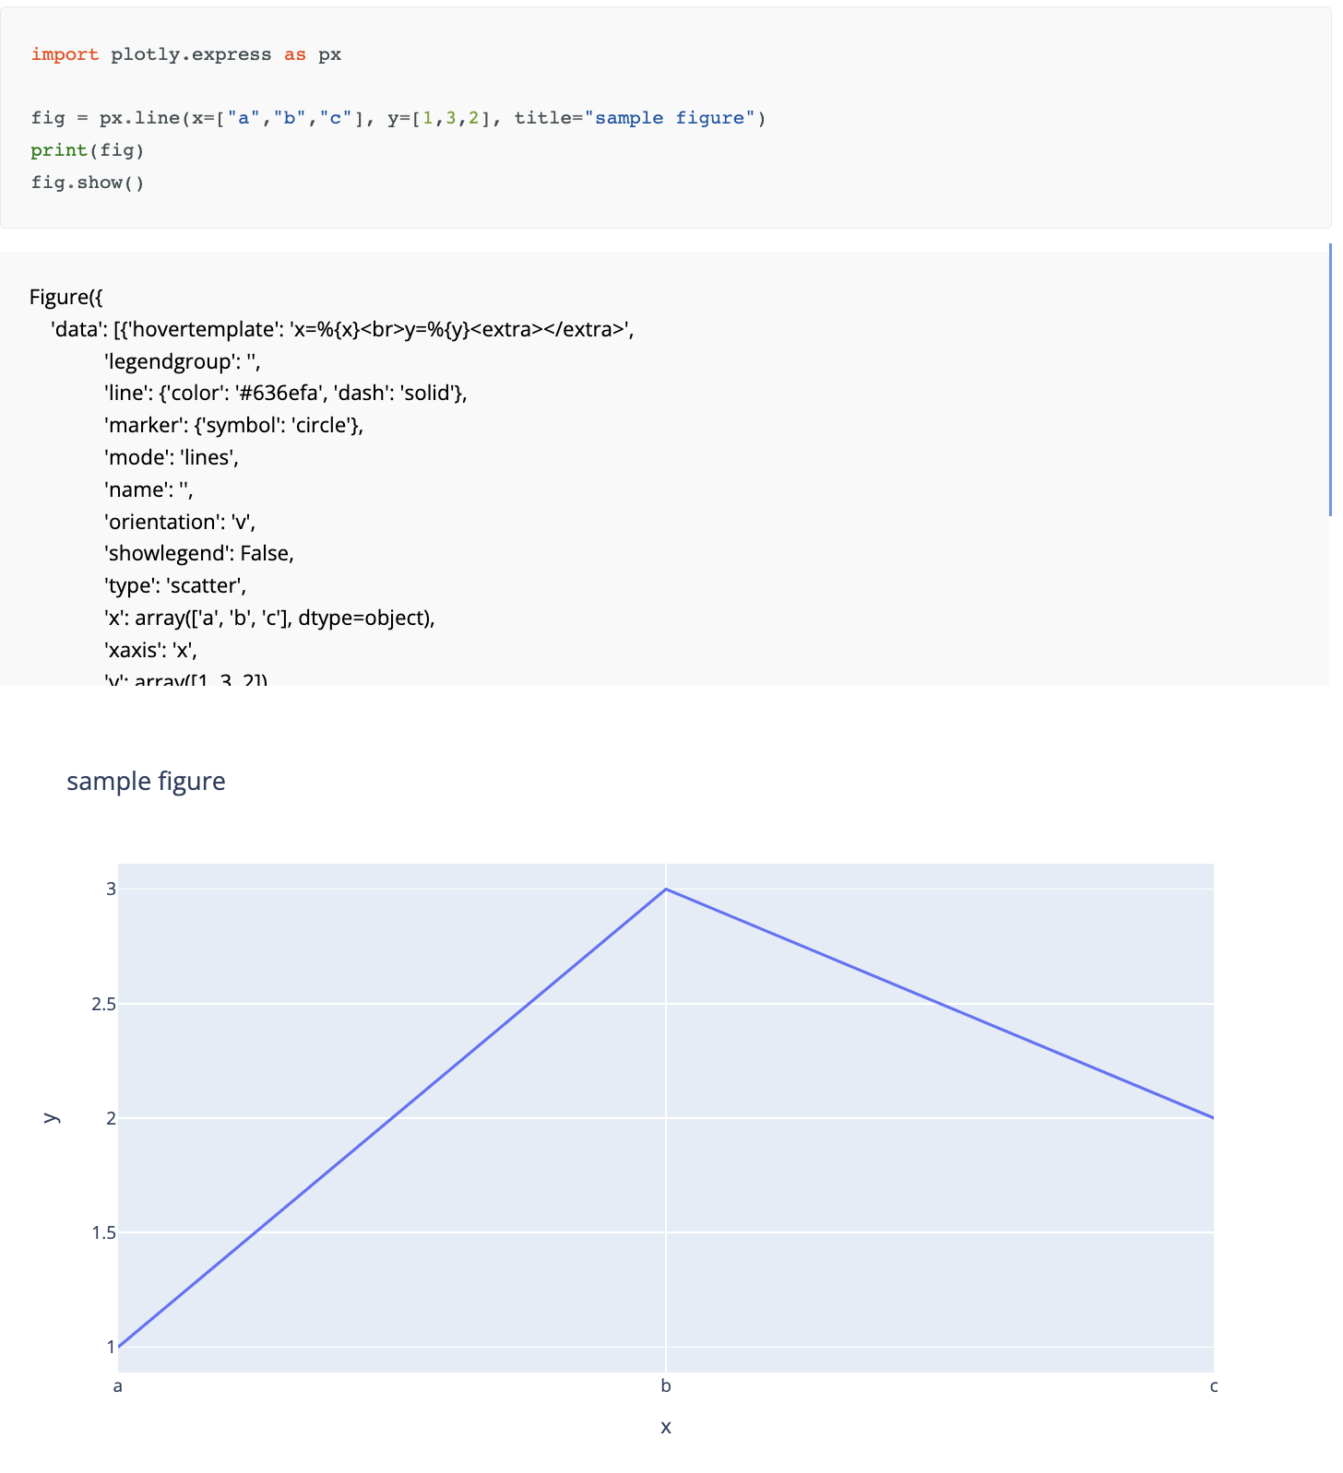
Plotly and Plotly Express
Python graphing library
plotly.graph_objects.Figure
Wide range of graph objects
Interactive, customisable, integratable
Plotly express: high-level module consisting of python functions returning fully-populated plotly.graph_objects.Figure objects

Slide 6
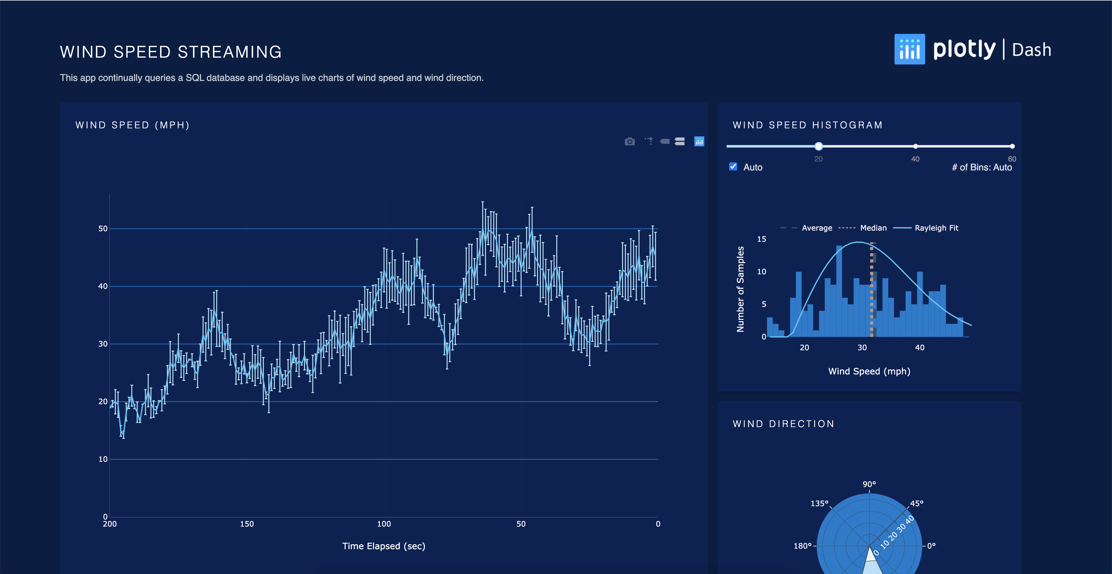
Dash
Build interactive HTML apps using Python, R, Julia
Low code
Rendered in web browser
Deployable: cross platform and mobile friendly
Open source!

Slide 7
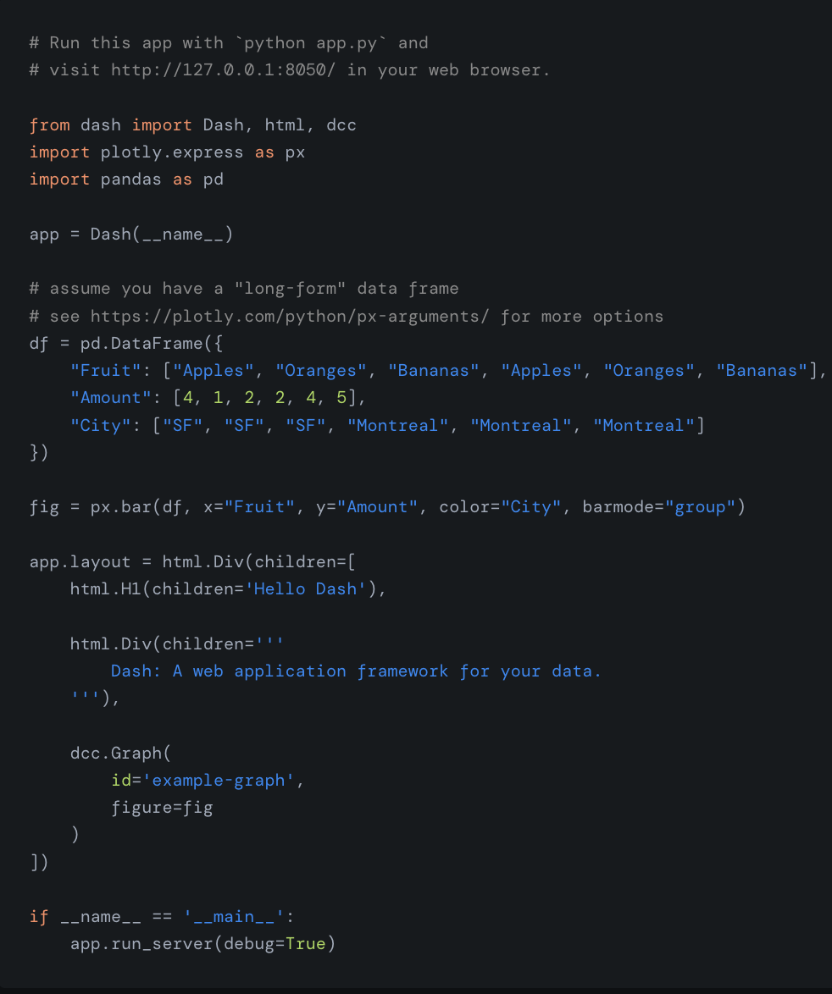
The dash layout
Make an app object
Load some data
Create a graph
Update the hierarchical tree layout using HTML
Call the run method
App is deployed to browser instance
Dash HTML components
Dash core components
Dash bootstrap components

Slide 8
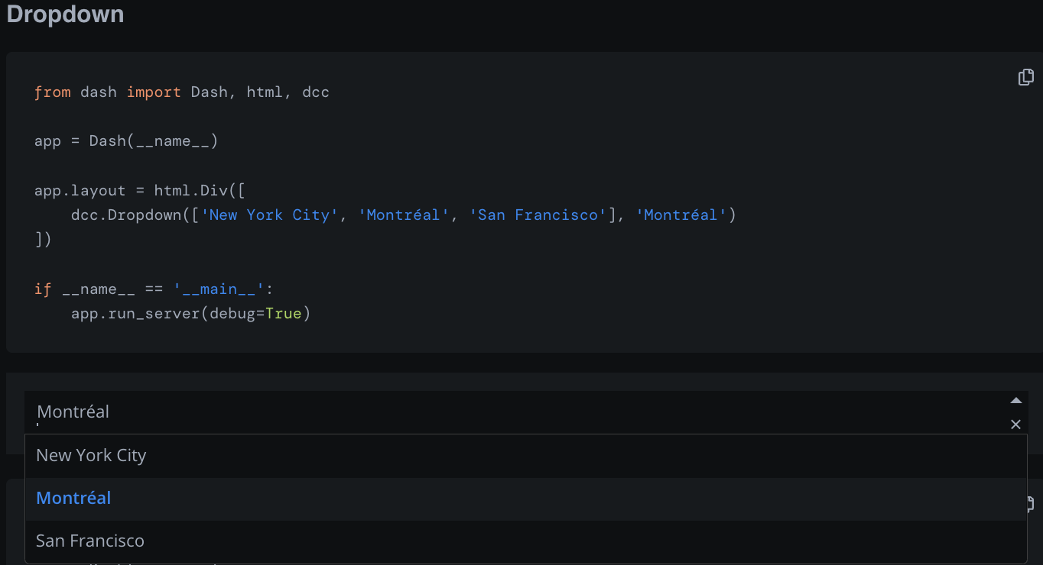
Dash core components
Collection of interactive components like sliders, dropdowns checklists
Perfect for users input and interaction
All core components have an ID

Slide 9
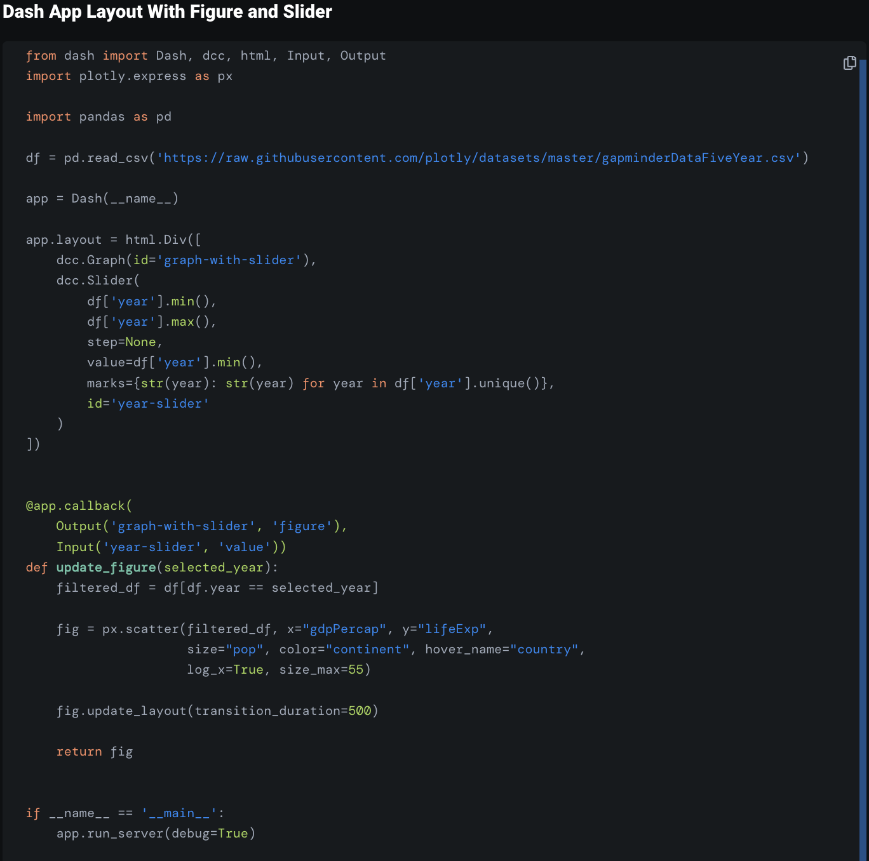
Basic callbacks
Callback functions
Automatically called whenever an input component property changes
Input usually user input through a dash core component
Function changes a property of another component, usualy a graph
Callback function can have multiple inputs, and multiple outputs

Slide 10
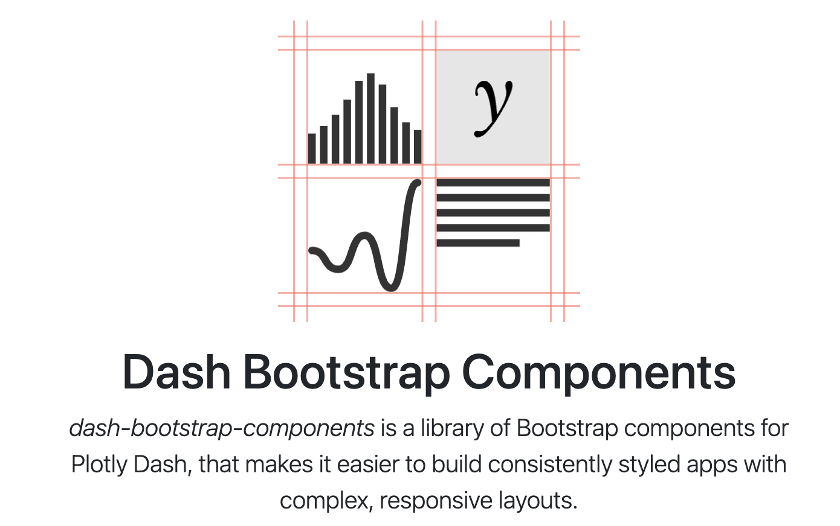
Making things pretty with Bootstrap
Wide range of advanced and pretty inputs
Precise layouts
Themes

Slide 11
Excersizes for today
Install
Install Plotly, Dash, Dash bootstrap components
Download
Download the code
Run
Run the interactive.py app
Add
Add another filter
Add a Navbar
Pick a cool theme
Add an interactive table to the app! Showing the underlying data

