Slide 1


Introduction to Full-Stack App Development

Slide 2
Week 0

Slide 3
Recap…

Slide 4

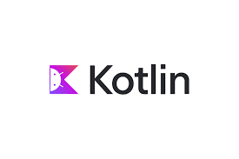

App Development
Single Platform App Development:
Java or Kotlin: Android App Development
Swift: iOS App Development
Cross Platform App Development:
Flutter: Android; iOS; Windows; Web; Linux; MacOS

Slide 5
Language vs Framework
Language: A language is like the words you use to talk.
Examples: Java, Swift, Python, C, C++, etc.
Language alone doesn’t help us build apps quickly, we would have to code everything from scratch.
Framework: A framework is like a toolbox + shortcut for building something.
Examples: React Native, Angular, Django, etc.
It is built on top of a language and provides: ready made tools like Widgets, libraries, structure, etc.
In our Case:
Language: Dart
Framework: Flutter
Both are developed by GOOGLE

Slide 6

Intro to Dart

Slide 7
Dart Topics
Hello World Program
main()
Variables and Constants
User Input
If-else control
Loops
Functions
Lists, Set, Map

Slide 8
Lecture 2 begins…

Slide 9

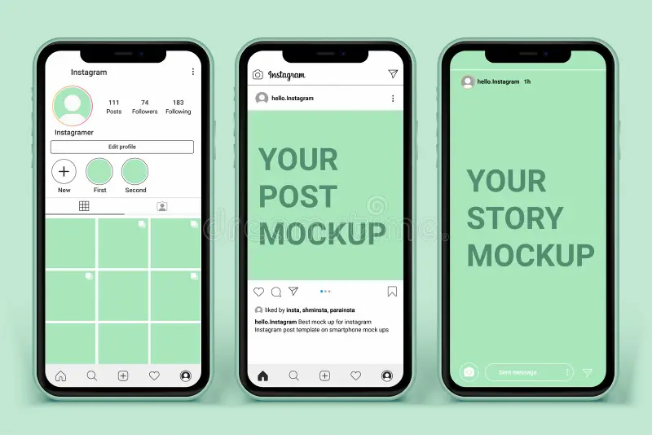
Frontend
Client side.
It is the visible part of the app that user can interact with.
It focuses on user experience (UX) and design (UI).
Written using Dart with the framework Flutter.
It needs to be responsive.

Slide 10

Backend
Server side.
It is like the engine for the app.
Handles logic, security, authentication, and processing user requests.
Written in JavaScript using framework Express.js.
Manages communication between Frontend and Database.
Written using JavaScript with framework Express.js.

Slide 11

Databases
Storage system for apps.
Stores user accounts, product catalogue, transactions, etc.
Ensures data is retrievable, secure and consistent.
2 types:
  SQL (Relational) : Organized in Tables (e.g.: MySQL, PostgreSQL)
  NoSQL (Non-relational) : flexible structure (e.g.: MongoDB, Firebase)

Slide 12
API
API = Application Programming Interface.
Set of rules that let different software components talk to each other.
Acts like a messenger between our apps and third-party software.
Examples:
  Food delivery apps use APIs to fetch live restaurant menus.
  Payment gateways (Razorpay/PayPal API) handle transactions securely.
  Weather app shows live updates using weather APIs.

Slide 13
OOPs…

Slide 14
OOPs Features
Modularity: breaking code into independent, reusable module. (class/object)
Reusability: using existing code instead of rewriting.
Maintainability: encapsulation and modularity makes it easy to update/debug.
Extensibility: new features can be easily added without breaking the existing code.
Security: data hiding (encapsulation) protects from unauthorized access.
Scalability: OOP design supports scaling large application by organizing code into classes.

Slide 15
OOP vs POP
Feature | POP (Procedure-Oriented) | OOP (Object-Oriented)
Approach | Focus on functions/procedures | Focus on objects & classes
Data | Data is global & shared, less secure | Data is encapsulated inside objects
Reusability | Harder to reuse code | Code reusability through inheritance & polymorphism
Maintainability | Complex as project grows | Easier due to modular design
Examples | C, Pascal | Java, C++, Python, Dart

Slide 16
OOPs Concepts
Class
Object
Data Abstraction
Encapsulation
Inheritance
Polymorphism

Slide 17
Class
A blueprint or template for creating objects.
Defines properties (variables/attributes) and methods (functions/behaviours).
Helps organize and modularize code.
Example: A car with attributes: colour, model and methods: drive().

Slide 18
Object
Instance of a class.
Real-world entities.
Each object has its own data and can perform actions.
Multiple objects can be created from the same class.
Example: Tesla, BMW, Mercedes.

Slide 19
Data Abstraction
Shows only essential details, hides the internal complexity.
Achieved through abstract classes or interfaces.
Makes system easy to use and maintain.
Example: Camera, Mobiles, Cars.

Slide 20
Encapsulation
Bundling of data (variables) and methods (functions) into one unit (class).
Uses access modifiers (public, private, protected) to restrict access.
Increases data security and data protection.

Slide 21
Inheritance
Allows a class (child) to reuse code from another class (parent).
Promotes reusability and hierarchy in code.
Types: Single, Multiple, Multilevel.
Example: Parent Class: Car -> Sub class: Maruti -> Object: Swift Dzire.

Slide 22
Polymorphism
One name, many forms.
Same method behaves differently depending on the context.
Makes system flexible and extensible.
Type:
  Compile-time (Overloading): Same method name, different parameters.
  Run-time (Overriding): Subclass provides its own version of parent’s method.

Slide 23
Time to Code…

Slide 24
Open DartPad https://dartpad.dev/

Slide 25


Slide 26
Thank You!!!

