Slide 1
Project:
Car Dheko - Used car price prediction

Slide 2
Domain: Automotive Industry
The automotive industry encompasses the design, production, and sale of vehicles, integrating advanced technologies to enhance performance, safety, and sustainability. It is a dynamic field driving innovations in electric, autonomous, and connected vehicles.

Slide 3
Project Introduction
This project focuses on building a machine learning model to predict used car prices based on various features, aiming to enhance customer experience and streamline pricing. The model will be deployed as a user-friendly Streamlit web app, allowing customers and sales representatives to input car details and instantly receive an estimated price.

Slide 4
Data Cleaning and Preprocessing

Slide 5
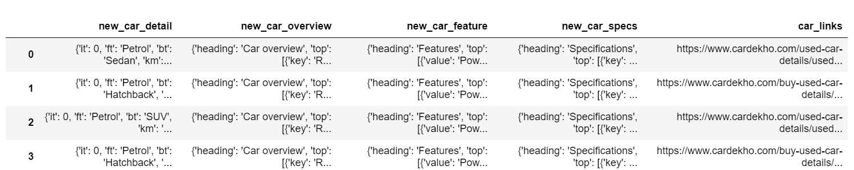
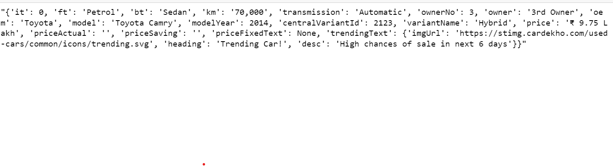
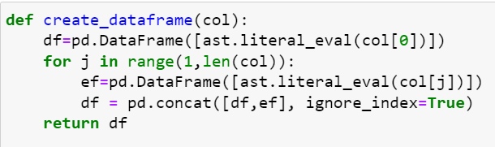
Handling first column ‘new_car_detail’
First column is the string of dictionary. So, created a def function to convert it to dictionary and create data frame out of it

Slide 6
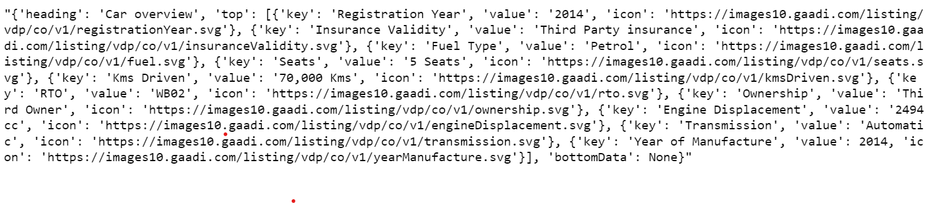
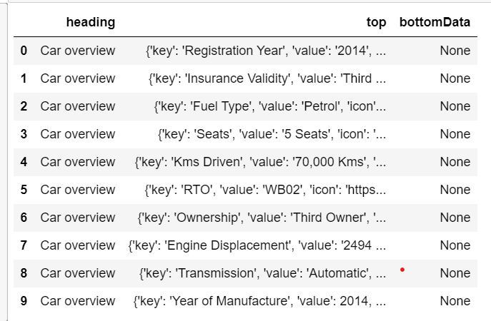
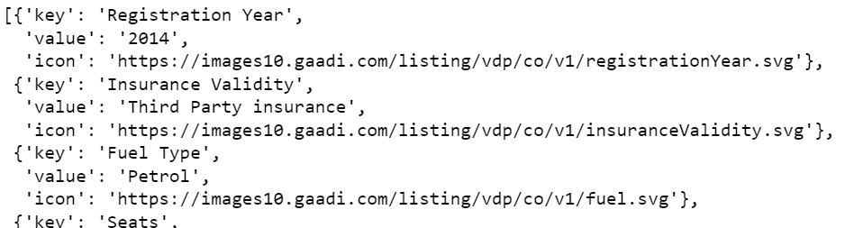
Handling second column ‘new_car_overview’
First converting it to data frame and then treating top column only because the other two are unnecessary

Slide 7
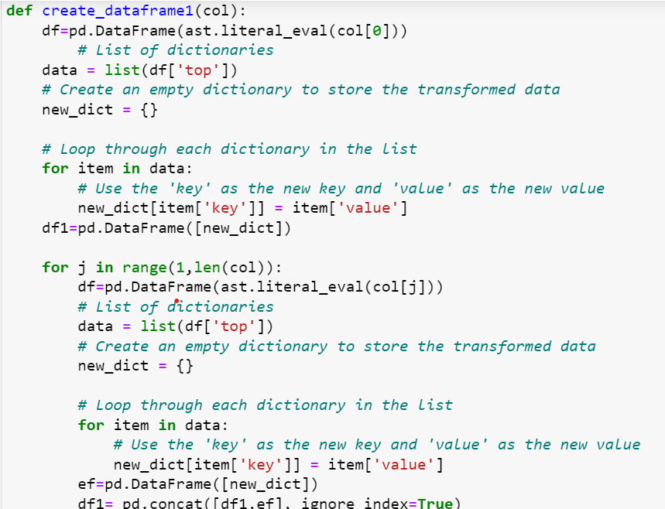
Created this def function to prepare the dictionary of features and its values then converted to data frame .
First done with 0 index then loop all the other for concatenation purpose

Slide 8
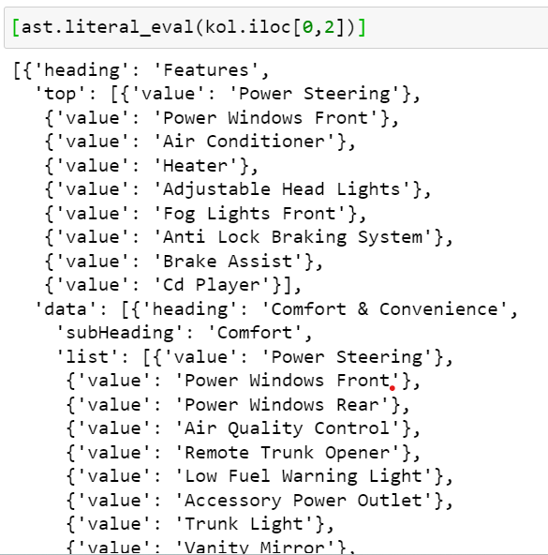
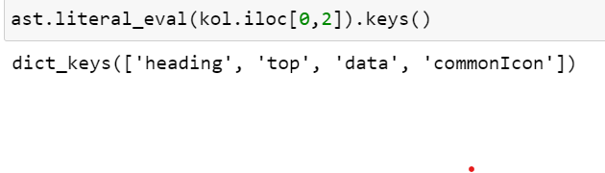
Handling third column ‘new_car_feature’
Converted it to list of dictionary

Slide 9
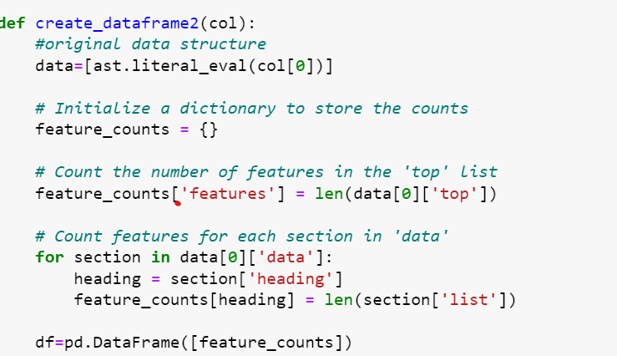
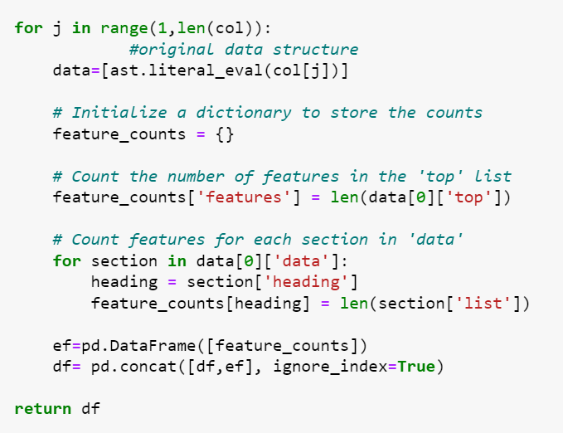
Created the def function:
First counting the ‘features’ value, then counting all the other feature values by considering key as the heading and value as the length of the list. Here values are counted because there is no value for each feature keys
First done with 0 index then loop all the other for concatenation purpose

Slide 10
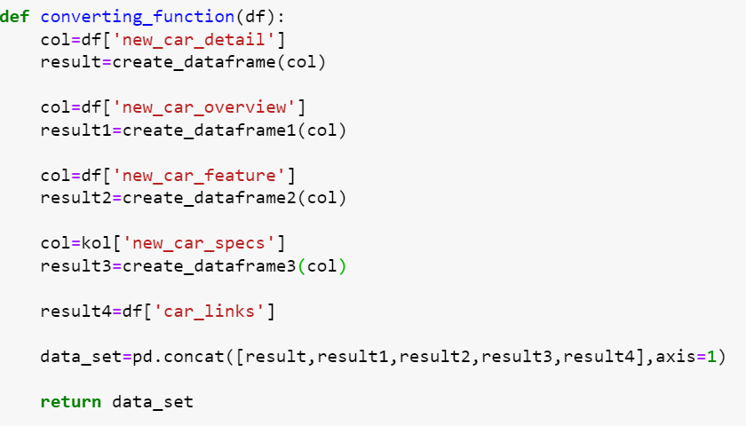
For the fourth column ‘new_car_specs’:
following the same procedure of third column,
The only difference is instead of counting the features dictionary is created because each has its own value.
Fifth column is left as it is
Then created the converting function to call the respective functions of the respective columns and concating all those together
After converting all the data sets , it is merged into a single data

Slide 11
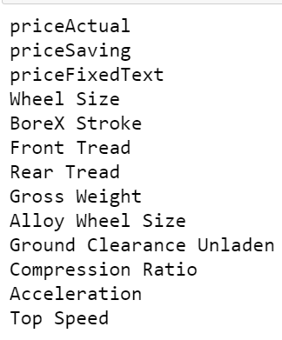
Handling Missing Values:
These columns are having null values more than 40 percent of the whole data. So these columns were dropped.

Slide 12
Data Preprocessing:
After concatenating them into a single, structured dataset, handling missing values, standardizing formats, encoding categorical features, and normalizing numerical features are applied. Finally null values are imputed according to the data set. Then the features are selected by using correlation matrix and random forest with domain knowledge. Finaly, the datasets are scaled and encoded for model building.

Slide 13
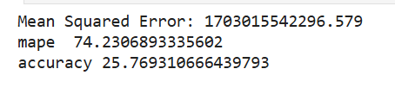
Model Building And Finding The Best Fitting Model
Decision Tree

Slide 14
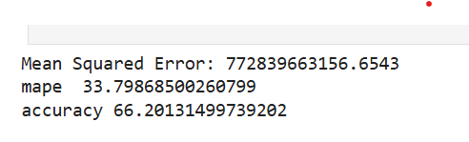
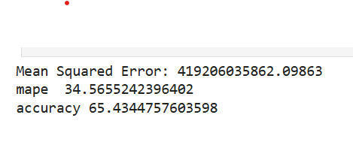
k-Nearest Neighbours (kNN)
Random Forest

Slide 15


Linear regression
Ridge

Slide 16
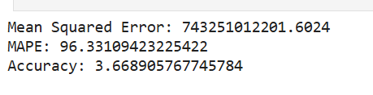

Lasso
Neural Networks

Slide 17
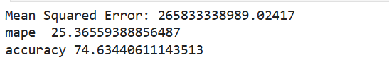
Gradient Boosting Machines
Concluding gradient boosting machines as the best fitting model

Slide 18
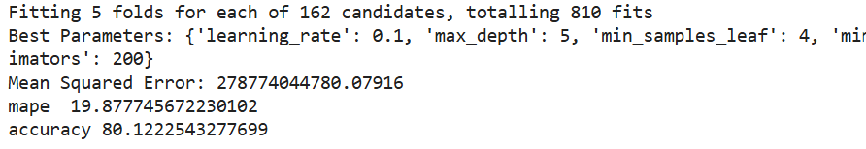
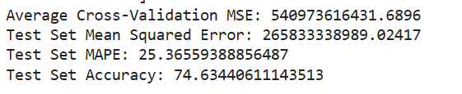
Hyperparameter tunning
Grid search
Cross Validation

Slide 19


Random Search
Gradient Descent With Random Search

Slide 20
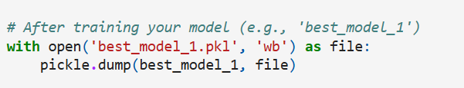
Choosing The Gradient Boosting Method With Hyperparameter Tuning Random Search And Gradient Descent as best model and pickling it.

Slide 21
Streamlit Application Creation
This Streamlit app predicts car prices based on user inputs, such as engine displacement, features, and brand. It scales and encodes the input data before using a pre-trained model to estimate the car price and display it in a readable format.

