Slide 1
DATASPARK: ILLUMINATING INSIGHTS FOR GLOBAL ELECTRONICS

Slide 2
Domain
The project focuses on inserting, processing, and analyzing sales, product, customer, and store data, with key metrics displayed via views and dashboards.

Slide 3
Introduction to the project
The project focuses on inserting, processing, and analyzing sales, product, customer, and store data, with key metrics displayed via views and dashboards.

Slide 4
Objective of the Project:
The objective is to identify insights that improve marketing strategies, optimize inventory management, and enhance sales forecasting, ultimately increasing customer satisfaction and driving business growth.

Slide 5
Data Migration:
The preprocessed data is loaded into Mysql Workbench using pymysql in pandas.

Slide 6
Details of the given data
Customers - Customer details
Exchange rates - Exchange rate compared to USD details
Products - Product details
Sales - Details of the orders of the products
Stores - Details of the stores

Slide 7
Project Structure
Data Ingestion: Using Pandas and PyMySQL to load CSV data into a MySQL database.
Data Analysis: Creating views to analyze various business metrics like total sales, top-selling products, and customer demographics.
Power BI: Dashboards for visual representation of key performance indicators (KPIs).

Slide 8
Data Cleaning and Preparation
All the data sets were cleaned, and null values were handled properly.
Data types of some columns in the data sets were changed for later use.
Some data sets were merged for analysis purposes.
Null values are imputed.

Slide 9
Loading Data
Def function “insert_data” is created to load data sets to Mysql using insert statement
Power BI Visualizations
Data sets were connected to power bi and interactive dashboards are created and used for analysis

Slide 10
SQL QUERIES
Total Sales by Date (in USD)
Displays total sales for each date, converting the currency to USD using exchange rates.
Top 10 Most Sold Products (by Quantity)
Shows the top 10 products with the highest sales volume.
Top 5 Customers by Total Purchases (in USD)
Lists the top 5 customers with the highest purchase totals.
Total Revenue by Product Category (in USD)
Summarizes the total revenue for each product category.
Store Performance by Total Sales (in USD)
Ranks stores based on total sales in USD.

Slide 11
Average Order Value by Store (in USD)
Shows the average order value per store.
Sales by Customer Gender
Provides insights into sales by customer gender.
Top 5 Brands by Total Sales (in USD)
Highlights the top 5 brands based on total sales.
Sales by Customer Continent
Breaks down sales by the continent of the customers.
Most Profitable Products (by Profit Margin)
Displays the products with the highest profit margins.

Slide 12
Product Sales by Color
Analyzes sales by product color.
Store Sales by Square Meters
Displays sales efficiency by square meters of the store.
Sales by Customer Age Group
Categorizes sales by customer age group.
Store Performance by Opening Year
Compares the performance of stores based on their opening year.
Monthly Sales Trend
Shows the monthly sales trend across different years.

Slide 13
Analysis by Data sets:

Slide 14
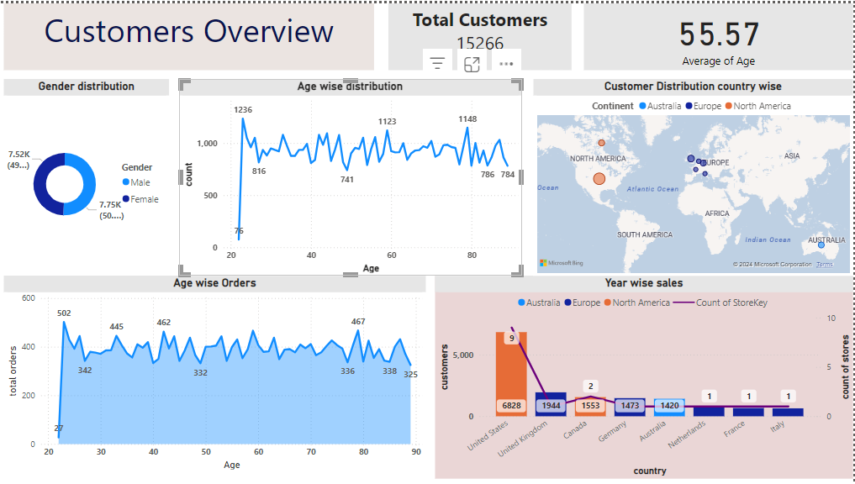

Slide 15
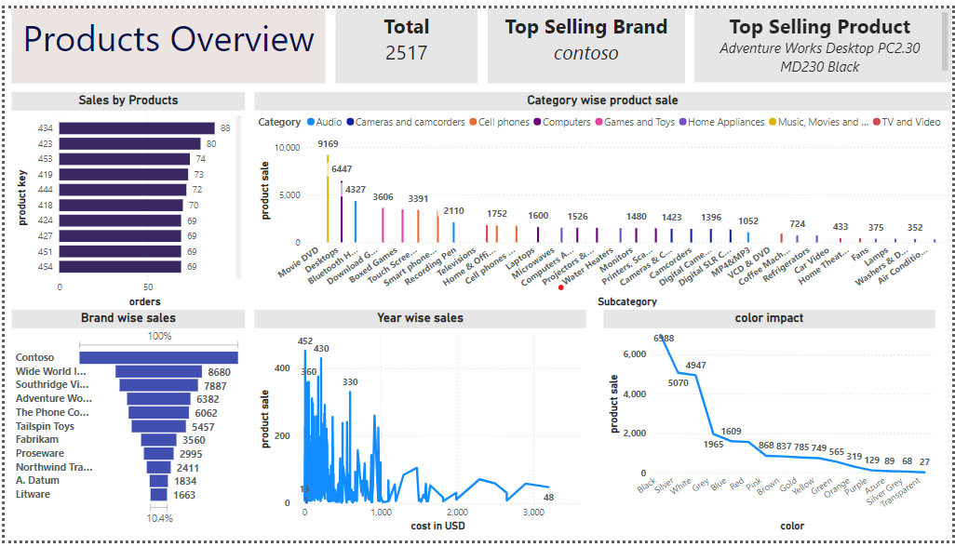

Slide 16
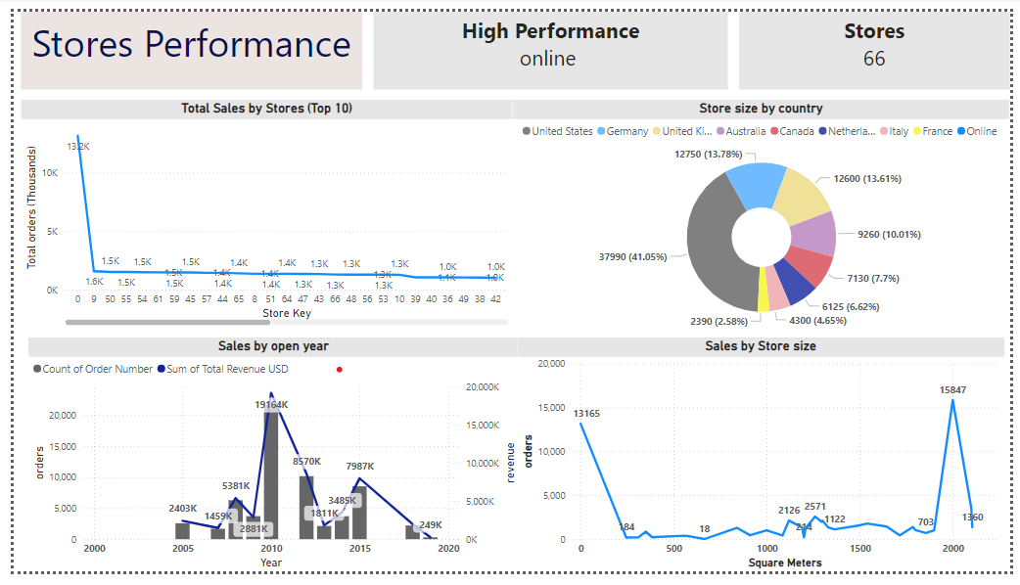

Slide 17
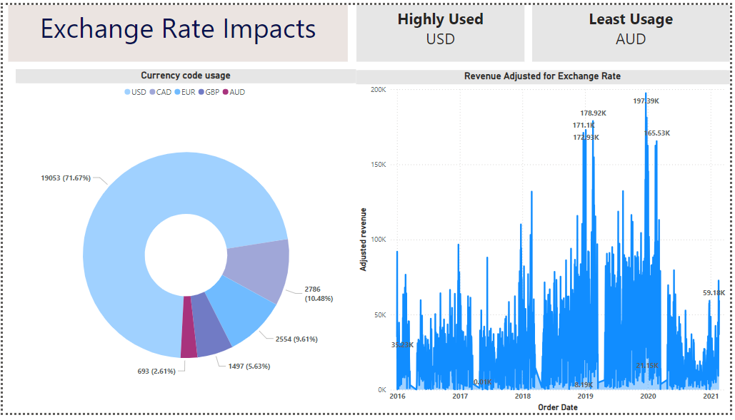

Slide 18
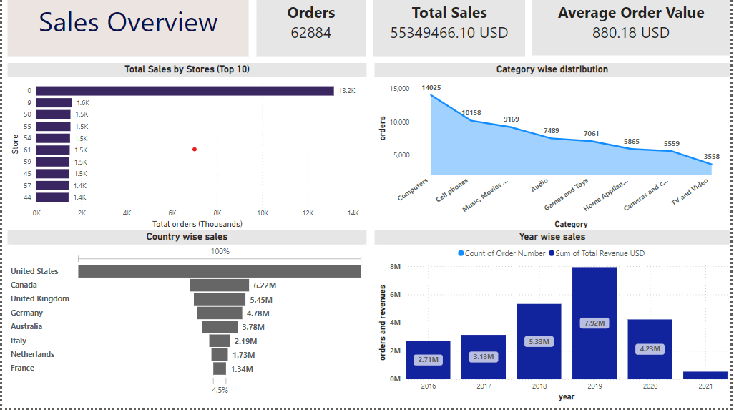

Slide 19
Business suggestions
Pricing and Promotions:
Monthly Sales Trends: Use this analysis to identify seasonal sales patterns. Plan promotions and pricing strategies around low-sales months to smooth out revenue volatility.
Most Profitable Products: Consider bundling high-margin products with lower-margin items to increase overall profitability.
Store Opening Year:
If newer stores outperform older ones, evaluate and refresh the layout, technology, or management practices in older stores
Product Exhibition:
Conducting product exhibitions and evaluations can help increase sales.

Slide 20
THANK YOU

