Slide 1
DATASPARK: ILLUMINATING INSIGHTS FOR GLOBAL ELECTRONICS

Slide 2
DETAILS OF THE GIVEN DATA
CUSTOMERS - Customer details
EXCHANGE RATES - Exchange rate compared to USD details
PRODUCTS - Product details
SALES - Details of the orders of the products
STORES - Details of the stores

Slide 3
Data Cleaning and Preparation
All the data sets were cleaned, and null values were handled properly.
Data types of some columns in the data sets were changed for later use.
Some data sets were merged for analysis purposes.

Slide 4
Loading Data
Data sets were loaded into MySQL Workbench to apply SQL queries for analysis purposes.
Power BI Visualizations
Data sets were connected to power bi and interactive dashboards are created and used for analysis

Slide 5
Analysis by Data sets:

Slide 6
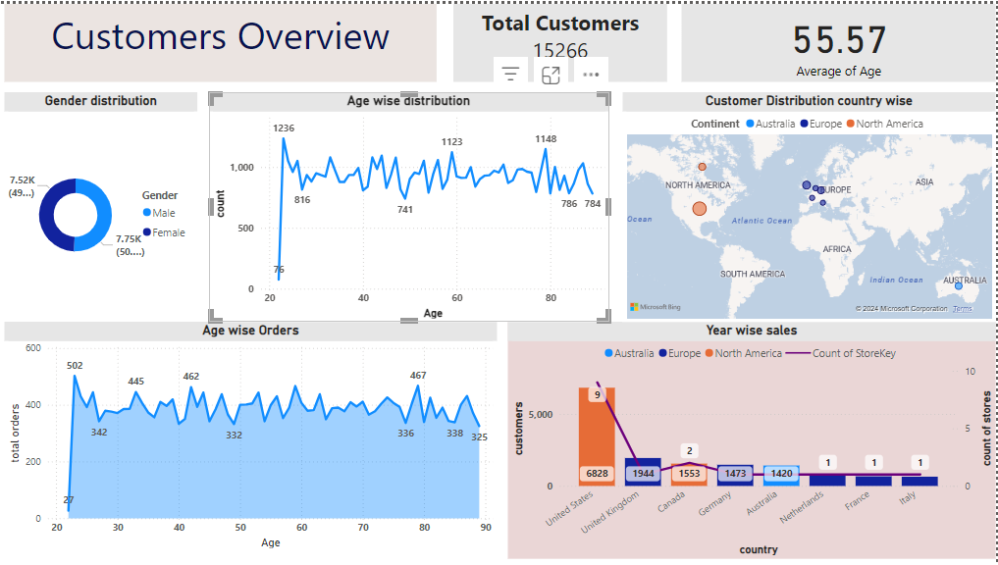

Slide 7
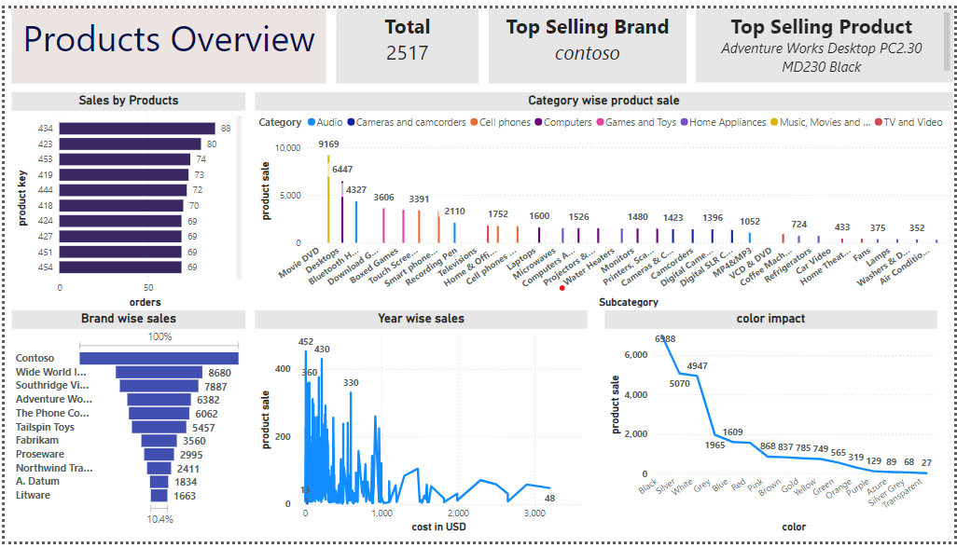

Slide 8
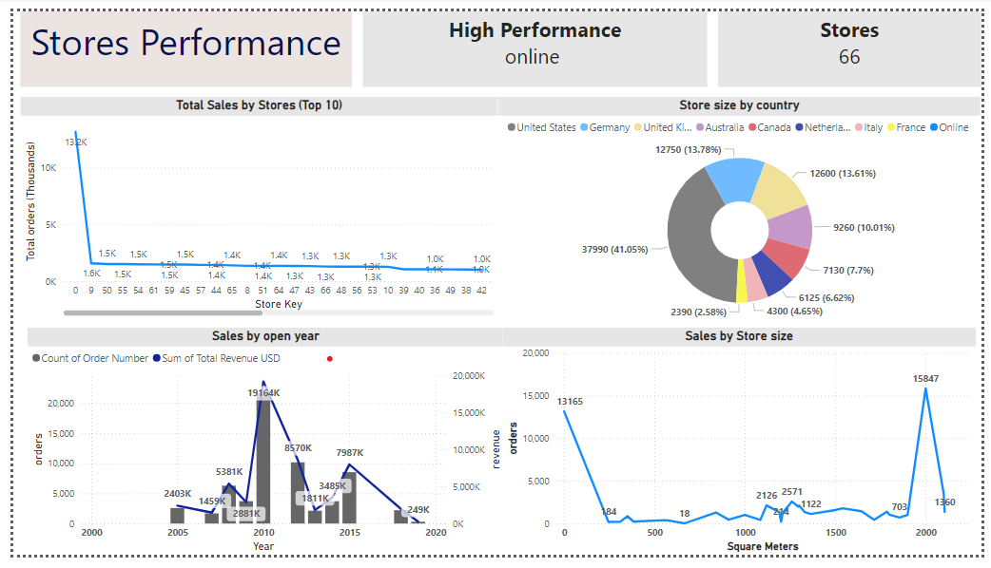

Slide 9
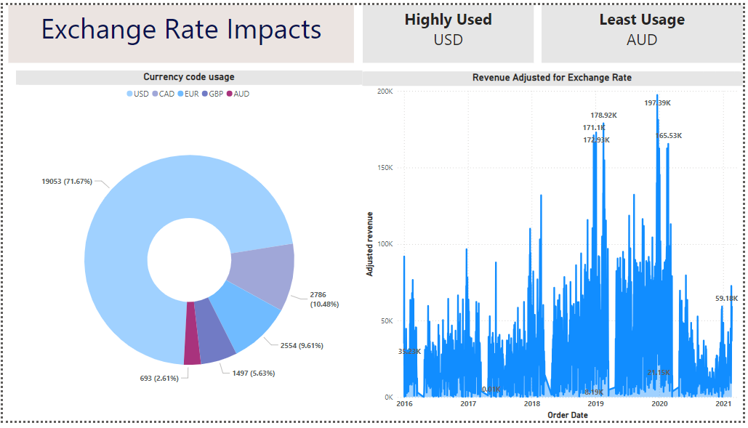

Slide 10
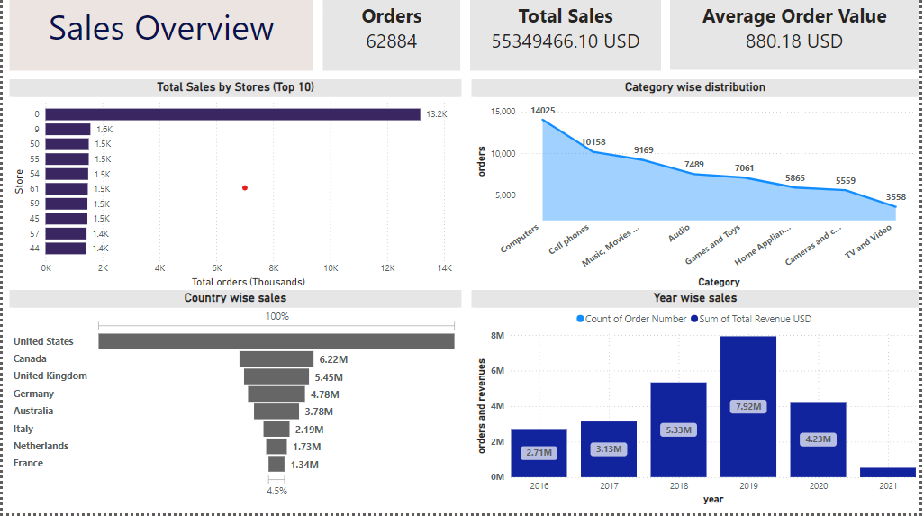

Slide 11
THANK YOU

