Slide 1
Project: Fake Review Classification and Topic Modelling

Slide 2
Domain:
E-Commerce & NLP - Fake Review Detection and Classification focuses on identifying and categorizing fraudulent reviews in online marketplaces using Natural Language Processing (NLP) techniques. It aims to ensure trust and fairness by analyzing text patterns, sentiment, and user behavior to detect deceptive or biased reviews.

Slide 3
Project Introduction:
This project focuses on detecting and classifying fake reviews in e-commerce using NLP techniques, including machine learning, deep learning, and Transformers. It also clusters similar reviews and identifies key topics to enhance customer trust and product feedback analysis.

Slide 4
Project Approach:
Preprocessing and Topic Modeling: Clean and vectorize review text using TF-IDF/Word2Vec; extract key themes with LDA or NMF.
Clustering and Classification: Group similar reviews using K-Means/DBSCAN and classify fake vs. real reviews using machine learning (SVM, Logistic Regression) and deep learning (LSTM, BERT).

Slide 5
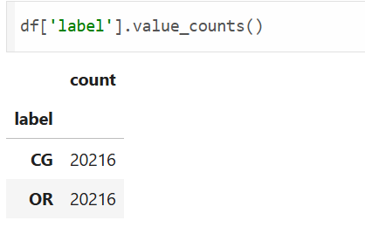
Pre-processing:
Since the target classes are balanced there is no need for data balancing process like smote

Slide 6
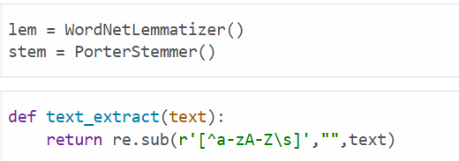
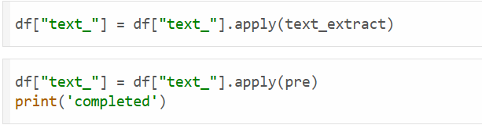
Creating a pred function
pre = lambda text:[lem.lemmatize(word) for word in tqdm(nltk.word_tokenize(text.lower()))
if word not in stopwords.words("english")]

Slide 7
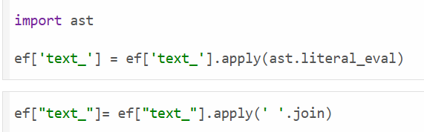
After applying the lemmatizing , removing stop words and done with the preprocessing, converting it toa single string using

Slide 8
Implementing Classification Using Different Machine Learning And Deep Learning Models

Slide 9
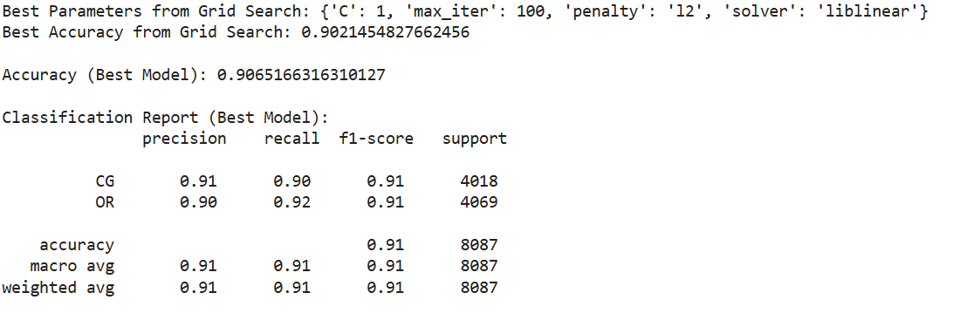
Best model for classification:
Logistic Regression

Slide 10
Best model for Clustering:
K-means with TruncatedSVD

Slide 11
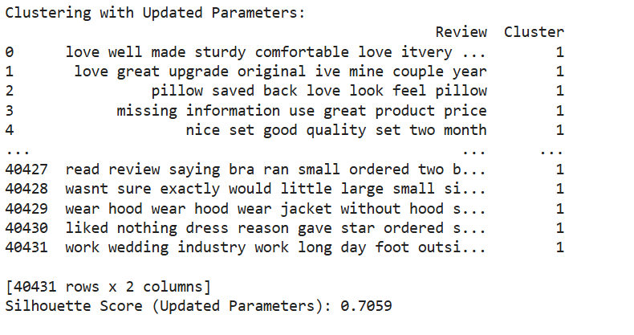

Slide 12
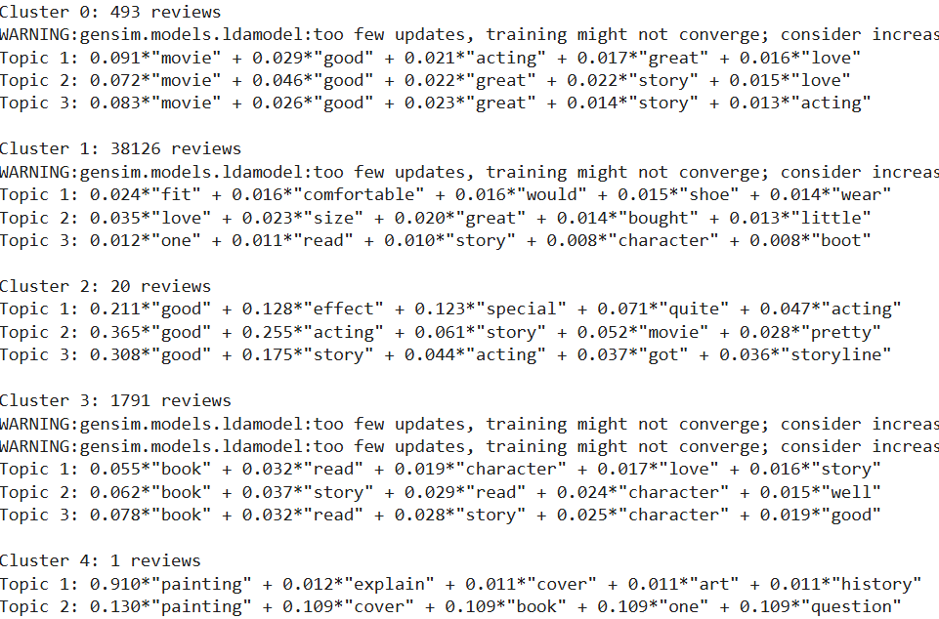
Topic Modeling For Clusters using LDA

Slide 13
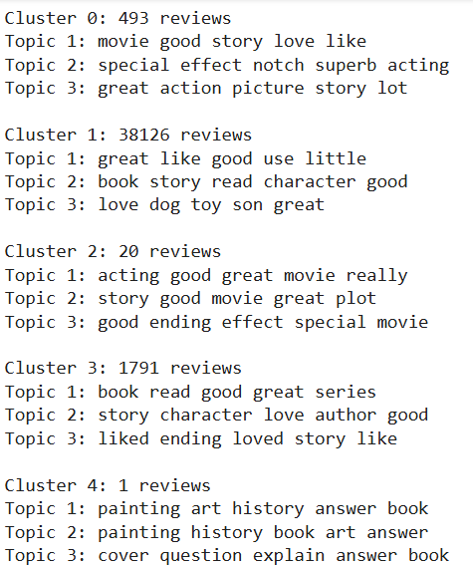
Topic Modeling For Clusters using NMF

Slide 14
Sentiment Analysis Using
Transformers
("text-classification", model="mrm8488/distilroberta-finetuned-financial-news-sentiment-analysis")

Slide 15
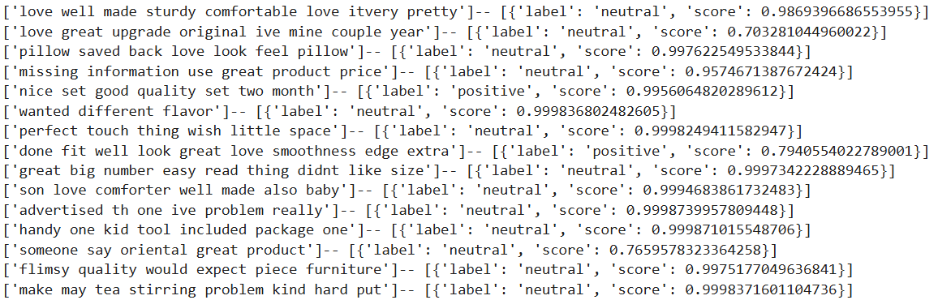

Slide 16
Class File Creation for model calling and further model deployment
A Single class file”review_classify_cluster_topic_senti” is created. Inside every model which is pickle is accessed using individual def functions which returns the outcome. This is further used for model deployment and user interactive streamlit application creation.

Slide 17
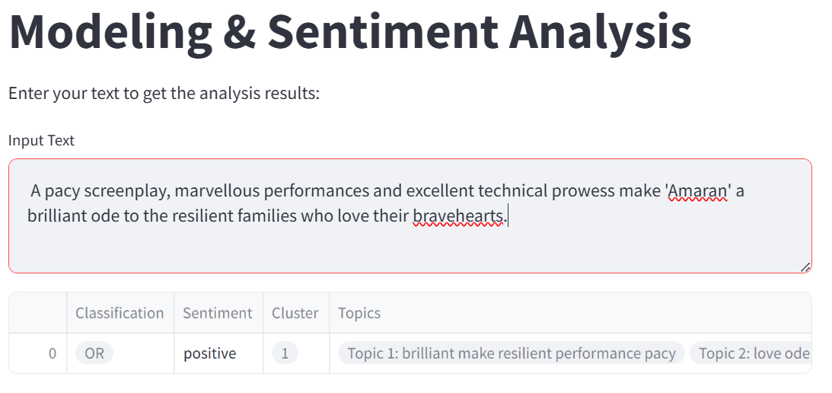
Streamlit Application Building:

Slide 18
Flask API – Creation:
from class_def import review_classify_cluster_topic_senti
from flask import Flask,jsonify,request
import numpy as np
app=Flask(__name__)
@app.route('/predict', methods=['POST'])
def predict():
data = request.get_json() # Parse JSON data from request body
text = data.get('text', '') # Extract 'text' from the JSON
if not isinstance(text, str) or not text.strip():
return jsonify({'error': 'Invalid input. Text must be a non-empty string'}), 400
class_fun = review_classify_cluster_topic_senti()
# Ensure text is passed as a single string
label = class_fun.classify(text)
cluster = class_fun.cluster(text)
topic = class_fun.topic(text)
sentiment = class_fun.senti(text)

Slide 19
# Prepare output
output = {
'Classification': label,
'Sentiment': sentiment,
'Cluster': cluster,
'Topics': topic
}
# Convert any ndarray to list to make it JSON serializable
for key, value in output.items():
if isinstance(value, np.ndarray): # Check if the value is a NumPy ndarray
output[key] = value.tolist() # Convert ndarray to list
return jsonify(output)
if __name__ == '__main__':
app.run(debug=True)

Slide 20
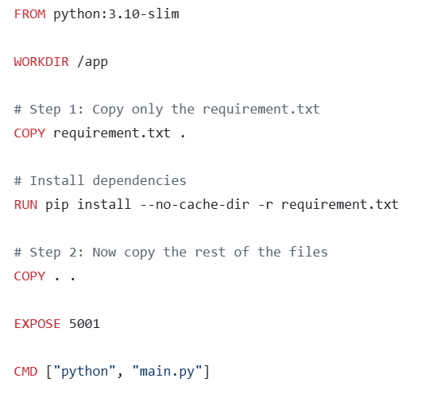
Docker Image Building:

Slide 21
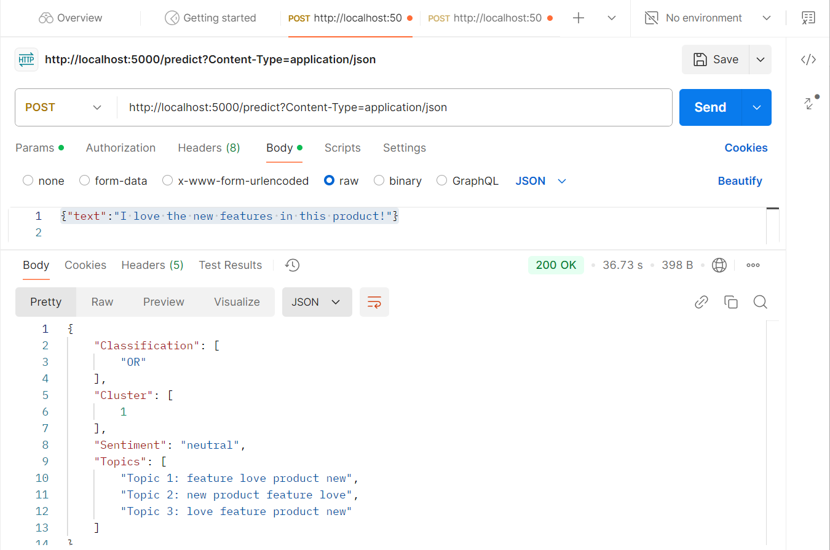
API Testing using Postman:

Slide 22
Business Use Case:
Customer Trust: Use NLP to detect and filter fake reviews, ensuring authentic feedback and building consumer confidence.
Product Feedback Analysis: Cluster similar reviews to identify common product issues and highlight key features for improvement.
Content Moderation: Automate the removal of fake or harmful reviews, maintaining a trustworthy and clean platform.

