Slide 1
Online Event Management System
PRESENTED BY :
Kushagra Singh Bohra (c) : 24scse1410267
Mohammad Uvaish shekh : 24scse1410303
Course: B.Tech in Cse with Artificial Intelligence
Java Swing + MySQL Application
Summary: A desktop app for booking and managing event details.

Slide 2
Objectives
Automate event booking: Streamlines the entire event reservation process.
Manage customers: Handles customer details with validation and easy retrieval.
Provide event scheduling: Allows users to choose event types and enter event-specific information.
Simulate payment: Includes a simple payment-processing workflow for confirmation.
Secure storage: Stores all event and customer data safely using MySQL and JDBC.
Summary:
Ensures smooth event planning, efficient user management, and secure data handling throughout the booking process.

Slide 3
System Description
Java Swing UI: Provides an interactive and user-friendly desktop interface for event booking.
MySQL Storage: Stores customer, event, and payment details in a structured and reliable database.
OOP Architecture: System is built using classes such as Customer, Event, Payment, and Database Manager to maintain modularity and reusability.
Automatic Schema Creation: On first launch, the system creates required tables automatically, reducing manual setup.
Summary:
A modular, scalable system built with strong OOP principles and efficient Java–MySQL integration to ensure smooth event management operations.

Slide 4

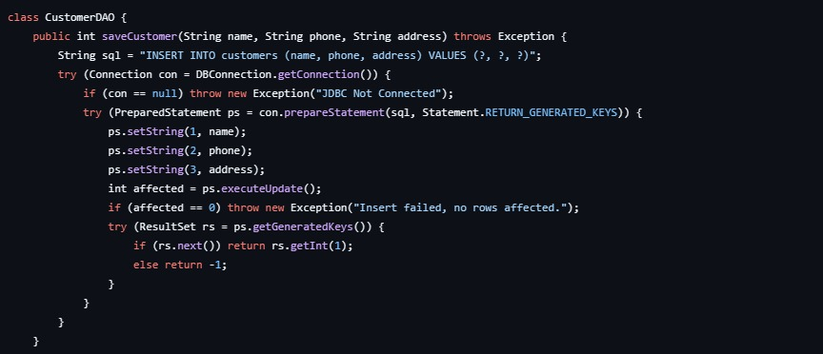
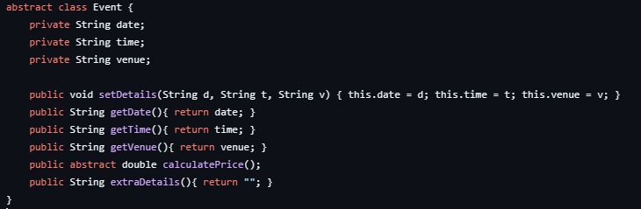
System Modules
1. Customer Module
Capture customer information
Validate phone number and basic details
2. Event Module
Select an event type
Fill event-specific forms and requirements
3. Payment Module
Perform simulated payment process
Display booking confirmation to the user
4. Database Module
Store customer information
Save event booking details
Update payment status in the database
Summary:
Each module performs a dedicated function, ensuring clear separation of responsibilities and smooth system workflow.

Slide 5

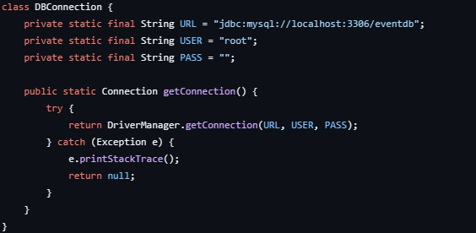
JDBC connectivity
Establishes a stable connection between the Java application and the MySQL database using the JDBC driver.
Executes SQL operations, including INSERT, UPDATE, DELETE, and SELECT, to manage all event and customer records.
Uses Connection, Statement, and PreparedStatement classes for secure and efficient database interactions.
Manages data flow safely by opening connections only when needed and closing them properly to avoid resource leaks.
Provides exception handling through SQLException, ensuring the system stays reliable even during database errors.
Summary:
JDBC enables smooth and secure communication between the application and the database, making data storage, retrieval, and management efficient and reliable.

Slide 6
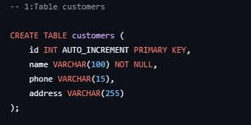
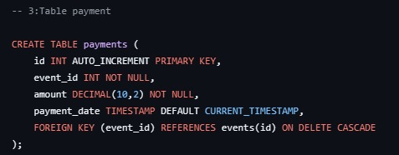
Database Design
TABLES :
customers – stores user information
bookings – stores event booking details
Key Fields:
Attributes :
customers: id, name, phone, address
bookings: event_type, date, time, venue
bookings: price, extra_details, customer_id (foreign key)
Summary:
Two relational tables maintain all customer data and link each booking using a foreign key for proper database integrity.

Slide 7

Technologies Used
Java: Core programming language used to build the entire system
Java Swing: Provides the graphical user interface (GUI) for user interaction
JDBC: Enables seamless connection between the application and the database
MySQL: Stores customer, event, and payment data
OOP: Ensures modular, maintainable, and extensible code structure
Multi-threading: Used to simulate payment delay and improve responsiveness
Summary:
Java OOP, JDBC, and MySQL together ensure a stable, structured, and scalable event management system.

Slide 8

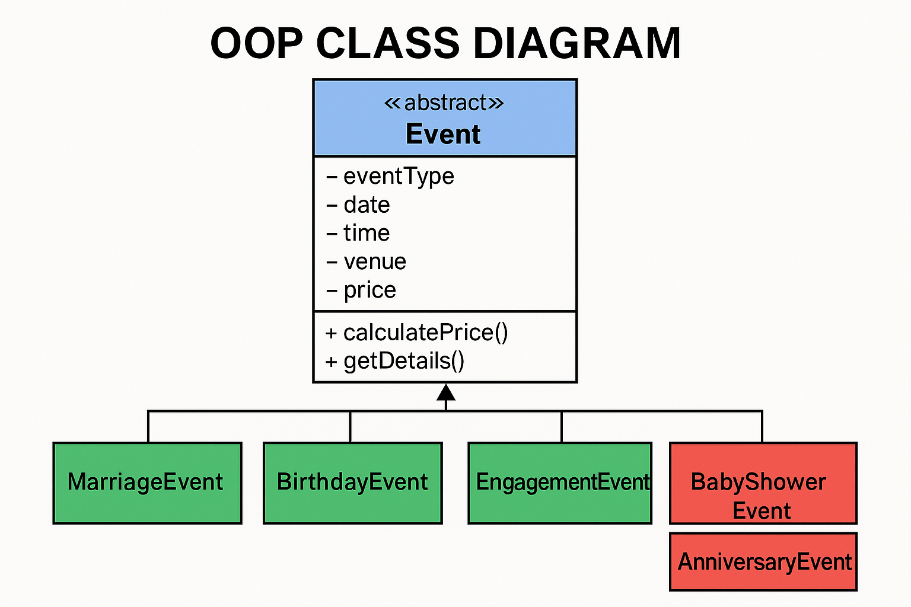
OOP Class Diagram

Slide 9

Workflow of the Application
Enter Customer
Details
Select Event
Type
Fill Event
Details
Payment
Processing
Confirmation
Receipt

Slide 10
Key Features
OOP event handling
Uses object-oriented principles to manage different event types, ensuring clean separation of logic and easy scalability when adding new features.
Reusable Event superclass
A common parent class defines core properties and methods, allowing all event types to inherit shared functionality and avoid code duplication.
Auto DB schema
The system automatically creates the required database tables on startup, reducing manual setup effort and preventing schema-related errors.
Input validation
Ensures that customer details, dates, phone numbers, and event information are correct and safe before processing, improving reliability.
Payment simulation
Mimics real-world payment flow using controlled delays and confirmations, helping users understand the experience without integrating a payment gateway.
Persistent storage
All customer and booking data is stored securely in MySQL using JDBC, ensuring the information remains available even after restarting the application.
Summary:
A well-structured, modular design enhances maintainability, simplifies updates, and ensures the system remains robust and scalable as more features are added.

Slide 11
Advantages
Simple UI: Clean and easy-to-navigate interface for all users
Modular design: Each component is separated for better maintenance and clarity
Extensible event types: New event categories can be added easily using inheritance
Secure database: Reliable MySQL storage with proper data handling
Summary:
The system is beginner-friendly while still offering scalability and flexibility for advanced users and future expansion.

Slide 12
Future Enhancements
Web-based version: Expand the system into an online platform accessible from any device
Login system: Add user authentication for admins and customers
Analytics: Generate reports on bookings, event trends, and customer activity
Online payment: Integrate real payment gateways for secure transactions
Summary:
These future upgrades can significantly improve usability, scalability, and overall system performance.

Slide 13
Project Summary
WHAT IT DOES
Collects complete customer information with validation
Allows users to choose from multiple event categories
Provides tailored event-specific forms for accurate data entry
Simulates payment processing with a smooth user workflow
Stores all event and user details securely using JDBC–MySQL
Fully desktop-based Java application with a simple, intuitive UI
Summary:
The system offers a streamlined event-booking workflow—guiding users from registration to event selection, form submission, and payment, ensuring a reliable and structured event management experience.

Slide 14
Conclusion
The Event Management System is a complete Java-based application designed to simplify event organization, customer management, and payment handling.
It provides a user-friendly interface, structured modules, and an efficient workflow that guides users from registration to final confirmation.
The project demonstrates practical implementation of Java OOP, Swing UI design, JDBC connectivity, and MySQL database integration.
It highlights how software architecture, inheritance, and modular design can be applied to solve real-world problems.

