Slide 1
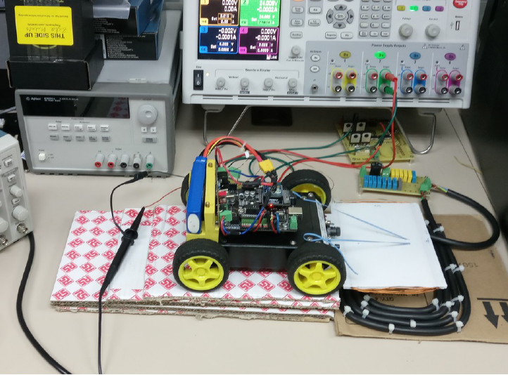
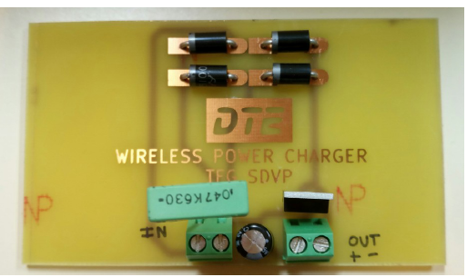
Primary board
Primary coil
Secondary coil
Secondary board
(Under the UGV)

